Slide 1
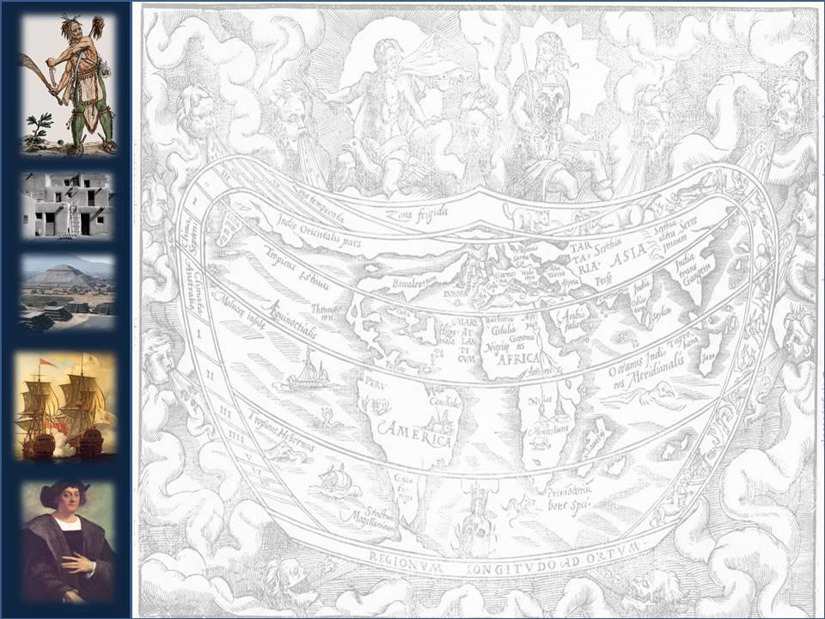
Contact: Europeans and
Amerindians
AP U.S. Chapter 1

Slide 2
BIG PICTURE THEMES:
Chapter 1
1. The New World, before Columbus, there were many different Native American tribes. These people were very diverse. In what’s today the U.S., there were an estimated 400
tribes, often speaking different languages. It’s inaccurate to think of “Indians” as a homogeneous group.

Slide 3
BIG PICTURE THEMES:
Chapter 1
2. Columbus came to America looking for a trade route to the East Indies (Spice Islands). Other explorers quickly realized this was an entirely New World and came to lay claim to the new lands for their host countries. Spain and Portugal had the head start on France and then England.

Slide 4
BIG PICTURE THEMES:
Chapter 1
3. The coming together of the two world had world changing effects. The biological exchange cannot be underestimated. Food was swapped back and forth and truly revolutionized what people ate. On the bad side, European diseases wiped out an estimated 90% of Native Americans

Slide 5
Welcome back!
Quiz
Agenda and Objective: Through notes and class discussion students will identify the impact of
explorers upon the “new world” as well as analyze point of view on the impact of Christopher Columbus on American History.

Slide 6
Overview –Big Ideas
By 1600 Europeans had created the world’s first truly global economy.
The "age of discovery" resulted in the greatest human catastrophe in world history: 90% of Amerindians died by 1600; tens of millions of Africans were enslaved
Cultural differences between European and Amerindians were so immense that major conflicts occurred.
Relations between Europeans and Amerindians
varied between empires

Slide 7
Motives for exploration
in 15th & 16th centuries

Slide 8
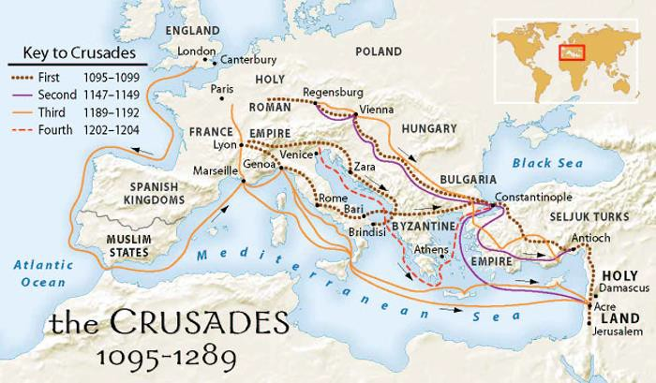
1
. Greater Interest in Eastern products (Asia)
1100-1300 C.E. (AD) – Christian crusades
stimulated European interest in the East
– Creates a growing demand for Eastern products in
Europe (growing population)
. Interest in wealth (gold, silver) 1295 C.E. (AD) – Marco Polo returns to Europe from Asia with popular tales of fabulous wealth
2

Slide 9
3. Growth of Economic Competition - Italian city states dominated trade with the East, which created a need for an all water route to Asia
– 1453 – Constantinople falls to the Turks led to an increased price in the price of eastern products
4. The rise of Nation States – centralization of power and consolidation of taxing power enabled states to pursue glory (e.g. funding exploration costs)

Slide 10
5. Rising spirit of nationalism – led to an increasingly competitive Europe (i.e. Spanish removal of the Muslim Moors)
6. The rise of the middle class - contributed to a
growing merchant class and tax base

Slide 11
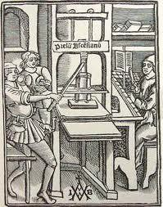
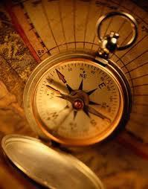
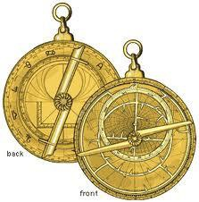
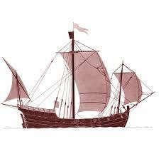
7. Technological advances - compass, astrolabe, caravel, lateen sail, printing press - all made sailing more predictable
8. Renaissance spirit – intellectual unrest, philosophy of Humanism, challenged existing notions

Slide 12
9. Missionary zeal – Protestant Reformation (beginning in 1517) led to religious competition in Europe

Slide 13
Warm up
List the motives for European
Exploration!
(hint..there are nine)

Slide 14

Essential Question: What are the similarities & differences among the Spanish, French, & British patterns of colonization in America?

Slide 15
America Prior to the
Arrival of Europeans

Slide 16
Native Americans/Amerindians
Population: perhaps 100 million
by 1500 CE
Arrived as early as 33,000 BCE: Bering Land Bridge (Beringia) is the most likely route taken by early Amerindians
By 8,000 BCE, Amerindians reached the tip of South America

Slide 17
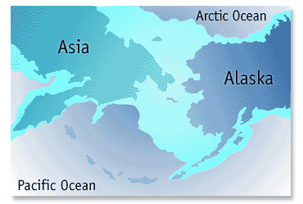
Bering Land Bridge

Slide 18
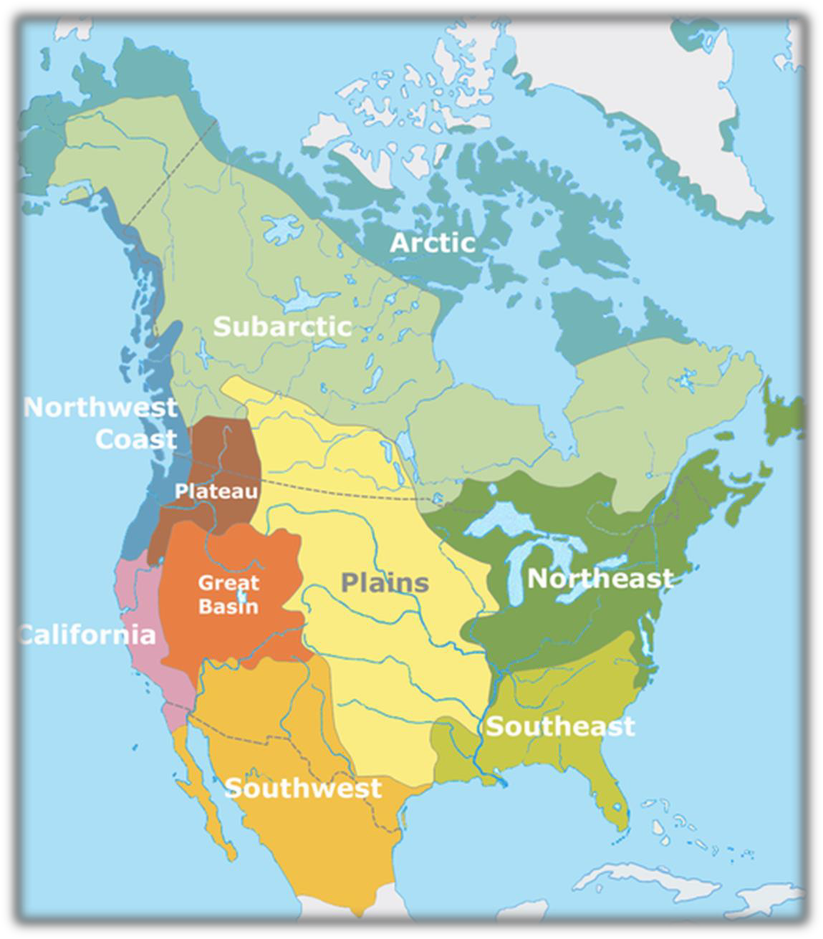
Native American Sub-Cultures

Slide 19
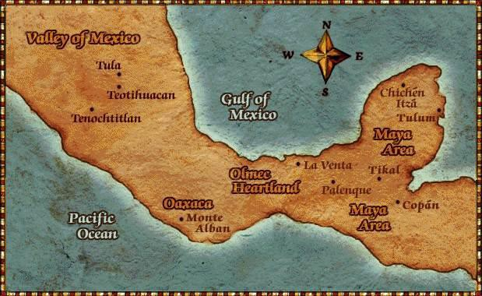
Most developed civilizations (sedentary societies) located in MesoAmerica and South America: Aztecs, Mayans, Incas

Slide 20
1. Pueblo
Exceptions:
Moundbuilders & Mississippians
Southeast: Creeks, Choctaw,
Cherokee
Iroquois Confederacy– Five
Nations

Slide 21
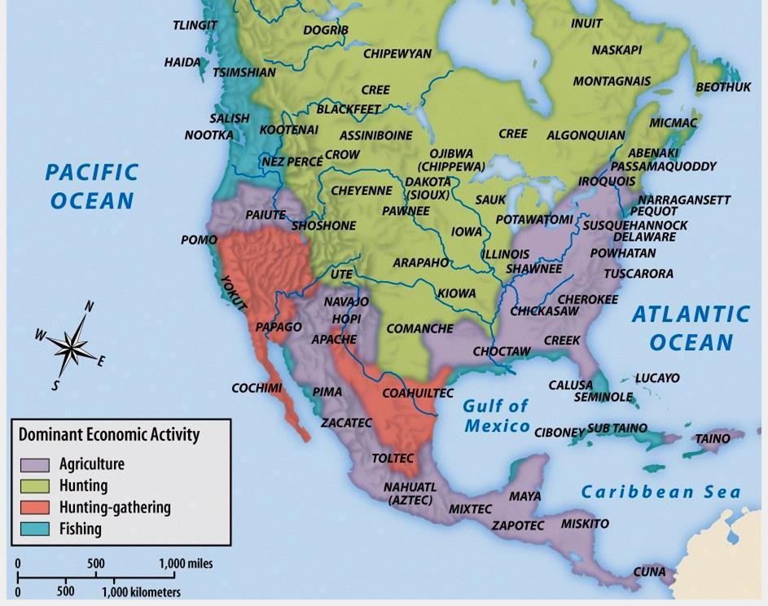

Slide 22
Eastern Woodland Cultures
Along the Atlantic Coast of North America, Native Americans lived in smaller, mobile bands:
  Farming was supplemented by hunting and
gathering
  Eastern woodland Indians were likely the first natives to be encountered by English settlers

Slide 23
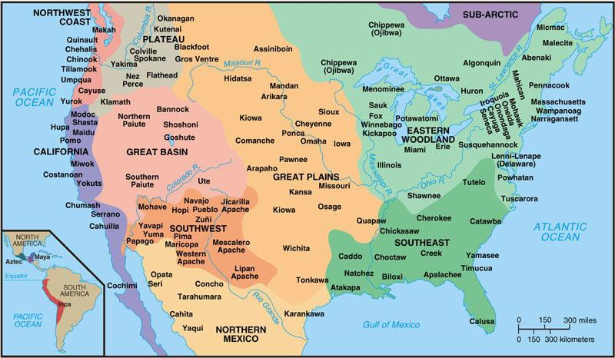
Locations of Major Indian Groups
and Culture Areas in the 1600s

Slide 24
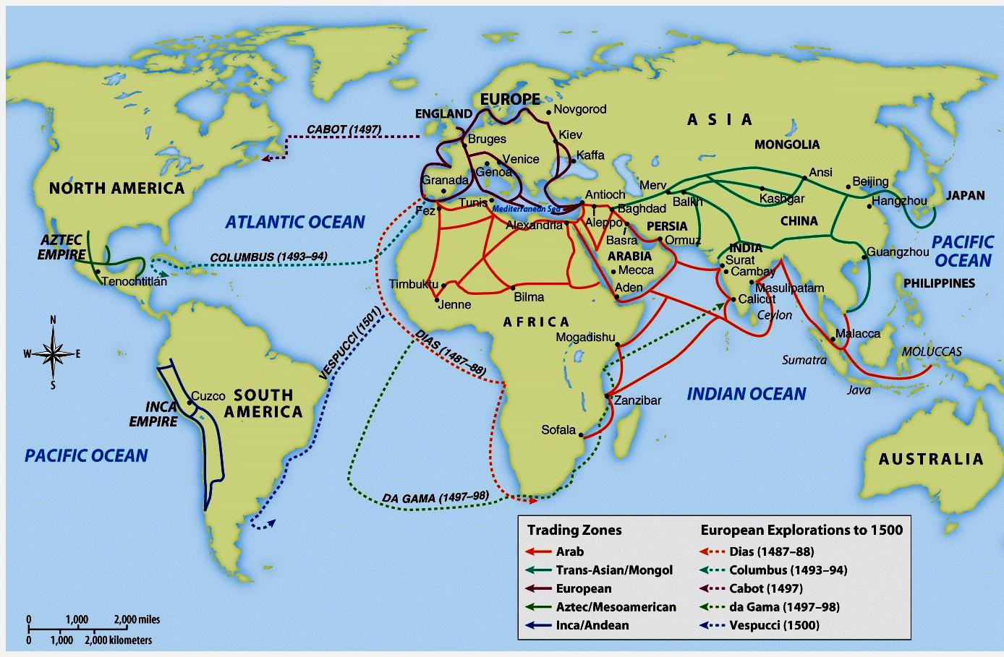
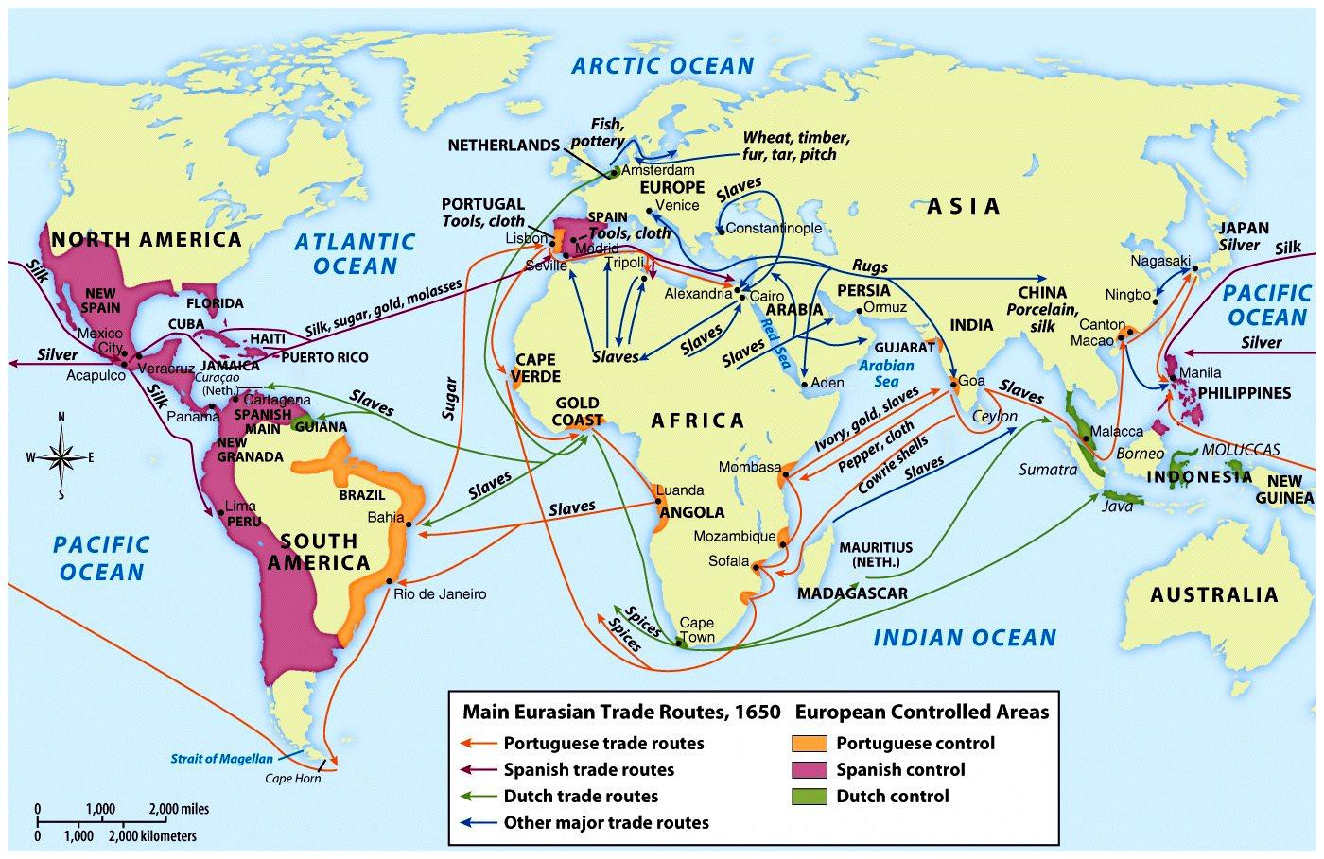
Voyages of European Exploration

Slide 25

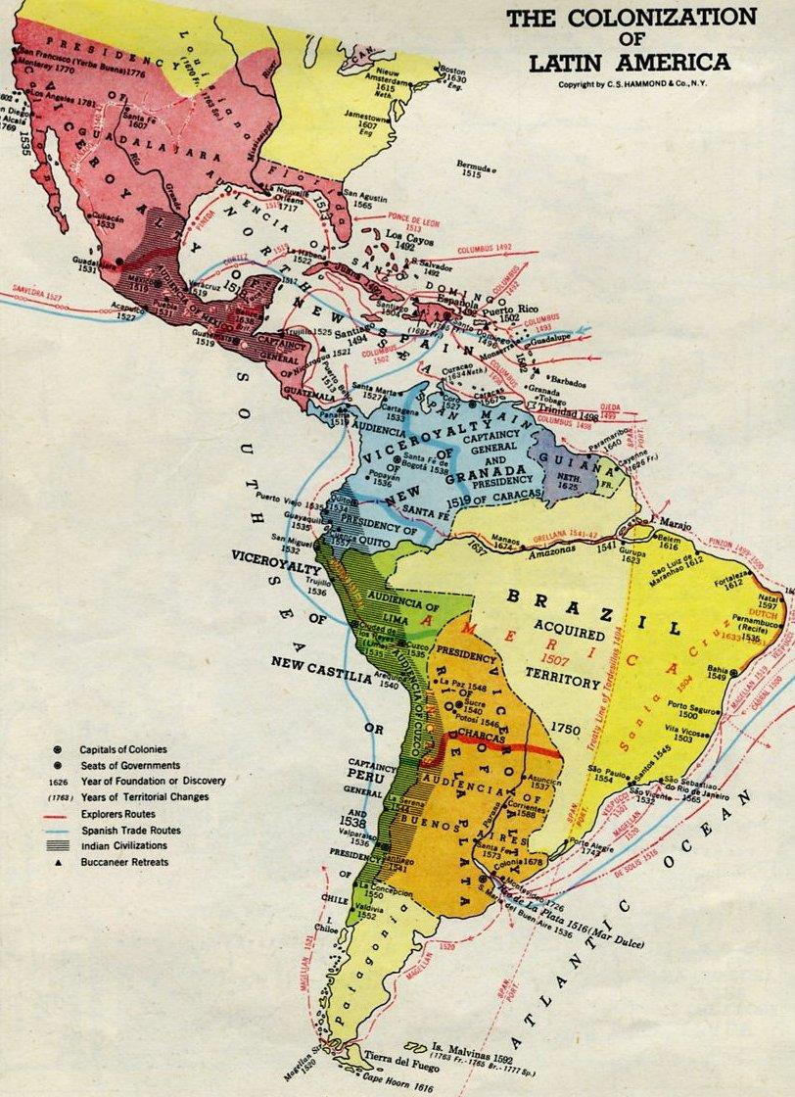
Exploration

Slide 26
Once the conditions were ripe for European discovery, who was the first European power to dominate exploration?

Slide 27
Spain and Portugal

Slide 28
A World Transformed
Native Americans were eager for European trade; they were not initially victims of Spanish exploration
They became dependent on and indebted to
Europeans
Disease decimated perhaps 95% of Native American population

Slide 29
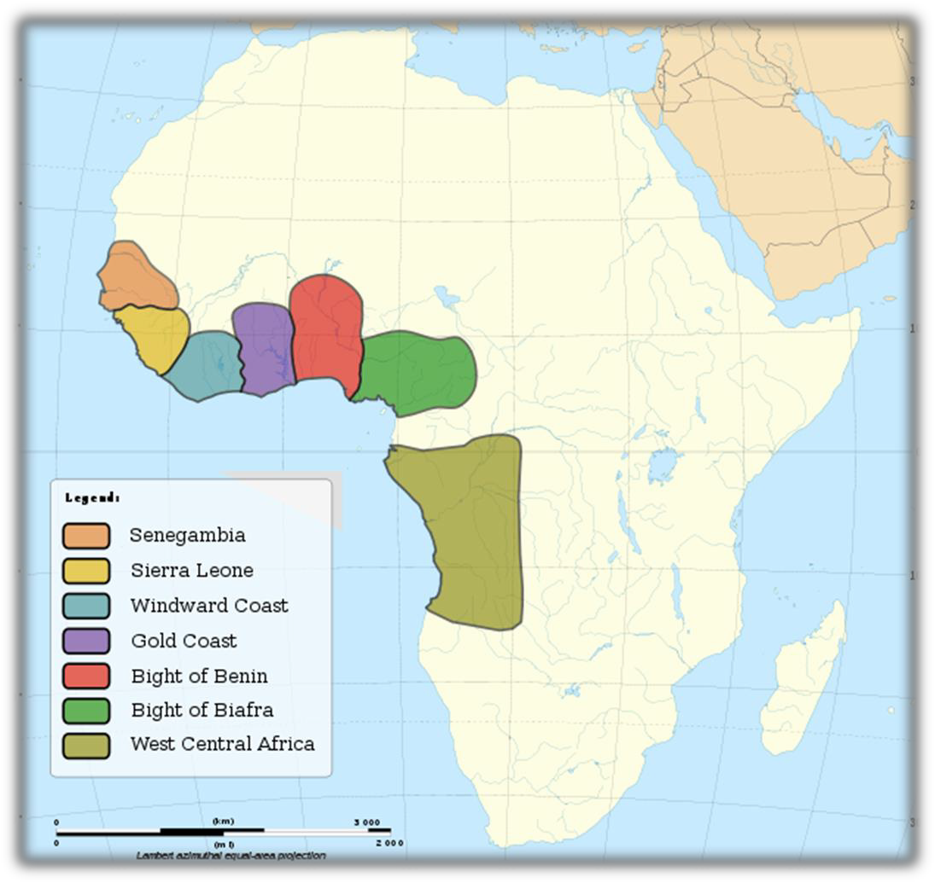
Portugal was the leader in exploration
Introduced slavery in the New World (Brazil)
Major Slave Trading Regions of Africa, 15th–19th centuries

Slide 30
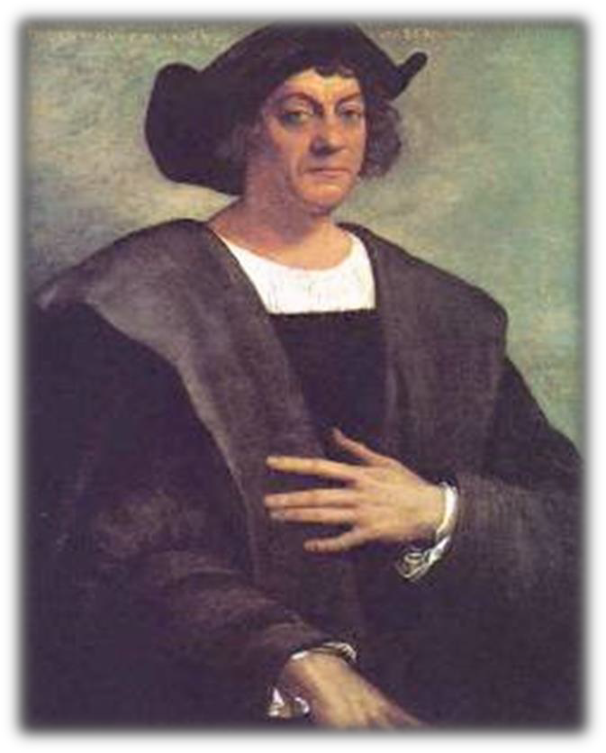
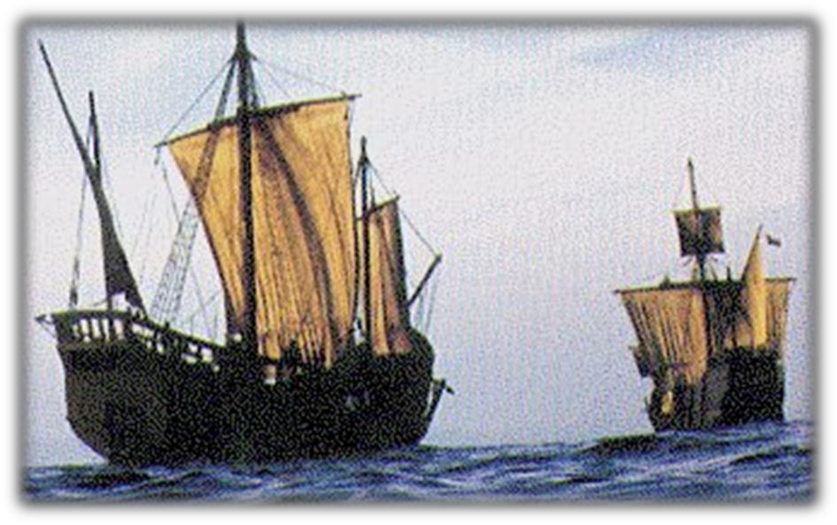
Spanish Exploration and Conquest
1. Christopher Columbus:
significance
Replicas of the Pinta and the Santa Maria

Slide 31
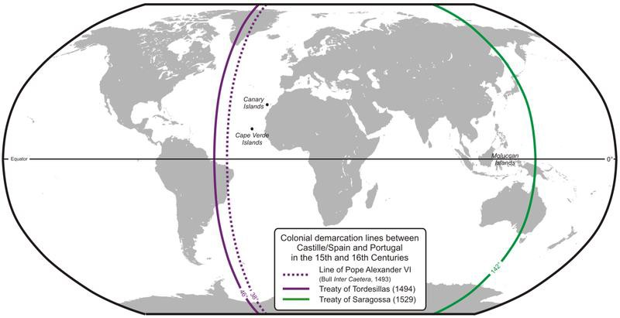
2. Treaty of Tordesillas (1494)
Provisions: Spain v. Brazil
Significance: Spanish motives “God, Gold, Glory)

Slide 32
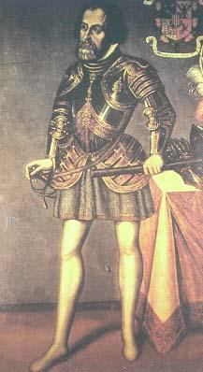
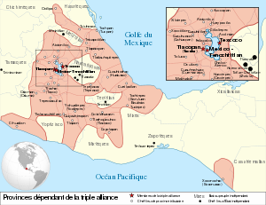
3. Spanish Conquistadors:
Hernan Cortés: conquered the Aztecs
Francisco Pizarro: conquered the Incas

Slide 33
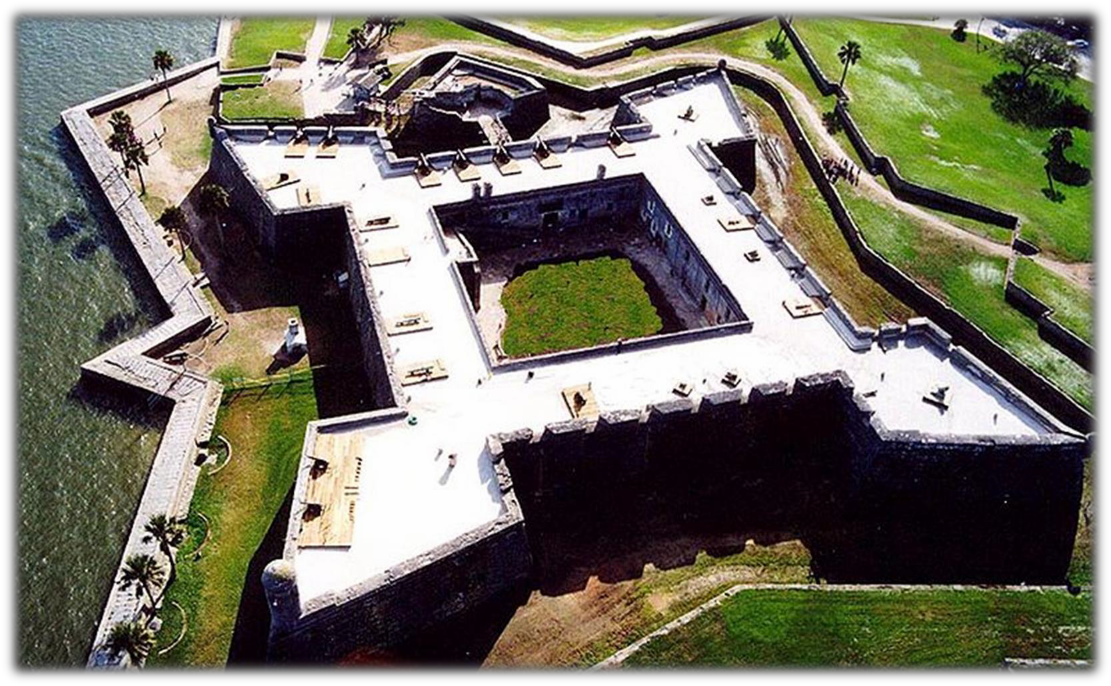
4. St. Augustine (1565): oldest European
settlement in modern-day U.S.
Castillo de San Marcos

Slide 34
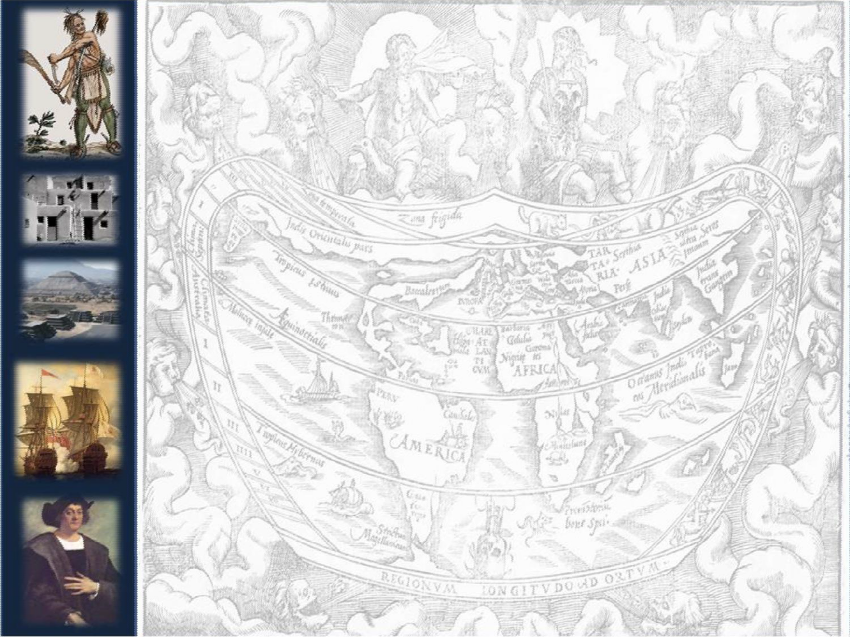
. Spain and the Pueblo Indians
in the Southwest
New Mexico established in 1598
  Santa Fe
Encomienda system
Mission System: Forcible conversion to Christianity

Slide 35
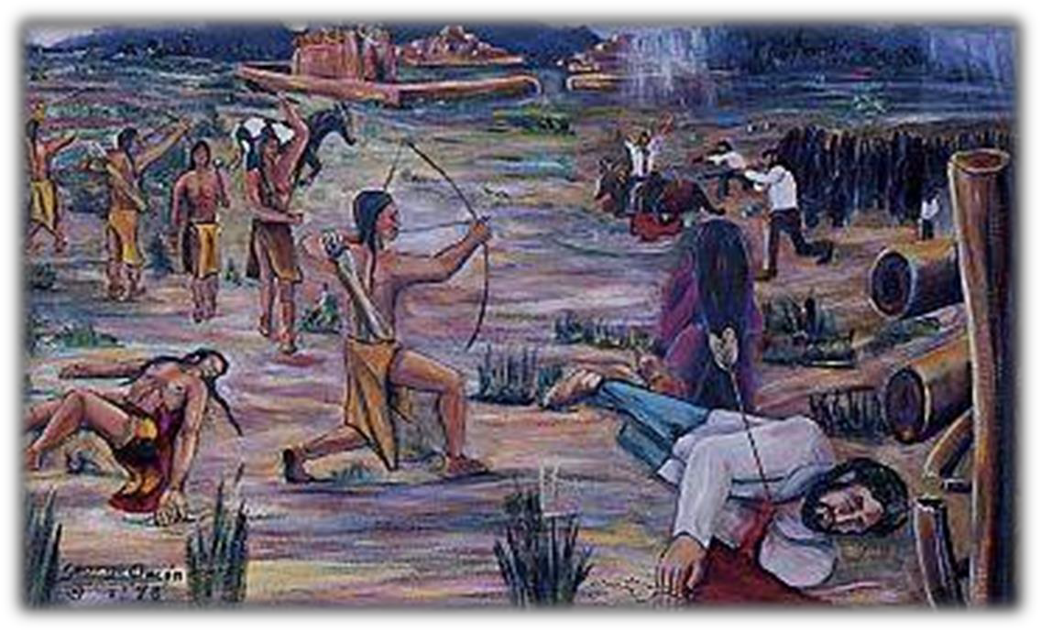
4. Intermarriage: mestizos
5. Pope’s Rebellion (Pueblo Revolt), 1680

Slide 36
From Plunder to Settlement
By 1650, 1/2 million Spaniards immigrated to the New World
  Mostly unmarried males came to New World;
intermarriage led to mixed-blood mestizos & mulattos
  Distinguished between peninsulares and creoles

Slide 37
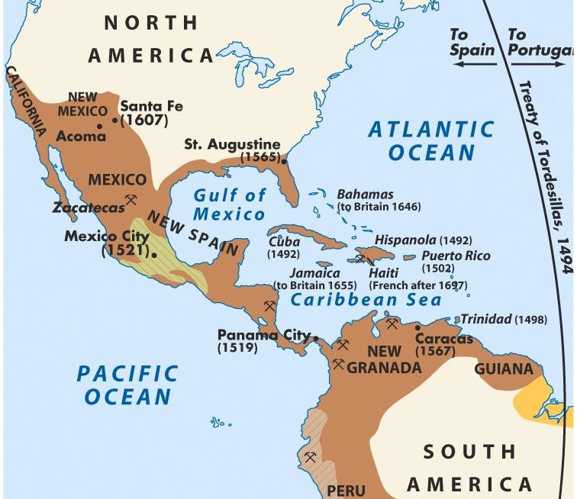
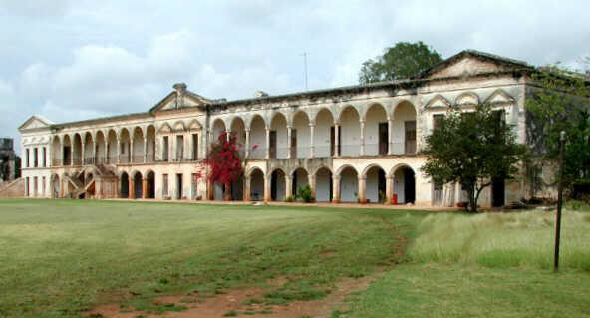
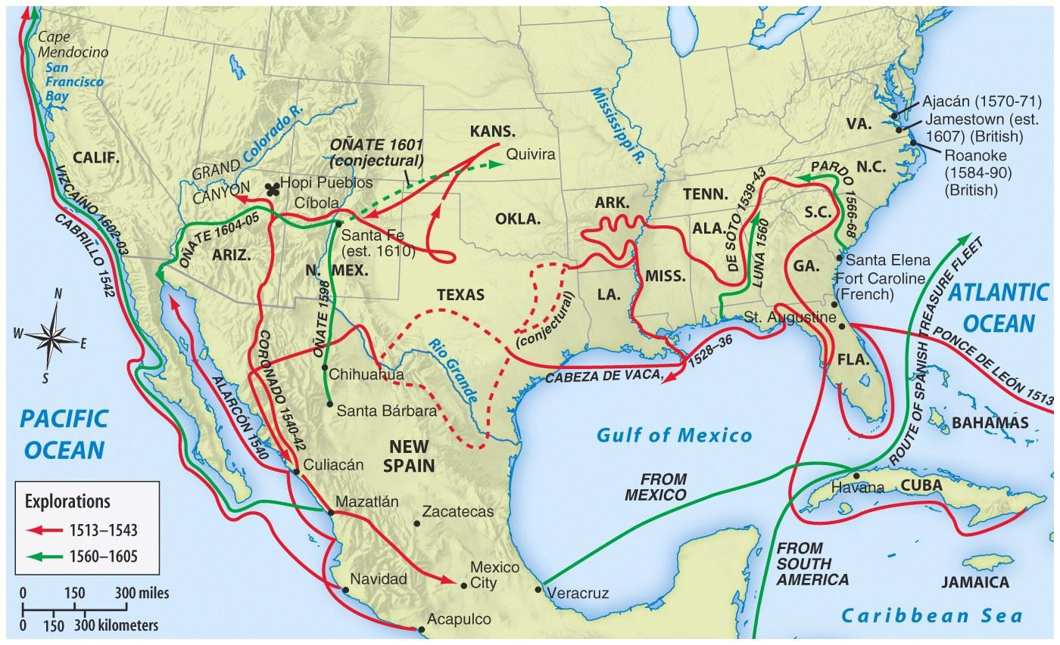
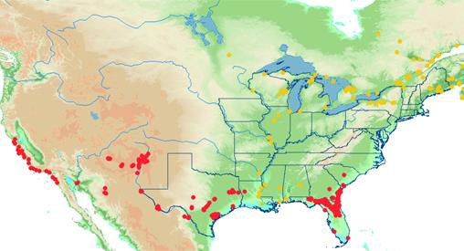
The Spanish used the encomienda system to
Spanish Conquests & Colonies
create large cash crop plantations using Native American & African slave labor
Spanish missionaries focused heavily on converting Native Americans & establishing missions

Slide 38
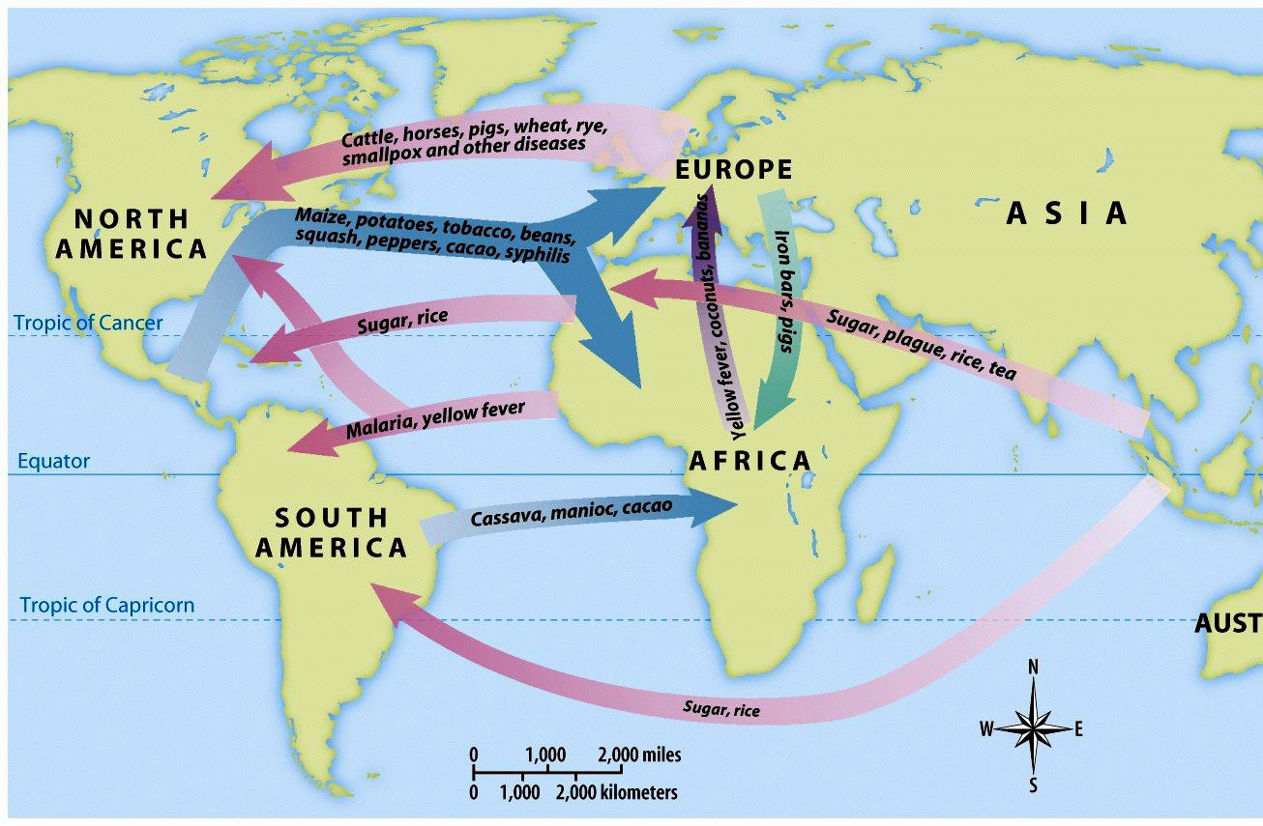

The Columbian Exchange

Slide 39
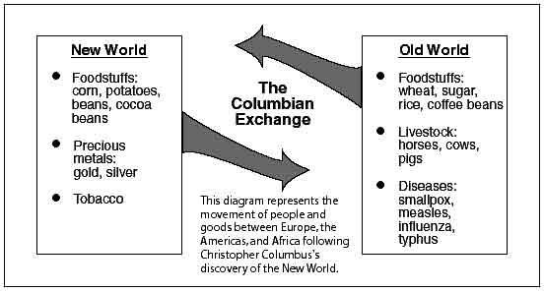
The Columbian Exchange
What affect did the Columbian Exchange have on the New World?
What affect did the Columbian Exchange have on the Old World?

Slide 40
The French Colonies in
America

Slide 41
The French Claim Canada
In 1608, Samuel de Champlain founded Quebec; French Empire eventually included St. Lawrence River, Great Lakes, Mississippi
The French gov’t strictly controlled the colonies but made little effort to encourage settlement
Because the fur trade was the basis of the colonial economy, Indians became valued trading partners (not exploitive like Spain)

Slide 42
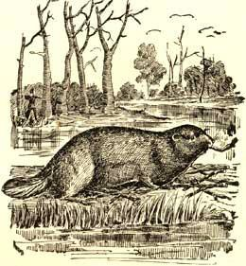
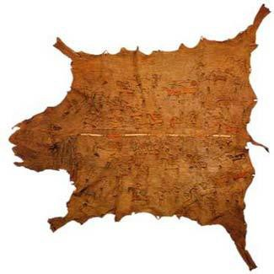
Relations between Europeans and
Amerindians
France in New France (later, Canada)
Most effective in their relations with
Amerindians
The French became great gift givers
Beaver trade led to French exploration of much of North America and contact with Amerindians
  Coureurs de bois
  Voyageurs

Slide 43
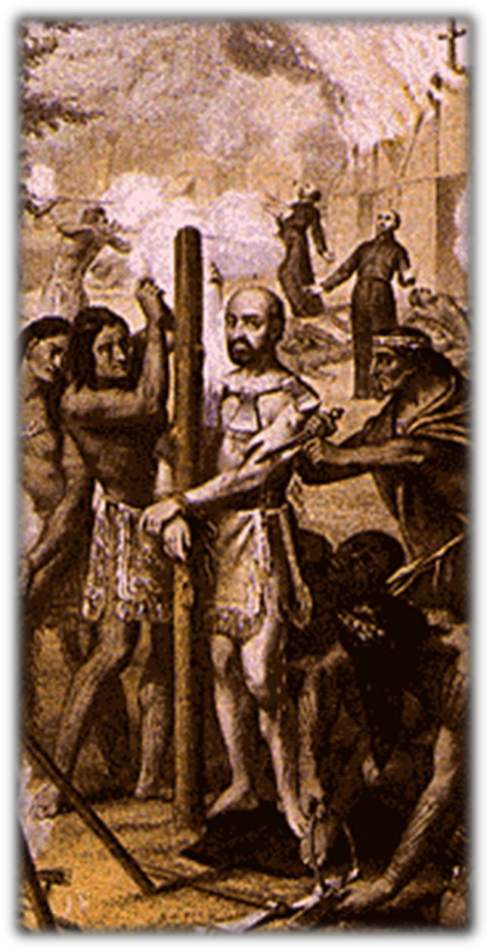
4. Jesuit missionaries came to New
France
Detail from The Torture of the
Jesuit Martyrs, 1664

Slide 44
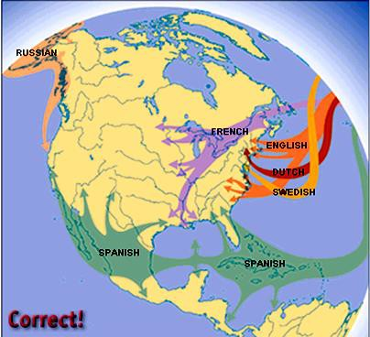
Like Spain, the French gov’t
encouraged converting Native
Americans & establishing missions

Slide 45
The English Colonies in
America

Slide 46
England’s search for empire
Motives:
  Eventual peace with Spain gave England overseas opportunities without harassment
  Population growth
  Unemployment, farm land, adventure, new markets, political and religious freedom, social change
  Joint-stock companies provided
the economic means

Slide 47
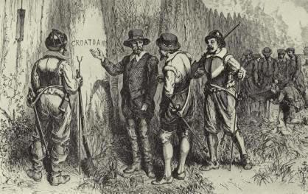
Competition with Spain
  1588- defeat of Spanish Armada
Roanoke, 1585

Slide 48
The English Colonies
In the 1600s, English settlers arrived in North America
  English colonization differed from Spanish & French because the English gov’t had no desire to create a centralized empire in the New World
  Different motivations by English settlers led to
different types of colonies

Slide 49
Migrating to the English Colonies
17th century England faced major social changes:
  The most significantly was a boom in population; Competition for land, food, jobs led to a large mobile population (vagrants?)
  People had choices: could move to cities, Ireland, Netherlands, or America (but this was most expensive & dangerous)

Slide 50
Migrating to the English Colonies
Motives for migration to America:
  Religious: purer form of worship
  Economic: Escape poverty or the threat of lifelong
poverty
  Personal: to escape bad marriages or jail terms
Migration to America was facilitated by the English Civil War & Glorious Revolution

Slide 51

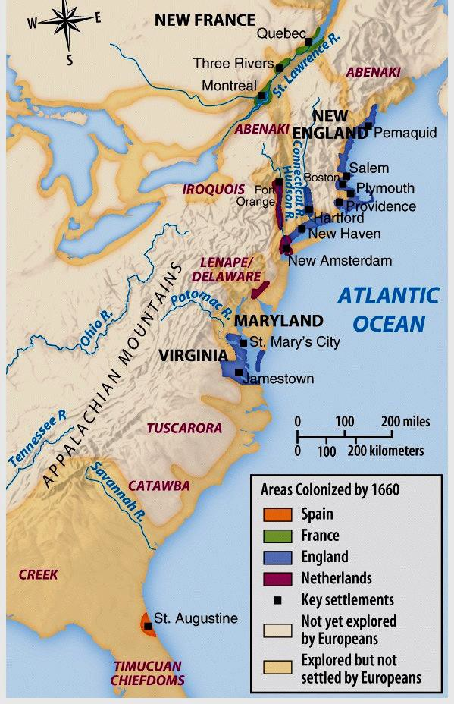
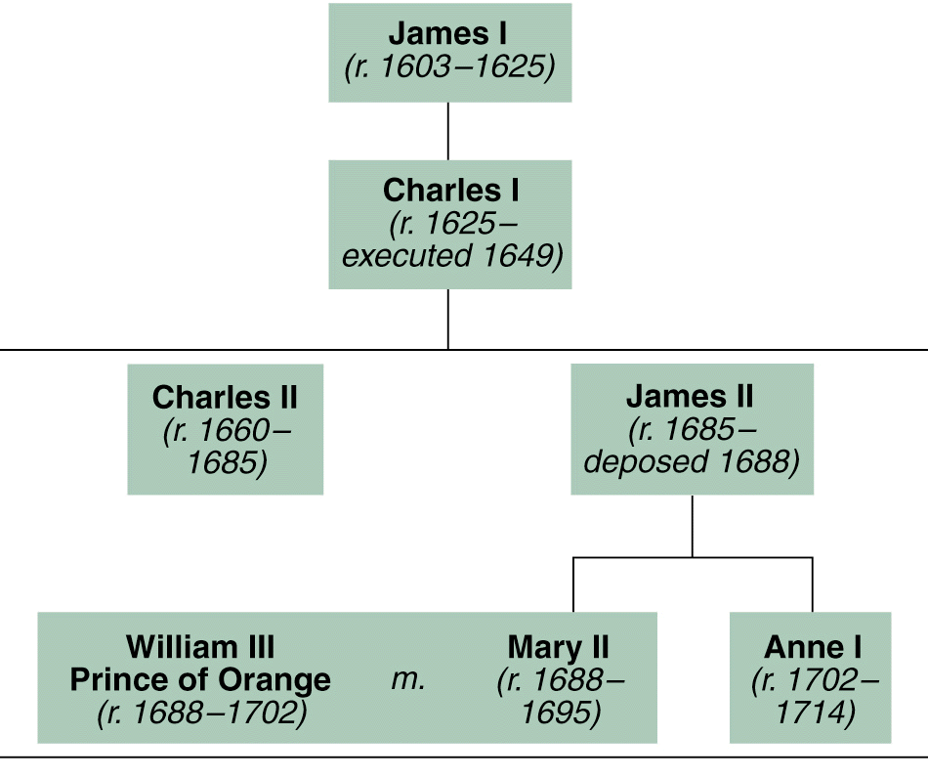
The Stuart Monarchs

Slide 52
Four Colonial Subcultures
The values of the migrants dictated the
“personality” of the newly created colonies; led to distinct (not unified) colonies
  The Chesapeake
  New England
  Middle Colonies
  The Carolinas & Georgia

Slide 53
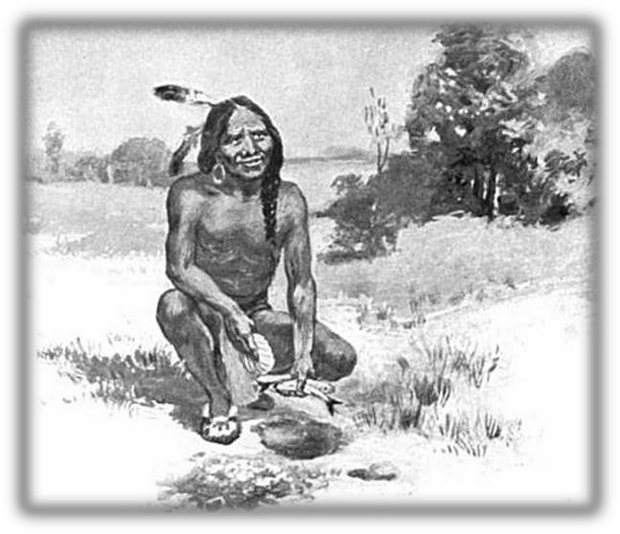
English colonial relations with Amerindians: removal or extermination
Pilgrims in Plymouth Bay had
good relations with Wampanoags
  Squanto
  Thanksgiving, 1621
Squanto shows Pilgrims how to plant maize (1911 engraving)

Slide 54
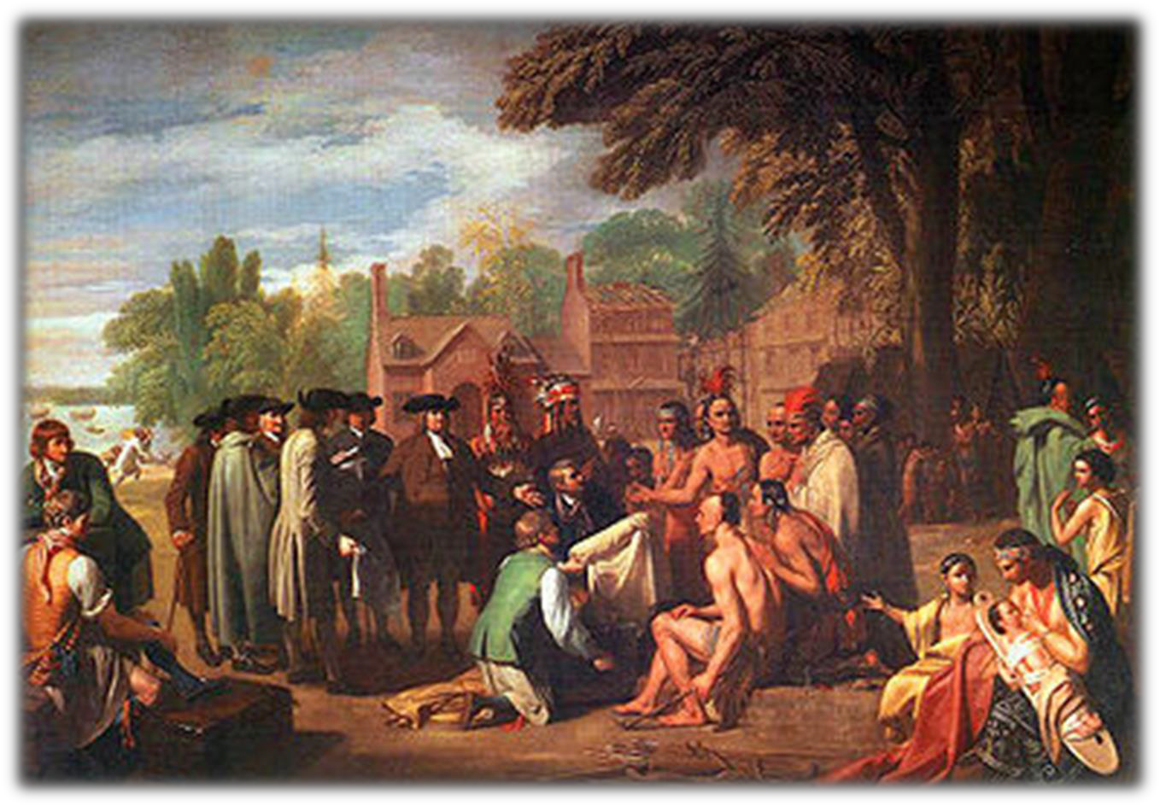
3. Quakers in Pennsylvania
-- Pacifist views resulted in positive
relations with Amerindians
Benjamin West, William Penn’s Treaty with the Indians, 1771-1772

Slide 55
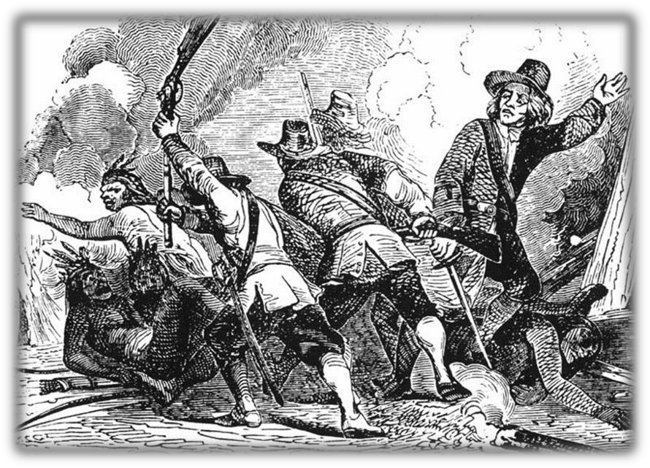
2. Puritans in Massachusetts Bay
Failure of “praying towns”
Pequot War, 1630s: Alliance of English and Indians destroyed Pequots
c. New England Confederation, 1643: collective security alliance against Amerindians

Slide 56
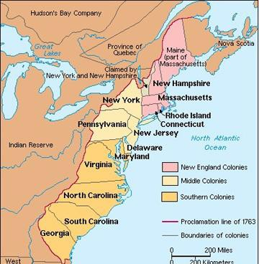

Slide 57
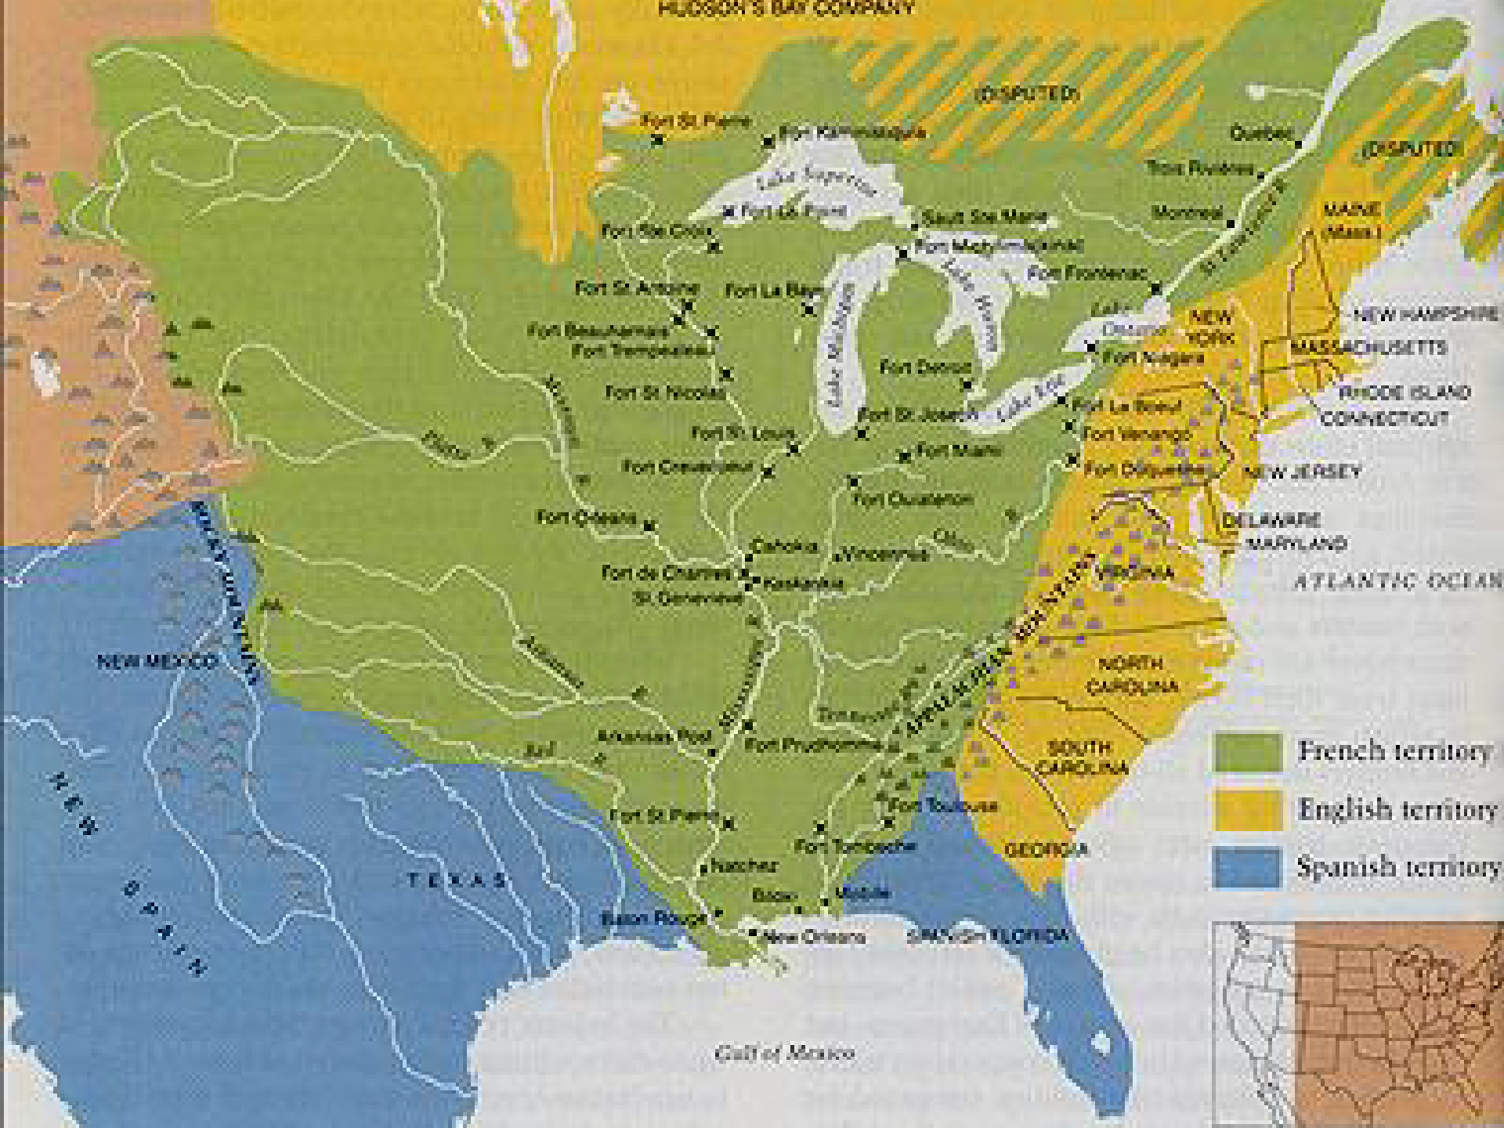
The Spanish & French adopted Frontiers of Inclusion while the British used Frontiers of Exclusion
By the early 1600s, Spain, England, & France had large territorial claims in North America (but these colonies were not heavily populated, especially in Spanish & French claims)
These colonial claims came largely at the expense of the Native Americans already living there

Slide 58
Results of Contact
For Amerindians
  Catastrophic loss of life: 90% by 1600
  European impact on Amerindian culture
    Horses, cattle, swine, firearms
For Europeans
  Global empires
  Commercial revolution
  Revolution in diet

Slide 59
Review…
Relations between Europeans and Amerindians varied between empires
Spain- Christianize and control (through encomienda and missions)
French- trade relations, Jesuits sought to convert
English-move them westward or annihilate them

Slide 60





Summary of Relations between
Europeans and Amerindians
Spain
Encomienda
system
Mission system Pope’s Rebellion Mestizos
France
Trade Jesuits Alliances Enemy of
Iroquois
England
Removal Pequot & King Philip’s Wars
Anglo-Powhatan
Wars

