Slide 1






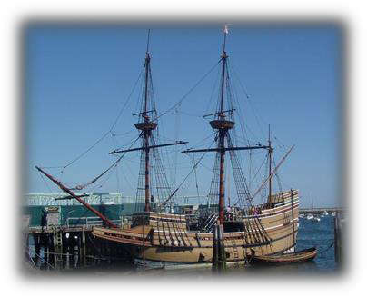
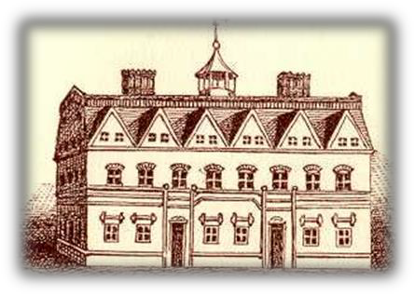
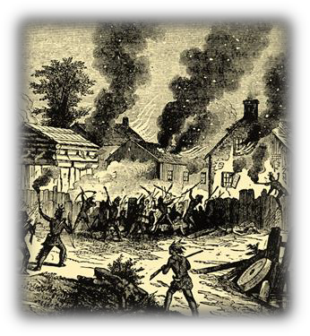
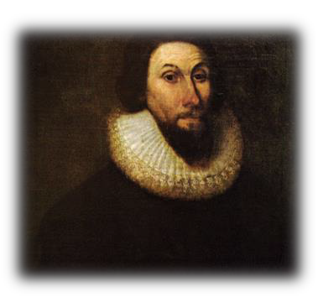
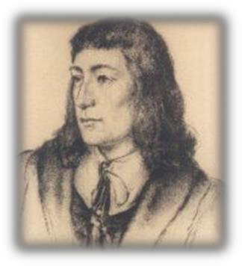
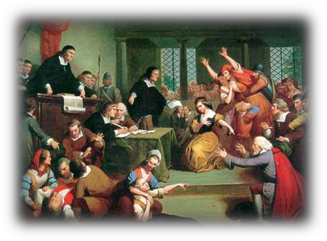
The New England Colonies in the
17th Century
Pilgrims arrive in Plymouth
Harvard College founded
King Philip’s War
1620
1629
1636 1644
1675
1692
Puritans found Massachusetts Bay
Rhode Island founded
Salem Witch Trials

Slide 2


Units 1.3
The New England Colonies
Theme #1:
Seventeenth-century New England was characterized by a homogeneous society that revolved largely around Puritanism and its stern ideal of perfectionism. The New England colonies contained a healthy population with long life spans, a strong family structure, tightly-knit towns and congregations, and a diversity of economic activities.

Slide 3
What political and religious circumstances in England led to the formation and development of New England?

Slide 4
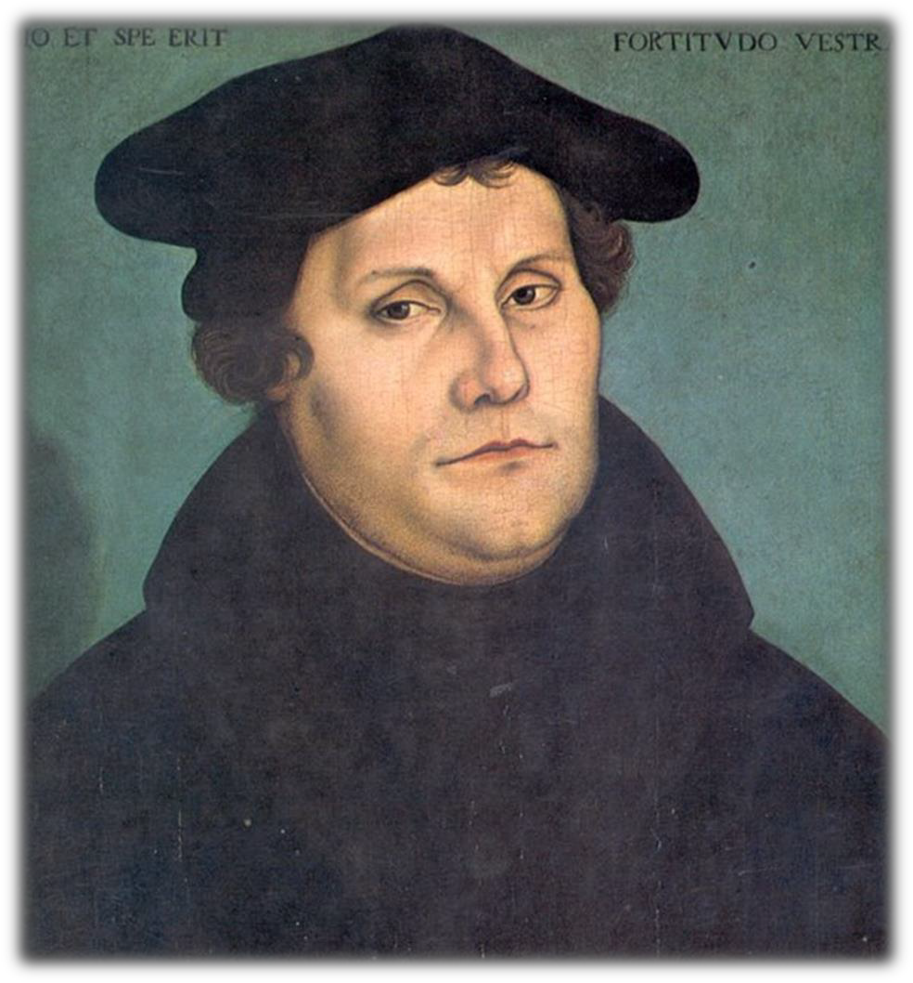
I. Protestant Reformation (1517)
A. Martin Luther: breaks with Catholic church

Slide 5
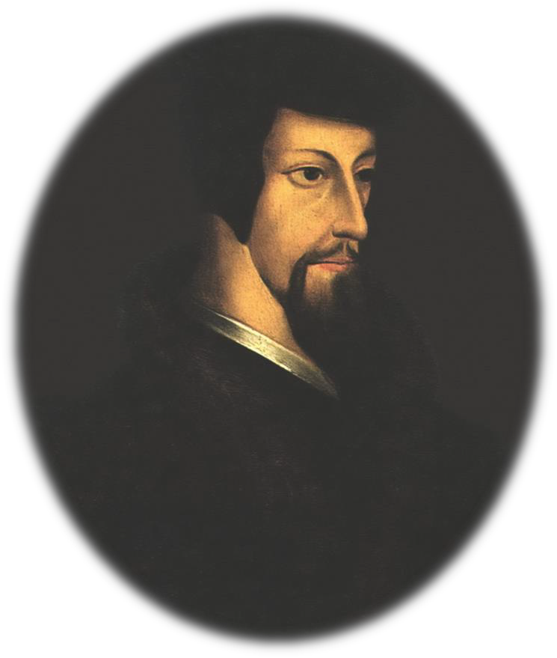
B. John Calvin: Institutes of the Christian Religion (1536)
Elaborated on Luther’s ideas
God was all-powerful, all-knowing, all-good
Humans were weak and wicked due to original sin

Slide 6
4. Predestination
“The elect”
“visible saints”– conversion
experience
Refuted “Good works” philosophy of the Catholic Church

Slide 7
C. Church of England
King Henry VIII broke with the
Roman Catholic Church in 1534
-- Leader of the Church of England (Anglican Church)
Puritans: sought to reform the church
Separatists (later, Pilgrims) sought to
leave the Anglican Church permanently
King James I was threatened by the Separatist challenge and persecuted them

Slide 8
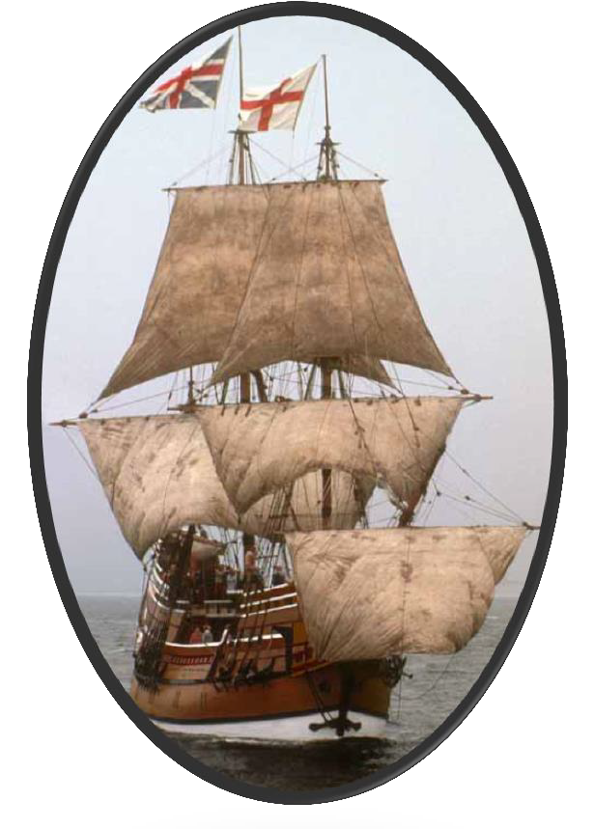
II. Pilgrims
First wave of Separatists
  Separatists left England for Holland
-- Led by Rev. John Robinson
  Separatists later left Holland
for America in
1620

Slide 9
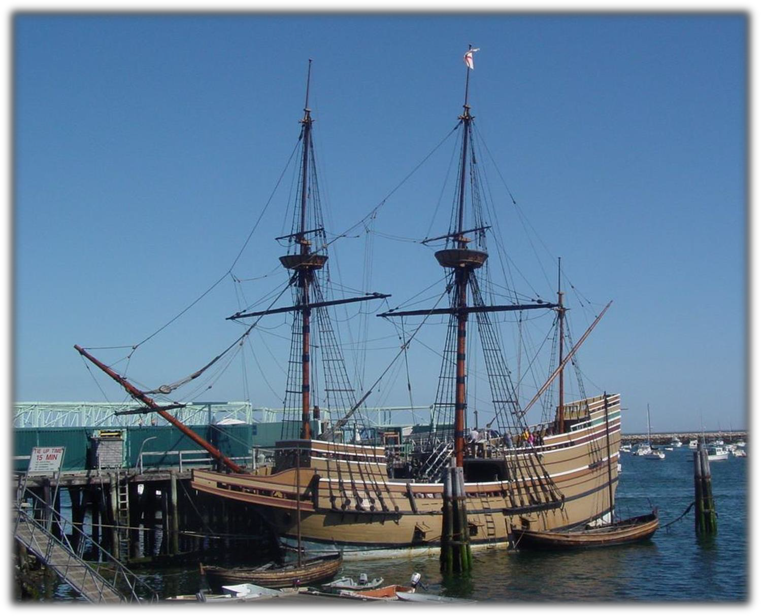
3. Mayflower, 1620
4. Plymouth Bay

Slide 10
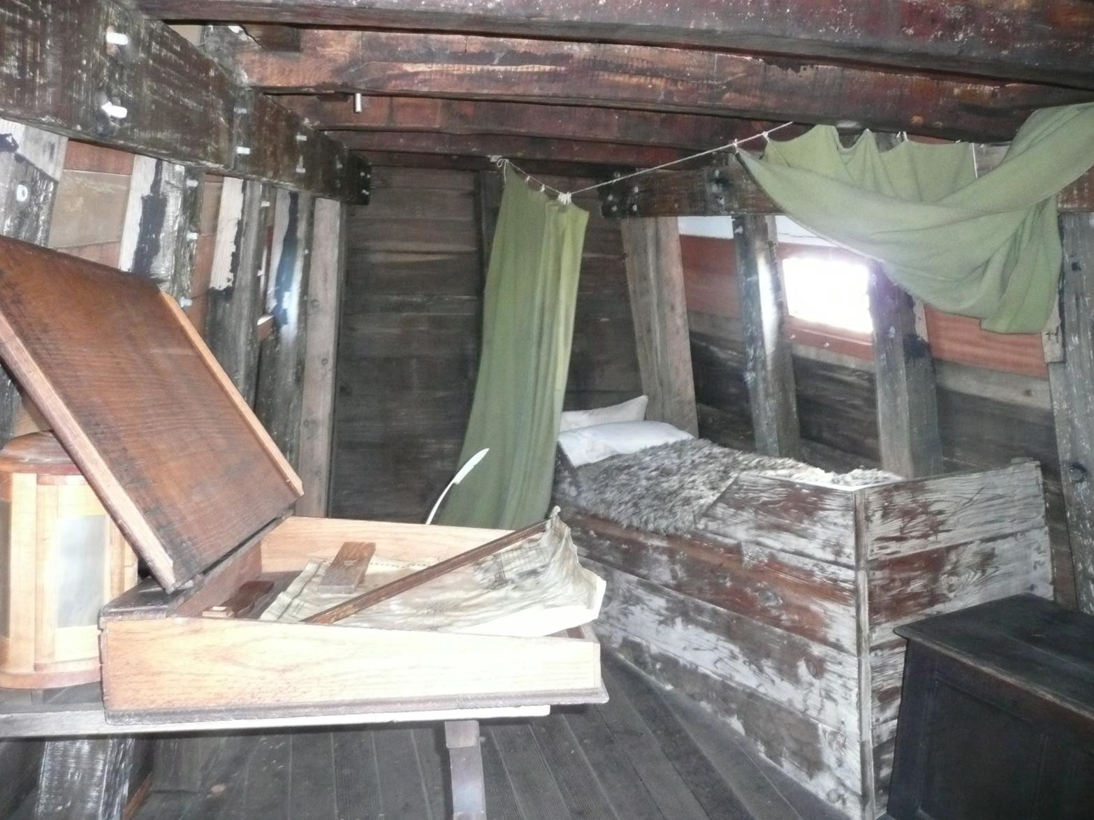

Slide 11
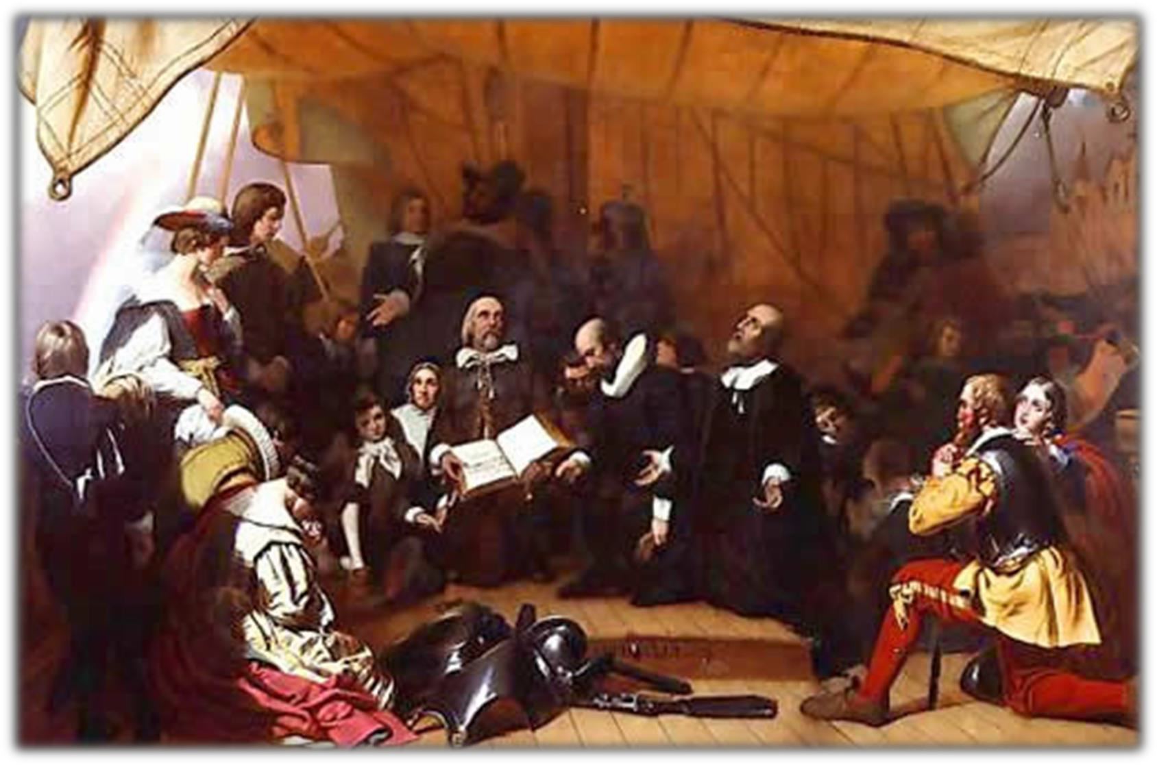
The Rev. John Robinson and others aboard the Mayflower

Slide 12
5. Mayflower Compact, 1620
-- Rule of the majority under the regulations agreed upon.
“Having undertaken, for the Glory of God, … and honor of our King and Country, a voyage to plant the first colony in the Northern parts of Virginia,
…covenant and combine ourselves together into a civil body politic; for our better ordering, and preservation… and by virtue hereof to enact, constitute, and frame, such just and equal laws, ordinances, acts, constitutions, and offices, from time to time, as shall be thought most meet and convenient for the general good of the colony; unto which we promise all due submission and obedience.”

Slide 13
Mayflower Compact
What did the signers promise?
What do you believe the impact of the
Compact was upon early colonial America?

Slide 14
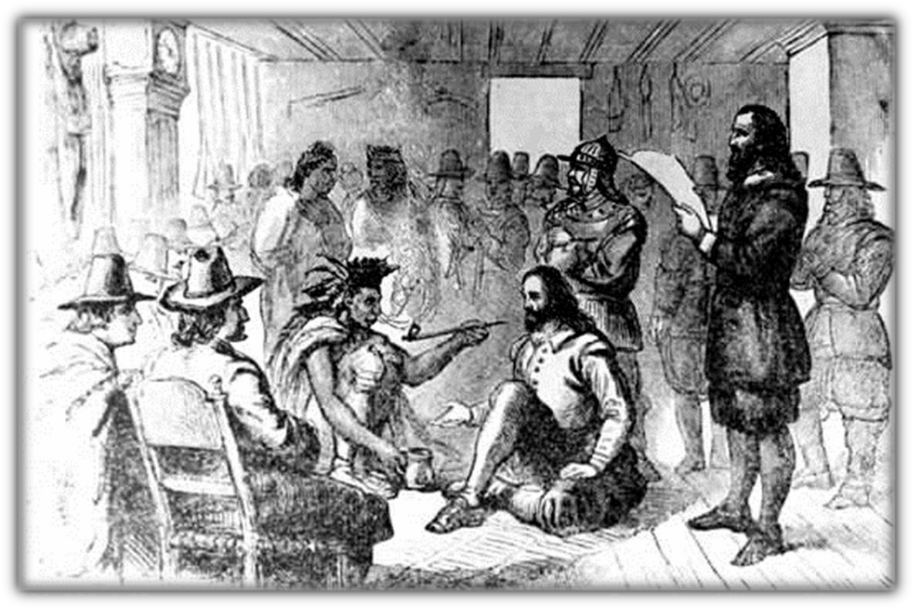
B. Relations with Amerindians
Squanto
Wampanoag (Pokanokets) led by Chief Massasoit, helped Pilgrims to survive
Massasoit and Pilgrims sign a peace treaty

Slide 15
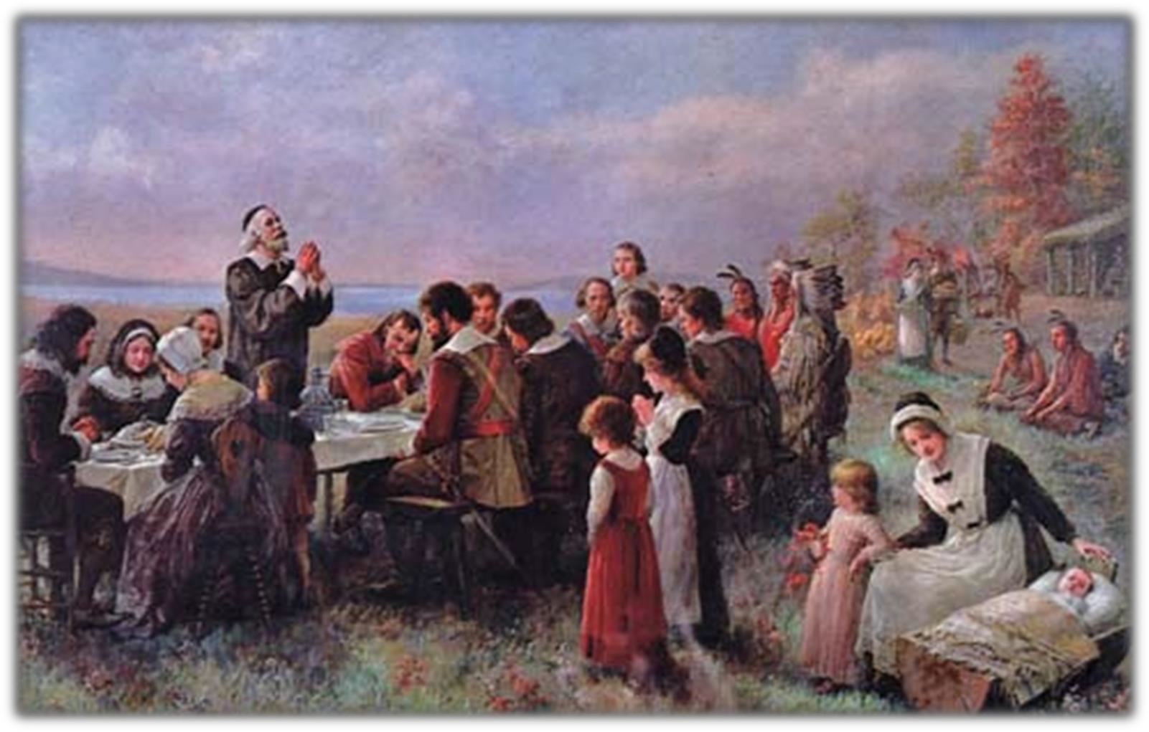
3. The First Thanksgiving, 1621

Slide 16
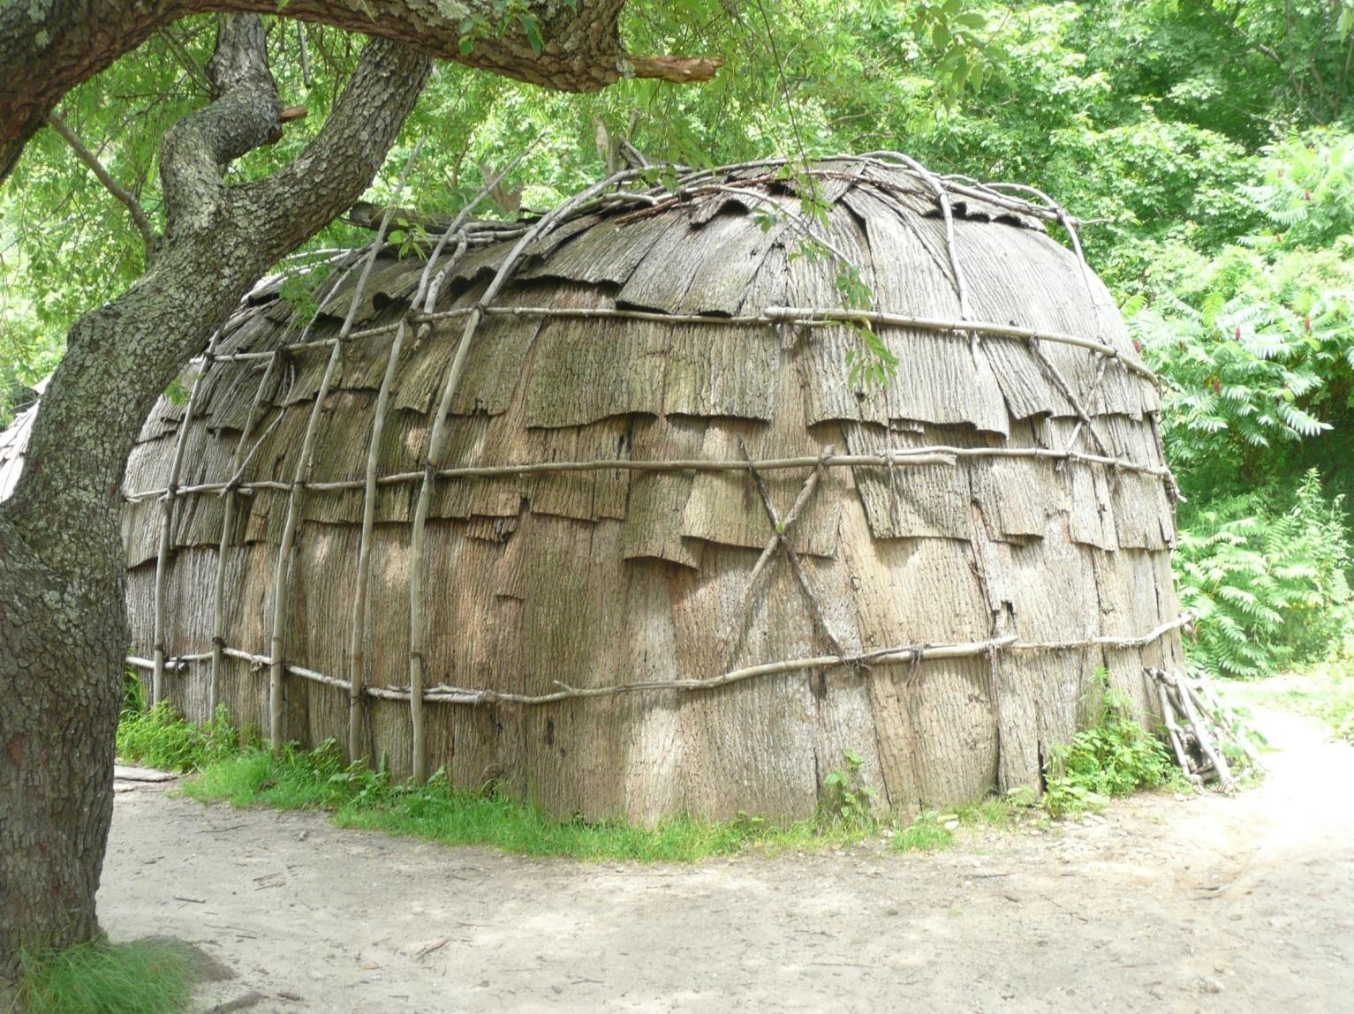
A Wampanoag dwelling

Slide 17
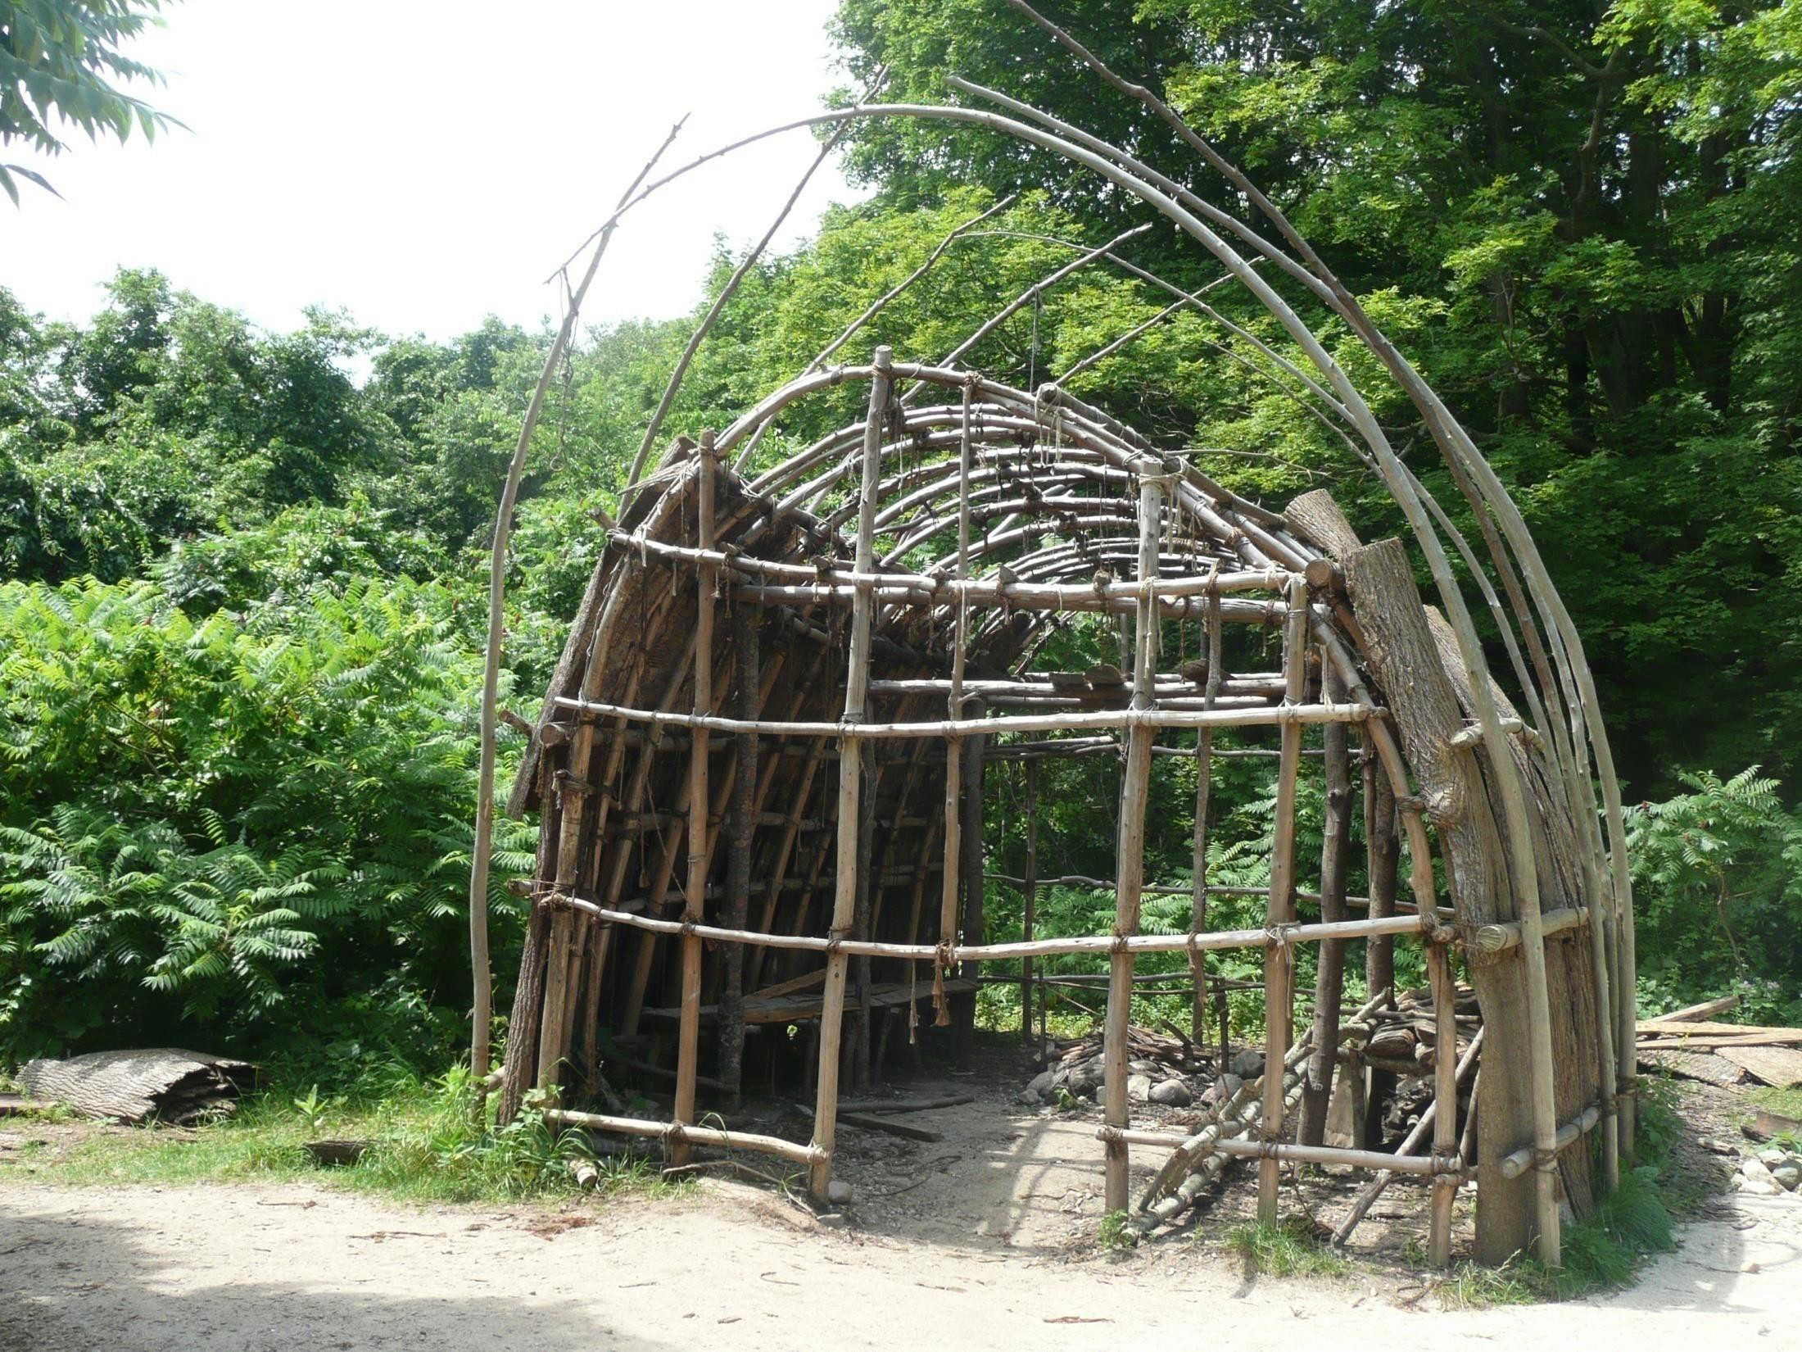

Slide 18
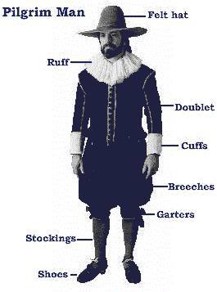
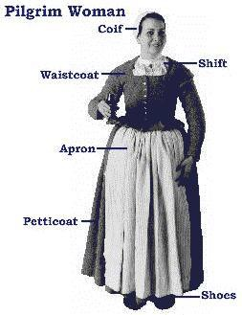
C. Success of the Pilgrims
Fur trade, fishing and lumber
William Bradford
D. 1691, merged with Massachusetts
Bay Colony

Slide 19
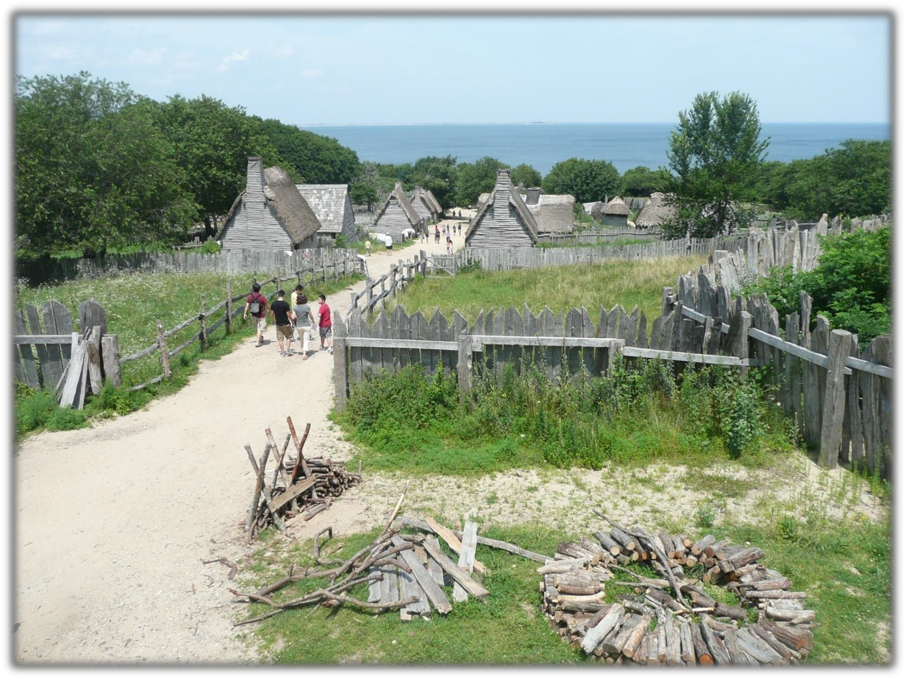
Plimoth Plantation

Slide 20
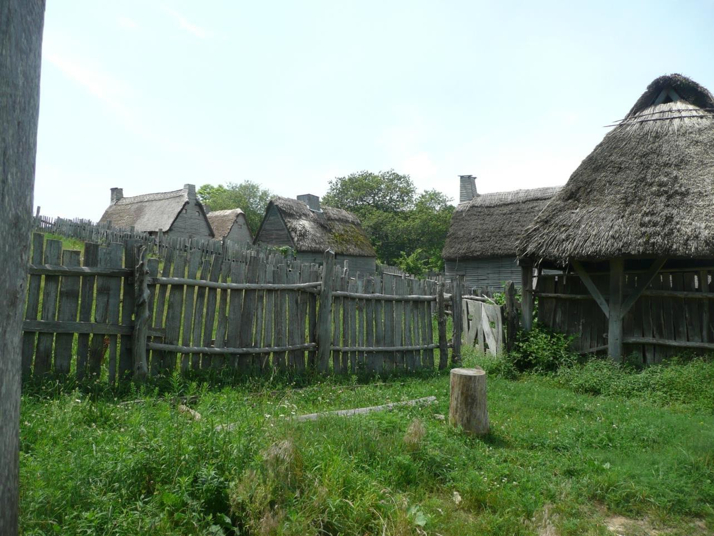

Slide 21
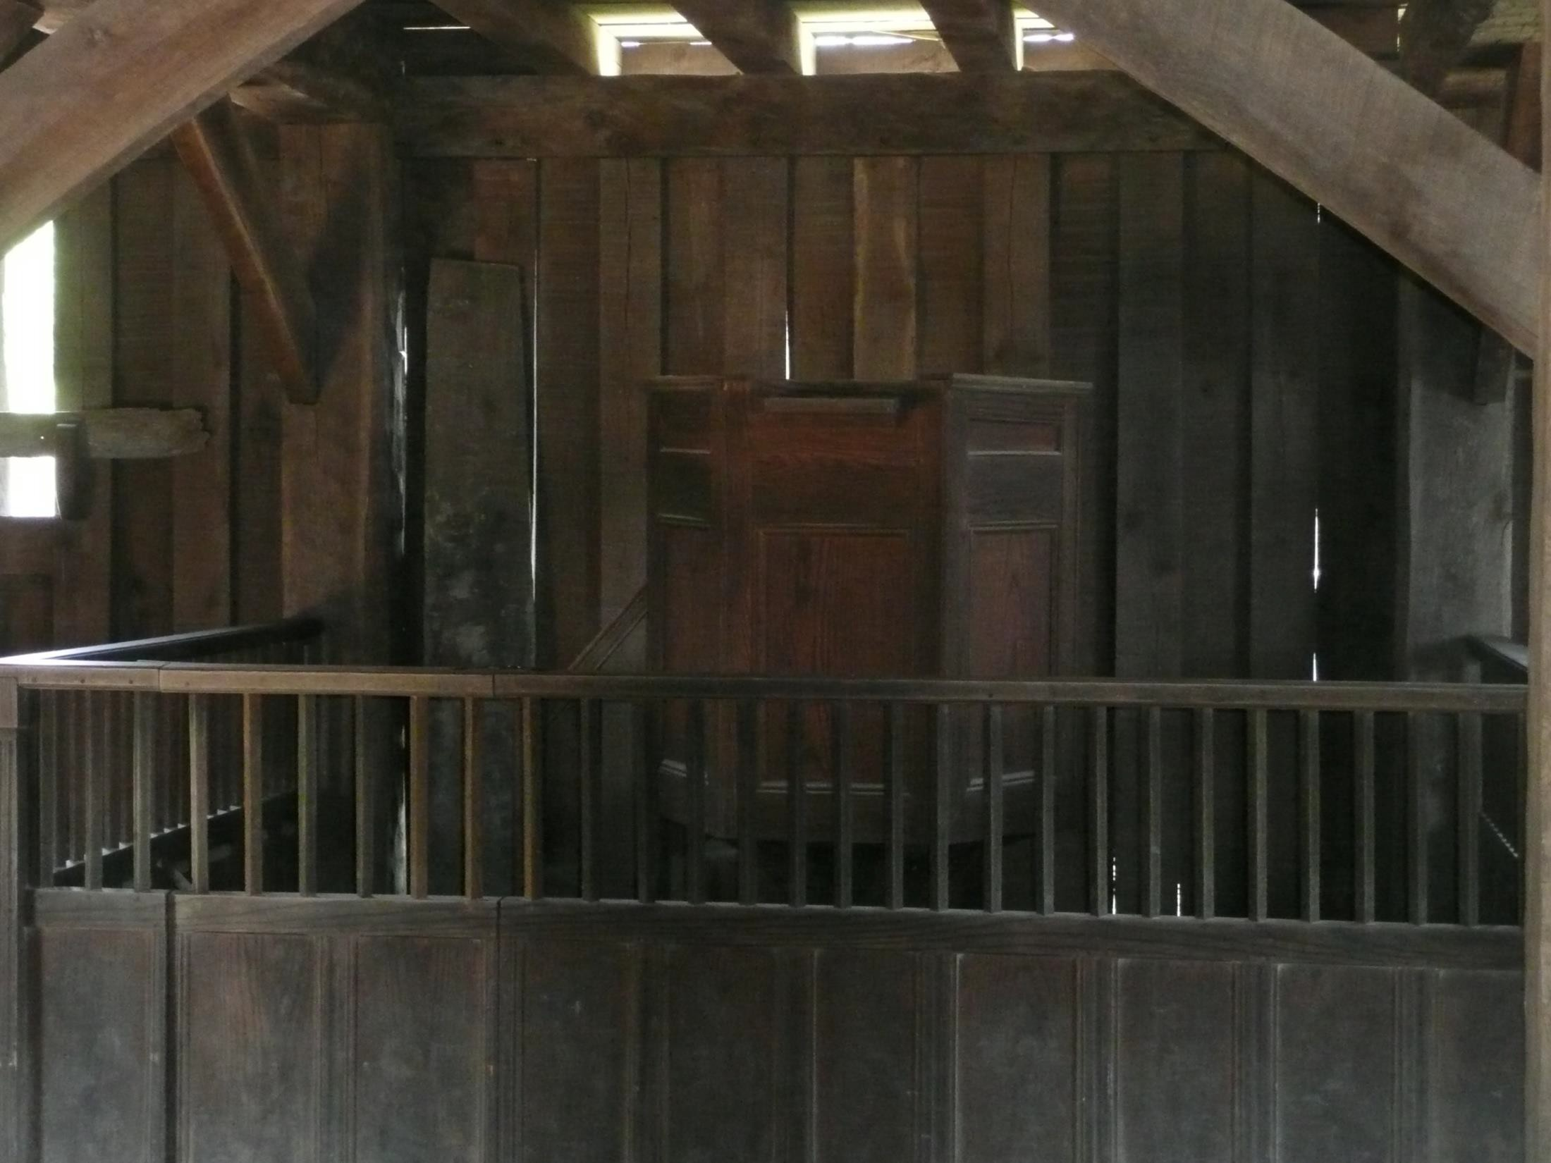
The pulpit in the church at
Plimoth Plantation

Slide 22
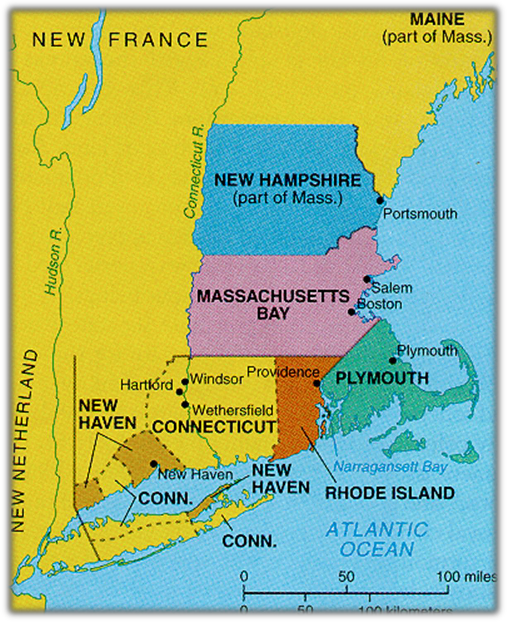
Map of Colonial New England

Slide 23
III. Massachusetts Bay Commonwealth
Why did Puritans leave England?
-- Fled tyranny of Charles I &
Archbishop Laud
MBC founded in 1629 by non-
Separatist Puritans
-- Royal charter served as the MBC constitution for many years
The Great Migration (1630s)
  Over 15,000 Puritans arrived in New England
  Ended due to English Civil War

Slide 24
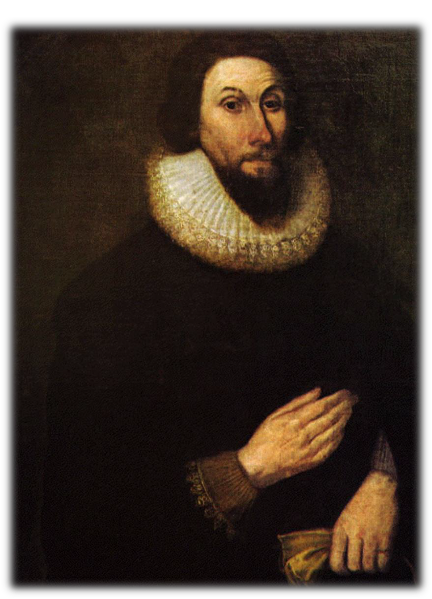
D. Governor John Winthrop
1. Covenant theology
“We shall build a city on a hill.”
-- Model of Christian Charity, 1630

Slide 25
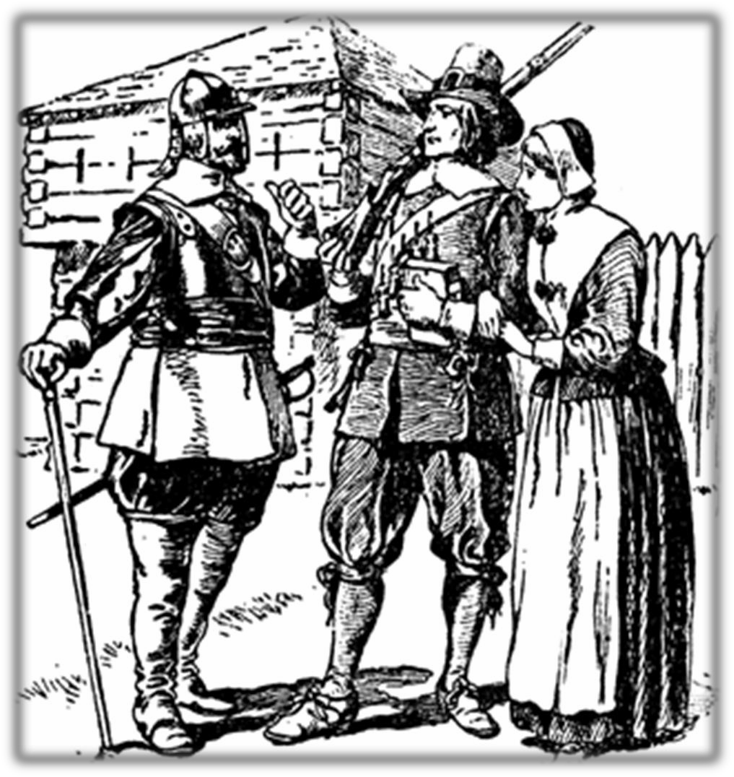
E. MBC became largest and most influential
colony in New England
-- Protestant work ethic

Slide 26
How did Puritanism in New England
lean towards democracy?

Slide 27
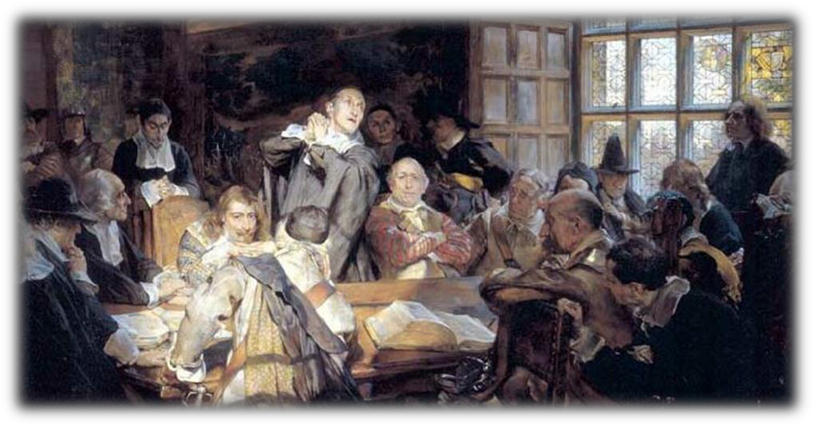
IV. Religion and Politics in the MBC
Governing open to all free adult males
  Congregational Church (based on
Calvinism)
  Male Voting rights (1631)
  Townhall meetings (mostly property
owners, majority rule)

Slide 28
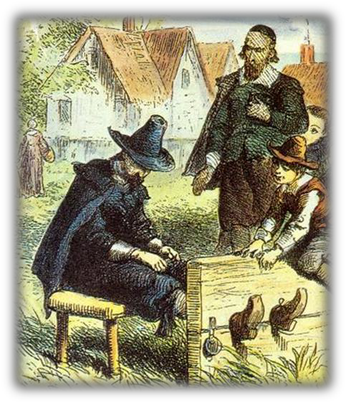
B. Purpose of government: enforce Gods laws!
Gov’t under Winthrop was not a democracy (only
visible saints were free men and thus could vote)
Congregational Church was “established” (all
paid taxes)
Religious dissenters were often punished
(NE became the least tolerant!)

Slide 29
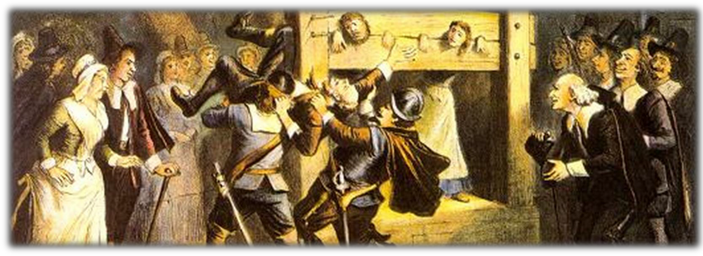
In Puritan Massachusetts, religious nonconformists suffered
this fate—and much worse.

Slide 30
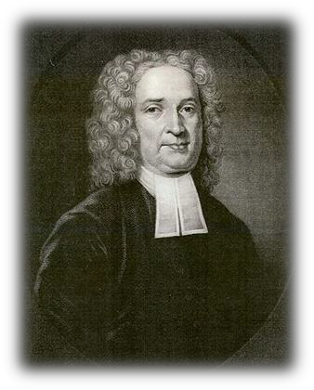
C. Church leadership (experienced conversion)
John Cotton (defends govt’s duty to enforce religion but advocated a civil government)
Clergy barred from formal
political office: (sep. of church and state!)
Cambridge Platform (1648)-MBC, Plymouth, CT,
New Haven (more uniform)
D. Representative assembly formed in 1634

Slide 31
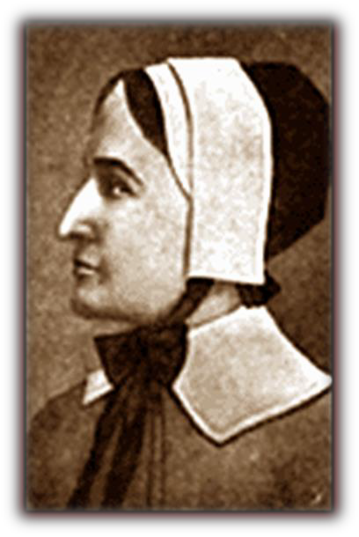
E. Early dissension in the MBC
Quakers (persecuted)
Anne Hutchinson
•antinomianism (declared that faith alone, not obedience to religious law is necessary for salvation)
•Banished and set out to R. I.

Slide 32
1. Complete religious freedom develops, in part, because leaders have the desire to protect their philosophy from the state
Question: Why might Roger Williams and other exiles desire religious freedom?
Guarantee of freedom written into charter
Almost complete white male suffrage (mentioned before)
Other colonies refer to R.I. as Rogues Island – that sewer
Hutchinson later killed in an Indian attack in New York (John Winthrop said it was divine retribution for her false teachings)

Slide 33
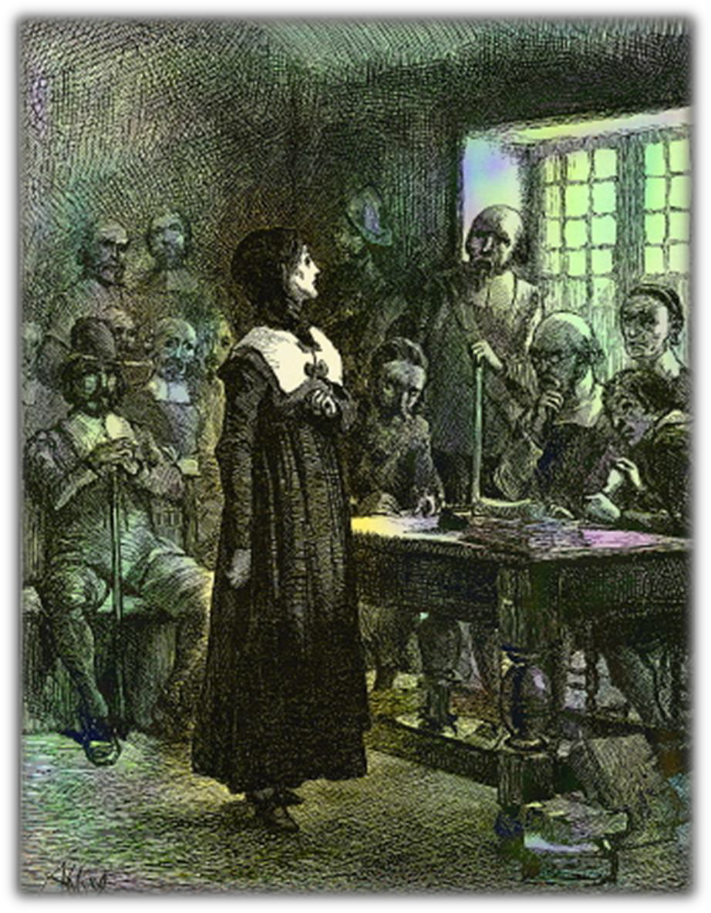
The Trial of Anne Hutchinson
“You have stepped out of your place, you have rather been a husband than a wife, and a preacher than a hearer. You have been a naughty woman.”

Slide 34
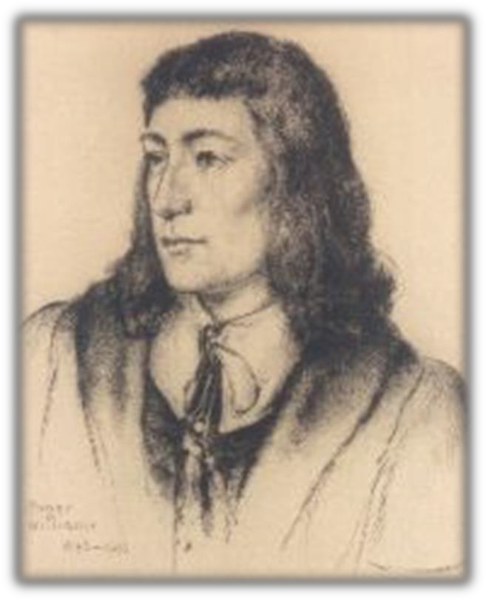
3. Roger Williams
“liberty of conscience”
“Wall of
separation” (Jefferson! And no
establishment clause)
Rhode Island
Denied authority of civil govt.
to regulate religious behavior
No man should be forced to go to church

Slide 35
Why the decline in power of the
Puritan Clergy in the late 17th?

Slide 36
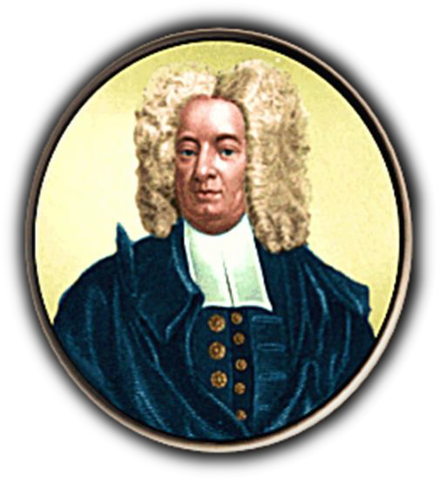
F. The decline of Puritanism
Loss of religious zeal and spread of population
Response:
  Jeremiad-had to be more committed, children of non-converted members could not be baptized.
  Half-way Covenant (1662)-partial
membership to those who were baptized as children.
  Open membership by 1700
Salem Witch Trials (1692) a.
Cotton Mather-supported trials

Slide 37
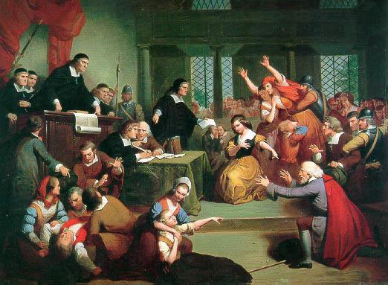
Salem Witch Trials, 1692

Slide 38
Salem Witch Trials
Many believed devil worked with witches in
the real world
1st accusation when young girls listen to tales of voodoo from a black servant, began behaving oddly
Older women became targets
Young accusers were poor from the west,
accused the wealthy from the east.
20 people executed.

Slide 39
V. Completing the New England Colonies
Rhode Island: Founded by
Roger Williams, 1636
  Founded first Baptist church in America
    Freedom of religion
    No compulsory worship
    No taxes to support state church
  Simple manhood suffrage
  Charter colony: Given charter from Parliament in 1644

Slide 40
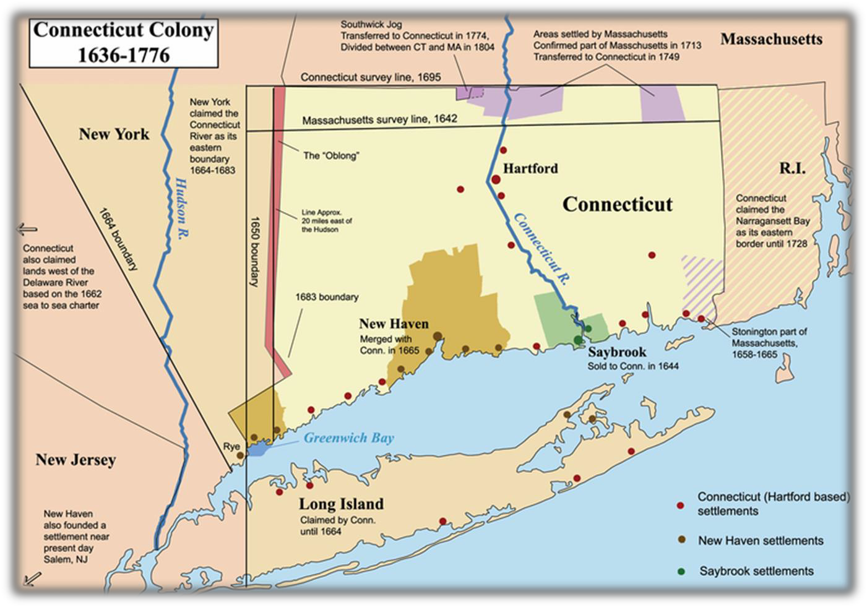
B. Connecticut River Colony (1636)
Thomas Hooker
Fundamental Orders (1639)
-- Significance

Slide 41
C. Maine absorbed by Massachusetts
Bay in 1677
D. New Hampshire separated from MBC in 1679

Slide 42
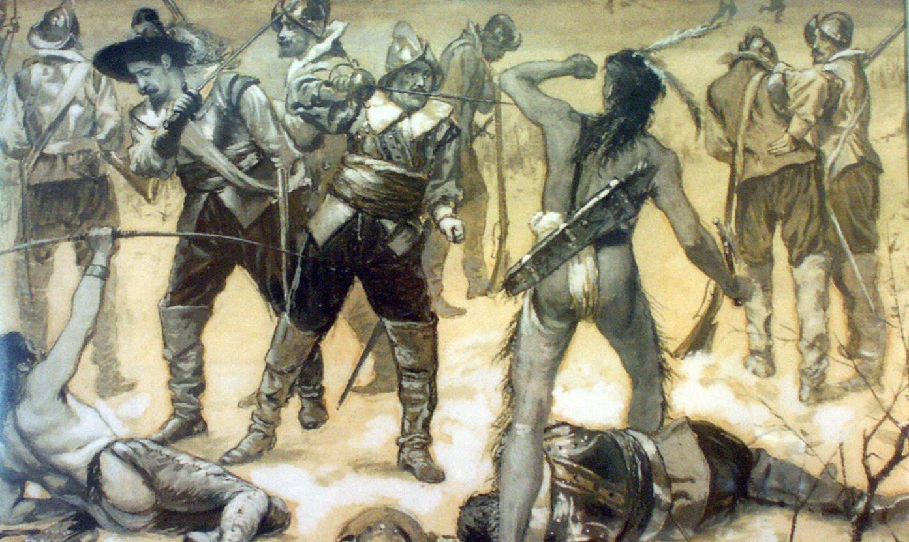
New England Confederation (1643): MBC, Plymouth, Connecticut River settlements, & New Haven
  Pequot War, 1636
-- Results: Pequots were destroyed

Slide 43
B. Colonies were left to fend for
themselves during English Civil War
-- 1st milestone on the road to colonial unity

Slide 44
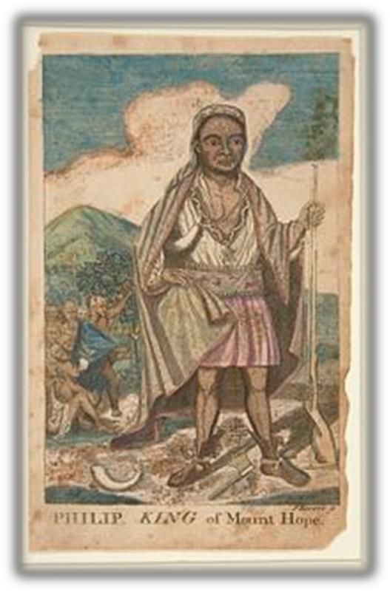
C. King Philip’s War, 1675
1. Metacom, Wampanoag chief, attacked MBC towns after being provoked by settlers.
-- New England Confederation put to
the test

Slide 45
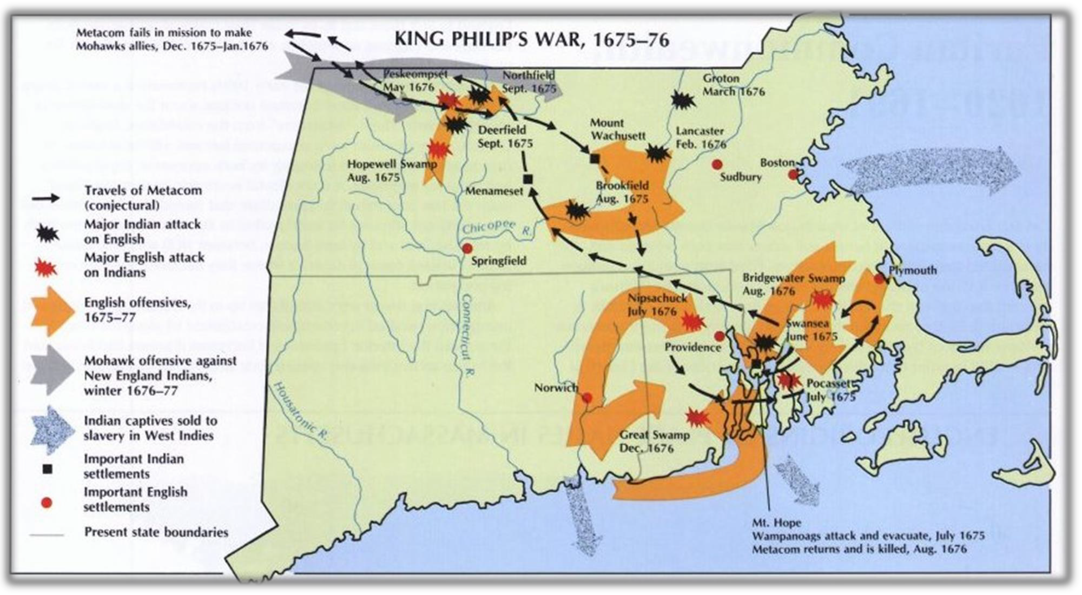
2. Bloodiest war ever fought on New
England soil

Slide 46
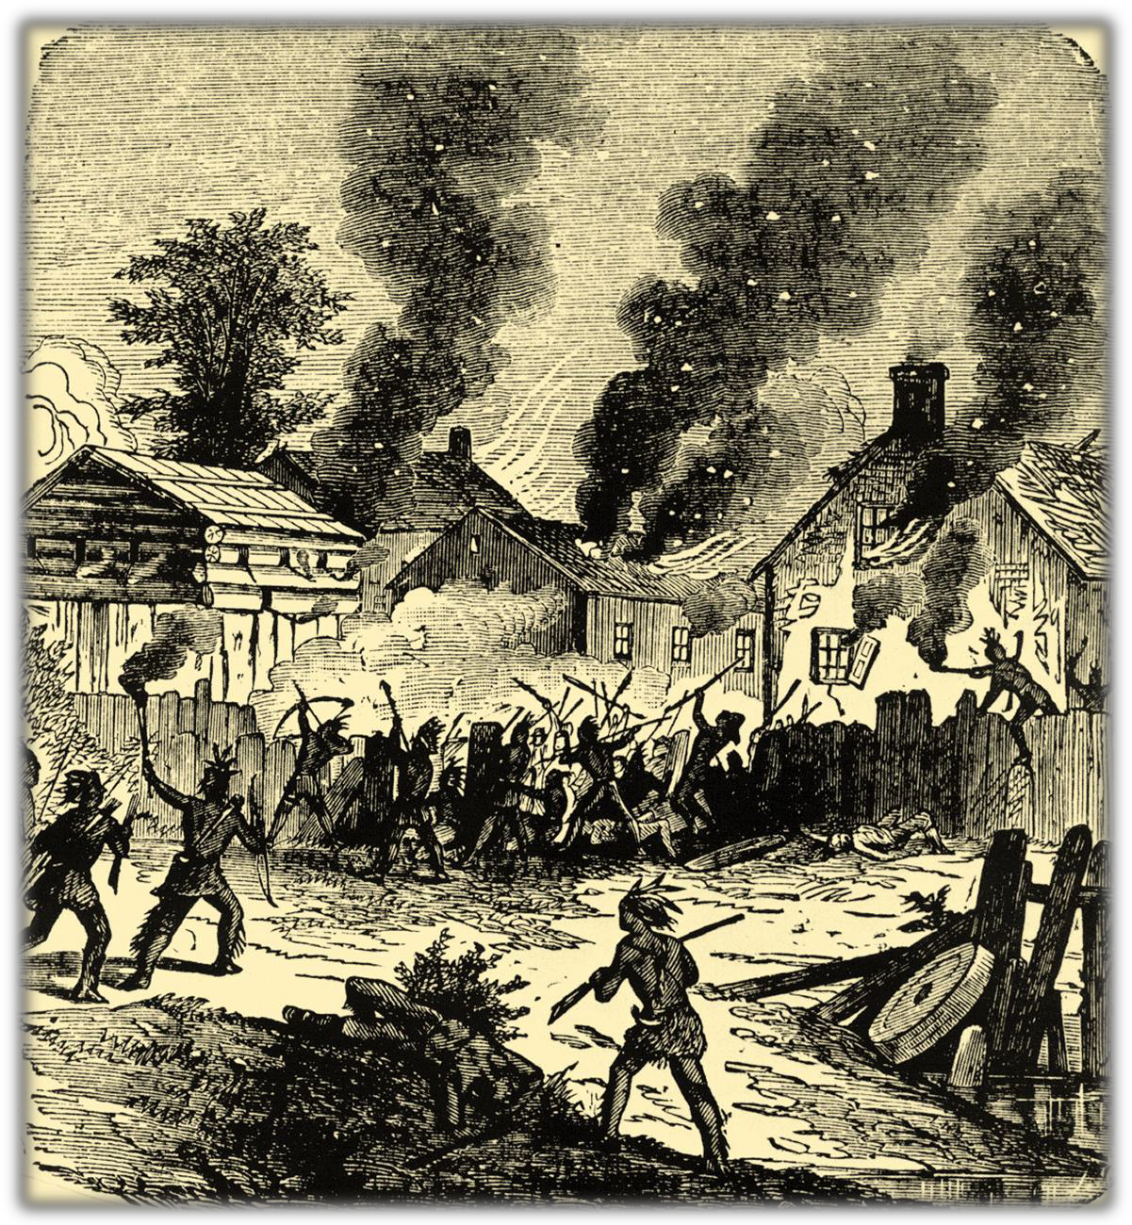
Wampanoags attack a Puritan settlement

Slide 47
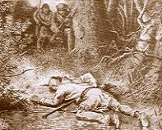
3. Results: Native Americans were defeated and effectively removed from much of MBC, CT & RI.
The death of King Philip at the hands of two Massachusetts colonists.

Slide 48
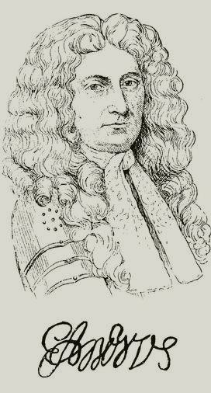
VII. Dominion of New England (1686) and the
“Glorious Revolution”
The crown clamped down on MBC
Dominion of New England
  Purposes: mercantilism
    Enforce Navigation Laws
    Provide defense for colonies
  Sir Edmund Andros
“Glorious Revolution” (1688)
  Inspired “1st American Revolution”
  Andros was removed

Slide 49
D. Post-Glorious Revolution New England
1691, MBC made a royal colony
-- Loss of charter colony status
Tighter administrative control
by the crown over British America

Slide 50
VIII. New England Life and Contributions
to the American character
Geography & Economy
  Rocky soil: few cash crops
--Subsistence farming common
  Diverse economy: fishing, shipbuilding, lumbering, shipping, fur, dairy

Slide 51
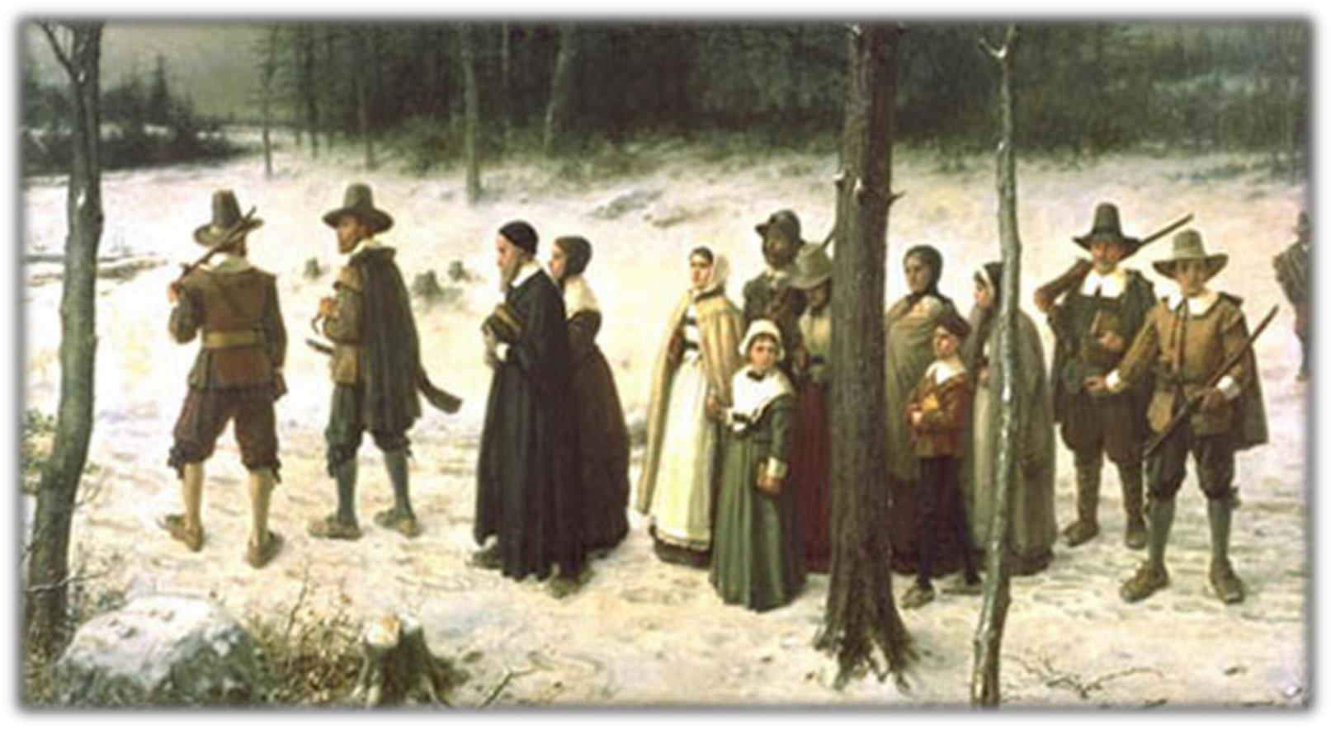
3. Less ethnic diversity

Slide 52
B. Puritan contribution to American character
Seeds of democracy
  Townhall meetings
  Voting rights to church members, 1631
Perfectibility of society (“perfectionism”)
Covenant theology & Protestant work ethic
Inspired later reforms: abolition movement, women’s
rights, education, prohibition
3. Protestant work ethic

Slide 53
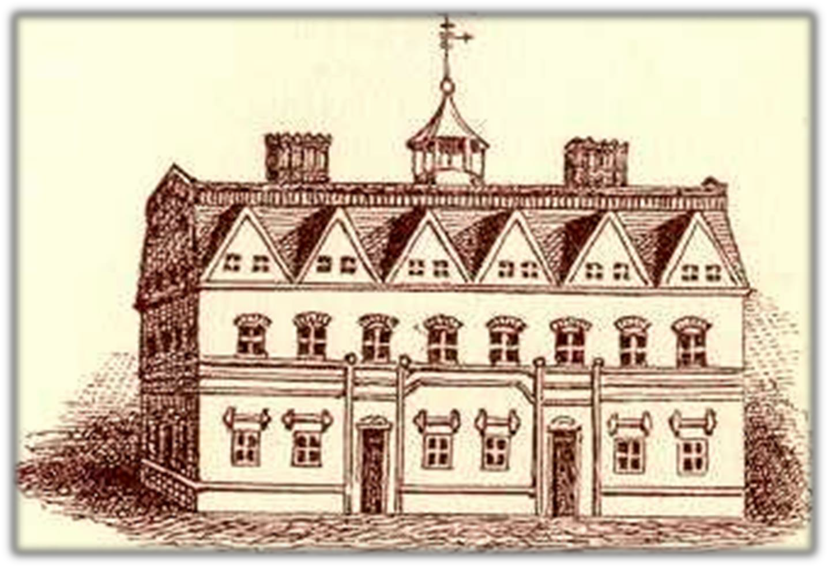
Education
  Purpose: train the clergy
  Harvard College (1636)

Slide 54
3. Massachusetts School of Law,
1647
Towns with 50 or more families required to provide public education
Resulted in a highly literate population

Slide 55
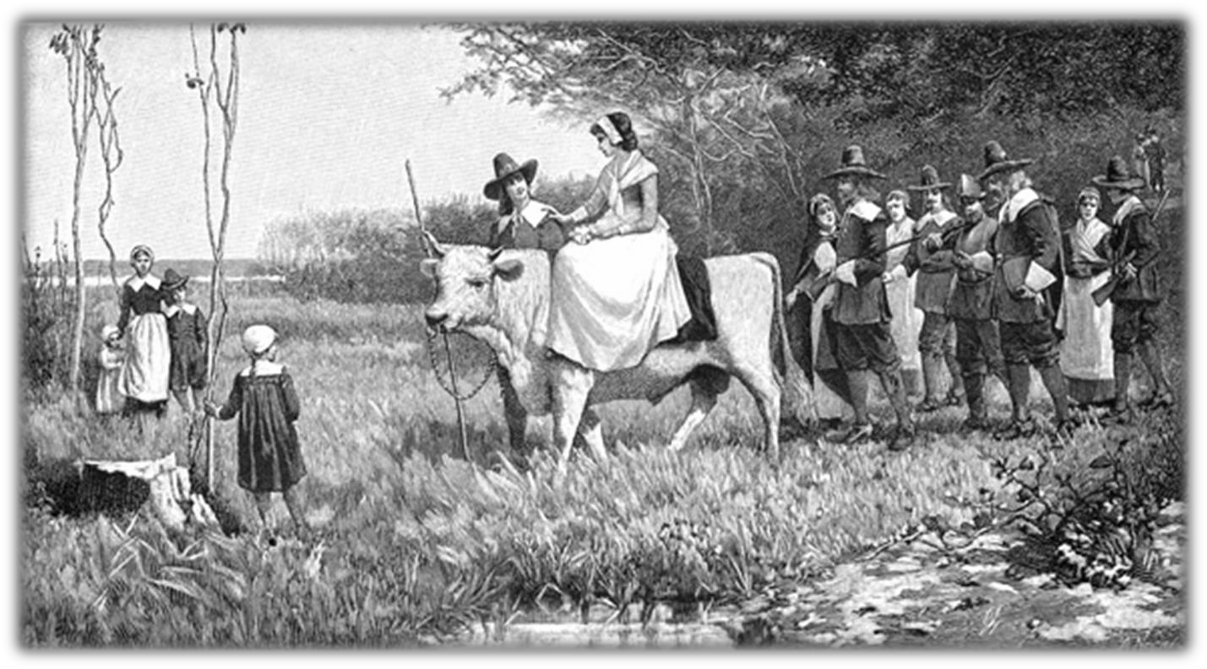
IX. New England Family
High life expectancy
Family migration
High natural reproduction
Strong family stability
A Puritan Wedding Procession

