Slide 1
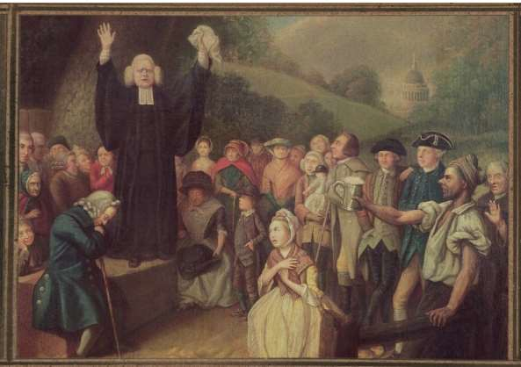
Colonial Society in the 18th Century
The English Colonies on the
Eve of Revolution

Slide 2
What is an American?
It is a “strange mixture of blood, which you will find in no other
country… What then is the American, this new man?”
- M.G. de Crevecoeur

Slide 3
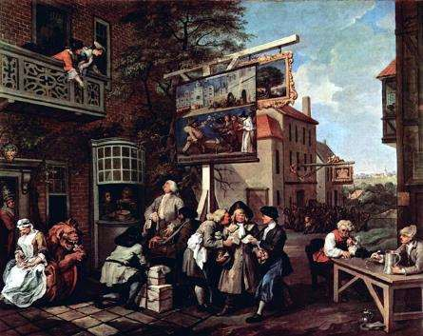
Essential Question
By 1754, to what extent had the British colonies developed a sense of an
“American” identity?

Slide 4
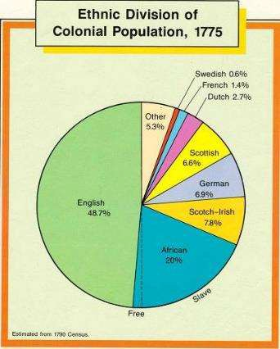
Population Growth
Doubling every 25 years
By 1700: 250,000. Free
& Slave
By 1775: 2.5 million
(500,000 African)
Causes:
  Reproduction rate (unparalleled in modern world history)
  Immigration

Slide 5
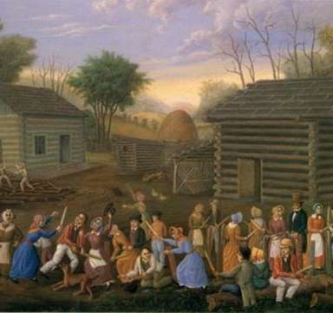
European Immigrants
Most Settled in Middle
Colonies
English
  Limited numbers
Germans
  Pennsylvania
Scotch-Irish
  Virginia, Carolinas, Georgia
Others
  French Protestants, Dutch,
Swedes

Slide 6
Africans
Largest non-English group
  20% of population
    90% in South
      Majority in SC & GA
In North, occupations ranged
  Enslaved
  Laborers
  Tradesmen
  wage earners

Slide 7
The Interesting Narrative of The Life of Olaudah Equiano, or Gustavus Vassa, the African
…At last, when the ship we were in had got in all her cargo, they made ready with many fearful noises, and we were all put under deck, so that we could not see how they managed the vessel. But this disappointment was the least of my sorrow. The stench of the hold while we were on the coast was so intolerably loathsome, that it was dangerous to remain there for any time, and some of us had been permitted to stay on the deck for the fresh air; but now that the whole ship's cargo were confined together, it became absolutely pestilential. The closeness of the place, and the heat of the climate, added to the number in the ship, which was so crowded that each had scarcely room to turn himself, almost suffocated us…
-- Olaudah Equiano, 1789

Slide 8
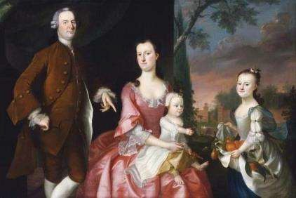
Structure of Colonial Society
General Characteristics:
  Self-Government
  Religious Toleration
  No Hereditary
Aristocracy
  Social Mobility

Slide 9
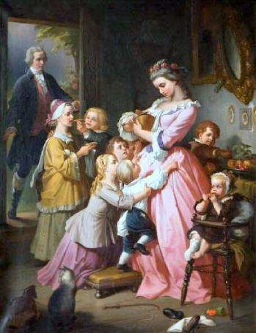
The Family
More than 90% of colonists
lived on farms
  High standard of living
Men
  English common law gave
most power to men
    Landowning, politics
Women
  Avg # of children = 8
  Household work, education
of children
    Origins of “cult of domesticity”

Slide 10
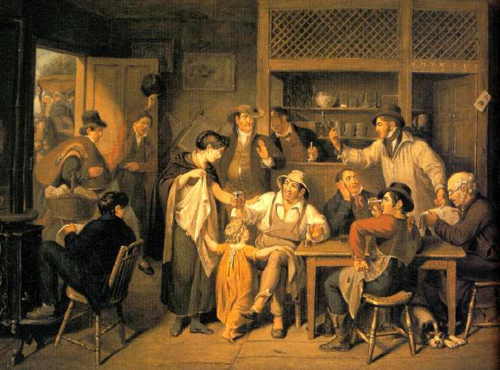
The Economy
Mercantilism & British
restrictions
  Navigation Acts (1651, 1660,
1663)
  Molasses Act (1733)
New England
  Smalls farms, logging,
shipbuilding, fishing, trade
Middle Colonies
  Wheat, corn, family farms, small manufacturing, trade (Philadelphia & New York)

Slide 11
The Economy
Southern Colonies
  Smalls subsistence farming, large plantations, cash crops
Monetary System
  Limited hard currency
  Many developed paper
currency
Transportation
  Deficient over land
  Important ports for sea
trade:
    Boston, New York,
Philadelphia, Charleston
  Importance of taverns

Slide 12
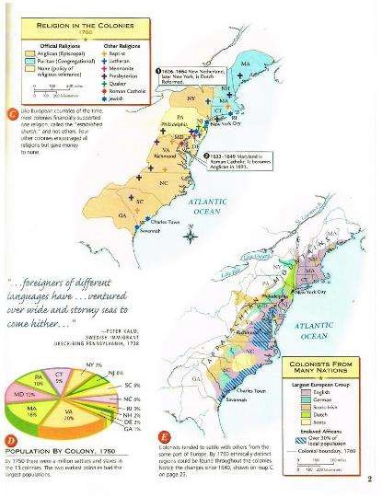
Religion
Religious Diversity
  Especially in Middle
Colonies
Witches in Salem
(1692)
Challenges to Established Churches
  Protestants vs.
Congregationalists
Expansion of Protestant evangelism
  Anti-Anglican sentiments

Slide 13
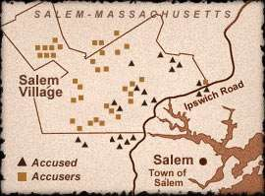

Slide 14
“The Salem trials, now being busily commemorated, were not the first or the last time that charges of witchcraft were heard in New England, but the extent of the alarm was unparalleled in the American colonies. The trials were the theme of Arthur Miller's play "The Crucible", written in the 1950s, which implicitly connected the 17th-century witch hunt with the communist scare triggered by Senator Joseph McCarthy. Since then, a spate of new studies has appeared.
Feminists see the frenzy as part of the misogyny of Puritan culture, and the witch-hunts as a backlash against unconventional women--or those climbing the economic ladder. Racial interpretations see in Salem a colonial outpost where the slave Tituba embodies white fears of alien peoples in an unconquered continent.
Religious and political historians are having their say, too. The town of Salem was becoming prosperous (and secular) more quickly than the surrounding rural areas. Rivalries had developed, and the charges of witchcraft, which came first from the poorer, more devout countryside, helped to feed the tension...
The climate was ripe for an emotional eruption, and here medical science steps in. Some physicians...suggest that the wet winter may have led to the growth of ergot, a delusion- causing fungus, in the local grain supply.”
--‘the Salem Witch-trials: Misogyny, Ergot, or Envy?’ the Economist, published 1992

Slide 15
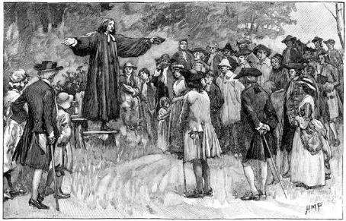
The Great Awakening
Characteristics:
  Fervent expression of religious
beliefs
  Mass movement
  Itinerant preachers
Jonathan Edwards
  “Sinners in the Hands of an
Angry God”
George Whitefield
  Large outdoor audiences
Impact:
Trans-atlantic exchanges
  “New Lights” vs. “Old Lights”
    Rise of Baptists and Methodists
    New Institutions – Colleges
  Greater independence and diversity of thought (religious beliefs
    Challenges to authority

Slide 16
Primary Source
“The bow of God's wrath is bent, and the arrow made ready on the string, and justice bends the arrow at your heart, and strains the bow, and it is nothing but the mere pleasure of God, and that of an angry God, without any promise or obligation at all, that keeps the arrow one moment from being made drunk with your blood.”
— Jonathan Edwards, Sinners in the Hands of an Angry God

Slide 17
A Divine and Supernatural Light
“That there is such a thing as a supernatural and divine light, immediately imparted to the soul by God, of a different nature from any that is obtained by natural means... I would show what this spiritual and divine light is...
There is therefore in the spiritual light: a true sense of the divine and superlative excellency of the things of religion; a real sense of the excellency of God and Jesus Christ, and of the work of redemption, and the ways and works of God revealed in the gospel. There is a divine and superlative glory in these things; an excellency that is of a vastly higher kind, and more sublime nature, than in other things; a glory greatly distinguishing them from all that is earthly and temporal. He that is spiritually enlightened truly apprehends and sees it, or has a sense of it. He does not merely rationally believe that God is glorious, but he has a sense of the gloriousness of God in his heart...”
--Jonathan Edwards, 1733

Slide 18
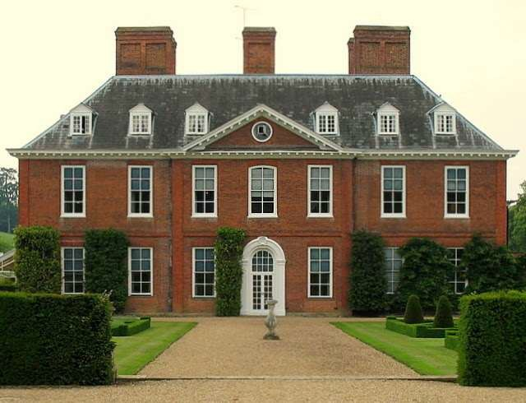
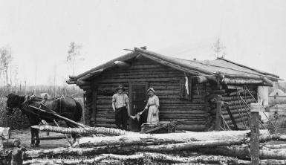
Cultural Life
Arts and Sciences
  Architecture
    Borrowed (Georgian)
    Frontier Log Cabins

Slide 19
M/C Question
Jonathan Mayhew
AMSCO p. 59
Read stimulus and answer questions #7-10
4 minutes

Slide 20
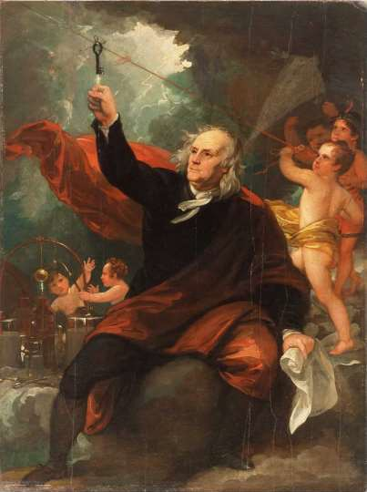
Cultural Life
Benjamin West
Benjamin Franklin Drawing Electricity from the Sky, 1816

Slide 21
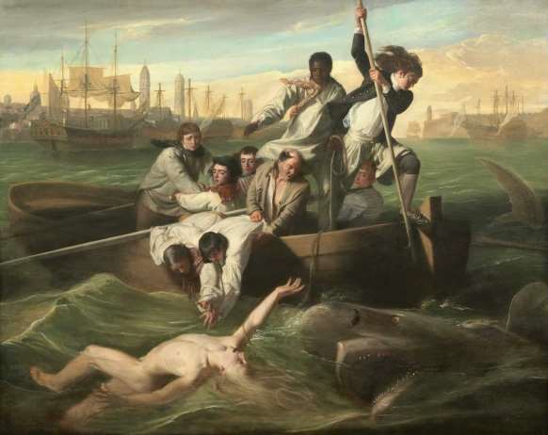
Cultural Life
John Copley
Watson and the Shark,
1778

Slide 22
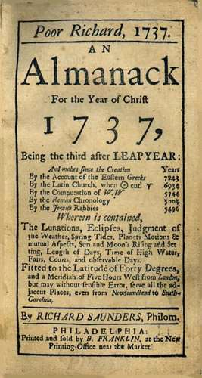
Cultural Life
Literature
  Religious (Mather &
Edwards)
  Writers
    Otis, Dickinson
  Poetry (Wheatley)
Science
  Benjamin Franklin

Slide 23
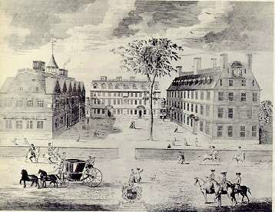
Elementary Education
The Old Deluder Act & Massachusetts School Law (1647)
Middle Colonies: private or
church schools
South: limited; owner’s
children on plantations

Slide 24
Higher Education
Sectarian Colleges:
  Harvard (1636)
  William and Mary (1694)
  Yale (1701)
  New Light Colleges:
    Princeton, Columbia, Brown, Rutgers, & Dartmouth
First Liberal Arts College:
  Pennsylvania (1765)
Ministry
Physicians
Lawyers

Slide 25
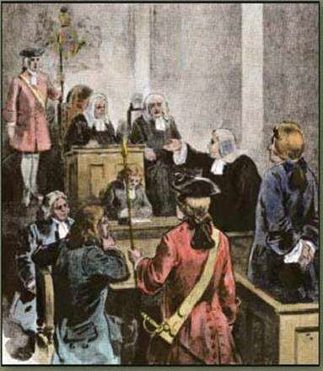
Colonial Folkways
The Press
  Newspapers
  Zenger Trial (1735)
Rural Life
  Reliance on Seasons
  Entertainment (wealthy):
    Card-playing, horse-racing
Influence of the Enlightenment
  Hobbes, Locke, Rousseau
Emergence of a National
Character
  “Freedoms”

Slide 26
M/C Question
Zenger Trial
AMSCO p. 58
Read stimulus and answer questions #4-6
3 minutes

Slide 27
Second Treatise of Government
“The state of nature has a law of nature to govern it, which obliges everyone. That law is reason, and it teaches all mankind, that since we are all equal and independent, no one ought to harm another’s life, health, liberty or possessions.
Since men are, as has been said, by nature all free, equal, and independent, no one can be put out of this estate and subjected to the political power of another without his own consent. Giving this consent is done by agreeing with other men, to join and unite into a community to promote their comfortable, safe, and peaceable living, and a secure enjoyment of their property. When any number of men have so consented to make one government, the majority has a right to act and conclude the rest.
Wherever law ends, tyranny begins. A situation may arise in which the law is transgressed and someone is harmed, and then the monarch exceeds the power given him by the law by making use of force to compass that upon the subject which the law allows not. If this occurs, the monarch may be opposed, just as would any other man who by force invades the right of another.”
--John Locke, 1690

Slide 28
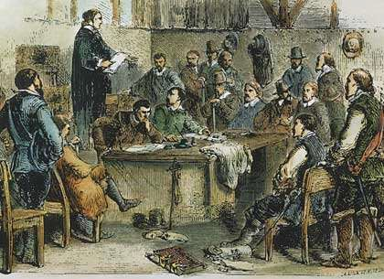
Politics
Structure of Government
  8 Royal
  3 Proprietary
  2 Popularly Elected (CT, RI)
  All had bicameral legislatures
Local Governments
  Town meetings
  Counties/parishes
Voting
  Restrictions
  Removal of religious
restrictions

Slide 29
M/C Question
John Locke
AMSCO p. 57
Read stimulus and answer questions #1-3
3 minutes

Slide 30
Analysis: Historical Perspectives
Was colonial America “democratic”?
In favor:
New England Town
Meetings
Universal manhood
suffrage?
  Class did not determine voting rights
Opposed:
Little political conflict
nor debate
Limited voting rights
Emergence and dominance of new elite

Slide 31
End of Session 2
Review Assignment: Answer question 3 (a, b, c) on p. 61

Slide 32
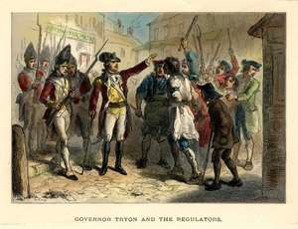
Tension & Conflict
Class Tensions:
  Bacon’s Rebellion: Virginia (1676)
  Coode’s Rebellion: Maryland (1689)
  Leisler’s Rebellion New York (1690)
  Tenant Riots
    New Jersey (1746)
    Vermont (1760)
    New York (1765-6)
  Paxton Boys: Pennsylvania (1760’s)
  The Regulators: Carolinas (1760)
Slave Revolts
  Stono Rebellion (1739)
  New York Conspiracy (1741)

Slide 33
Writing/Discussion Assessment
By 1754, to what extent had the British colonies developed a sense of an
“American” identity?
Provide evidence

Slide 34
Writing/Discussion Assessment
Support, amend or refute the following statement with
supporting evidence
The British colonies participated in political, social, cultural, and economic exchanges with Great Britain that encouraged both stronger bonds with Britain and resistance to Britain’s control.

