Slide 1
Imperial Wars and Colonial Protest
America on the Verge of Revolution
1754 - 1774

Slide 2

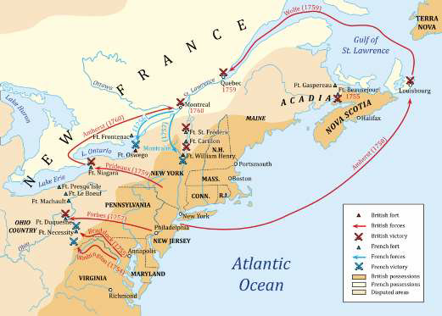
Essential Question
 In what ways did the French and Indian War alter the political, economic, and ideological relations between Britain and its American colonies?

Slide 3

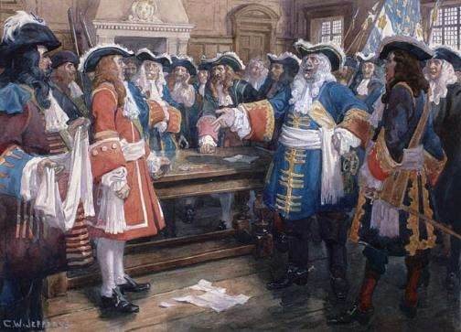
Empires at War
 Great Britain, France, and
Spain
 The First Three Wars
 King William’s (1689-1697)
 French attack on NY
 Queen Anne’s (1702-1713)
 Treaty of Utrecht (1713)
 King George’s (1744-1748)
 Capture of Louisburg

Slide 4

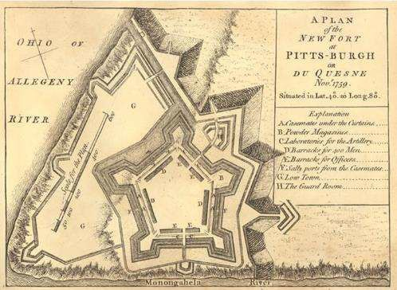
Causes of the Seven Years’ War
http://www.history.com/topics/french-and-indian-war/videos/what-was-the-french-and-indian-war?m=528e394da93ae&s=undefined&f=1&free=false
French Forts in the Ohio River
Valley
 Virginia militia (Washington)
called in
 Fort Duquense (French)
 Fort Necessity (British)
 forced to surrender
(1754)
 Braddock Expedition (Fort Duquesne)
 Albany Plan of Union (1754)
 Ben Franklin

Slide 5

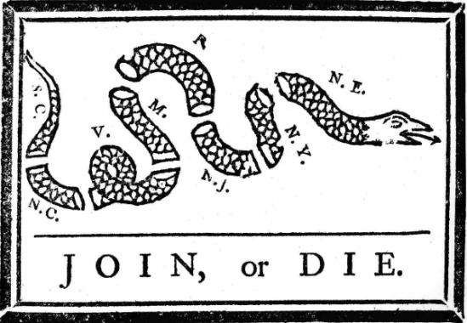



Image #4
H – Context?
I – Audience? P – Purpose? P – P.O.V.?

Slide 6

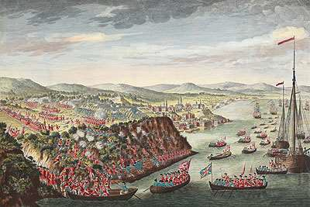
Events of the Seven Years’ War
 Lord Pitt, Prime Minister
 Recapture of Louisburg
(1758)
 Surrender of Quebec (1759)

Slide 7


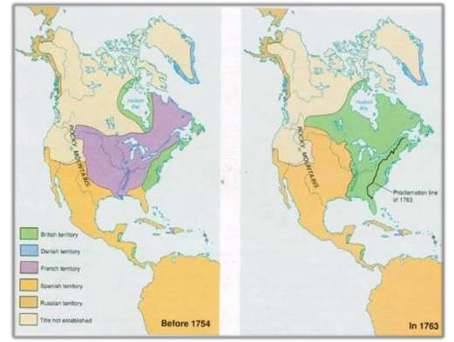
Results of the Seven Years’ War
 Treaty of Paris (1763)
 France Loses Almost all
Colonial Possessions
 Britain Dominant Naval
Power
 British View
 Contempt and low opinion for the colonies
 Colonial View
 Proud of military
performance
 Shattered myth of British
invincibility

Slide 8
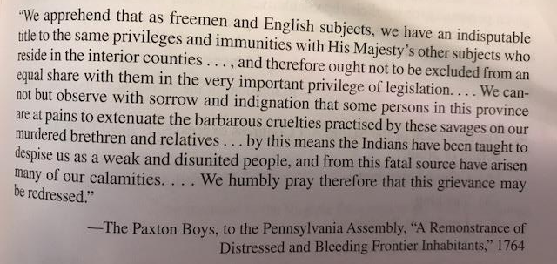

M/C Question
 AMSCO p. 79 # 1-3

Slide 9
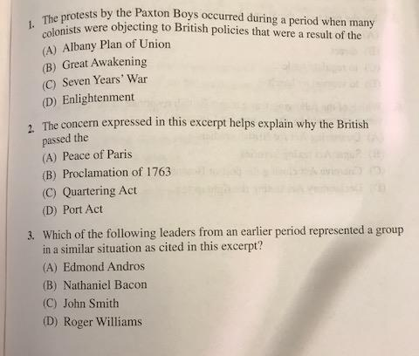

Slide 10
have not yet conquered us! We are not your slaves…
“Englishman, although you have conquered the French, you
Historical Content?
Englishman…the King of France employed our young men to make war upon your nation. In this warfare many of them have been killed, and it is our custom to retaliate until such time as the spirits of the slain are satisfied. But the spirits of the slain are to be satisfied in either of two ways; the first is by the spilling of the blood of the nation by which they fell; the other by covering the bodies of the dead, and thus allaying the resentment of their relations. This is done by making presents.
Englishman, your king has never sent us any
presents,…wherefore he and we are still at war; and until he does these things we must consider that we have no other father, nor friend among the white men than the King of France…”
Minavavana, Chippewa chief, 1761
Intended Audience?
Purpose?
POV?

Slide 11

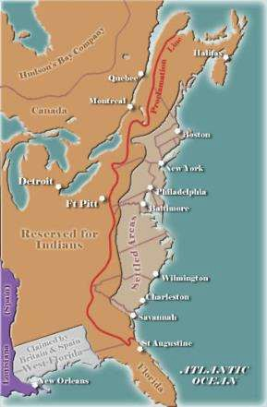
Reorganization of the British Empire
 Effect of War on British
Economy
 Desire to tax the colonies
 Legacy of Salutary
Neglect
 Pontiac’s Rebellion
(1763) – westward movement of European settlers
 Proclamation of 1763

Slide 12
Historical Content?
“And whereas it is just and reasonable, and essential to our interest, and the security of our colonies, that the several nations or tribes of Indians with whom we are connected, and who live under our protection, should not be molested or disturbed in the possession of such parts of our dominions and territories as, not having been ceded to or purchased by us, are reserved to them, or any of them, as their hunting grounds. We do therefore… declare… that no governor or commander in chief in any of our colonies…[may] grant warrants of survey, or pass any patents for lands beyond the bounds of their respective governments.
…We do further strictly enjoin and require all persons whatever who have either willfully or inadvertently seated themselves upon any lands within the countries above described, or upon any other lands which, not having been ceded to or purchased by us, are still reserved to the said Indians as aforesaid, forthwith to remove themselves from such settlements.”
King George III, Royal Proclamation, 1763
Intended Audience?
Purpose?
POV?

Slide 13


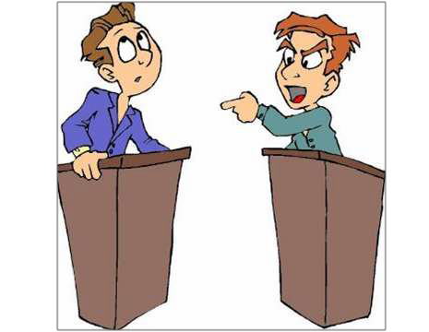
Questions for Debate
 Evaluate the relative importance of three of the following as factors prompting Americans to rebel in 1776:
 Parliamentary Taxation
 Denial of Political and Civil Liberties
 British Military Measures
 Salutary Neglect
 Evaluate the relative effectiveness of three of the following colonial responses to British Parliamentary policies and actions from 1763 to 1776:
 Boycotts
 Mob Violence
 Organizational Structures
 Propaganda

Slide 14
levied, collected, and paid unto his majesty, his heirs, and
“…by the authority of [Parliament], that there shall be raised,
Historical Content?
successors, throughout the colonies and plantations in America…
For every skin or piece of vellum or parchment, or sheet or piece of paper, on which shall be engrossed, written, or printed, any declaration, plea, replication, rejoinder, demurrer or other pleading, or any copy thereof; in any court of law within the British colonies and plantations in America, a stamp duty of three pence…
For every skin or piece of vellum or parchment, or sheet or piece of paper, on which shall be engrossed, written, or printed, any such order or warrant for surveying or setting out any quantity of land above one hundred and not exceeding two hundred acres, within the said colonies and plantations, a stamp duty of one shilling…”
Parliamentary legislation, March 22, 1765
Intended Audience?
Purpose?
POV?

Slide 15

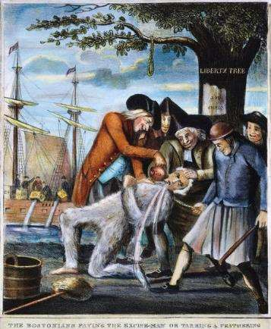
British Actions and Colonial Reactions
 New Revenues and Regulations
 Sugar Act (1764)
 Quartering Acts (1765)
 Stamp Act (1765)
 Organizational Structures
 House of Burgesses
 Patrick Henry’s Resolves
 Stamp Act Congress (NY)
 Sons and Daughters of
Liberty
 Boycott
 Home manufacturing
 Tarring and feathering
 Repeal of Stamp Act and Introduction of Declaratory Act (1766)

Slide 16
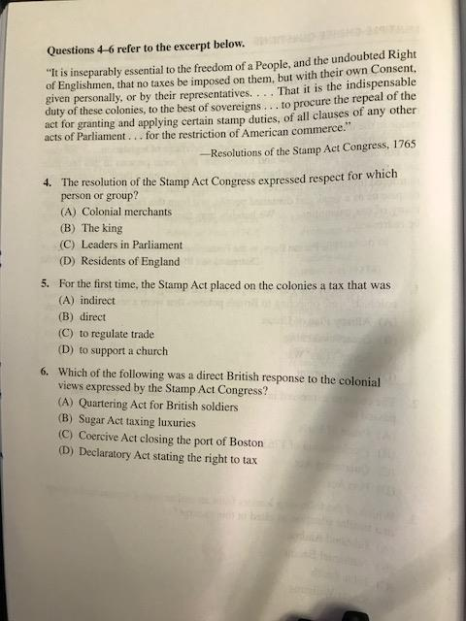
M/C Question
 AMSCO p. 80

Slide 18

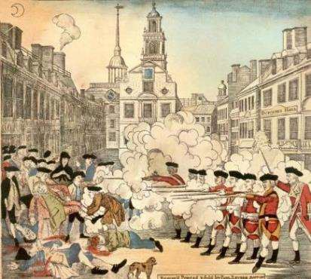
Second Phase of the Crisis
 Townshend Acts (1767)
 Duties on tea, glass, lead, and paper
 Writs of Assistance
 New York Restraining Act
 Renewal of Boycott
 The Boston Massacre (March, 1770)
 Repeal of Townshend Acts (1770)
 Tea tax remained

Slide 19

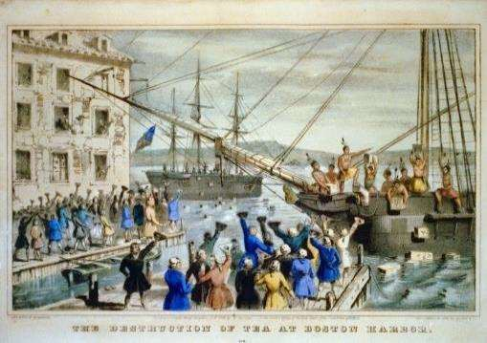
Renewal of the Conflict
 Committees of Correspondence (1772)
 Boston Tea Party (Dec.
1773)
 Tea Act of 1773
 Coercive Acts (1774)
 Quebec Act (1774)

Slide 20



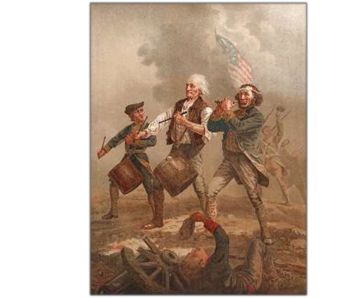
Philosophical Foundations of the American Revolution
 Legacy of Salutary Neglect
 Self-Government
 Religious Freedom
 Personal Profit/Gain
 Mercantilism vs.
Capitalism
 Enlightenment Ideals
 Locke, Rousseau
 Social Contract
 Inalienable Rights

Slide 21



Effects of Pre- Revolutionary Period
Political
 Legacy of Self- Government
Economic
 Legacy of
Salutary Neglect
Ideological
 Desire to retain Individual Rights
 Foundations of
State Sovereignty
 Move from Mercantilism to Capitalism
 Transition from identity as British to “American”
 Republican
virtue

Slide 22
M/C Question
 AMSCO p. 81
 Read stimulus and answer questions #7-8
 2 minutes

