Slide 1
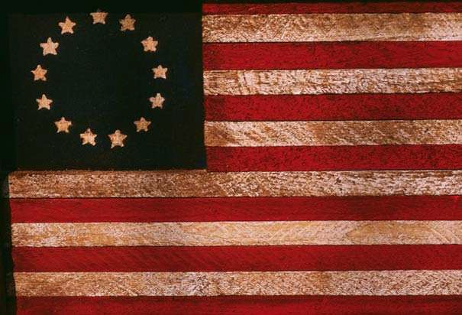
The American Revolution & Confederation
The Birth of the United States 1774-1787

Slide 2
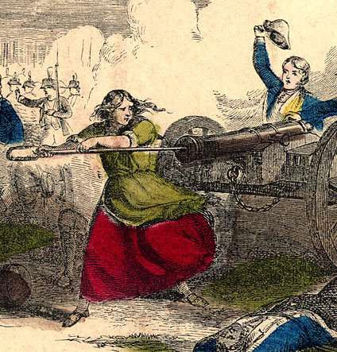
Essential Question
Evaluate the extent to which the Revolution fundamentally changed American society.

Slide 3
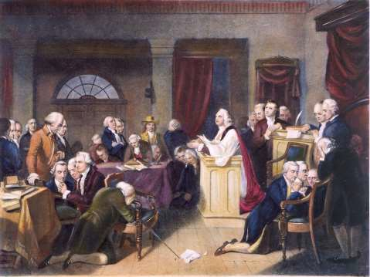
The First Continental Congress
12 Colonies meet in Philadelphia (Sept. 1, 1774)
Delegates
Objectives & Resolutions:
  Declaration of Rights and Grievances
  Obtain repeal of Coercive Acts (Suffolk Resolves)
  Created Continental Association
    boycott

Slide 4
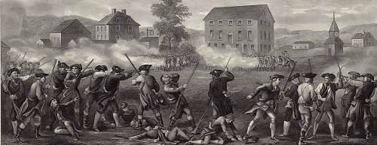
Fighting Begins
Lexington and Concord
(April, 1775)
  “Minutemen”
Bunker Hill (June 17, 1775)
  British tactical victory,
American moral victory

Slide 5
Lexington and Concord
Commander of British Troop, Thomas Gage, led an army into the town of Concord to seize colonial military supplies
British troops also traveled to arrest John Hancock
and Samuel Adams
“Shot Heard Around the World”

Slide 6
Bunker Hill
June 17, 1775
British troops attacked the colonists’ position and took the hill, but suffered over a thousand casualties
Americans succeeded in inflicting heavy losses on the attacking British army
  “Don’t shoot until you see the whites of their eyes!”
  showed the British that American military was organized and
determined, and more than a local conflict

Slide 7
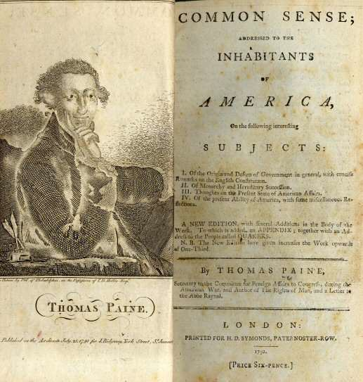
The Second Continental Congress
May, 1775
Radicals vs. Moderates
Actions & Resolutions
  George Washington selected as commander-in-chief of Continental Army
  Olive Branch Petition (July)
    George’s Response (Prohibitory Act – August)
Paine’s Common Sense
-push for independence
-break all ties with British monarchy

Slide 8
Olive Branch Petition
Goal: seek reconciliation with the Crown by stating colonial
grievances
Colonists pledged their loyalty and asked the King to intercede with Parliament to secure peace and the protection of colonial rights
King George ignored the colonists’ plea and instead agreed to the
Prohibitory Act, which declared the colonies in rebellion

Slide 9
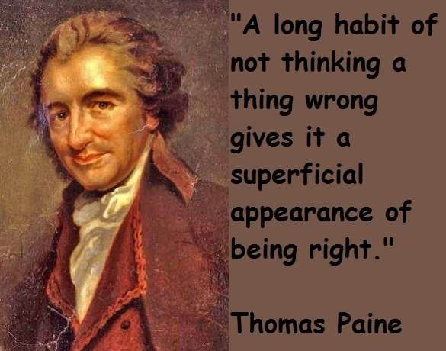
Common Sense
written by Thomas Paine; published in January 1776
was used to gain support for the idea of independence from Great Britain
  used clear and forceful language to convince colonists to break all political ties with the British monarchy

Slide 10

·...Were the impul
of con cience clear uniform, nd irr i tibly ob yed, man would need no
oth r la, ;giver .; but that not being the ca , h finds it nee
ary to surr nder upa part of hi
property to furni h mean for the prot ction of th
r t...Whcreforc, security being the true
d ign and end of government it unan werabl · follows that whate r form thereof appears mo t likely to en ure it to u , with the least expense and gr ate t benefit, i preferable to all
other ....
...a [a] colony increase , the public concerns will increase Jike\'\ise, and the distance at
hich
the members may b separated, \\ill render it too incon,enient for all of them to meet on every occasion as at first when their number was small, their habitations near, and the public concern few and trifling. This will point out the convenience of their consenting to leave the legi lative part to be managed by a select number chosen from the whole body.... And as thi frequent interchange will establish a common interest with every part of the community the· will mutually and naturally support each other, and on this (not on the unmeaning name of king) depends the strength of government and the happiness of the governed.
--Common Sense pamphlet Thomas Paine, 1 6

Slide 11
M/C Question
King George III’s Speech
•AMSCO p. 97
Read stimulus and answer questions #1-3
3 minutes

Slide 12
ANSWERS
C
D
B

Slide 13
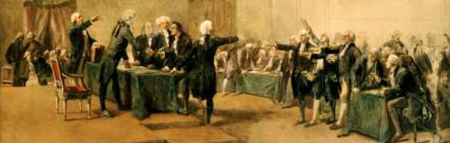
The Second Continental Congress
Declaration of Independence
– July 4, 1776
Articles of Confederation (1777)
  Lack of Centralized Power
  Power= Legislative Branch

Slide 14
Second Continental Congress
Additional Info
Congress was divided
  One group of delegates wanted to declare independence and others wanted to negotiate by creating a new relationship with Great Britain
Delegates from all colonies met, EXCEPT from Georgia

Slide 15
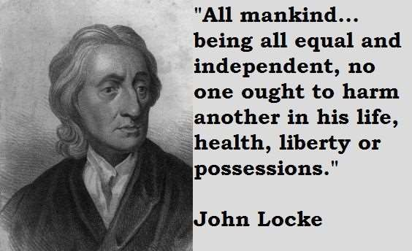
John Locke
Enlightenment
Political philosopher
Believed it was the government’s responsibility to secure life, liberty, and property

Slide 16

Declaration of Independence
Drafted by Thomas Jefferson
Greatly influenced by Enlightenment ideas like those of John Locke
Listed specific grievances against George III’s government and justified the Revolution
Derived from other local colonial
declarations of independence
adopted on July 4, 1776

Slide 17
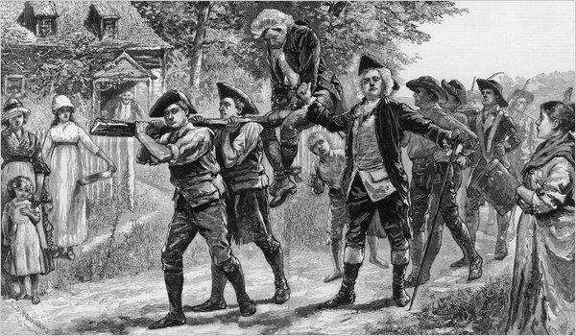
The Revolutionary War
Profile of Colonies:
  Population: 2.6 million
    40% actively participated
    20-30% loyalists
Patriots
  Center: New England & Virginia
  Continental Army:
    Poorly equipped, short of supplies,
rarely paid
    African Americans – 5,000
Loyalists (Tories)
  Center: NY, NJ, GA
  60,000 fought w/British
  American Indians
    Largely sided w/British

Slide 18
M/C Question
Alexander Hamilton
•AMSCO p. 99
Read stimulus and answer questions #7-8
2 minutes

Slide 19
ANSWERS
7. D
8. B

Slide 20
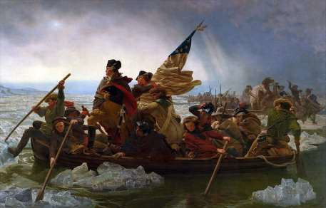
Major Events & Crises
Siege of Boston (April 1775-March 1776)
British Capture New York and
Philadelphia (1776-1777)
Battles of Trenton & Princeton (December 1776 & January 1777)
Winter at Valley Forge (1777-1778)
  Paine’s The Crisis
  Von Steuben & Lafayette
Economic Woes
  95% decline in trade
  Rampant inflation (continentals)

Slide 21
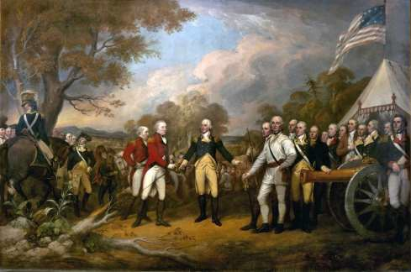
The Turning Point
British Strategy
  Cut off New England
    Howe from NY
    Burgoyne from Champlain
Courting France
  Benjamin Franklin
Saratoga (Oct. 1777)
  Arnold and Gates vs. Burgoyne
Franco-American Alliance
(1778)
  France lends Navy

Slide 22
Battle of Saratoga
October 1777; American troops were victorious in Saratoga and it
served as a turning point for American revolutionaries
After Saratoga, France and America created an alliance
  France helped the colonists with military and financial assistance during the American Revolution

Slide 23
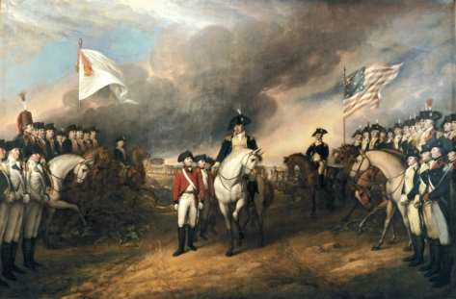
Victory
Patriot forces move from North
  Capture Illinois and Ohio (1778-1779)
Britain’s Southern Strategy
  Gain Loyalist support
  Secure Chesapeake
Yorktown (1781)
  Surrender of Cornwallis

Slide 24
Battle of Yorktown
Last major battle of the Revolutionary War
Showed the significance of French aid to the Americans’ effort
Washington’s army forced the surrender of a British army led by Charles Cornwallis

Slide 25
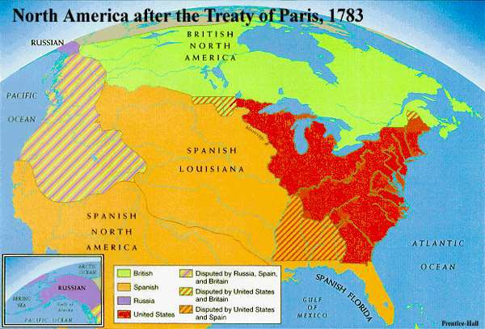
Treaty of Paris, 1783
Tories replaced by Whigs in England
– Support for war becomes unpopular
Provisions of Treaty
  Britain recognizes United States as independent
  Mississippi River becomes western
boundary
  Americans granted fishing rights off the coast of Canada
  Americans would pay debts/claims
to British merchants and Loyalists

Slide 26

Organization of New Governments
State Governments
  By 1777, 10 had new constitutions
    Common Traits:
      Bill of Rights
      Separation of Powers
      Suffrage
» White, male, landowners
      Republican
The Articles of Confederation
  Ratification (1781)

Slide 27
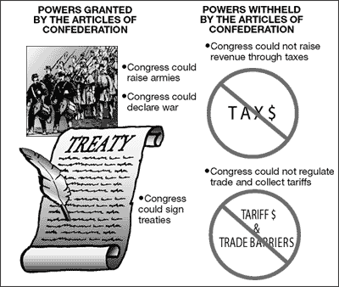
The Articles
Structure:
Unicameral
Legislation
  9 of 13 (Unanimity to amend)
Committee of States
Powers:
  Wage War
  Make Treaties
  Conduct Foreign Diplomacy
  Borrow Money
Prohibitions:
  Regulate Commerce
  Collect Taxes
Weaknesses:
  No formal executive
  No judiciary
Success
- Resolution of Western land issues in the Northwest Territory

Slide 28
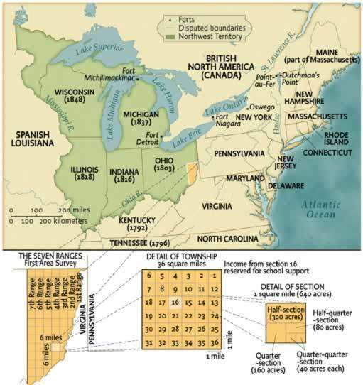
Under the Articles
Accomplishments:
  Winning the War
  Land Ordinance of 1785
    Settled boundary disputes
    Established provision for public
education
  Northwest Ordinance of 1787
    Established rules for statehood
    (promoted expansion)
    Prohibited slavery in territories

Slide 29

Under the Articles
Problems:
  Financial
    War debt; no power to tax
    States had own currencies
    Interstate trade
  Foreign Policy
    Threats from Britain and Spain
    States could form own treaties
  Domestic
    Protection
    Shays’ Rebellion (1787)

Slide 30

..Each tat r tains its over ignty fr edom, and in dependence, and every power, juri diction, and righ,t, ¹ hich i not by thi Confi d ration expr . ly d legat d to the United Stat , in Congres a em led.
The aid t hereby \:erally cnt r into a firm league of friendship with each oth r, for their common d n e the curit) of their liberti , and their mutual and general welfare, binding th m elv to a i t ach other, againstall force off r d to, or attacks made upon them, or an · o them on a count o r li ·on ,o reignty trade, or any other pretense vhatever...
Fo the mo t conv ni nt mana ment of the general interests of the United States delegates hall b annually ppointed... to meet in Congr ...every year... The United States in
Con a em led hall have the ol and exclusive right and power of determining on
peace and war.... The ni ed Stat in Congr a mbled hall also be the last resort on ppeal in all dispute and differenc now subsisting or that hereafter may arise between two or mor tat concerning boundary, juri diction or any other causes whatever.
--Articles of Confederation.1m

Slide 31
'k ;:s::::===::::::=::
'11ie inhabitants of
ork pulling down the statue of George II .

Slide 32
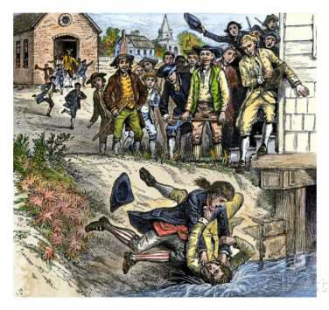
Shay’s Rebellion
Farmers’ rebellion against high state taxes, imprisonment for debt, and lack of paper money
No formal military to help out
Strengthened the movement to produce a new national constitution
State militia of Massachusetts broke the rebellion in January 1787

Slide 33
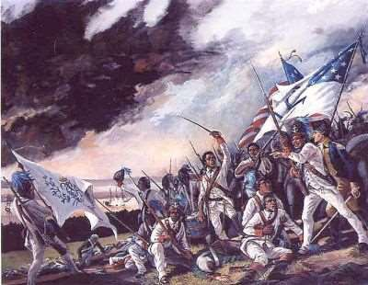
Social Change
Abolition of Aristocratic Titles
  Elimination of titles of nobility
and primogeniture
  Confiscation of Loyalist estates
Separation of Church and
State
  Virginia Statutes (Jefferson,
1786)

Slide 34
Women & Slaves
Women
The revolution had a significant effect on women because of their roles as teachers of republican virtue to their children
They also provided food and
clothing for the war effort
Still remained in second-class status
Slaves
Slavery contradicted the spirit of
the Revolution and the idea that ‘all men are created equal’
For most African Americans, the Revolution had little significance
Many Northern states ended slavery

Slide 35

American Revolution or Evolution?
How radical were the changes made by the American Revolution?
– Was the revolution a radical break from the past or a conservative attempt to safeguard traditional liberties?

Slide 36
Past Essay Topics
Analyze the political, diplomatic, and military reasons for the United States victory in the Revolutionary War. Confine your answer to the period 1775–1783
Analyze how the ideas and experiences of the revolutionary era influenced the principles embodied in the Articles of Confederation.
Evaluate the extent to which the Articles of Confederation were effective in solving the problems that confronted the new nation.

