Slide 1
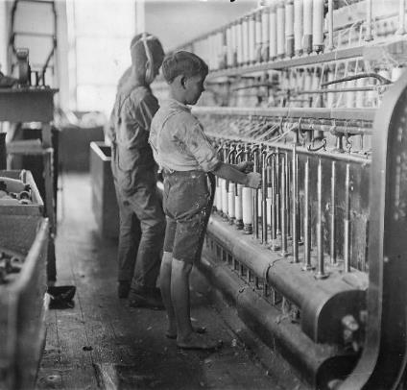
The Rise of Industrial America
Economic Expansion
from 1865-1900

Slide 2
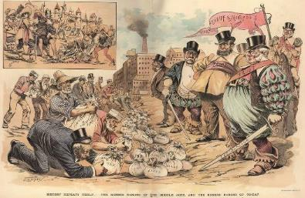
Essential Questions
To what extent was economic expansion during the period 1865-1900 a continuation of prior industrialization, and to what extent was it a departure?
For some, the new entrepreneurs and industrialists of the late 19th century were “Captains of Industry,” who piloted revolutionary growth for both business and labor, as opposed to the “Robber Barons,” who created massive profits for themselves and their investors at the cost of laborers and the environment. Support, modify, or refute this contention.
Notes:
Image: http://rolandsheppard.com/Site/Return_of_the_%22Robber_Barons_%22_Energy_Cartels_Rip_Off_California.html

Slide 3
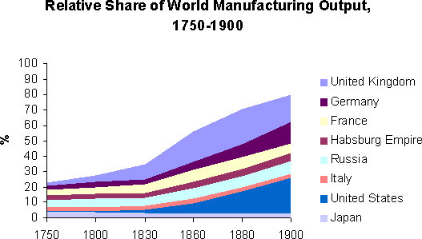
The United States by 1900
Leading industrial power in the world
Out-produced all European powers
Wealth of natural resources
Coal, oil, iron, timber
Tremendous labor supply - immigration
Ever-increasing population
Large investment of capital – Europeans and Americans investing in economic expansion
Extreme ingenuity and productivity
More than 400,000 patents filed from 1860-1900
Business-friendly government policies
Subsidies, land-grants, loans, and protective tariffs
A new class of entrepreneurs and enterprise
Notes:
Graph: http://en.wikipedia.org/wiki/Economic_history_of_the_United_Kingdom

Slide 4
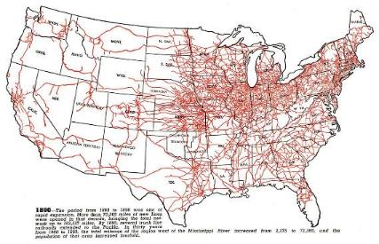
The Business of Railroads
Fivefold increase in RR’s following the Civil War
Created:
Mass production
Mass markets
Mass consumption
Economic specialization
Impact:
Growth of related industries:
Coal, steel, travel and transportation
Time zones (1883)
Boom in stockholder corporations
Other Developments
Technology & Safety
Airbrakes, standard gauge, telegraphy
Government Subsidies
Notes:
Map: http://users.humboldt.edu/ogayle/hist111/industrial.html

Slide 5
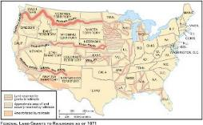
Railroad Expansion
Eastern Trunk Lines
Consolidation/integration of competing RR’s
Vanderbilt’s New York Central (1867)
Baltimore & Ohio and Pennsylvania Railroads
Western Railroads
Impact of Federal Land Grants
Homestead Act (1862) – helps sell the land to new settlers
Pacific Railway Act (1862)
Transcontinental Railroads
Central Pacific and Union Pacific – May 10, 1869 - Utah
The Southern Pacific
Atchison, Topeka, and Santa Fe
Northern Pacific
Notes:
Map: http://claver.gprep.org/fac/sjochs/historical-blank_maps_for_quizzes-.htm

Slide 6
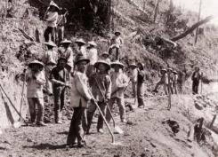
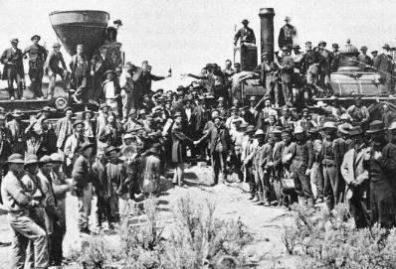
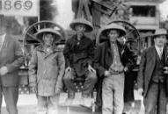
The Transcontinental
Notes:
Chinese Workers: http://blogs.baruch.cuny.edu/his1005fall2010/2010/09/21/the-transcontinental-railroad/ & http://apa.si.edu/ongoldmountain/gallery2/gallery2.html
C/C pictures – although the Central Pacific and Union Pacific were constructed mainly by Irish (UP) and Chinese (CP) immigrants, why were they left out of the “Golden Spike” ceremony?

Slide 7
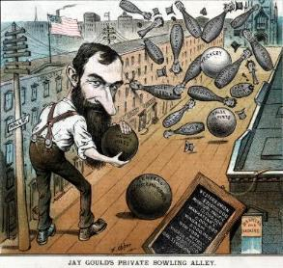
Competition and Consolidation
Investments lead to over-speculation and corruption
Jay Gould
Overexpansion and stock-watering- inflating the value of a corporations assets and profits before selling its stock to the public
RR companies begin to offer rebates and kickbacks to maintain competition
Offers for large companies, punished small farmers
Formation of pools
Competing companies agreed secretly to fix rates
Panic of 1893
¼ of all RR’s bankrupt
Rise of JP Morgan
Consolidation = elimination of competition
By 1900, seven companies controlled 2/3 of RR’s
Made the system more efficient but only a few powerful men dominated the boards of competing railroad corporations
Notes:
Cartoon: http://commons.wikimedia.org/wiki/File:Jay_Gould's_Private_Bowling_Alley_-_Opper_1882.jpg

Slide 8
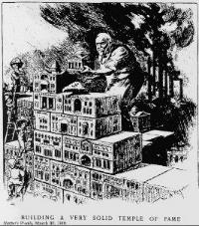
Industrial Empires - Steel
Impact of the Bessemer (England) Process (Kelly in KY) – production of high quality steel
Carnegie Steel
Vertical Integration
Assume/purchase all parts of the process
Andrew Carnegie
Scottish immigrant
Started in telegraphy & RR’s, used profit to form Pittsburgh steel industry
Sold to Morgan in 1900 for $400 million, became:
US Steel
First billion $ company
Employed over 168,000
Controlled 3/5 of all steel production
Notes:
Harper’s Weekly, 1901

Slide 9
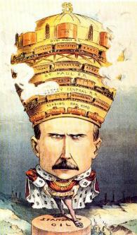
Industrial Empires - Oil
First oil discovery – Edwin Drake, Titusville, PA (1859)
Boom in drilling as a result of demand
John D. Rockefeller - $900 million by his retirement
Standard Oil
Horizontal integration & predatory pricing – former competitors were brought under a single corporate umbrella
By 1881, 90% of all refineries
Formation of trusts
Notes:
Image: http://explorepahistory.com/imagegallery.php?gallery_id=1-7-3A&bcolor=Red&display_image=1&imgId=1-2-1936

Slide 10
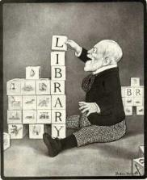
Laissez-Faire Capitalism
Conservative Economic Theories
Adam Smith, The Wealth of Nations – business should be regulated not by the government but by the “invisible hand”
Laws of supply and demand should control it.
Business will be motivated by their own self-interest to offer improved goods and services at low prices
Impact of monopolization
Argument for:
Maintained high-quality, consistent product
Argument against:
Gouged consumers and allowed for inferior products (non-competition)
Social Darwinism (Spencer)
Darwin’s natural selection applied to economics
Concentrate wealth in the hands of the “fit” benefited everyone
Gospel of Wealth (Carnegie)
Responsibility of the wealthy to give back – civic philanthropy
Over $350 million for libraries, universities, and other public institutions
Notes:
Cartoon: http://www.libraryhistorybuff.com/carnegie-175th.htm

Slide 11
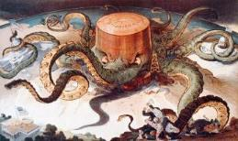
Antitrust Movement
Trust - A trust is a three-party fiduciary relationship in which the first party, the trustor or settlor, transfers a property upon the second party for the benefit of the third party, the beneficiary
Trusts Under Attack
Middle-class rises up against perceived unchecked power
Old wealth vs. nouveau riche
Sherman Antitrust Act (1890)
Prohibited organizations created with intent to regulate or control interstate trade or commerce
Monopolies now illegal
Impact:
Weakened by Supreme Court
US v. E.C. Knight (1895)
Could not apply to manufacturing
Used primarily against labor unions
Notes:
http://commons.wikimedia.org/wiki/File:Standard_oil_octopus_loc_color.jpg

Slide 12
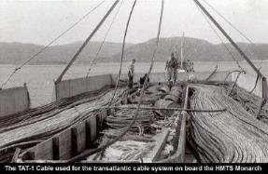
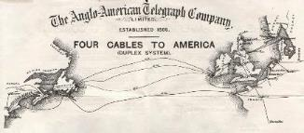
Technology and Innovations
Inventions
Telegraph
Morse (1844)
Field
Transatlantic cable (1866)
Conveniences
Typewriter (Remington, 1867)
Telephone (Bell, 1876)
Cash register (1879)
Adding machine (1888)
Kodak Camera (Eastman, 1888)
Safety blade (Gillette, 1895)
Notes:
Laying the transatlantic: http://www.canadaka.net/achievements/33-the-first-submarine-transatlantic-telephone-cable-system.html
Cables Map: http://atlantic-cable.com/CableCos/AngloAmerican/

Slide 13
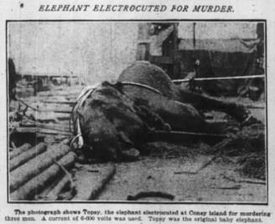
“Let There Be Light”
The “Wizard of Menlo Park”
More than 1,000 inventions
Vote-recording machine
Phonograph
Dynamo
Mimeograph
Motion-picture
Light bulb
Edison vs. Westinghouse
Direct current vs. alternating current
“Westinghouse” → Topsy
Impact:
Westinghouse wins contract for World’s Columbian Exhibition, 1893
Electrified cities
Streets, streetcars, subways, machinery, and appliances
Notes:
Edison vs. Westinghouse: http://www.smithsonianmag.com/ist/?next=/history/edison-vs-westinghouse-a-shocking-rivalry-102146036/
Picture is a link to video of electrocution: http://www.youtube.com/watch?v=VD0Q5FeF_wU

Slide 14
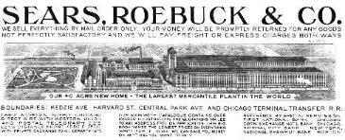
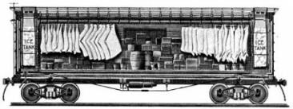
Marketing Consumer Goods
Department Stores
Cities
RH Macy’s (NY)
Marshall Field’s (Chicago)
Rural America
Woolworth’s
RFD (Rural Free Delivery)
Sears-Roebuck
Montgomery Ward
Transportation
Packaged foods
Kellogg and Post
The “Battle of Battle Creek”
Refrigerated Car (Swift)
Mass produced meats & vegetables
Advertising
Birth of the consumer culture (shopping)
Notes:
Sears Image: http://upload.wikimedia.org/wikipedia/commons/3/3b/Sears,_Robuck_%26_Co._letterhead_1907.jpg
Battle of Battle Creek Link: http://www.digitaldeliftp.com/LookAround/advertspot_kelloggs.htm
Swift Refrigerator Car: http://historyproject802.wikispaces.com/Gustavus+Swift

Slide 15
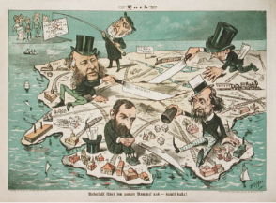
Impact of Industrialization
The Concentration of Wealth
By 1890’s, 10% controlled 90% of the nation’s wealth
The New Class of Multi-millionaires
Vanderbilts, Morgan, Carnegie, Rockefellers
Mansions, yachts, and lavish parties
Wealthy neighborhoods
Park Avenue (NY)
Gold Coast (Chicago)
Nob Hill (SF)
Horatio Alger Myth
The “self-made man”
Ragged Dick, Mark the Match Boy
Carnegie was the exception, not the norm
Notes:
https://apus-b.wikispaces.com/gilded+age+political+cartoons

Slide 16
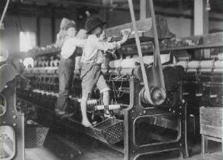
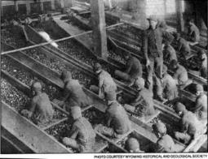
Industrial Workers
Growth of corporations led to increase in both white-collar and blue-collar positions
Higher paying jobs → increase demand for services → increase service sector
Overall impact:
More wage earners = more spending → expanding middle class
Wage Earners
By 1900, 2/3 of Americans
Large #’s of immigrants kept wages low
“iron law of wages”
Most did not earn enough to survive
Families depended on income of women and children
Working Women
By 1900, 1 in 5
Only 5% of married
Gender roles extended to factories
Resulted in lower pay
Clerical work expanded w/white collar jobs
Notes:
Child Labor: https://progressivesapush4.wikispaces.com/Woman+and+Child+Labor
Breaker Boys: https://www.mca-marines.org/mcaf-blog/2011/08/29/warrant-officer-faustin-wirkus-breaker-boy-king

Slide 17
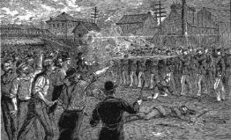
The Struggle of Organized Labor
Labor Discontent
Poor conditions, long hours, low pay
Workers easily replaceable
Industrial Warfare
Lockouts – closing factory to break labor movement before organized
Blacklists – pro-union workers circulated
Yellow-dog contracts – sign agreement to not join union
Great Railroad Strike of 1877
Began with B & O Railroad and spread to 11 states and 500,000 workers from other industries
Hayes forced to call in troops to end strike
Results:
Millions in damages and over 100 dead
Some employers began to address workers’ grievances
Strengthened resolve for organized labor
Notes:
Great Railroad Strike: http://libcom.org/history/1877-the-great-railroad-strike

Slide 18
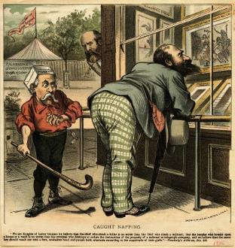
Attempts to Organize National Unions
National Labor Union (1866)
Goals:
Higher wages
8-hour workday
Failed during depression (1873-1877)
Knights of Labor (Powderly, 1869)
Unskilled
Included African Americans and Women
Tenets:
Worker cooperatives, abolish child labor, abolish trusts
Strategy: strikes
American Federation of Labor (Gompers, 1886)
Skilled workers
Created associations of trades workers
Discouraged membership of women, immigrants, and minorities
“Bread and Butter” Unionism
Better hours, conditions, wages
Strategies: strikes and collective bargaining
Notes:
http://explorepahistory.com/hmarker.php?markerId=1-A-3BE

Slide 19
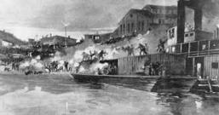
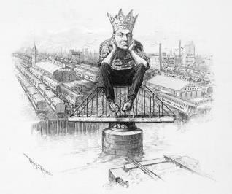
Major Strikes
Haymarket Riot (Chicago, 1886)
May Day strike at McCormick plant
Blamed on Knights of Labor
Became symbol of anarchist movement
Homestead Strike (Pittsburgh, 1892)
Frick vs. steel workers
Use of Pinkertons & strikebreakers
Failure
Pullman Strike (Chicago, 1894)
American Railway Union (Debs)
Cleveland sends army and federal court issues injunction – mail service
In re Debs (1895)
Led to formation of American Socialist Party (1900)
Impact of Strikes
Limited success, mostly failures
By 1900, only 3% of workers belong to unions
Notes:
Homestead Strike: http://explorepahistory.com/hmarker.php?markerId=1-A-3BE
Debs: http://2012books.lardbucket.org/books/united-states-history-volume-2/s06-02-national-politics-and-the-popu.html

Slide 20
The New Industrialists:
Made massive profits at expense of workers
Annual salaries were more than anyone could spend
lived in lavish mansions
Fostered poor working conditions
Monopolized trade so as to regulate prices
Revolutionized:
travel
oil production
steel
Large volume of production:
drove down prices
created convenience products
created jobs
Philanthropy created:
museums
institutes of higher education
Made America #1 industrial producer
Robber Barons or
Captains of Industry

Slide 21
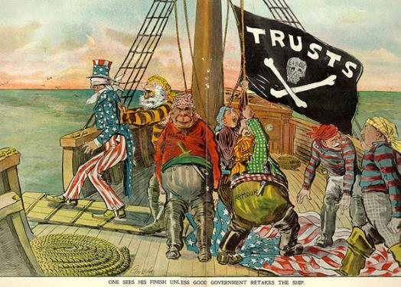
Image Analysis
Historical Context – H
Intended Audience – I
Purpose – P
Point of View - P
Notes:
Gilded Age Cartoons: https://apus-b.wikispaces.com/gilded+age+political+cartoons

