Slide 1
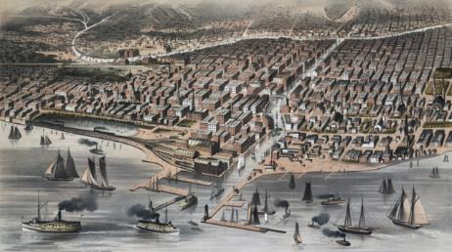
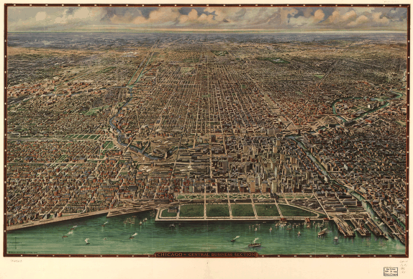
The Growth of Cities and American Culture
Immigration, Urbanization, and Entertainment
During the Gilded Age: 1865-1900
Chicago, 1870
Chicago, 1916
Notes:
Image, 1870: http://hd.housedivided.dickinson.edu/node/18438
Image, 1916: http://memory.loc.gov/cgi-bin/query/r?ammem/gmd:@filreq(@field(NUMBER+@band(g4104c+pm001550))+@field(COLLID+pmmap))

Slide 2
Essential Questions
Explain the impact of industrialization on the growth of cities and the shift in population, both in terms of immigration and urbanization.
In what ways and to what extent did industrialization and urbanization create a new American culture?
Notes:
http://dig.lib.niu.edu/gildedage/

Slide 3
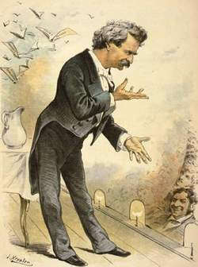
The Gilded Age
Coined by Mark Twain
gild:
To cover with or as if with a thin layer of gold
gilded:
1.covered or highlighted with gold or something of a golden color. 2.having a pleasing or showy appearance that conceals something of little worth

Slide 4
A Nation of Immigrants
Growth of Immigration
By end of 19th Century, US population had tripled
23.3 million (1850) → 76.2 million (1900)
16.2 million immigrants
Causes:
Push factors
Poverty, political turmoil, overcrowding, religious persecution
Pull factors
“land of opportunity”
Availability of industrial jobs
“Old” vs. “New” Immigrants
Southern & Eastern Europeans
Many poor and illiterate
Catholic, Greek Orthodox, Russian Orthodox, and Jewish
Non-WASP
“birds of passage”
Largely retained old world customs
Segregated
“Little Italy’s” and “Chinatowns”
Notes:
Image: http://grossmanproject.net/The%20Exodus.htm

Slide 5
Reaction to Immigration
Statue of Liberty (1886)
Restricting Immigration
Chinese Exclusion Act (1882)
Restrictions on “undesirables” (1882)
Contract Labor Law (1885)
Gentleman’s Agreement (1907) - Japan
Immigration Centers
Ellis Island, NY
Angel Island, SF
Policies
Medical Exams & Quarantines (fear of TB)
Detention & Questioning
Preventing temporary workers and “paper brides”
Nativism
American Protective Association (1887)
Immigration Restriction League (1894)
Social Darwinists
Notes:
http://historyproject.ucdavis.edu/ic/image_details.php?id=9158

Slide 6
Urbanization
Impact of Industrialization and Improved Transportation
By 1900, 40% of Americans live in cities
Changes in the Nature of Cities
Transportation
Electric trolleys, elevated trains, subways
Suspension bridges (Brooklyn Bridge – Roebling, 1883)
Impact:
Faster travel times
Exodus of high-income earners:
Bedroom communities & early suburbs
Skyscrapers
Home Insurance Company Building (Chicago, 1885)
Enabled by:
Elevators (Otis, 1852)
Central heating
Notes:
http://chicagopubliclibrary.tumblr.com/post/197902876/chicago-home-to-the-first-skyscraper-the-home

Slide 7
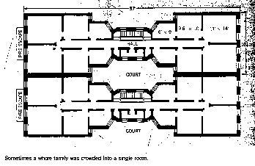
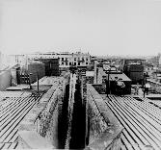
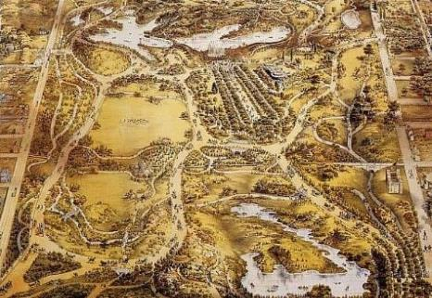
City Life
Ethnic Neighborhoods
Slums
Tenements and flophouses
Poor conditions, poor ventilation
Rampant disease
NYC City Ordinance results in “dumbbell tenements”
“Ghettos”
Residential Suburbs
“City Beautiful Movement”
Frederick Law Olmstead (Central Park, NY)
Rise of single-family homes
Private vs. Public City
Private wealth created growth
Public concern led to need for municipal reform
Utilities, sanitation, infrastructure, etc.
Rate of growth led to rise of Political Machines
Notes:
NY Street, Dumbbell Tenement Blueprint, Rooftop view of dumbbell tenement
Central Park: http://macaulay.cuny.edu/eportfolios/groupd/sam-rodriguezs-lab-two-d/

Slide 8
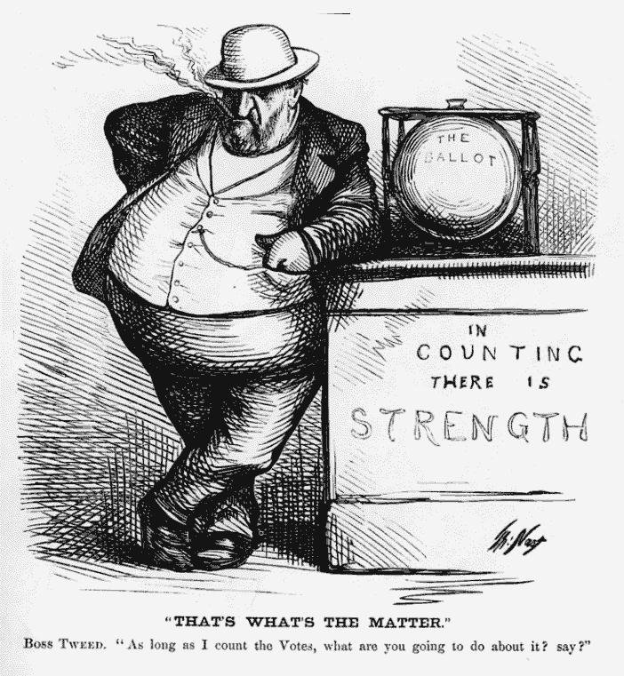
Boss and Machine Politics
Consolidation of power also happened inside urban politics
Political parties in major cities came under the control of tightly organized groups of politicians – political machines
Boss – top politician who gave orders to the rank and gave government jobs to loyal supporters
Tammany Hall – NYC – social club later developed into a power center to coordinate the needs of businesses, immigrants, and the underprivileged. In return, machines asked for people’s votes on election day.
Brought modern services to city
Greed too – often stole millions from taxpayers in fraudulent ativities
65% of public building funds ended up in the pockets of Boss Tweed and his cronies.

Slide 9
Awakening of Reform
Reactions to Mass Industrialization and Urbanization

Slide 10
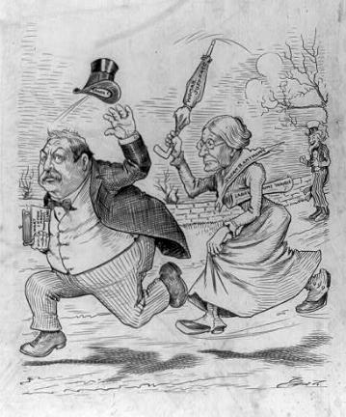
Social Issues
Problems Associated w/Urban living
Conditions and sanitation
Impact of Urbanization on the American Family
Families became isolated
Birth and Marriage Rates Decreased
Family size decreased
Votes for Women
Renewed Suffrage Debate
NAWSA
Stanton and Susan B. Anthony
Wyoming first to grant suffrage
Renewed Temperance Movement
WCTU (1874)
Notes:
Susan B. Anthony: http://www.americaslibrary.gov/jb/gilded/jb_gilded_susanb_2_e.html
Carrie A. Nation: http://porterbriggs.com/carrie-a-nation-a-bulldog-with-a-battle-axe/

Slide 11
Other Reforms
Settlement House Movement
Jane Addams and Hull House (1889)
Social Gospel
Apply Christian principles to social problems
Urban Reforms
Grassroots efforts to combat municipal corruption
Teddy Roosevelt – clean up Police dept
VP 1896, P 1900
Notes:
http://www.glogster.com/eswaym/social-gospel-movement/g-6l8403u8p0vli9c1ojk8va0

Slide 12
Changes in Education
Public Schools
Compulsory attendance laws
Literacy rate improves to 90% by 1900
Introduction of kindergarten
Tax-supported high schools
Higher Education
Impact of the Morrill Land Grant Act (1862, 1890)
Universities Established through philanthropy
University of Chicago (Rockefeller), Stanford, Vanderbilt
Colleges for Women
Smith, Bryn Mawr, Mount Holyoke
By 1900, 71% of colleges coeducational
Changes toward liberal arts curriculum & expansion of graduate schools
Effects on liberal thought, sciences, and progressive leanings
Notes:
http://okeechobee.ifas.ufl.edu/Morrill.150.htm

Slide 13
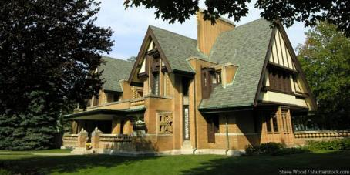
Literature and the Arts
Realism and Naturalism
Literature
Mark Twain – racism, violence, greed – Huckleberry Finn
Jack London
Impact on early environmentalist movement
Painting
Winslow Homer
Thomas Eakins
Technology and anatomy
James Whistler
The “Ashcan School”
George Bellows
Architecture
Louis Sullivan
“Form follows function”
Impact of Columbian Exposition & City Beautiful Movement
Olmstead
Burnham & Root
Frank Lloyd Wright
Music
City Orchestras & Marching Bands (Sousa)
Blues & Early Jazz
Notes:
George Bellows: http://en.wikipedia.org/wiki/George_Bellows
Wright Home: http://www.chicagotraveler.com/attractions/frank-lloyd-wright-home-and-studio.html

Slide 14
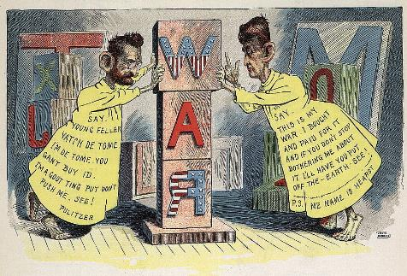
Popular Culture
Popular Press
Newspapers
New York World (Pulitzer) vs. New York Journal (Hearst)
Magazines
Cosmopolitan, McClure’s, Ladies Home Journal
Importance of Advertising
Birth of the “Weekend”
Decreased working hours, increased leisure time, disposable incomes → demand for entertainment
Notes:
Yellow Journalism: http://en.wikipedia.org/wiki/Joseph_Pulitzer
http://www.collectorsweekly.com/articles/wp-content/uploads/2014/01/offending_chinreducer.jpg

Slide 15
Entertainment
Amusements
Theaters
Vaudeville
The Circus
Ringling Brothers and Barnum & Bailey
Buffalo Bill’s “Wild West” Show
Parks for Sunday Picnics and Outings
Sponsored by streetcar and rail companies
Amusement Parks
Coney Island
Spectator Sports
Boxing
Baseball (Cartwright Knickerbockers)
Football (Walter Camp)
College > Professional
Basketball (James Naismith)
Amateur Sports
Croquet, bicycling
Athletic Clubs
Golf and tennis
Polo and yachting
Notes:
http://upload.wikimedia.org/wikipedia/commons/2/23/Buffalo_bill_wild_west_show_c1899.jpg

