Slide 1
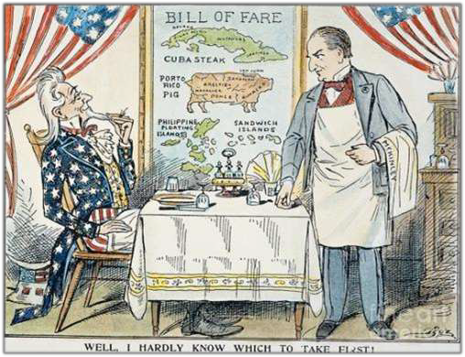




BECOMING A WORLD POWER
American Imperialism (1877-1917)

Slide 2


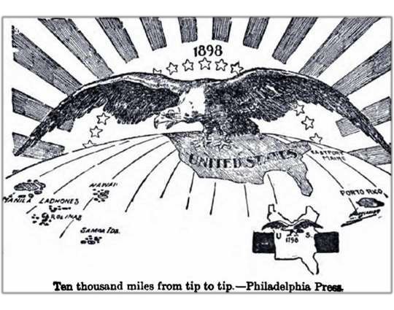
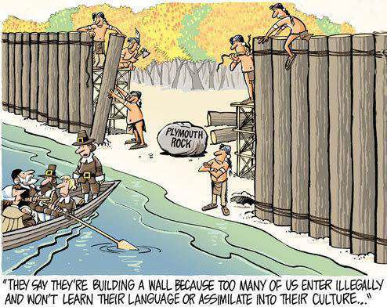









ESSENTIAL QUESTION
To what extent was the late nineteenth-century and early twentieth century United States expansionism a continuation of past United States expansionism and to what extent was it a departure?

Slide 3


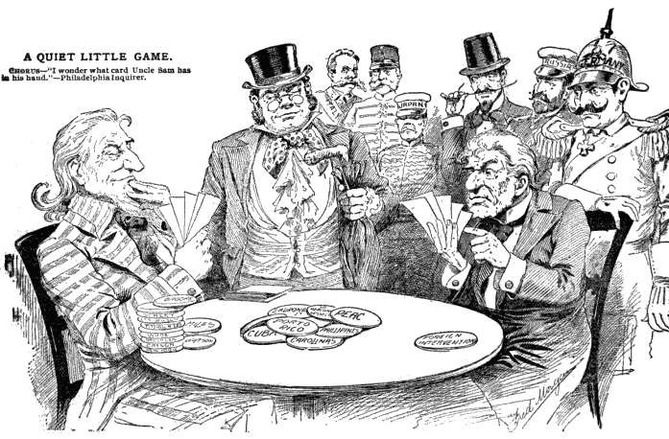

QUESTIONING THE CAUSES
Why would the United States choose to enter the competition for foreign lands and markets?
George Washington’s Warning
  “entangling alliances”
Causes of US Imperialism:
  Economic
    Industrialization, Competition,
Need for Markets
  Desire for world power?

Slide 4
Imperialism: Pros & Cons
For Imperialism
 Economic Growth
 Markets
 Investments (banana
republics)
 Promote Security
 Expand Navy - Naval Advisory Board 1881
 Preserve American
Spirit
  Social Darwinism
Anti-Imperialism
 Economic Expansion →
Regional Tension → War
 US Navy not capable of protecting overseas empire
 US should not be potential leaders of oppressed foreign peoples
 Parallel to treatment of
American Indians
 Manifestations
 William Jennings Bryan
 Anti-Imperialist League
(1898) - Phillipines

Slide 5



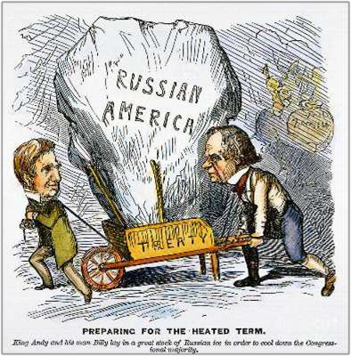












WILLIAM H. SEWARD
Secretary of State (1861-1869)
Annexations and Purchases
  Nicaragua
  Midway (1867)
  “Seward’s Folly” (1867)
    $7.2 million
Lasting Influence
  Kept England & France out of Civil War
  Invoked Monroe Doctrine against
Napoleon III in Mexico
  Inspired trade treaty w/Hawaii (1875)

Slide 6

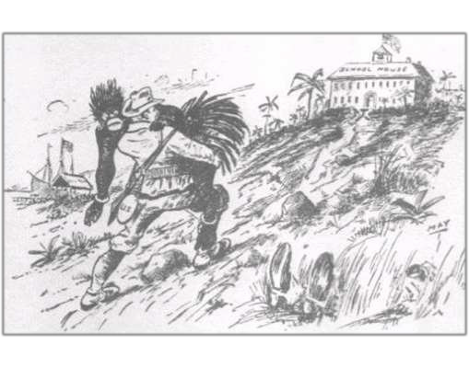
THE “NEW” IMPERIALISM
International Darwinism
  Imperialism
    “White Man’s Burden”
  Missionaries
    Josiah Strong – white, American Protestants have duty to colonize and spread Christianity
  Politicians- Republicans endorse the use of foreign affairs to search for new markets
    Henry Cabot Lodge – for global expansion
  Naval Power
    The Influence of Sea Power Upon History
(Alfred T. Mahan, 1890) – strong navy crucial to securing foreign markets and becoming a world power
    Impact of Asst. Sec. of Navy (Roosevelt)- Convince Congress to fund growth of steel ships and naval expansion
  Popular Press
    Sensationalist journalism – print of adventurous stories, stimulate public interest

Slide 7


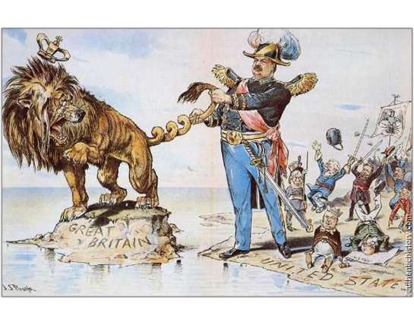
LATIN AMERICA
James Blaine (Sec of State) and the Pan-American Conference (1889)
  Hemispheric cooperation - achieved
  Tariff/trade policies – hope to lower but not achieved
Cleveland, Olney, and the Monroe Doctrine
  Venezuela (1895)
    Dispute w/British Guiana
    Olney Declaration
      Led to US-British alliance
  Spain in Cuba

Slide 8



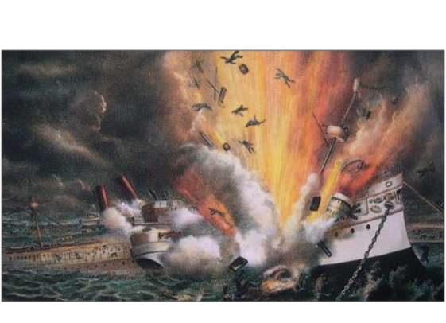
THE SPANISH-AMERICAN WAR
Causes of War
Jingoism – intense form of nationalism calling for aggressive foreign policy
Desire to become world power
Cuban Revolt
  “The Butcher” Weyler – Spanish general and forced civilians into camps – death & starvation followed
Yellow Journalism
  Pulitzer vs. Hearst- exaggerated, false accounts of Spanish in Cuba
    Called for US interference in Cuba
  The DeLôme Letter – letter highly critical of President McKinley - insult
  The USS Maine – Havana, Cuba
    Exploded – killed 260 Americans
    Spain blamed

Slide 9




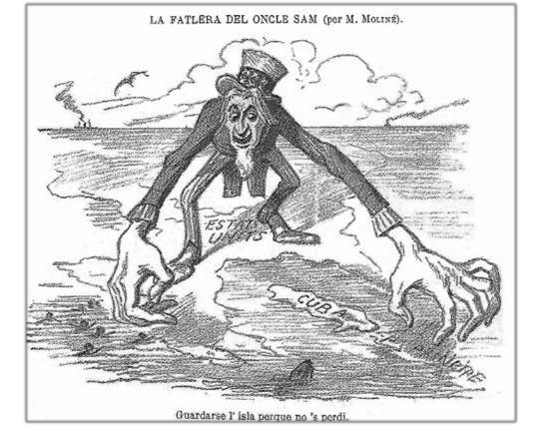


















MCKINLEY’S MESSAGES
Attempts at Peace/Ultimatum to Spain:
  compensation for Maine
  end reconcentration camps
  truce in Cuba
  independent Cuba
Spain accepts all except last stipulation

Slide 10
MCKINLEY’S MESSAGES
McKinley Goes to Congress
  “Put an end to the barbarities, bloodshed, starvation, and horrible miseries: in Cuba
  Protect the lives and property of U.S. citizens living in Cuba
  End “the very serious injury to the commerce, trade, and business of our people”
  End “the constant menace to our peace” arising from disorder in Cuba
Response: The Teller Amendment
Self-determination for Cuba
US would not annex Cuba

Slide 11

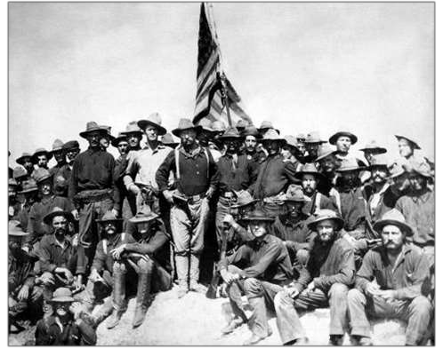
A “SPLENDID LITTLE WAR”
The Philippines (May 1-August 13, 1898)
  Spanish fleet destroyed
  Manila Bay captured
Invasion of Cuba
  The Rough Riders on San Juan Hill – led by Theodore Roosevelt
  Remainder of Spanish fleet
destroyed @ Santiago Bay (July 3)
More death due to diseases like typhoid, malaria and dysentery than battle (5000 vs. 500)

Slide 12



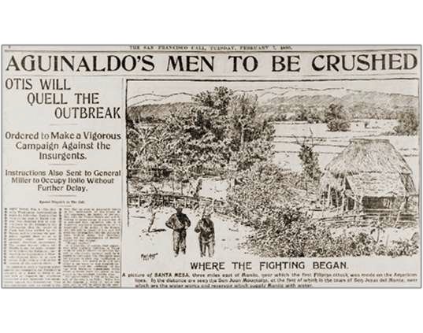

















RESULTS OF THE WAR
Treaty of Paris, 1898
  Recognition of Cuban independence
  U.S. acquisition of Puerto Rico and Guam
  U.S. acquisition of the Philippines for $20 million
The Philippine Question
Aguinaldo and the Independence
Movement
  War w/U.S. (1899-1902)
  Over 200,000 Filipinos killed
Independence not granted until
1946!

Slide 13

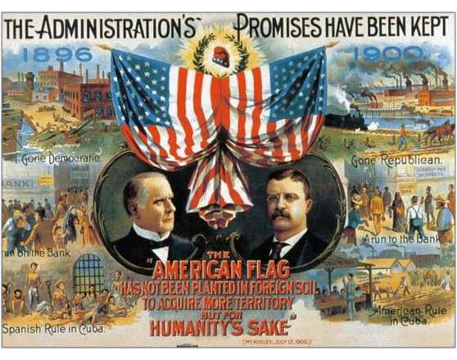

IMPACT OF THE WAR
Insular (Island) Cases (1901-1904)
  Question before the Court:
    “Does the Constitution follow the
flag?” – Does the Constitution apply to whatever territories fall under the US flag?
Not automatic – power belongs to Congress
Cuba
  Platt Amendment
No foreign agreements
Allow for US intervention
Allow US naval bases (Guantanamo)
Annexation of Hawaii
  Sanford P. Dole & Liliuokalani (1893)
    Cleveland against annexation
  McKinley & Congress annex (1898)

Slide 14
IMPACT OF THE WAR
Puerto Rico
  Foraker Act (1900) – civilian government in Puerto Rico
Election of 1900
  McKinley vs. Bryan
  McKinley: Cross of Gold Speech
  “You shall not crucify man across a cross of gold”
McKinley (P) & Roosevelt (VP)
Recognition of U.S. Power
  Ensuing debate over role
  National pride at an all time high
  France, Great Britain and other European nations recognize the US

Slide 15

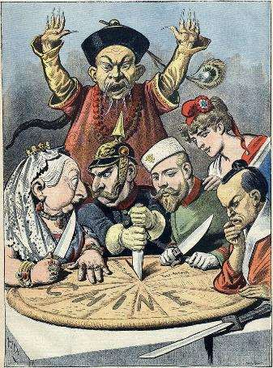
OPEN DOOR POLICY IN CHINA
History of Europeans in China:
  Opium Wars
  Spheres of Influence
  John Hay’s “Open Door” (1899)
Boxer Rebellion (1900)
  Cause: increased xenophobia and desire to remove outsiders
  Impact: further weakening of imperial regime
Open Door Notes (1900)
Preserve China’s territorial integrity
Safeguard “equal and impartial trade with all parts of the Chinese empire.”

Slide 16
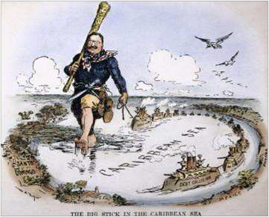
“SPEAK SOFTLY AND CARRY A BIG STICK.”
McKinley’s Assassination (1901)
  TR becomes youngest President in history
The Panama Canal
  Revolution
  Colombia wouldn’t work with US – US helps orchestrate a revolt for Panama’s independence
    Hay-Bunau-Varilla Treaty (1903) – US has rights over the 51 mile long/10 mile wide Canal Zone to keep US protection over the area.
  Building the Canal
    Establishment of Canal Zone
    Started in 1904 ; completed 1914
    Resented by many Americans – 1921 – paid $25 million to Colombia; 1999 – Canal Zone returned to Panama
The Roosevelt Corollary (1904)
  Result of British involvement in Venezuela – repayment of debts
  US would send gunboats to Latin America – sailors and marines collect taxes until payments are made
The “Great White Fleet” - Expansion of Navy & World Tour

Slide 17


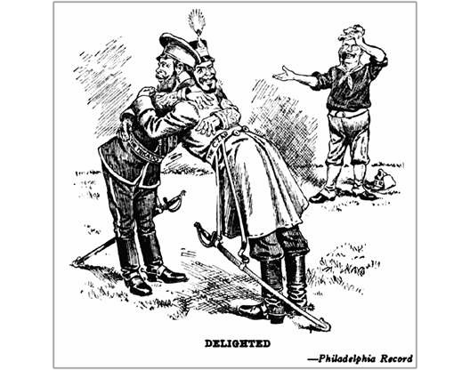
IMPERIALISM & PEACE IN EAST ASIA
Russo-Japanese War (1904)
  Treaty of Portsmouth (1905)
    Japanese nationalists blame US for not giving their country all they deserved from Russia
“Gentlemen’s Agreement” (1908)
  Restrict Japanese immigration but allow Japanese students to go to school with Americans in San Francisco
Root-Takahira Agreement (1908)
  Mutual respect and support for Open Door policy in China
  Mutual respect between Japan and US for each other’s Pacific possessions

Slide 18

WILLIAM H. TAFT’S FOREIGN POLICY
Dollar Diplomacy
  Investments would lead to greater stability instead of building military
  Railroads in China (1911)
    Issues w/Manchuria – Japan and Russia – joint sphere of influence
  Nicaragua
    Marines sent to quell civil war to protect American investments (1912 – 1933)
The Lodge Corollary (1912)
  Added non-European nations (Asia) to Monroe Doctrine
    Angered Japanese and Latin American countries
    Taft opposed it

Slide 19
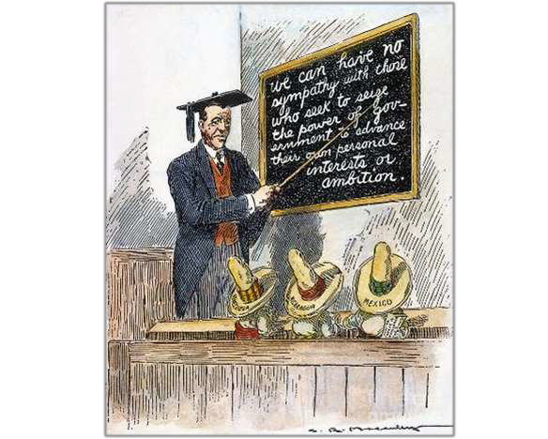
WOODROW WILSON & FOREIGN AFFAIRS
Wilson’s Moral Diplomacy
  Spread democracy/opposed to imperialism
    Sec. of State: WJB
The Philippines
  Jones Act (1916)
Full territorial status
Bill of rights & universal male suffrage
Independence w/arrival of stable gov’t

Slide 20
WOODROW WILSON & FOREIGN AFFAIRS
Puerto Rico
  Jones-Shafroth Act (1917) – US citizenship to all the inhabitants and allowed for limited self-government
Panama Canal
  Repealed US toll exemption
Conciliation Treaties - 30 created
  Negotiate treaties in which nations pledge to :
    Submit disputes to international commission
    Observe one year cooling-off period before taking military action
Intervention
  Mexico – failure of US to support military dictatorship of General Huerta – seized power after having elected president killed
    Tampico Incident (1914)
      Arms embargo against Mexico, blockade port of Vera Cruz; war averted by ABC – Argentina, Brazil & Chile
    Huerta vs. Carranza & Villa
      U.S. Expeditionary Force (Pershing)

