Slide 1
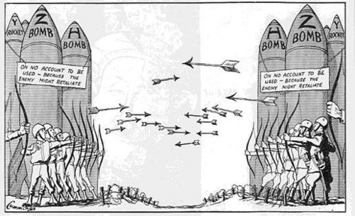
Truman and the Cold War
1945-1952
Notes:
Cartoon: https://bu.digication.com/ss202/Welcome/published

Slide 2
Essential Questions
Analyze the developments from 1941-1949 that increased suspicion and tension between the United States and the Soviet Union.
What were the Cold War fears of the American people in the aftermath of the Second World War? How did these fears affect both foreign and domestic policy?
Explain the causes and consequences of the following population movements in the United States during the period 1945– 1985.
Suburbanization
The growth of the Sun Belt
Notes:
Image: http://www.investwithalex.com/as-cold-war-2-starts-pentagon-says-its-not-ready/

Slide 3
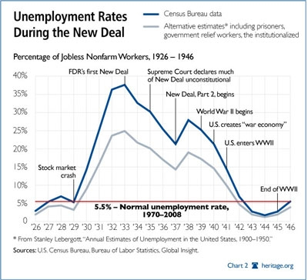
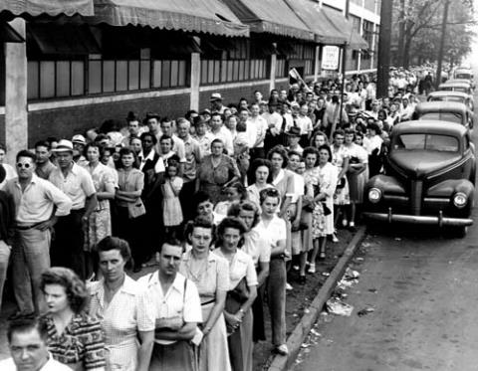
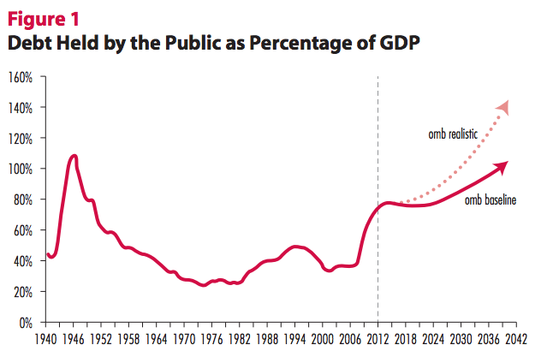
Postwar Economic Anxieties
V.E. & V.J but…
Has there been a V.A.?
Economic Scars if Great Depression remain in memory
High unemployment
Low birthrate
Early Postwar Years
Confirms predictions & repeats history
GNP drops (1946-47)
Prices rise 33%
Growth of Unions
Notes:
Image 1: Unemployment rates from crash to end of WWII – notice steep incline following the war.
Image 2: Compares debt to % of GDP – we were much worse off during the Depression than now.
Image 3: Unemployment line in Detroit (1945) – notice # of women
UMW Strike: Truman Calls in Troops to work mines

Slide 4
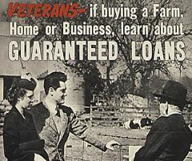
Postwar America
Brief period of economic uncertainty followed by unprecedented prosperity
Higher incomes – savings accnts
Highest standard of living
G.I. Bill – Help for Veterans
15 million returned from war
Servicemen’s Readjustment Act (1944)
Education and Low-interest Loans
Over $16 Billion in low-interest, government-backed loans to buy homes and farms
2 million attend college
Notes:
GI Bill Education & Race: http://whereistheoutrage.net/military/the-gi-bill-and-race/
GI Bill Housing: https://azgolfandhome.wordpress.com/2011/11/22/get-rid-of-foreclosure-inventory-with-new-g-i-bill/

Slide 5
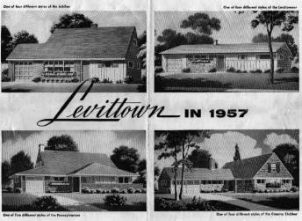
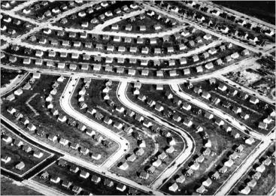
Populating the Country
Baby Boom
50 million born (1945-1960)
Suburban Growth
Levittown, NY
Daly City, CA
Middle Class movement (“white flight”)
To the suburbs
Cities increasingly poor and racially divided
Rise of the Sunbelt
Draw of warmer climates and air conditioning
Shift of political power from one region to another
Notes:
Baby Boom: http://www.conservapedia.com/Baby_boom
Levittown: http://www.nytimes.com/slideshow/2007/10/12/nyregion/20071013_LEVITTOWN_SLIDESHOW_index.html?_r=0
Levittown Ad: http://www.capitalcentury.com/1951.html
Effects on education: growth in construction & number of schools (and hospitals), especially elementary & secondary
Effects on cities: racially diverse (and divided) & centers of poverty (couldn’t afford to leave/commute)
Effects on politics: traditional NE power center lost, huge impact on electoral college (demographic shift still continues to this day)

Slide 6
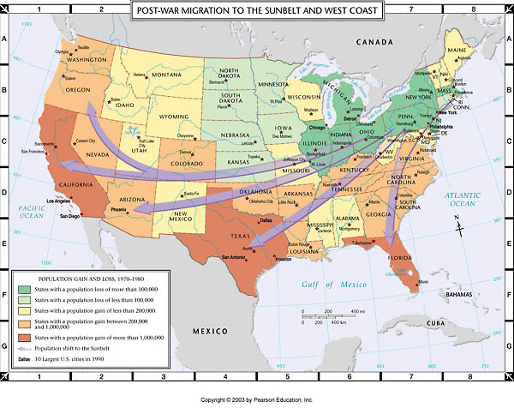
The Sunbelt
Notes:
http://wps.pearsoncustom.com/wps/media/objects/2428/2487068/atlas/atl_ah6_m006.html

Slide 7
Postwar Politics
FDR to Truman
Attempt to continue New Deal tradition
Economic Programs and Civil Rights
Employment Act of 1946
national health insurance, increase in minimum wage, bill to maintain full employment
Council of Economic Advisors – counsel President & Congress on promoting economic welfare nationally
Coalition between Republicans and conservative Southern Democrats – hinders domestic programs set forth by Truman
Civil Rights – challenge of racial discrimination
EO - Committee on Civil Rights (1946)
To Secure These Rights (Oct. 1947)
Executive Orders 9980 & 9981
Desegregated federal gov’t & armed forces
Fair Employment Practices Commission
Notes:
To Secure These Rights Report: http://www.trumanlibrary.org/civilrights/srights4.htm

Slide 8
Republican Control of the 80th Congress
Impact of the Election of 1946
Republican majority in Congress
22nd Amendment (1951)
Two-Term Limit
Taft-Hartley Act (1947)
Outlawed closed shops
“right to work” laws
Outlawed secondary boycotts
Presidential 80-day “cooling off period” before strike
Truman vetoed “slave-labor” bill
Congress overrode
Major divide between Dems & Repub
Notes:
Anti T-H Rally: http://blogs.baruch.cuny.edu/his1005fall2010/2010/11/09/msg-rally/

Slide 9
Election of 1948
Democrats
Truman (incumbent)
J. Strom Thurmond
Dixiecrat – states’ rights
Republicans
Thomas E. Dewey – overly confident and “do nothing”
Campaign
Truman’s national tour
“Give ‘em hell, Harry”
Results
Truman:
50% pop, won with 2 million more votes
303 Electoral
Notes:
Photo & Election Coverage: http://www.canyoncountryzephyr.com/blog/2012/11/01/nbc-coverage-of-election-1948-truman-vs-dewey/
Map: http://www.slideshare.net/ntengowski/truman-powerpoint

Slide 10
Truman’s Fair Deal
Proposals:
National Health Care
Federal aid to education
Civil Rights legislation
Public housing
Farming programs
Minimum wage increase (.75/hr)
Expand Social Security
Results:
Most bills defeated in Congress
Except min. wage & Soc. Security
Reasons:
Truman’s political conflict w/Congress
Pressing foreign policy concerns with Cold War
Notes:
Cartoons: https://apus-b.wikispaces.com/post+war+domestic-political+cartoons

Slide 11
Origins of the Cold War
U.S.-Soviet Relations During the Early Cold War (1945-1952)

Slide 12
U.S.-Soviet Relations to 1945
Bolshevik Revolution (1919)
1st Red Scare
Soviet Union considered a threat to capitalism and liberty
Official Recognition (1933)
FDR did not consider Soviets trustworthy
Non-aggression Pact (1939) – split Europe w Germany
Allies in World War II
Postwar Cooperation and the U.N.
Atomic Energy Commission
Rejection of Baruch Plan – regulation of nuclear energy and elimination of atomic weapons
Rejection of World Bank (Bretton Woods, 1944) – goal to fund rebuilding of war-torn Europe
USSR saw it as an instrument of capitalism
Cooperation at Nuremberg Trials (1945-46)
Notes:
Nuremberg Trials Gallery: http://www.yadvashem.org/yv/en/exhibitions/nuremberg/gallery.asp

Slide 13
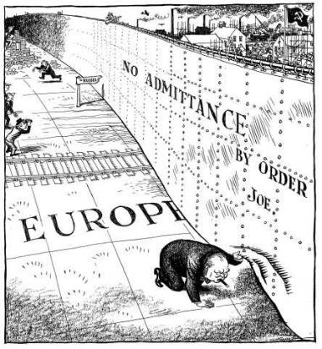
The Spread of Communism
Satellite States in Eastern Europe
Poland, Romania, Bulgaria, Albania, Hungary, Czechoslovakia
Need for “buffer” states
West views as violation of self-determination and open markets
Occupation Zones in Germany
Formation of German Democratic Republic
Soviet Sector
Berlin
The “Iron Curtain” – call for stand against Communism
Winston Churchill (Missouri, 1946)
Notes:
Map: http://www.memorial-caen.fr/10EVENT/gb/ciel_tex21.htm
Churchill’s Speech: http://www.johndclare.net/cold_war7.htm

Slide 14
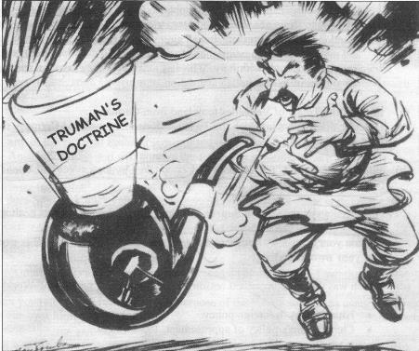
Containment in Europe
George Kennan
Contain and prevent expansion of Soviet communism
The Truman Doctrine (1947)
Implementation of containment
Response to:
Communist uprising in Greece
Soviet demands for Dardanelles – water route
$400 million to Greece and Turkey
Assist “free people” against “totalitarian” regimes
Notes:
Truman Doctrine Cartoon 1: http://fineartamerica.com/featured/truman-doctrine-cartoon-granger.html
Truman Doctrine Cartoon 2: http://histoforum.net/toetsopdrachten/gcse.htm

Slide 15
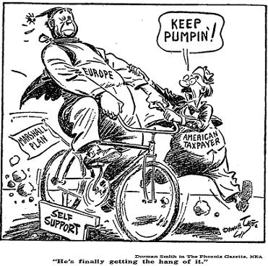
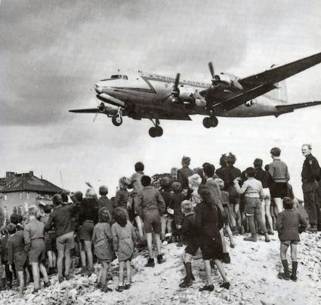
Containment in Europe (con.)
The Marshall Plan (1947)
$12 Billion in aid to Western Europe
Soviets rejected aid
Effects:
Western Europe self-sustaining by 1950’s
Bolstered US prosperity (exports)
Increased rift & tension w/Soviets
Berlin Airlift
Soviet blockade of Berlin (June, 1948)
Effective: Stalin lifts blockade (May, 1949)
Notes:
Marshall Plan: http://www.ourdocuments.gov/doc.php?flash=true&doc=82
Marshall Cartoon: http://usdocuments.wikispaces.com/Truman+Doctrine,+1947
Berlin Airlift: http://en.wikipedia.org/wiki/Berlin_Blockade

Slide 16
NATO and National Security
North Atlantic Treaty Organization
Ten European nations, the U.S., and Canada
Work outside the Soviet Union’s veto power
“Peacekeeping” Forces
Supreme Commander: Eisenhower
Soviet Response: Warsaw Pact
National Security Act (1947)
Department of Defense
Air Force
Joint Chiefs of Staff
National Security Council – creation of foreign policy on the Cold War
Central Intelligence Agency
Notes:
Synthesis – Cold War 2?: http://crosschek.net/category/end-time-perspective/

Slide 17
Atomic Weapons
Soviet Union Tests First Atomic Bomb (1949)
NSC-68 (1950) – needed to fight Cold War
4x defense spending
20% of GNP
Convince public spending was necessary
Alliances w/non-communist countries
“New Look” Policy
Missile, Bomber, and Submarine Development
U.S. Develops First Hydrogen Bomb (1952)
First test - 1954
Soviets respond, 1955
Notes:
Photo: http://ocean.si.edu/ocean-photos/nuclear-bombs-coral-reef Video: https://www.youtube.com/watch?v=kT59uo3kz98

Slide 18
The Cold War in the East
The Effects of Cold War Policy

Slide 19
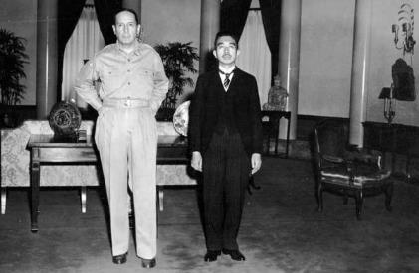
Japan
US Occupation
Tojo executed
MacArthur
New Constitution adopted (1947)
Parliamentary democracy established
Hirohito gives up claim to divinity
Military limited – reliance on US for protection
US-Japanese Security Treaties
Japan surrenders Korea and Pacific islands
US ends formal occupation
Treaty of San Francisco (1952)
Japan becomes ally in fight against communism
Notes:
Japanese Flag – Before and After: https://gdblogs.shu.ac.uk/b3019344/2014/04/23/graphic-logo-based-research-protest-project/
MacArthur-Hirohito: https://iconicphotos.wordpress.com/2012/09/28/when-macarthur-met-the-emperor/

Slide 20
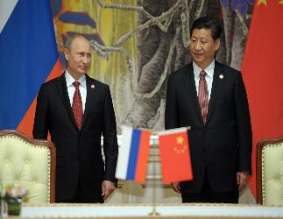
The Philippines and the Pacific
Philippine Independence
July 4, 1946
US Retains naval bases
China
Civil War Continues (1946-1950)
US support of Nationalists Chiang Kai-shek
US Policy
$400 million in aid to Chiang Kai-shek
Two Chinas
Formosa (Taiwan)
People’s Republic of China (1949) – Mao Zedong
U.S. refuses to formally recognize
Sino-Soviet Pact (1950) – Stalin & Zedong
Notes:
Stalin-Mao: https://www.haikudeck.com/sino-soviet-relations-education-presentation-Pdzffws0SV
Putin-Jinping: http://www.usnews.com/opinion/blogs/world-report/2014/05/28/whats-driving-the-china-russia-natural-gas-deal

Slide 21
The Korean War
Korea Divided Following Defeat of Japan
Soviet Protected North
US Supported South
Invasion
June 25, 1950: North Korea Invades South Korea
Soviets were boycotting UN
As a result, UN deploys forces to Korea
Douglas MacArthur
Inchon Landing and Counterattack (Sept. 1950)
MacArthur’s “Home by Christmas” Campaign
China’s Warning
MacArthur vs. Truman – limited war
Armistice
Stalemate & Peace
38th Parallel
Results
2.5 million deaths (54,000 Americans)
New Tech: B-52
Test of Containment Policy
Political fallout
Notes:
Animated Map: http://commons.wikimedia.org/wiki/File:Korean_war_1950-1953.gif
Cartoon & Story: http://www.returnofkings.com/30830/truman-sacks-macarthur-a-lesson-in-leadership

Slide 22
The Cold War at Home
The Second Red Scare

Slide 23
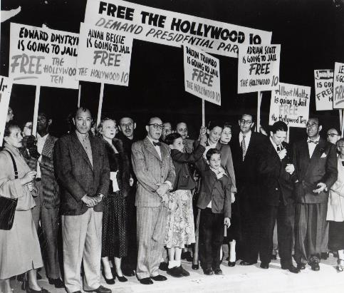
Security and Civil Rights
Prosecutions Under the Smith Act (1940)
Dennis v. U.S. (1951)
McCarran Internal Security Act (1950)
Illegal to support establishment of totalitarian government
Restricted employment of communists
Creation of detention camps for subversives
House Un-American Activities Committee (HUAC)
The Hollywood Ten
Notes:
Herblock Cartoon: http://coldwarprojectslo.weebly.com/huac-interviews.html
Hollywood Ten Protest: http://theredscare1950s.weebly.com/mass-hysteria.html

Slide 24
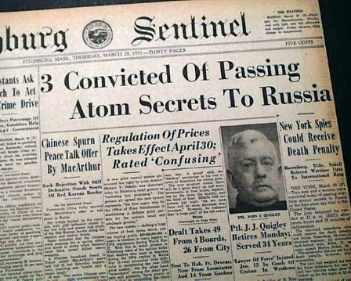
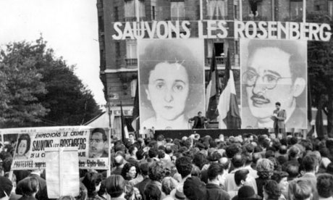
Espionage Cases
Alger Hiss
HUAC, 1948
Accused of being Communist
Prosecuted by Richard Nixon and convicted of perjury
Saul and Ethel Rosenberg
Investigation of Klaus Fuchs led to FBI discovery of the Rosenbergs
Found guilty of treason and executed
Notes:
Nixon: http://www.authentichistory.com/1946-1960/4-cwhomefront/1-mccarthyism/
Klaus Fuchs: German-born, British exiled physicist. Gave Manhattan Project secrets to Russians, convicted of espionage in Britain (sentenced to 14 years)
Paris Protest to Save the Rosenbergs: http://www.theguardian.com/theguardian/2012/jun/16/archive-1953-rosenbergs-spies-execution

Slide 25
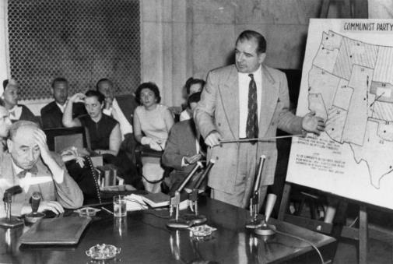
McCarthyism
Joseph McCarthy (Republican, WI)
Targeted federal bureaucracy and the Truman administration
Army-McCarthy Hearings (1954)
Televised “witch-hunt”
Smith’s Declaration of Conscience
Discredited McCarthy
Notes:
Cartoon: http://newmanology.tumblr.com/post/33969927026/rock-the-vote-joe-mccarthy
Margaret Chase Smith’s “Declaration of Conscience”: http://www.americanrhetoric.com/speeches/margaretchasesmithconscience.html
Army-McCarthy Hearings: http://en.wikipedia.org/wiki/Army–McCarthy_hearings

Slide 26
Legacy of Truman Era
Early Cold War Policy
Containment
Effective?
Beginning of Arms Race
First Major Proxy War
Korea
Civil Rights
First Federal Policies
Red Scare
Impact on Civil Liberties & Labor
Notes:
Cartoon: http://www.loc.gov/exhibits/herblocks-history/fire.html

