Slide 1
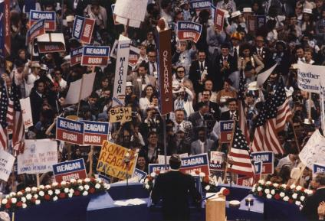
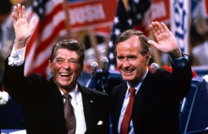
A Conservative Resurgence
The United States from 1980-2000
Notes:
1980 RNC image 1: https://en.wikipedia.org/wiki/Republican_Party_presidential_primaries,_1980
1980 RNC image 2: http://neilleifer.com/ptags/1980-republican-national-convention/

Slide 2
The Rise of Conservatism
Political Figures:
Barry Goldwater
Nixon & Ford
Theorists:
William F. Buckley, Jr.
Milton Friedman
Response to:
Big Government
New Deal Liberalism
Feminism
Gay Rights
Welfare
Affirmative Action
Sexual Permissiveness
Drug Use
Gun Control
“Liberal” SCOTUS Decisions
Notes:
Cartoon: http://www.cartoons.org.nz/cartoons/welfare-state

Slide 3
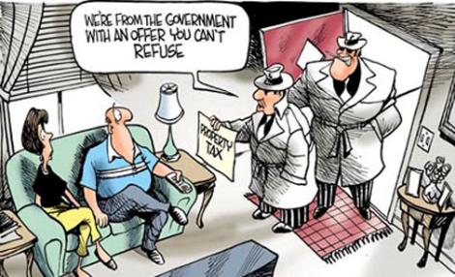
Leading Issues
Taxpayers’ Revolt
CA’s Prop 13
Laffer Curve
Inspiration for tax cuts
Conservative Religious Revival
The Televangelists
Robertson, Roberts, Baker
Falwell & the “Moral Majority”
Pro-Life Movement
Elimination of Racial Preferences
U.C. Regents v. Bakke (1978)
De-Regulation of Business
PAC’s & “Think Tanks”
Heritage Foundation & Cato Institute
U.S. Chamber of Commerce
Notes:
Prop 13 Cartoon w/description of current status: http://www.santamonicapropertyblog.com/senators-dare-to-tamper-with-prop-13/
Time Falwell Cover: http://content.time.com/time/covers/0,16641,19850902,00.html

Slide 4
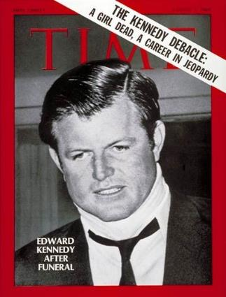
Ronald Reagan and the Election of 1980
Background:
Actor, SAG President, Governor of California
Campaign
Democratic Squabbles:
Kennedy vs. Carter
Memories of Chappaquiddick
Republican Attacks
“Are you better off now than four years ago?
Results:
Reagan:
51% popular, 91% Electoral
The “Reagan Revolution”
Demographic shift to Republican party
Notes:
Map: http://kc-johnson.com/history-3442-the-1980-election/1980-presidential-election-map-picture/

Slide 5
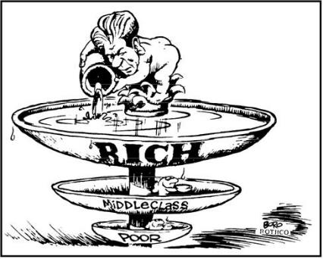
The Reagan Revolution
Iranian Hostage Crisis Ends (Jan. 20, 1981)
Result of Demographic Shift
Conservative Republicans & the “Boll Weevils”
Supply Side Economics
“Trickle Down Theory”
Federal Tax Reduction
Economic Recovery Act (1981)
Spending Cuts
$40 billion
Deregulation
PATCO Strike
Notes:
Cartoon: http://thecompanion.in/serious-thoughts-after-watching-in-time/
PACO Strike, with description: https://historyrat.wordpress.com/2012/10/14/reagan-and-the-patco-strike-broken-promises/

Slide 6
Recession & Recovery
The “Reagan Recession”
Bank failures
11% Unemployment
“Reaganomics” ends recession, but increases wealth gap
“Yuppies”
Social Issues
SCOTUS Nominations
O’Connor, Scalia, Kennedy
Rehnquist = Chief Justice
Restrict Affirmative Action & Limit Scope of Roe

Slide 7
The Election of 1984
Republicans:
“It’s Morning Again in America”
Democrats
Jesse Jackson & the “Rainbow Coalition”
Walter Mondale & Geraldine Ferraro
Results:
Electoral Tally: 525 to 13
Notes:
“It’s Morning in America” – Link to ad: http://www.livingroomcandidate.org/commercials/1984/prouder-stronger-better#4085
Cartoon: http://apushrshs.wikispaces.com/Political%20Cartoons%201980s-2004
Rainbow Coalition Button: http://i.ebayimg.com/00/s/NTAwWDQ3Mw==/z/B5kAAOSwDNdV6JAP/$_1.JPG

Slide 8
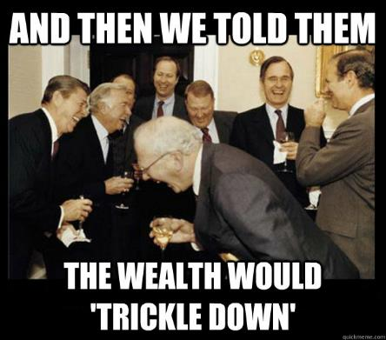
Economic Legacy
Budget & Trade Deficits
$200 billion deficit per year
Debt: $900 billion (1980) → $2.7 trillion (1988)
Tax cuts increased consumption…
Of foreign goods
Trade deficit = $150 billion per year
1985 Gramm-Rudman-Hollings Balanced Budget Act (1985)
Impact of Reaganomics
Legacy of social spending cuts and increased military spending
Proliferation of the national debt
Notes:
Time Cover: http://content.time.com/time/covers/0,16641,19810921,00.html
Meme: https://theprogressivecynic.com/2015/02/09/reaganomics-or-rigonomics-the-right-wings-nonfactual-economic-ideology/

Slide 9
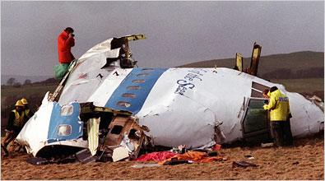
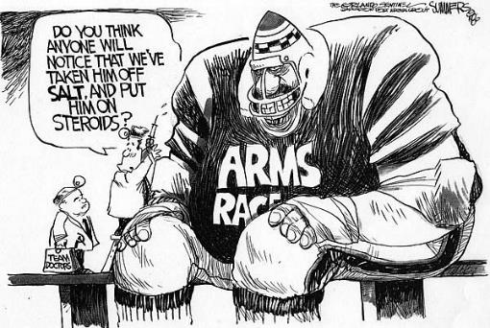
Foreign Policy
Renewing the Cold War
Military Buildup
B1 program, SDI, Pershing II
Central America
Nicaragua (1979-1985)
Boland Amendment
El Salvador (1979-1985)
Grenada (1983)
Iran-Contra Scandal
Iran-Iraq War (1979)
John Poindexter & Oliver North
Against Hezbollah, for Contras
Lebanon, Israel, and the PLO
Israeli invasion (1982)
Beirut Bombing (1983)
West Berlin Bombing (1986)
Gaddafi
Air Strikes on Libya
Pan-Am Flight 103 (1988)
Notes:
SDI: http://www.globalsecurity.org/space/systems/sdi.htm
Cartoon: http://deadspin.com/5958173/a-brief-history-of-sports-in-political-cartoons
Pan-Am 103: http://topics.nytimes.com/top/reference/timestopics/subjects/a/airplane_accidents_and_incidents/pan_am_flight_103/index.html

Slide 10
Improved U.S.-Soviet Relations
1980 (Moscow) & 1984 (Los Angeles) Olympic Games Boycotts
Mikhail Gorbachev (1985)
Glasnost & Perestroika
INF Treaty (1987)
“… tear down this wall!”
Notes:
https://www.youtube.com/watch?v=YtYdjbpBk6A

Slide 11
Assessing Reagan’s Policy
Military Buildup
Pro: Ended Cold War
Con: Debt
End of the Cold War
Most responsible?
Kennan
Nixon
Reagan
Gorbachev
The “Reagan Revolution”
Extreme Popularity
Changed the face of politics
Notes:
Did Reagan Win the Cold War?:http://www.salon.com/2006/01/25/gaddis/

Slide 12
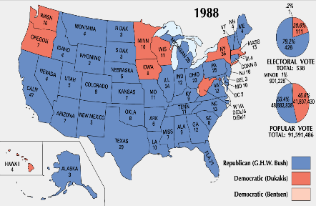
The Election of 1988
Background:
1986 midterms saw Democrats take control of both houses
Massive deficits and debt gave Democrats strength
Candidates:
Michael Dukakis & Lloyd Bentsen
George H.W. Bush & Dan Quayle
Impact of the Campaign:
Bush attacks Dukakis on Foreign Policy & Crime
“Read my lips…”
Notes:
Photo: http://bostonlocaltv.org/blog/2012/10/election-season-1988/
Map: http://www.philipcaruso-story.com/222-election-of-1988/
“Dan Quayle” is a link to the Vice-Presidential Debate – “you’re no Jack Kennedy”: https://www.youtube.com/watch?v=iQ5CIkSlUFI
“Foreign Policy” is a link to the “tank” ad: http://www.livingroomcandidate.org/commercials/1988/tank-ride#4119
“Crime” is a link to the Willie Horton ad: http://www.livingroomcandidate.org/commercials/1988/willie-horton#4123

Slide 13
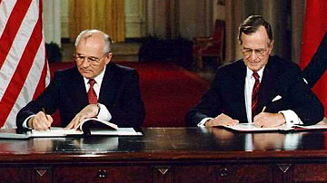
The End of the Cold War
Tiananmen Square (1989)
Collapse of Satellites (1989-1992)
Poland (Walesa)
Hungary, Czechoslovakia, Bulgaria, & Romania
East Germany
Collapse of Berlin Wall (1990)
Yugoslavia, Bosnia & Herzegovina
End of the Soviet Union
START I (1991)
Gorbachev → Yeltsin (1991)
START II (1992)
Notes:
Tiananmen, Goddess of Democracy: http://bhoffert.faculty.noctrl.edu/HST265/12.ARoadIsMade.html
START Signing: http://www.atomicarchive.com/History/coldwar/page25.shtml

Slide 14
Foreign Policy
Panama
Operation Just Cause (1989)
Manuel Noriega
Persian Gulf War (1990-91)
Operation Desert Storm
Saddam Hussein
Notes:
Operation Just Cause: https://en.wikipedia.org/wiki/United_States_invasion_of_Panama

Slide 15
Domestic Issues
Nomination of Clarence Thomas
Taxes and the Economy
S&L Scandal
Democratic Congress proposes tax hikes
Political Inertia
Struggles w/Congress
ADA (1990)
Notes:
Clarence Thomas: http://www.salon.com/2010/10/27/anita_hill_clarence_thomas/

Slide 16
Election of 1992
Background:
Anti-incumbent mood
27th Amendment (1992)
Partisan Politics on Capitol Hill
Democrats:
William Jefferson Clinton
An Independent Billionaire:
H. Ross Perot
Results:
Clinton wins w/less than 43% of the popular vote
Electoral tally: 370 to 168
Notes:
Debate image: http://popcultureblog.dallasnews.com/2014/11/george-w-bush-says-perot-cost-41-a-second-term-i-just-cant-prove-it.html/

Slide 17
Clinton’s First Term (1993-1997)
Goals:
Economic Stimulus
Campaign Finance Reform
Environmental Legislation
Health Care Reform
Results:
Senate Republicans use filibuster against all proposals
Compromise:
“Don’t ask, don’t tell.”
Accomplishments:
Family Medical Leave Act
“Motor-Voter” Law
Brady Bill
Spending Cuts and Tax Increases
NAFTA
Notes:
Cartoon: http://www.pbs.org/wgbh/americanexperience/features/teachers-resources/clinton-guide/

Slide 18
A Republican Revolution
1994 Midterms
“Contract with America”
Newt Gingrich
Results/Reactions:
Gridlock: 1995 shutdown
Oklahoma City Bombing (1995)
Balanced Budget (1998)
Impact of tech boom, Baby-boomer income, spending cuts, and tax increases
Notes:
Contract With America: http://content.usatoday.com/communities/onpolitics/post/2010/01/gingrich-offers-new-contract-with-america/1

Slide 19
Election of 1996
Republicans:
Bob Dole/Jack Kemp
15% tax cut proposal
Reform: Ross Perot
Results:
Less than 50% voter turnout
Electoral tally: 379 to 159
Notes:
“Bob Dole” – Link to SNL skit: http://www.nbc.com/saturday-night-live/video/cold-opening-nightline/n10863
Map: http://clinton.procon.org/view.resource.php?resourceID=004025

Slide 20
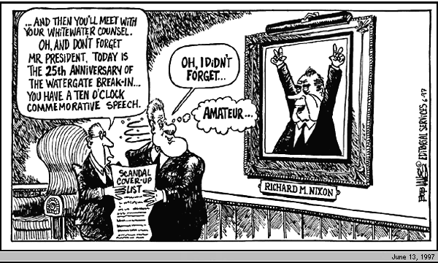
Clinton’s Second Term (1997-2001)
Economic Prosperity
Tech & Stock Boom
3.9% Unemployment
The Politics of Impeachment
Divided Government
Allegations, Investigation, and Impeachment
Whitewater, Travelgate, Filegate
Lewinsky
Independent prosecutor: Kenneth Starr
Clinton’s possible perjury
1998 Midterms → Dems gain House
Clinton escapes removal by Senate
Notes:
Time Cover: https://www.youtube.com/watch?v=xHlt1W83JFU
Picture is a link to the Clinton grand jury deposition – “definition of ‘is’ is…”: https://www.youtube.com/watch?v=xHlt1W83JFU
Cartoon: http://www.cnn.com/ALLPOLITICS/1997/12/24/toons.97/

Slide 21
Foreign Policy
Secretary of State: Madeleine Albright
Peacekeeping:
Somalia (1993)
Haiti (1994)
Northern Ireland (1998)
Europe
Formation of EU (2002)
Russia
Yeltsin → Putin
Chechnya (1999)
Serbia
Milosovic
Targets: Slovenia, Croatia, Bosnia-Herzegovina
Bosnia (1995) Kosovo (1999)
Middle East
Israel v. Palestine
Notes:
Synthesis – 20 Years After Somalia: https://horseedmedia.net/2014/01/11/somalia-20-years-black-hawk-us-military-advisers-back-somalia/

Slide 22
Assessing Clinton’s Legacy
Partisanship
Struggles w/Congress
Impeachment
Globalization
WTO
IMF
G8
Notes:
WTO Protest Seattle, 1999: http://www.herinst.org/BusinessManagedDemocracy/government/trade/millennium.html

Slide 23
American Society in 2000
Demographics
Nearly 300 million
Expansion in West and South
Political shift
Suburban expansion
Immigration
Immigration Reform and Control Act (1986)
Illegal immigration
27% of population growth of the ’90’s
Largest growing population: Hispanic
Aging and the Family
The “Graying” of America
Decline of Traditional Family
Income and Wealth
Home ownership 67%
Huge increase in per capita income
Extreme Wealth Gap: 5% control half of all income
Notes:
Graph: http://www.msnbc.com/rachel-maddow-show/welcome-the-new-gilded-age

