Slide 1
Chapter 38 Challenges to the Postwar Order 1973-1980

Slide 2
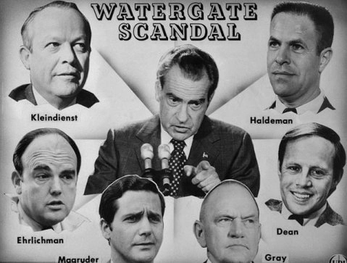
Watergate
June 17, 1972 - five men working for the Republican Committee for the Re-election of the President were caught breaking into the Watergate Hotel and bugging Democrats' rooms
Discovered After the Watergate Scandal - Nixon administration was involved in many other cases of corruption and "dirty tricks"
Many prominent members of the President's administration resigned.
Vice President Agnew also forced to resign for taking bribes
Congress replaced Agnew with Gerald Ford

Slide 3
the Unmaking of a President
Senate committee - led an investigation into the corruption
Nixon claimed no knowledge of the illegal activities
John Dean III, a former White House lawyer, testified about how Nixon tried to cover up the Scandal
October 20, 1973 ("Saturday Night Massacre")- Nixon fired Archibald Cox, the prosecutor of the Watergate Scandal case who had issued a subpoena of the tape
attorney general and deputy attorney general resigned because they did not want to fire Cox.
When conversations involving the Watergate Scandal were discovered on tapes, President Nixon refused to hand them over to Congress, despite denying any participation in the scandal
July 24, 1974 - Supreme Court ruled that President Nixon had to submit all tapes to Congress
August 5, 1974 - Nixon released the three tapes that held the most damaging information
One of the tapes ("smoking gun" tape) proved that Nixon had played an active part of the attempted cover-up of the Watergate Scandal

Slide 4
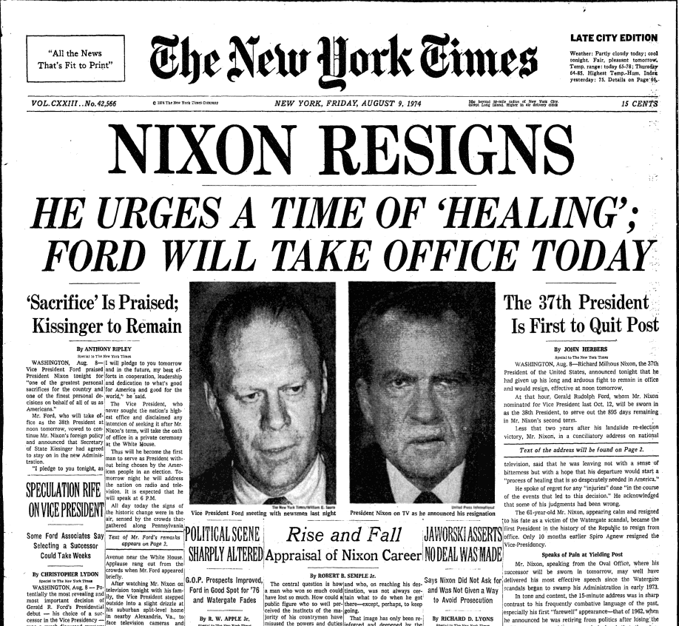
The First Unelected President
August 8, 1974, Nixon resigned due to pressures from own party
Gerald Ford became the first unelected president
President Ford's popularity and respect sank when he issued a full pardon of Nixon, thus setting off accusations of a "buddy deal"
July 1975 - Ford signed the Helsinki accords, which recognized Soviet boundaries and helped to ease tensions between the two nations

Slide 5
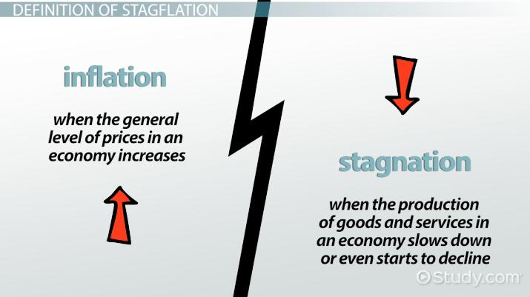
Sources of Stagnation
growth of the American economy slowed down in the 1970s
More women and teens were entering the works force → typically made less money than males
Deteriorating machinery and new regulations also hindered growth
Vietnam War and spending on Great Society programs also contributed to inflation
Countries like Japan and Germany started to dominate industries that had traditionally been led by the Americans
steel, automobiles, and consumer electronics

Slide 6
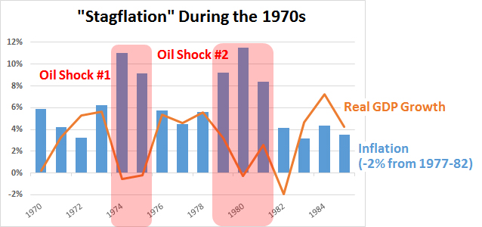

Slide 7
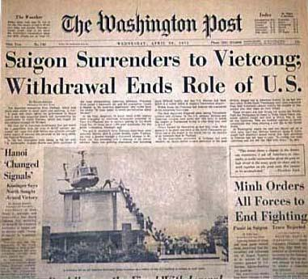
Defeat in Vietnam
Early in 1975 - North Vietnamese invaded South Vietnam
President Ford requested aid for South Vietnam, but was rejected by Congress
South Vietnam quickly fell
last Americans were evacuated - April 29, 1975
estimated cost to America was $188 billion, with 56,000 dead and 300,000 wounded
America had lost face in the eyes of foreigners, lost its own self-esteem, lost confidence in its military power, and lost much of the economic strength that had made possible its global leadership after WWII

Slide 8
Feminist Victories and Defeats
1972 - Congress passed Title IX of the Education Amendments
prohibiting sex discrimination in any federally assisted educational programs
Congress approved the Equal Rights Amendment (ERA)
never ratified by enough states
would have prohibited laws that discriminated based on sex
Anti-ERA Movement let by Phyllis Schaftly
Roe vs. Wade (1973)- Supreme Court invalidated laws banning abortion
Issue of privacy

Slide 9
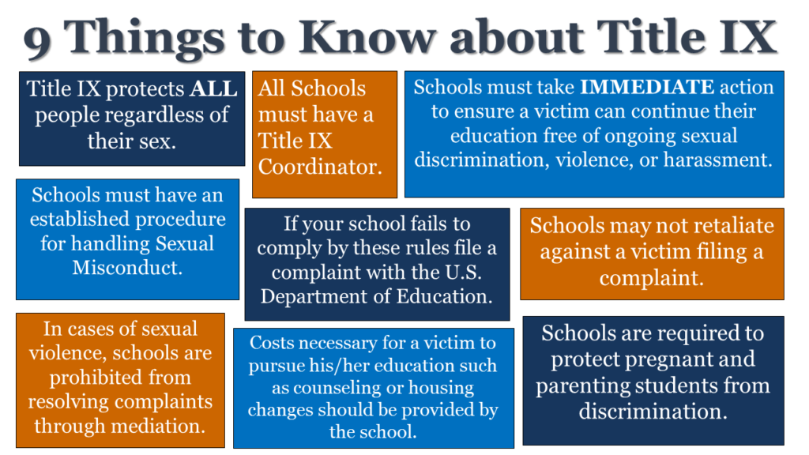

Slide 10
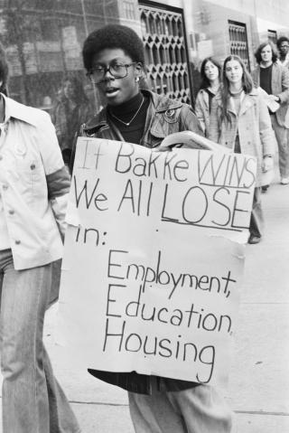
The Seventies in Black and White
1974 - Supreme Court ruled in Milliken v. Bradley that desegregation plans could not require students to move across school-district lines
reinforced "white flight"
1978 - Supreme Court ruled in University of California v. Bakke - universities could not favor applicants based on the quality of race
Supreme Court's only black justice, Thurgood Marshall, warned that the denial of racial preferences might erase the progress gained by the civil rights movement
United States vs. Wheeler (1978)- Supreme Court ruled that Native American tribes had limited sovereignty

Slide 11
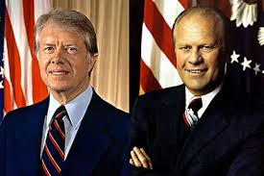
The Bicentennial Campaign
election of 1976 - Democrat Jimmy Carter beat Republican Gerald Ford to win the presidency
Carter promised to never lie to the American public
Carter was inexperienced in dealing with the politics of Washington
Unwilling to compromise with congress
High moral integrity

Slide 12
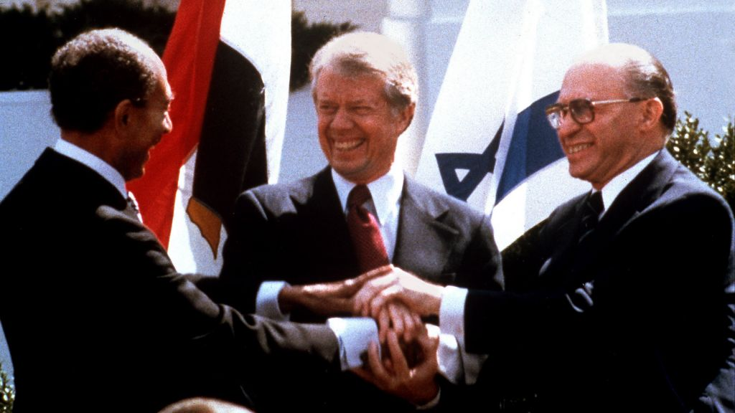
Carter's Humanitarian Diplomacy
President Carter mediated peace talks between Israel and Egypt
September 17, 1978 - President Anwar Sadat of Egypt and Prime Minister Menachem Begin of Israel signed peace accords at Camp David
Israel agreed to withdraw from territory it had gained in the 1967 war as long as Egypt respected Israel's territories
Camp David accords
President Carter pledged to:
return the Panama Canal to Panama by the year 2000
resume full diplomatic relations with China in 1979

Slide 13
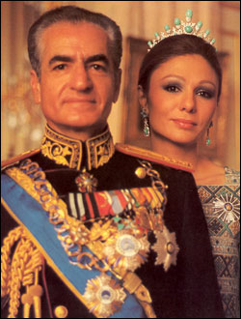
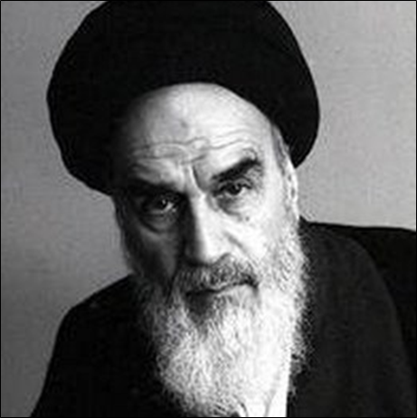
Economic and Energy Woes
rate of inflation had been steadily rising → by 1979 - at 13%
Americans learned that they were no longer economically isolated from the world
To reduce America's costly dependence on foreign oil - Carter called for legislation to improve energy conservation
didn't get much public support
1979 - Iran's shah Mohammed Reza Pahlevi(installed by America in 1953) – dictator overthrown and succeeded by Ayatollah Ruhollah Khomeini
Iranian fundamentalists very opposed to Western customs → stopped exporting oil
OPEC also raised oil prices and caused another oil crisis
July 1979 - arter retreated to Camp David and met with hundreds of advisors to come up with a solution to America's problems

Slide 14
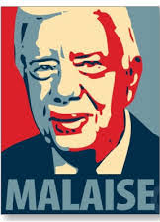
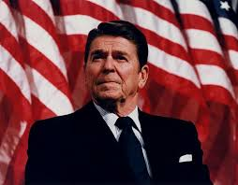
The Turn Toward the Market
July 15, 1979 - Carter gave his malaise speech
chastised American people for their obsession of material goods, stunning the nation
few days later, he fired four cabinet secretaries.
"Neoconservatives“ - fought for free-market capitalism and a return to traditional familial roles
grew in numbers as a result of the economic downturn

Slide 15
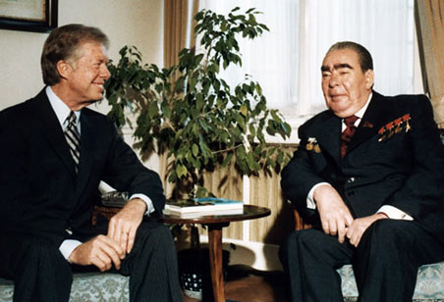
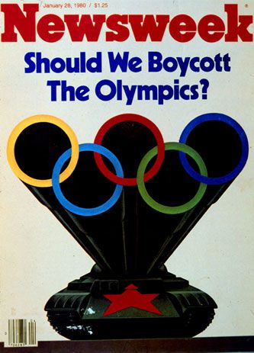
Carter and the cold war
1979 - Carter signed the SALT II agreements with Brezhnev, but
U.S. senate refused to ratify it
December 27, 1979 - Soviet Union invaded Afghanistan
ended up turning into the Soviet Union's version of Vietnam
Because Afghanistan bordered Iran, the Soviet invasion of Afghanistan posed a threat to America's oil supplies
President Carter placed an embargo on the Soviet Union and boycotted the Olympic Games in Moscow
proposed "Rapid Deployment Force" that could quickly respond to crises anywhere in the world

Slide 16
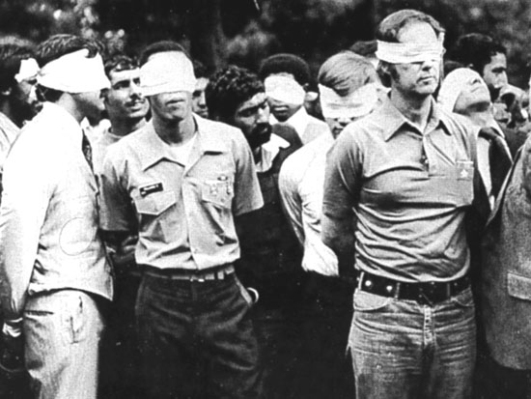
Iranian hostage crisis
November 4, 1979 - group of anti-American Muslim militants stormed the U.S. embassy in Tehran and took hostages
demanded that the U.S. return the exiled shah who had arrived in U.S. two weeks earlier for cancer treatments
To resolve the Iranian Hostage Crisis
Carter first tried economic sanctions on Iran – didn’t work
tried a commando rescuemission - had to be aborted
hostage crisis dragged on for most of Carter's term
hostages were not released until January 20, 1981
inauguration day of Ronald Reagan

