Slide 1
Period 5

Slide 2
Westward Expansion
Explain the causes and effects of westward expansion
What are the causes and effects of the belief in Manifest Destiny?

Slide 3
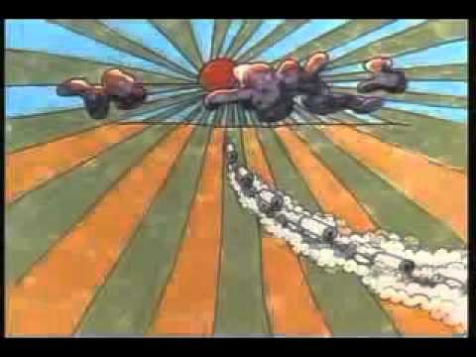
Understanding Manifest Destiny

Slide 4
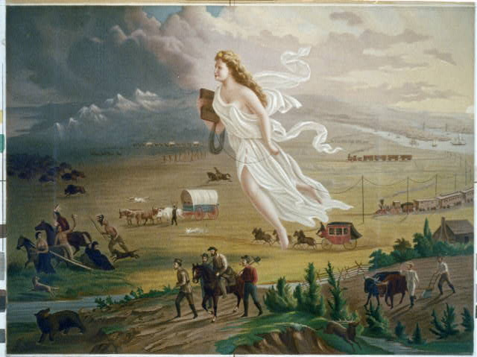
America Progress by John Gast, 1872

Slide 5
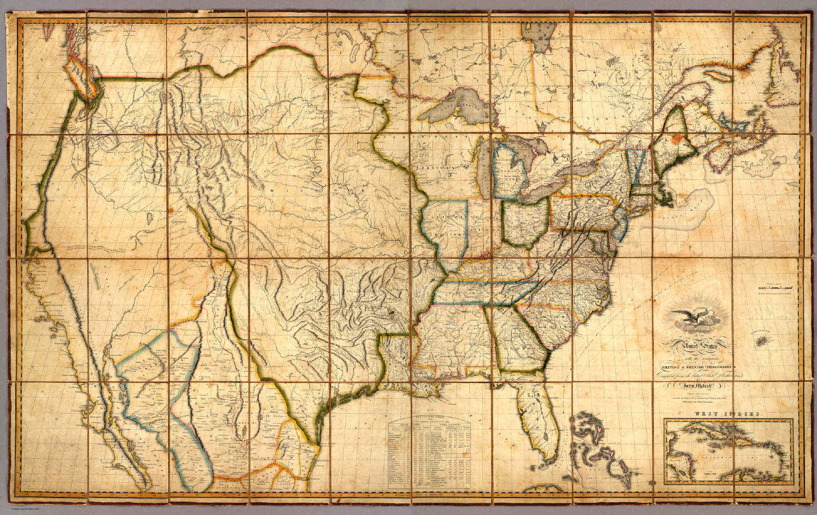
Melish Map of America “To present a picture of it was desirable in every point of view. The map so constructed, shows at a glance the whole extent of the United States territory from sea to sea; and in tracing the probable expansion of the human race from east to west, the mind finds an agreeable resting place on its western limits. The view is complete, and leaves nothing to be wished for. It also adds to the beauty and symmetry [balance] of the map; which will, it is confidently believed, be found one of the most useful and ornamental [decorative] works ever executed [created] in this country.” –John Melish, 1816

Slide 6
Short Answer Question Practice

Slide 7
“Our national birth (and the Declaration of Independence) was the beginning of a new history, which separates us from the past and connects us only with the future. We are the nation of progress, of individual freedom, of universal enfranchisement. Our future history will be to establish on earth the moral dignity and salvation of man — the undeniable truth and goodness of God. America has been chosen for this mission among all the nations of the world, which are shut out from the life-giving light of truth. Her high example shall put an end to the tyranny of kings, and carry the happy news of peace and goodwill to millions who now endure an existence hardly better than that of beasts of the field. Who, then, can doubt that our country is destined to be the great nation of the future?” – John O’Sullivan, “The Great Nation of Futurity,” 1839.
Answer (a), (b), and (c) .
(a) Briefly describe ONE way in which this excerpt showcases the basic ideas of Manifest Destiny. (b) Briefly describe ONE event from history that supports O’Sullivan’s view of the future of the United States. (b) Briefly describe ONE event from history that contradicts O’Sullivan’s view of the future of the United States.

Slide 8
Mexican American War
Explain the causes and effects of the Mexican American War
Explain the similarities and differences in how regional attitudes affected federal policy in the period after the Mexican American War
Was the Mexican American War justifiable? Why or why not?
What were the long and short terms impacts of the Mexican American War?

Slide 9
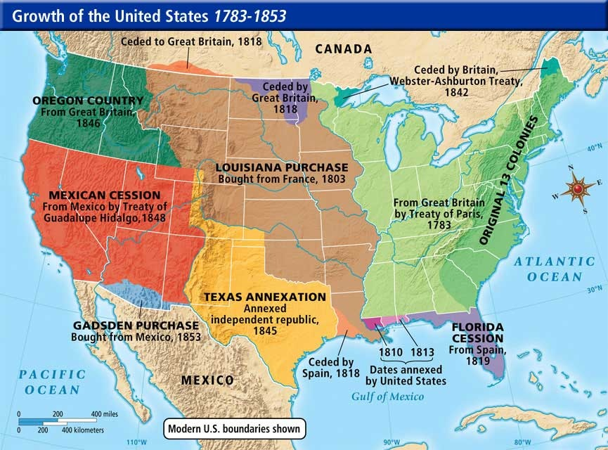

Slide 10
Mexican American War Activity
List the Causes & Effects
Rank them
In a one pager defend which cause and which effect you find the most significant and explain why

Slide 11
Expansion & Sectionalism
Explain how regional differences related to slavery caused tension in the years leading up to the Civil War
Explain the similarities and differences in how regional attitudes affected federal policy in the period after the Mexican American War
What is the relationship between expansion and the Civil War?
Why did the compromises not ultimately solve the problem of sectionalism?

Slide 12
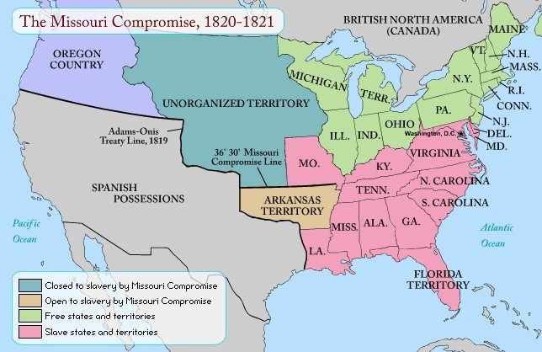
Compromise of 1820

Slide 13
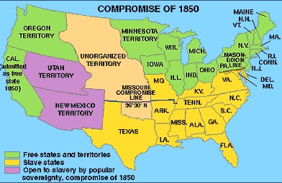
Compromise of 1850

Slide 14
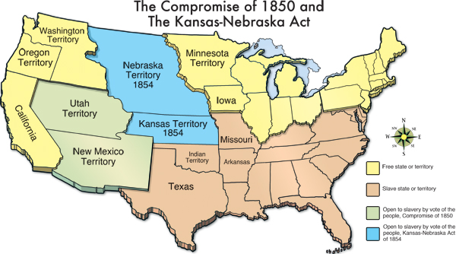
Kansas-Nebraska Act

Slide 15
Compromise and Sectionalism Packet

