Slide 1
Period 8
1945-1980

Slide 2
Cold War Overview

Slide 3
Questions?

Slide 4
Objectives
8.2 Explain the continuities and changes in Cold War policies from 1945 to 1980
8.7 Explain the various military and diplomatic responses to international developments over time

Slide 5
Overarching Questions
What were the reasons the United States and Soviet Union could not agree on a workable postwar relationship?
Why did the Soviet Union pursue the domination of Eastern Europe, including constructing the Berlin Wall?
What was the "Domino Theory"? What was "containment"? Why and how did the United States pursue containment as a strategy?
Why did crises like the Cuban Missile Crisis, the Vietnam War, or the Berlin Wall crisis not develop into war?

Slide 6
Task
Complete the Cold War Guide

Slide 7
Postwar America
1940s & 1950s

Slide 8
Questions?

Slide 9
Objectives
8.3 Explain the causes and effects of the Red Scare after World War II
8.4a Explain the causes of economic growth in the years after World War II
8.4b Explain the causes and effects of the migration of various groups of
Americans after 1945
8.5 Explain how mass culture has been maintained or challenged over time
8.6 Explain how and why the civil rights movements developed and expanded from 1945 to 1960

Slide 10
Red Scare

Slide 11
Red Scare
Explain the causes and effects of the Red Scare
Alger Hiss
The Rosenbergs
HUAC
Hollywood Ten
Duck & Cover

Slide 12
What does this tell us about the Red Scare and America during the 1950s?

Slide 13
Economics of 1950s

Slide 14
Economics of the 1950s

Slide 15
Economics of the 1950s

Slide 16
Economics of the 1950s
Explain the causes and effects of economic growth after WWII
Prosperity of 1950s
GI Bill
Safe for small business and corporate mergers
Saved income – depression mentality and rationing
Unions
What’s the but….?

Slide 17
GI Bill and Race

Slide 18
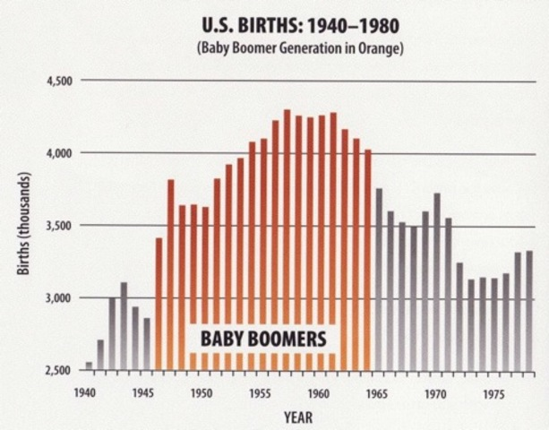
Baby Boom
Explain the causes and effects of economic growth after the war
Better medical technology and practice
More focus on childhood development
Polio Vaccine – Jonas Salk
Dr. Spock
Higher incomes
More mothers staying at home

Slide 19
Migration of 1950s

Slide 20
Rust Belt to Sun Belt
Explain the causes and effects of the migration of various groups after 1945

Slide 21
Suburbs
Explain the causes and effects of the migration of various groups after 1945
New products and materials created to help build them faster
Lead paint & asbestos
Levittown first major suburb
A house built ever 16 minutes
Highlighted conformity & racism
White flight

Slide 22
Little Boxes
What were the problems with the suburbs?
What did they show about the United States at this time in history?
Do we still see this today?

Slide 23
Levittown
Building your dream home

Slide 24
Problems with Levittown

Slide 25
New Tech of the 1950s

Slide 26
New Tech – What does this tell us about the culture during the 1950s?
Explain how mass culture has been maintained or challenged over time

Slide 27
Automobile
Explain how mass culture has been maintained or challenged over time
Automobiles became affordable for most families
Public transportation slowly because less used by many who lived in the suburbs
Government assistance
Highway Act
Automobile Culture spread
Drive in movies
Route 66 & family road trips
Roadside attractions and restaurants

Slide 28
Television
Explain how mass culture has been maintained or challenged over time
Aimed at portraying everyday life
Some genre shows as well
Became common culture
Any problems with these shows?

Slide 29
Beat Movement & Rising counterculture
Explain how mass culture has been maintained or challenged over time
Beat Movement
Mostly located in major cities – North Beach in SF and Greenwich Village in NYC and Venice North in LA
Opposed the conformity & inequality of the 1950s – “Squares”
Advocated for personal freedom and experimentation
Felt it necessary to withdraw from the structures of society
Mass protests limited, but instead made their mark in literature, music, & art
Jack Kerouac – On the Road & Alan Ginsburg – Howl

Slide 30
Early Civil Rights Leaders
Explain how mass culture has been maintained or challenged over time
Explain how and why the civil rights movements developed and expanded from 1945 to 1960
Legal fight against suburban race laws
Rosa Parks – segregation on public transportation - Montgomery Bus Boycott
Brown v. Board of Education
Little Rock Nine
Common Factor – NAACP

Slide 31
America as a World Power

Slide 32
Objective
8.7 Explain the various military and diplomatic responses to international developments over time

Slide 33
Questions?

Slide 34
Changing Foreign Policy
After WWI
After WWII

Slide 35
How did foreign policy evolve during the Cold War?
UN
Containment
Truman Doctrine
Marshall Plan
Berlin Crisis
NATO
Korean War
Use of CIA
Suez Crisis
Hydrogen Bomb
Bay of Pigs
Cuban Missile Crisis
Six-Day War
Berlin Wall
Space Race

Slide 36
Vietnam War

Slide 37
Objective
Explain the causes and effects of the Vietnam War

Slide 38
Questions

Slide 39
What are the causes and effects of the Vietnam War

Slide 40
The Great Society

Slide 41
Questions?

Slide 42
Objectives
Explain the causes and effects of continuing policy debates about the role of the federal government over time
Explain the various ways in which the federal government responded to the calls for the expansion of civil right
Explain how and why opposition to existing policies and values developed and changed over the course of the 20th century
Explain how and why policies related to the environment developed and changed from 1968 to 1980

Slide 43
Understanding the Great Society
Read Johnson’s Speech
Who is his audience?
What is his message?
What kind of programs does he seem to support?
Review the different focuses and programs
Which have you heard of?
Which do you have questions about?
What other time period does this era remind you of?

Slide 44
Great Society Video

Slide 45
Homework
Review the Pro and Con articles about the Great Society
Complete the graphic organizer

Slide 46
SAQ Practice – Great Society & New Deal
Answer (a), (b), and (c).
a) Briefly describe ONE similarity between New Deal and Great Society programs.
b) Briefly describe ONE difference between New Deal and Great Society programs.
c) Briefly explain ONE reason for a difference between New Deal and Great Society programs.

Slide 47
Civil Rights 1960s – 1970s

Slide 48
Questions

Slide 49
Objectives
Explain how and why various groups responded to calls for the expansion of civil rights from 1960 to 1980
Explain the various ways in which the federal government responded to the calls for the expansion of civil rights

Slide 50
Task
Civil Rights Leader Bio Poster
Museum Walk
Similarities and differences between the movements

Slide 51
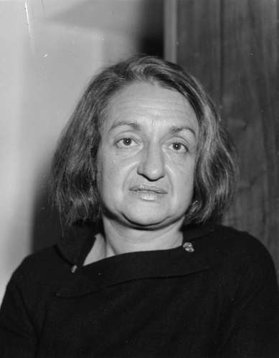
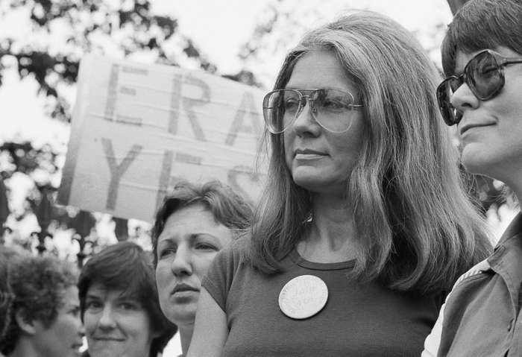
Women’s Movement
Betty Freidan – The Feminine Mystique & NOW
Gloria Steinem – NOW & W magazine
Focus on expanding women’s rights & economic & social equality
Embracing the concept of feminism
As more women enter the work force movement focuses on:
Equal pay, equal access to education and jobs, maternity leave, women’s choice, day care at work
Women taking control of the narrative of their lives and their desires - Sexual Revolution
More radical groups formed as well – The Redstockings
Took on issues of rape and domestic violence
Greatest issues with the movement
Lack of intersectionality
ERA not passing – growing anti-feminist movement

Slide 52
Youth Culture

Slide 53
Questions

Slide 54
Objective
Explain how and why opposition to existing policies and values developed and changed over the course of the 20th century

Slide 55
Youth Movement
As the generation born during the baby boom (aka Boomers) come of age, many begin to challenge the social, economic, and political values of their parents’ generation
As Vietnam War took off, more young people felt it was their right and duty to fight against the war
Being drafted without being able to vote
Youth movements existed in many formats across the country

Slide 56
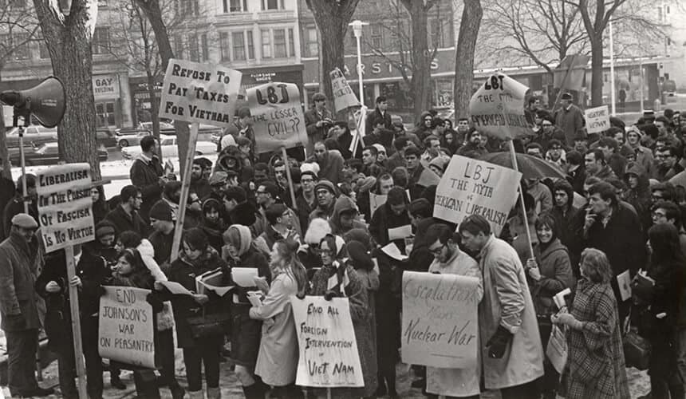
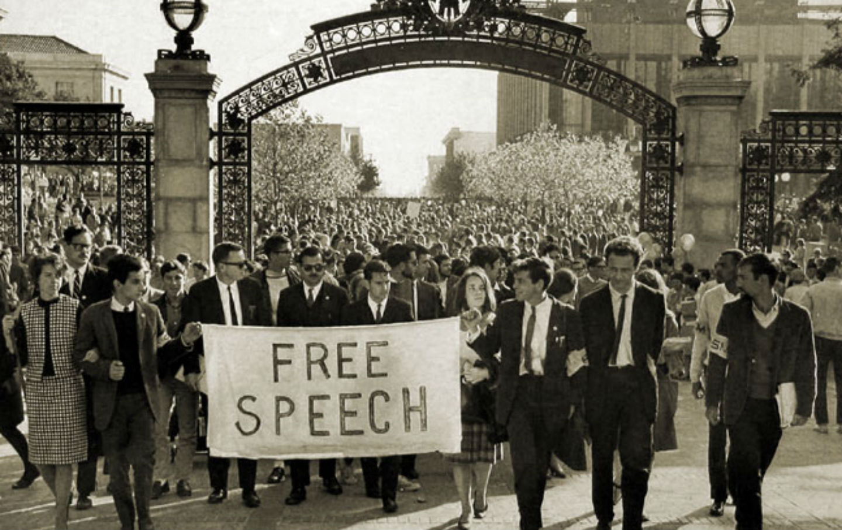
Student Led Movement
Participated in civil rights movements – Freedom Riders, Sit-ins, protests (SNCC)
SDS – Students for a Democratic Society – protests for civil rights, anti-Vietnam, free speech
Felt the current liberal political system was not doing enough
Free Speech Movement – UC Berkeley
Mostly seen on college campuses
Outliers – Weather Underground – used extreme measures to fight against Vietnam War and for political change – considered domestic terrorists

Slide 57
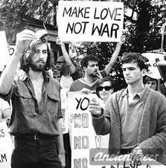
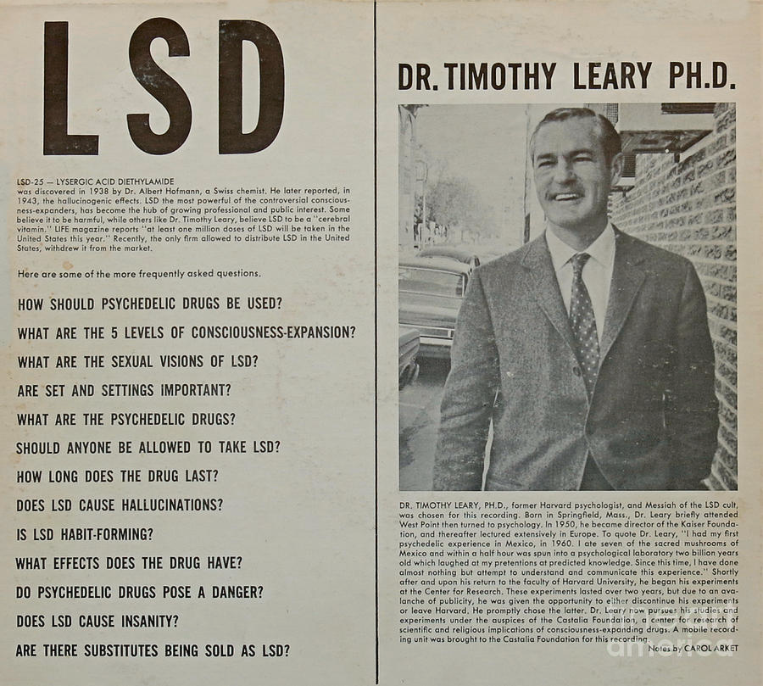
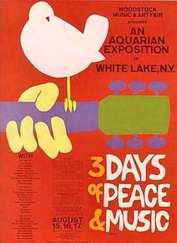
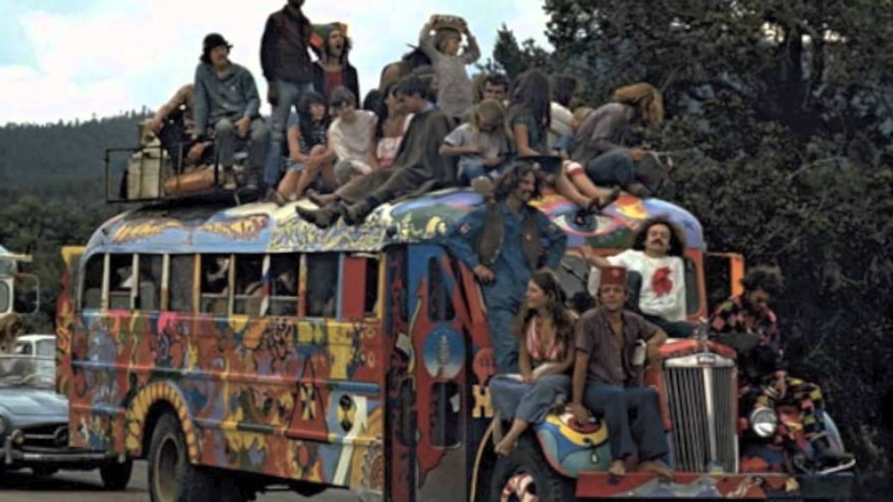
Counterculture
Rejected social and economic norms of their parents
Contemplated or experimented with communal living
Experimented with hallucinogenic drugs
Dr. Timothy Leary & Dr. Richard Alpert – Harvard
“Turn on, Tune In, Drop Out”
Sexual Revolution and challenges to gender norms
Challenged need for formal education
Exit from traditional society
Group known as the hippies
END WITH WOODSTOCK!

Slide 58
Document Analysis
Whole class read of the documents
Groups discuss and respond to questions on handout
Wrap-Up Class discussion

Slide 59
The Environmental Movement

Slide 60
Questions

Slide 61
Objectives
Explain how and why policies related to the environment developed and changed from 1968 to 1980

Slide 62
What happened during this time that led to so many laws being passed in favor of protecting the environment?
“Within a six year period, 1970-1976, the United States Congress enacted nearly all of the basic environmental legislation . . . most of it by overwhelming bipartisan majorities.”
Robert V. Percival, Director of the Environmental Law Program at the University of Maryland

Slide 63
How are emissions changing from the 1940s to 1990s?
Toxin | Health Impact
Carbon Monoxide25 | Visual impairment, reduced work capacity, reduced manual dexterity, poor learning ability, and difficulty in performing complex tasks
Nitrogen Oxide26 | Irritation of the lungs and lower resistance to respiratory infections such as influenza, increased incidence of acute respiratory illness in children
Sulfur Dioxide27 | Harmful effects on breathing, respiratory illness, alterations in pulmonary defenses, and aggravation of existing cardiovascular disease.
Lead28 | Anemia, kidney disease, reproductive disorders, and neurological impairments such as seizures, mental retardation, and/or behavioral disorders. Even at low doses, lead exposure is associated with changes in fundamental enzymatic, energy transfer, and other processes in the body

Slide 64
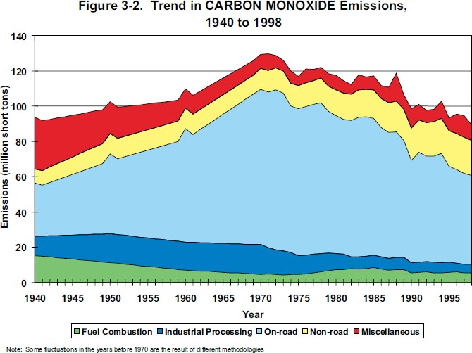
Analyzing the Graphs
What do you notice about air pollution during this time?
What factors would cause such a change?
What happened to these sources of pollution during this time period? What could have made the numbers increase or decrease?
What are some ways these causes of air pollution can be dealt with or reduced?
Year | Emissions (thousand short tons)
1940 | 93,616
1950 | 102,609
1960 | 109,745
1970 | 129,444
1980 | 117,434
1990 | 98,523
1996 | 95,480
1998 | 89,455
Table 1. Total National Emissions of Carbon Monoxide, 1940 through 1998 (thousand short tons)

Slide 65
Analyzing the Laws
Match the correct law to the correct description
Post matching questions
Are the laws federal, state, or both?
Do they seem flexible or inflexible?
Why did so much environmental legislation pass in such a short period of time?
Why are these laws so transformative?

Slide 66
Rachel Carson & Silent Spring
https://ca.pbslearningmedia.org/resource/arct.socst.ush.earth15carson/rachel-carson-silent-spring/
https://ca.pbslearningmedia.org/resource/envh10.sci.life.eco.silentspring/rachel-carsons-silent-spring/

Slide 67
Nixon and the Movement
https://ca.pbslearningmedia.org/resource/arct.socst.ush.earth16politics/environmentalists-enter-politics/

Slide 68
1st Earth Day
https://ca.pbslearningmedia.org/resource/arct.socst.ush.earth14earthdays/the-first-earth-day/

Slide 69
Society in Transition

Slide 70
Objective
Explain the causes and effects of continuing policy debates about the role of the federal government over time
Explain the effects of the growth of religious movements over the course of the 20th century

Slide 71
Questions

Slide 72
Loss of Trust in the Government
Pentagon Papers & the Vietnam War
Watergate, Nixon’s resignation, & Ford’s pardon
Stagflation
Oil Crisis and Malaise Speech
Iranian Hostage Crisis

Slide 73
Silent Majority and Moral Majority
Moral Majority
Growing evangelical movement
Televangelists & political activists
Jerry Falwell
Phyllis Schlafly & Anti-ERA
Anti-Abortion movement
Silent Majority
Most white Americans (esp. older wt. Americans) were actually okay with the slowing down of integration and less focus on progressive change
Supported Nixon’s slow down of bussing
Supported War on Drugs
Supported a leader who promised less government intervention
“Let’s Make America Great Again” – Ronald Reagan

Slide 74
Activity – Causation
List three causes of the Rise of the New Right
List three effects of the Rise of the New Right
Give the most important cause and effect and explain why
Give the least important cause and effect and explain why

