Slide 1








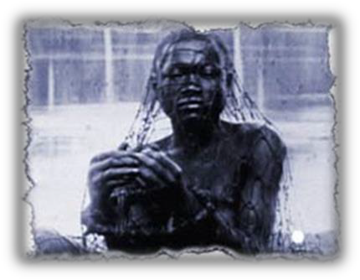
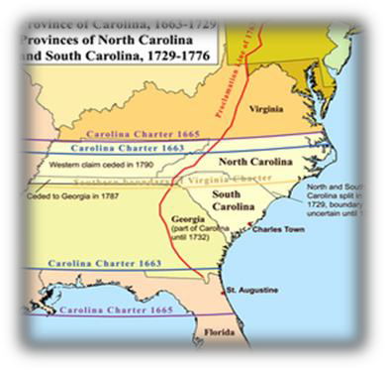
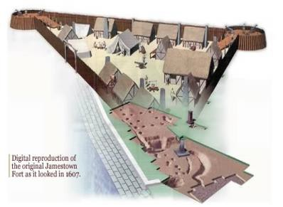



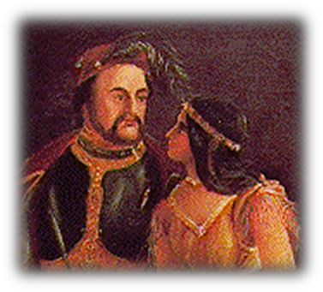
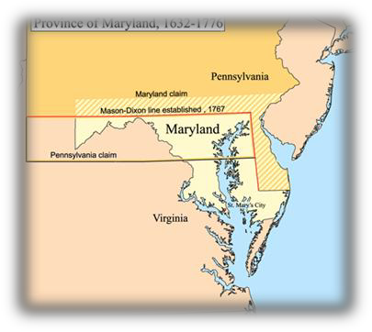
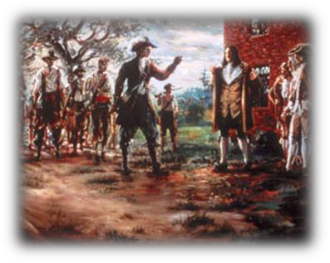
The Southern Colonies in the
17th Century
Jamestown Founded
First Africans Arrive in Jamestown
Carolina Founded
1607
1612
1619
1634
1670
1676
John Rolfe Plants Tobacco in Virginia
Maryland Founded
Bacon’s Rebellion

Slide 2
Theme 1
Beginning in 1607, England established five permanent colonies along the southeastern seacoast of North America. Despite displaying some differences, all of these colonies were characterized by plantation agriculture, the use of
indentured and slave labor, a strong social hierarchy, and a sparse population with little access to education, churches, and government institutions.

Slide 3
Overview of Plantation Colonies: Characteristics
Tobacco & rice
Slavery in all southern colonies
Indentured servitude-- largest percentage of the population
Africans arrived in 1619 (Virginia) -- About14% of population by 1700
Aristocratic gentry
Sparse population
Religious toleration (Anglican Church was the most prominent)
Expansionary attitude due to exhaustion of the soil from tobacco growing

Slide 4
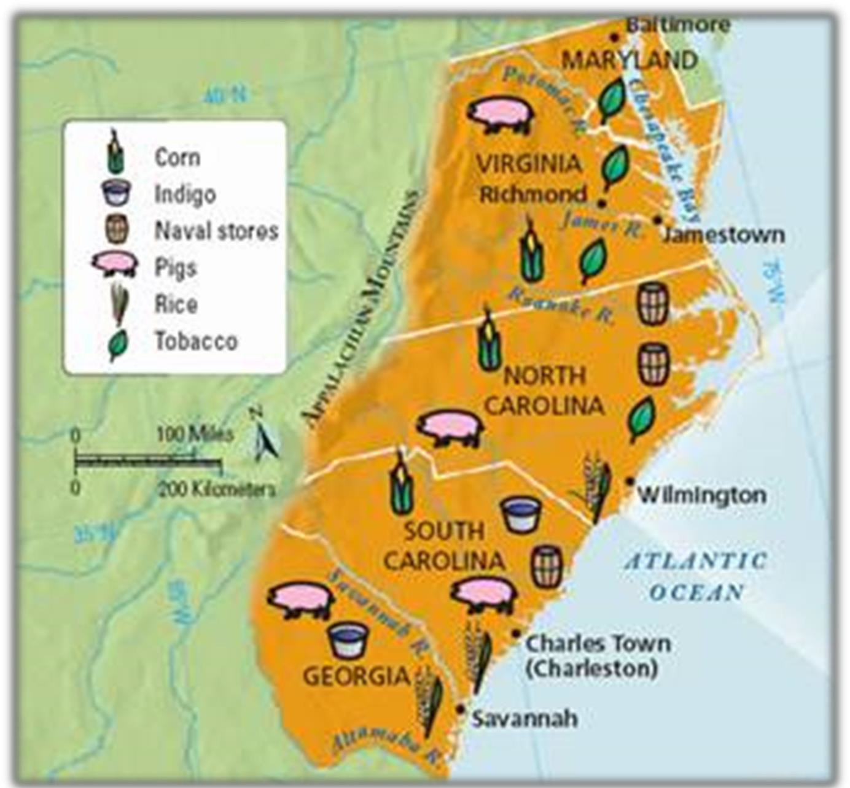
The Southern Colonial Economy

Slide 5
Theme 2
Society in the seventeenth- century Chesapeake—consisting of Virginia and Maryland—experienced low life-expectancies (largely due to disease), dependence on indentured servitude, weak family life, and a hierarchical structure that was dominated by planters at the top over the masses of poor white and black slaves at the bottom.

Slide 6
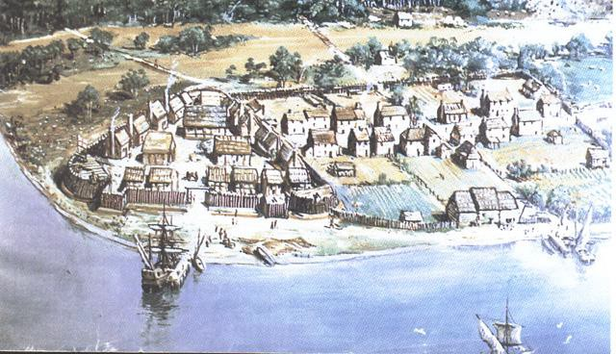
Jamestown
1st Permanent English Settlement - 1607

Slide 7


Motivations…
Promise of gold, conversion of Amerindians, new passage through N. America to the East Indies
Funded by a joint-stock company a
company whose stock is owned by a group of shareholders
shareholders divide the profits in proportion to their investment
forerunner of the modern corporation & tied to the development of capitalism
personal financing risky – ex: Raleigh lost $100,000

Slide 8


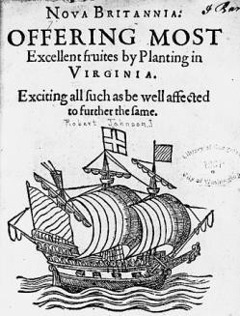
The Charter of the Virginia
Company
From King James I: Guaranteed to colonists the same
rights as Englishmen as if they had stayed in England.
This provision was incorporated into future colonists’
documents.
Colonists felt that, even in the Americas, they had the rights of Englishmen!
(foundation for American liberties: rights extended to
other colonies)

Slide 9

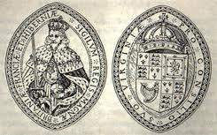
London company formed – divided
into Plymouth & Virginia Companies
Whichever settled its claim first got 100 miles into the
other’s territory
December 1606 - Godspeed, Susan Constant, and
Discovery leave England
May 14, 1607 -104 settlers
Indian attack (Powhatan) on May 26
only 38 left alive after the first six months - death rates of 1/2 to 1/3 were not uncommon in colonizing - settled in a low swampy area

Slide 10
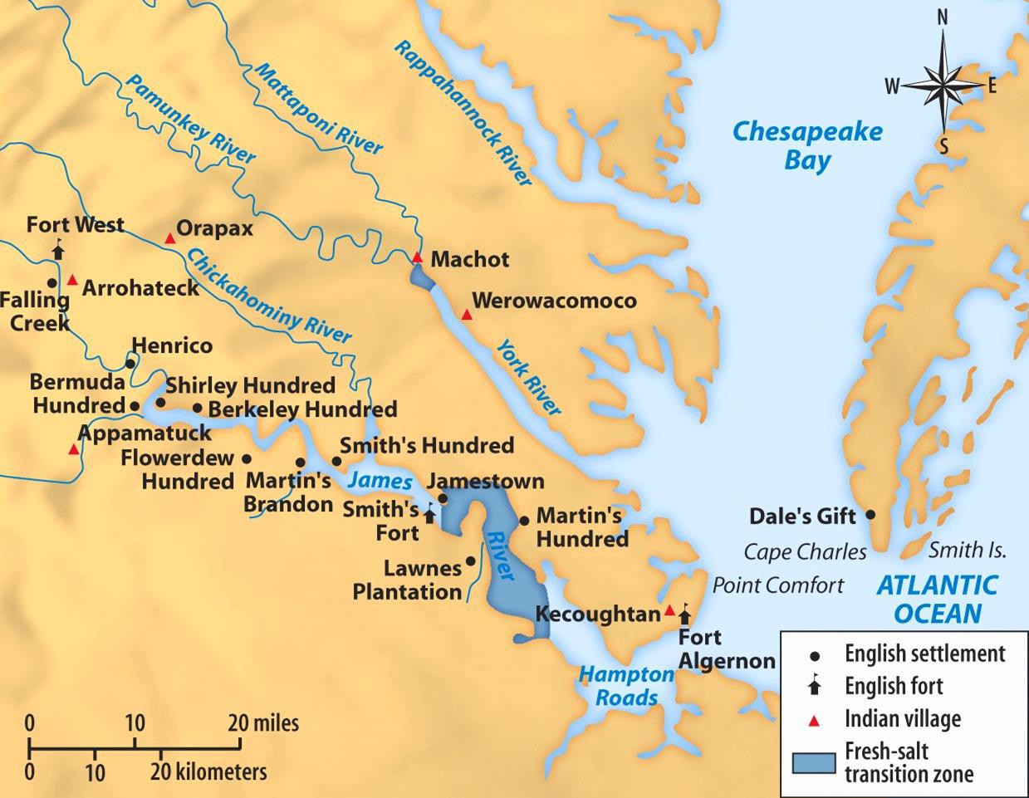
Chesapeake Bay
Geographic/environmental problems??

Slide 11
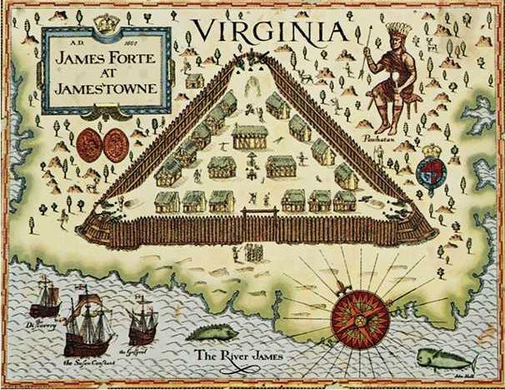
Jamestown Fort & Settlement Map

Slide 12
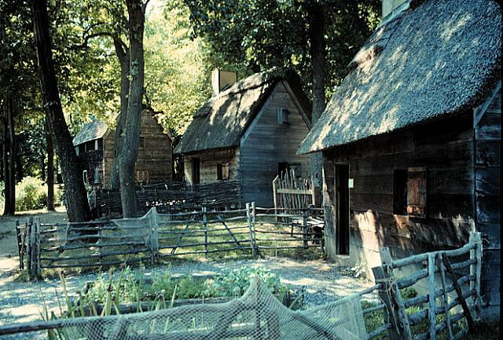
Jamestown Housing

Slide 13
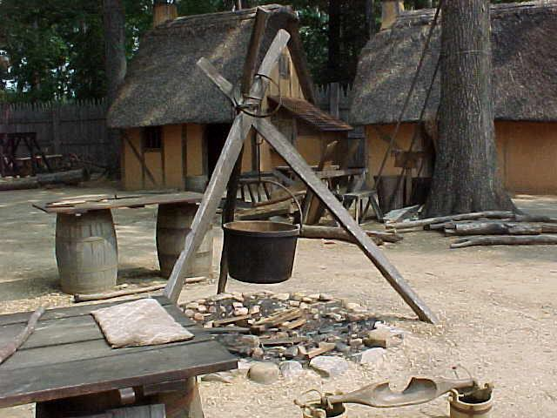
Jamestown Settlement

Slide 14
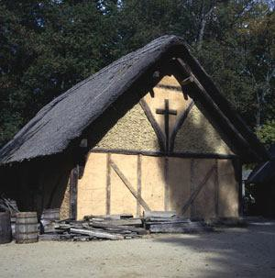
Jamestown Chapel, 1611

Slide 15
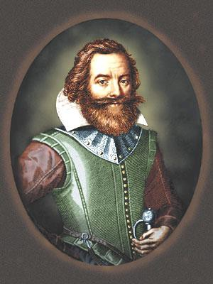
Captain John Smith: The Right Man for the Job??
There was no talk…but dig gold, wash gold, refine gold, load gold…

Slide 16


John Smith
Provides the early leadership and discipline necessary to make the colony successful
basic problem was the
expectation of easy gold
no work no eat policy
skillful Indian relations
periodically resupplied but continued to have problems
  no private property
  harsh military discipline - employees of the company marched to and from the fields twice a day to the beat of a drum
  lack of a cash crop

Slide 17

Starving time 1609-1610
Smith had left the colony
“Gentlemen” colonists would not work themselves
Settlers wasted time looking for gold instead of hunting or farming
reduced to eating dogs, cats, rats, mice, snakes, toadstools, horsehide, and the corpses of dead men and salted, or “powdered,” women

Slide 18
Starving time 1609-1610
1610 - relief expedition under new Governor Thomas Gates finds the men so pitiful they load up to go back to England
Military Leader Baron De La Warre (Robert West) intercepts them and forces them back to work - has ample supplies and 300 men
continued hard times, but optimistic leadership

Slide 19

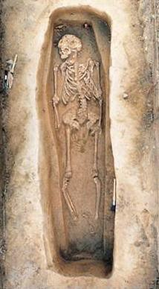
High Mortality Rates: Some Stats.
The “Starving Time”:
1607: 104 colonists
By spring, 1608: 38 survived
1609: 300 more immigrants
By spring, 1610: 60 survived
1610 – 1624: 10,000
immigrants
1624 population: 1,200
Adult life expectancy: 40 years
Death of children before age 5: 80%

Slide 20


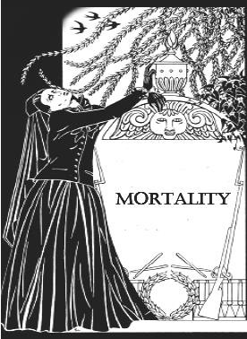
“Widowarchy”
High mortality among husbands and fathers left many women
in the Chesapeake colonies with unusual autonomy and wealth!

Slide 21









Why was 1619 a pivotal year for the Chesapeake
settlement?

Slide 22
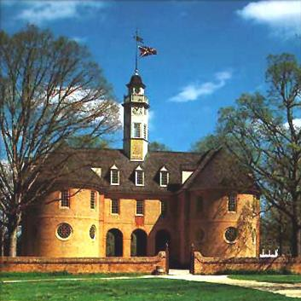
Virginia
House of Burgesses, 1619
Colonial Williamsburg

Slide 23


House of Burgesses
The House of Burgesses assumed the role of
the House of Commons in England
  Control over finances, militia, etc.
By the end of the 17^{c}, H of B was able to initiate legislation
A Council appointed by royal governor
  mainly leading planters
  functions like House of Lords
  high death rates ensured rapid
turnover of members

Slide 24

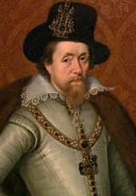
Virginia Becomes a Royal Colony
James I grew hostile to Virginia
  he hated tobacco
  he distrusted the House of Burgesses which he called a seminary of sedition
1624 → he revoked the charter of the bankrupt VA
Company
  Thus, VA became a royal colony, under the king’s direct control!
"loathsome to the eye, hateful to the
nose, harmful to the brain,
dangerous to the lungs“ – James I

Slide 25
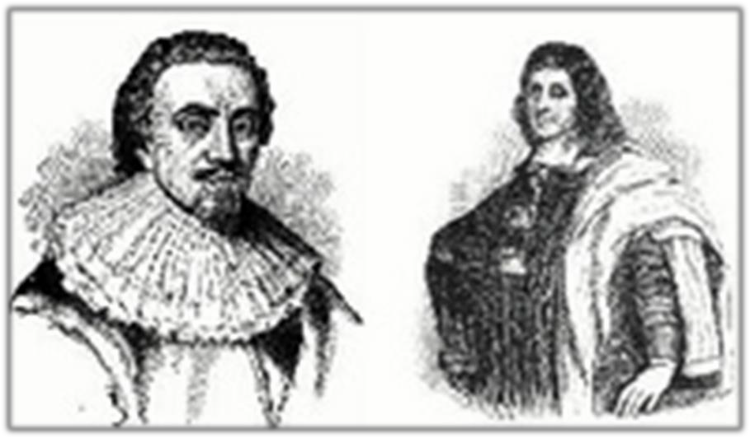
Maryland (1634)
Sir George Calvert (Lord Baltimore) Sought a haven for Catholics in the New World
Act of Toleration (1649)

Slide 26
Maryland Act of Toleration, 1649
That whatsoever person or persons within this Province and the Islands thereunto helonging shall from henceforth blaspheme God, that is Curse him, or deny our Saviour Jesus Christ to bee the sonne of God, or shall deny the holy Trinity the father sonne and holy Ghost, or the Godhead of any of the said Three persons of the Trinity or the Unity of the Godhead, or shall use or utter any reproachfull Speeches, words or language concerning the said Holy Trinity, or any of the said three persons thereof, shalbe punished with death and confiscation or forfeiture of all his or her lands and goods to the Lord Proprietary and his heires.

Slide 27
… Be it Therefore also by the Lord Proprietary with the advise and consent of this Assembly Ordeyned and enacted …that no person or persons whatsoever
Significance????
within this Province…thereunto belonging professing to believe in Jesus Christ, shall from henceforth be any ways troubled, Molested or discountenanced for or in respect of his or her religion nor in the free exercise thereof within this Province or the Islands thereunto belonging nor any way compelled to the belief or exercise of any other Religion against his or her consent…
Guaranteed toleration to all Christians but instituted death penalty for anyone denying the divinity of Jesus (Jews and Atheists)

Slide 28


Culture Clashes in the
Chesapeake
Relations between Indians and settlers
grew worse
General mistrust because of different cultures and languages
English raided Indian food supplies during the starving times
Lord De La Warr had orders to make war on the Indians
  Raided villages, burned houses, took

Slide 29

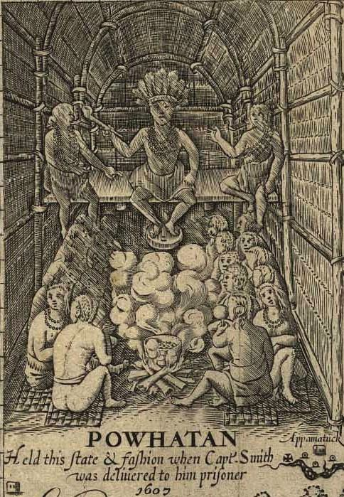
Chief Powhatan
Powhatan Confederacy
Powhatan dominated a few dozen small tribes in the James River
area when the English arrived.
The English called all Indians in the area Powhatans.
Powhatan probably saw the English as allies in his
struggles to control other Indian tribes in the region.

Slide 30
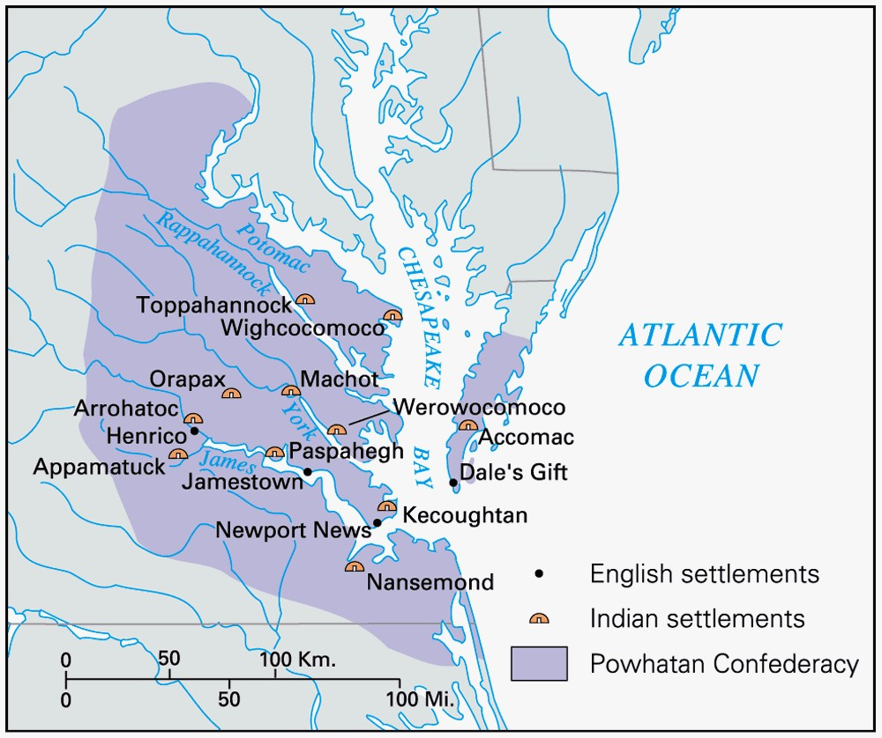
Powhatan Confederacy

Slide 31


Culture Clash in the
Chesapeake
1614-1622 →peace between Powhatans and
the English
  1614 peace sealed by the marriage of Pocahontas to Englishman John Rolfe
1622-1644 → periodic attacks between Indians and settlers
  1622 → Indians attacked the English, killing
347 [including John Rolfe]
  Virginia Co. called for a “perpetual war”
against the Native Americans
    Raids reduced native population and drove them further westward

Slide 32
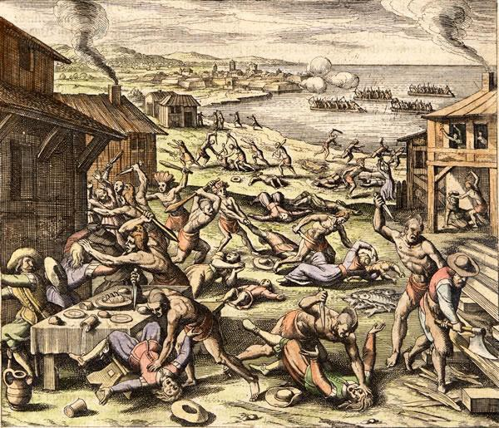


Powhatan Uprising of 1622

Slide 33

Culture Clash in the Chesapeake
1644-1646 → Second Anglo-Powhatan War
  Last effort of natives to defeat English
  Indians defeated again
Peace Treaty of 1646
  Removed the Powhatans from their original land
  Formally separated Indian and English
settlement areas

Slide 34
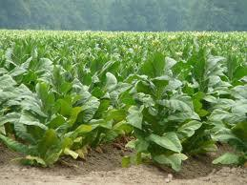
Tobacco makes a Permanent
gold
-- John Rolfe, 1612

Slide 35


Virginia: “Child of Tobacco”
What was Tobacco’s effect on VA’s economy?
vital role in putting VA on a firm
economic footing
ruinous to soil when continuously planted
chained VA’s economy to a single
crop
tobacco promoted the use of the
plantation system
a. need for cheap, abundant labor

Slide 36

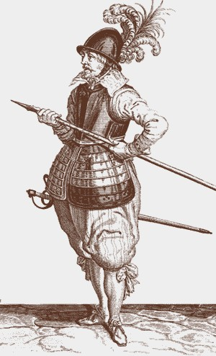
Tobacco Makes A Permanent settlement
John Rolfe: introduces new strain of tobacco and becomes major reason for Virginia's survival…”Colony built on smoke.”
First Africans arrived in Virginia in 1619 an indentured servants
White indentured servants were more predominant until late-17th century
Plantation system emerges

Slide 37


Indentured Servitude
Headright System:
  Each Virginian got 50 acres for each
person whose passage they paid
Indenture Contract:
  5-7 years
  promised “freedom dues” [land]
  forbidden to marry
  1610-1614: only 1 in 10 outlived their
indentured contracts!

Slide 38
Outcome of “Headright” system
Landowners gained 50 acres of land per payment for each laborer’s passage
By 1700, ¾ of European Immigrants to VA & MD came as indentured servants
Some landowners turned their
investments in labor into
vast estates.
Most indentured servants never escaped poverty
Expansion of plantations up river valleys provoked Indian attacks
Led To Bacon’s Rebellion (1676)

Slide 39
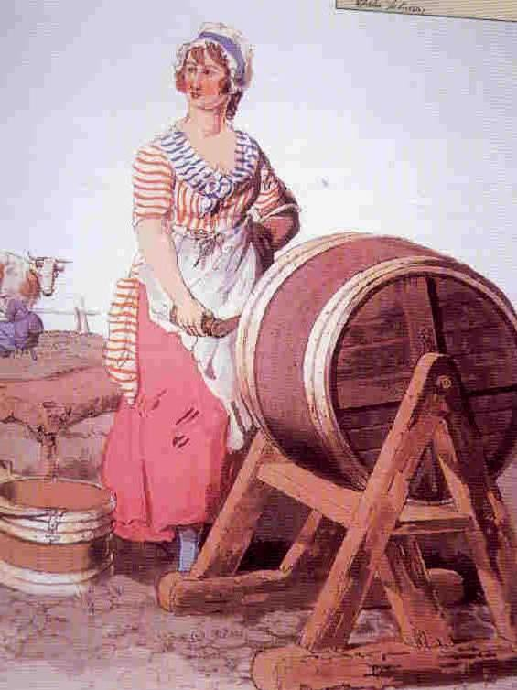
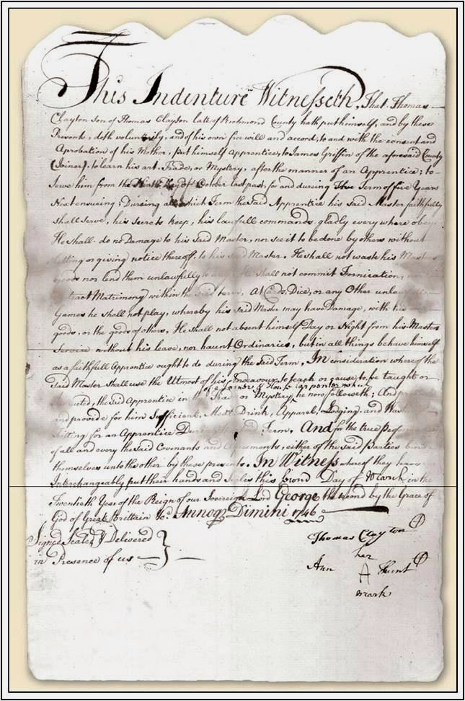
Indentured Servitude
Headright System
Indentured Contract, 1746

Slide 40


Frustrated Freemen
Late 1600s → large numbers of young, poor, discontented men in the Chesapeake area
  Little access to land or women
for marriage
1670 → The Virginia Assembly
disenfranchised most landless men!

Slide 41

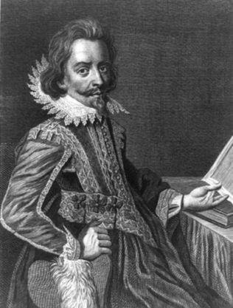
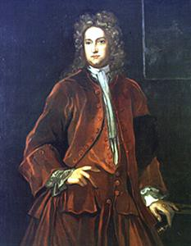






Nathaniel Bacon’s Rebellion: 1676
Led 1,000 Virginians in a rebellion against Governor Berkeley
Rebels resented Berkeley’s
close relations with Indians
  Berkeley monopolized the fur trade with the Indians
  Berkley refused to retaliate for Indian attacks on frontier settlements
Nathaniel
Bacon
Governor William Berkeley

Slide 42
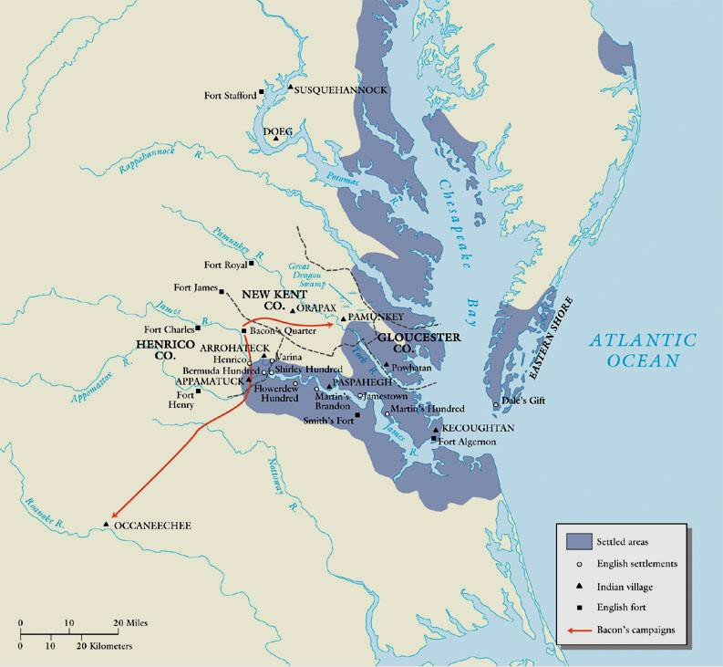
Bacon’s Rebellion: 1676

Slide 43


Bacon’s Rebellion
rebels attacked Indians, whether they were friendly or not to whites
Governor Berkeley driven from
Jamestown
they burned the capital
Rebels went on a rampage of plundering
Bacon suddenly died of fever
Berkeley brutally crushed the rebellion and hanged 20 rebels

Slide 44
RESULTS
The rebellion failed and several rebels were killed.
Significance: Plantation owners sought large numbers of
black slaves instead of indentured servants
White indentured servants were now seen as too troublesome.
Socio-economic class differences/clashes between rural and urban communities would continue throughout American history.
Planters used racism to manipulate poor whites

Slide 45
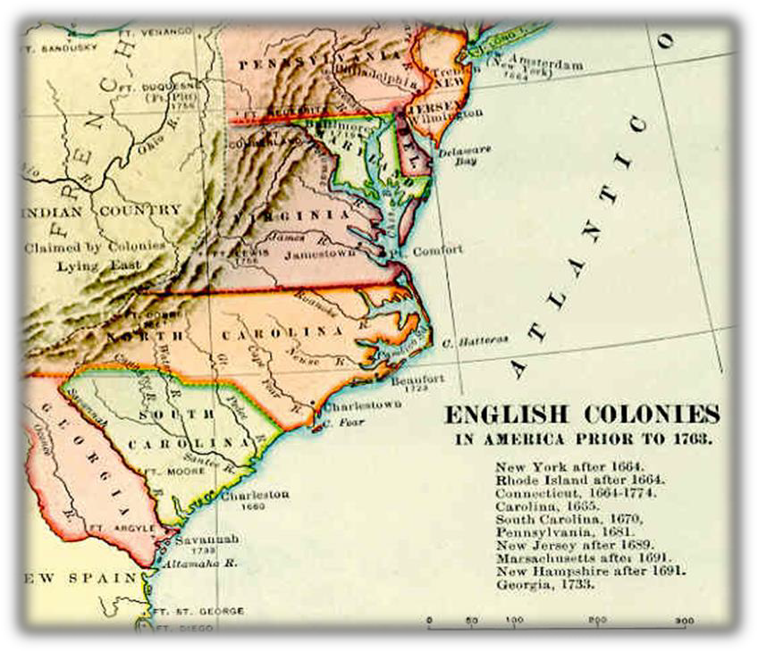
The Southern Colonies…
The Carolinas
Impact of British West
Indies
  Came to rely on British North America for food stuffs
  Some Barbados farmers came to Carolina and brought slaves with them to grow rice

Slide 46
The Southern Colonies…Carolina
founded in 1670 after the
English Civil War (part of the Restoration Colonies)
Goals: grow foodstuffs for sugar plantations in Barbados & export non- English items
Exported Indian slaves to West Indies & New England
Rice production was labor intensive; slavery grew dramatically
By 1719, blacks outnumbered whites
Charles Town (Charleston)-- Aristocratic haven
Turmoil with Spain and
Amerindians
in the South

Slide 47
Southern Colonies
North Carolina (1712)
Refuge for poor whites and religious dissenters from Carolina & Virginia
Among the most democratic and least aristocratic of all the original 13 colonies
Harsh treatment of
Amerindians
Georgia (1733)
last of the 13 colonies
Founded by James Oglethorpe
Founded as a haven for
debtors and buffer between
Spanish Florida
& South Carolina
Savannah: diverse community
Least populous of 13 colonies

Slide 48
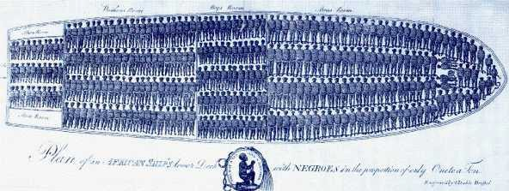
Colonial Slavery…

Slide 49
Colonial Slavery
West African slave trade
Middle Passage-- 10-15 million Africans sent into slavery in the New World, most brought in the holds of ships.
Most came after 1700 (1st in Jamestown-- 1619)
Rising wages in England reduced white immigration to the colonies
1698, Royal African Co. lost its monopoly on slave trade and the slave trade boomed as a result

Slide 50
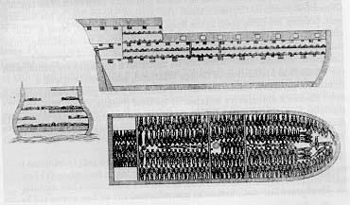
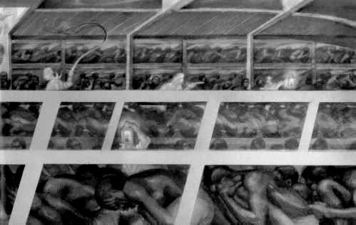
The “Middle Passage”

Slide 51
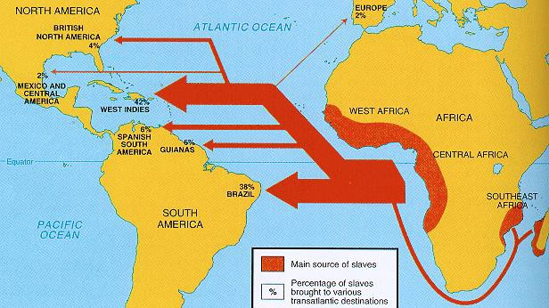
Map: Colonial Slave Trade

Slide 52
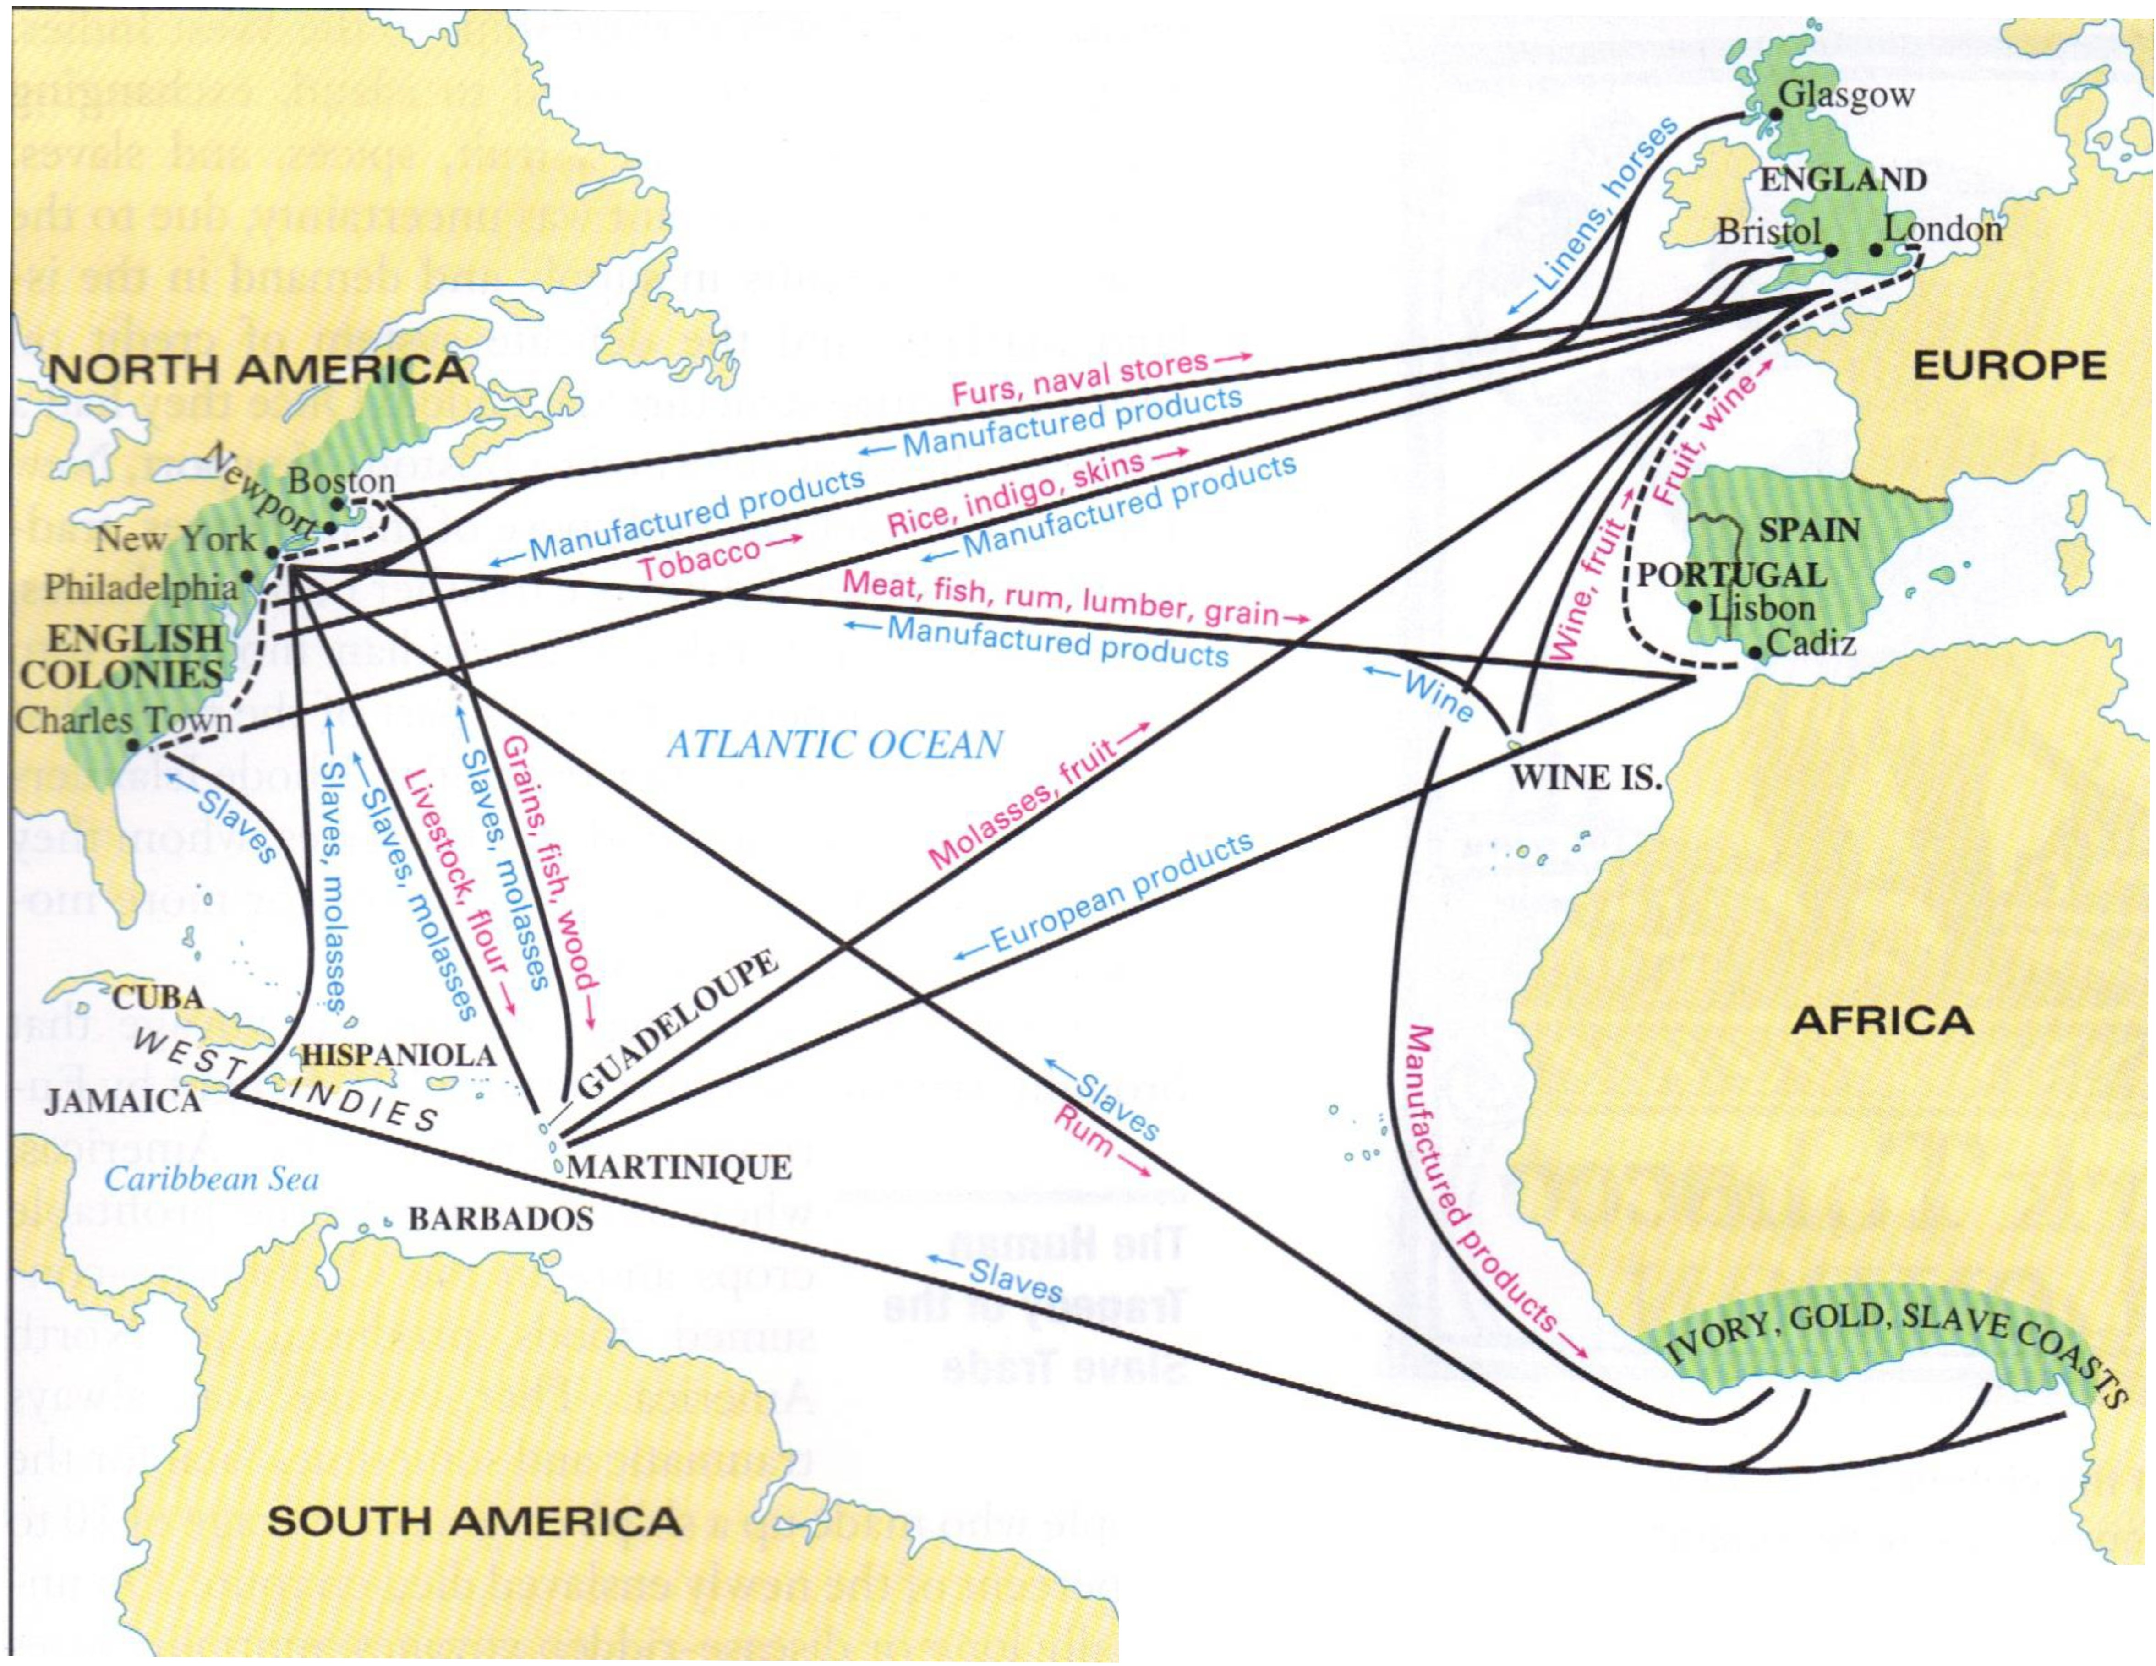
D Major point of trade Major trade route Intercoastal trade route

Slide 53
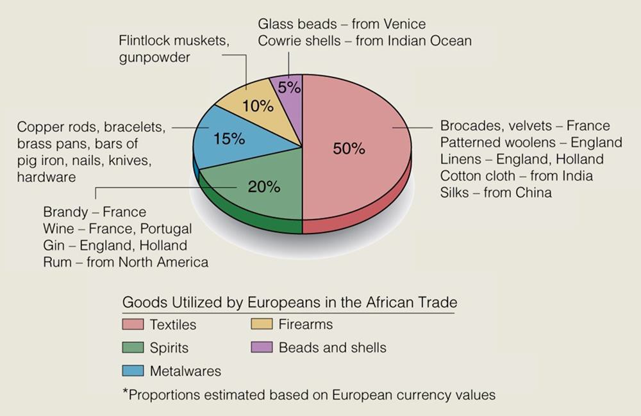
Goods Traded with Africa

Slide 54
slave codes
Blacks and their children property
for life of masters
Crime in some colonies to teach
literacy to slaves
Conversion to Christianity not
grounds for freedom
Slavery = roots of racism in America
Racism used to keep poor whites
from rebelling alongside blacks

Slide 55
Slave Codes…
Slavery harshest in deepest South (especially SC); less deadly in the Chesapeake
Slave culture became a mixture of
American and African folkways

Slide 56
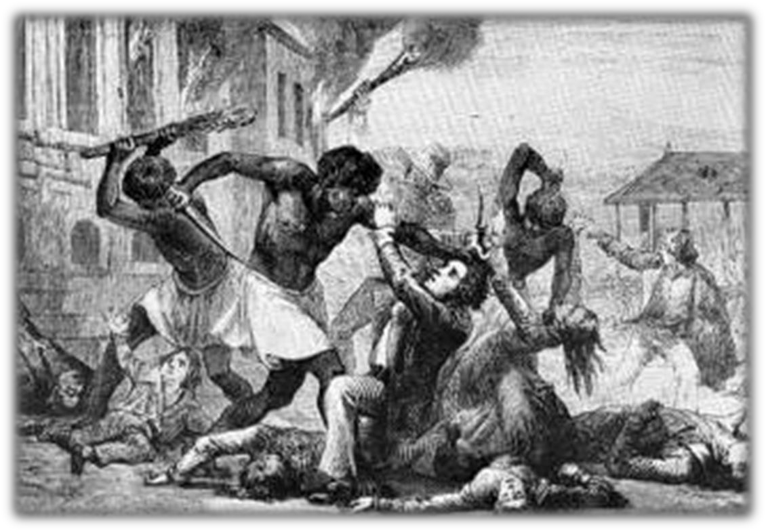
Stono Rebellion (1739)
Most important slave revolt of the 18th century
Slavery became even more tightly regulated and oppressive as a result
  In 1738, Spanish Florida declared that freedom and land would be given to runaways.
  year after the Stono Rebellion, South Carolina passed the Negro Act in 1740, which made it illegal for slaves to gather in groups, earn money, learn to read or raise food, and gave slave owners the right to kill rebellious slaves.

Slide 57
Slave Codes
Virginia, 1639
Act X. All persons except Negroes are to be provided with arms and ammunitions or be fined at the pleasure of the governor and council.
Maryland, 1664
That whatsoever free-born [English] woman shall intermarry with any slave. . . shall serve the master of such slave during the life of her husband; and that all the issue of such free-born women, so married shall be slaves as their fathers were.

Slide 58
Slave Codes…
Virginia, 1667
Act III. Whereas some doubts have arisen whether children that are slaves by birth. . . should by virtue of their baptism be made free, it is enacted that baptism does not alter the condition to the person as to his bondage or freedom; masters freed from this doubt may more carefully propagate Christianity by permitting slaves to be admitted to that sacrament.
Virginia, 1682
Act I. It is enacted that all servants. . . which [sic] shall be imported into this country either by sea or by land, whether Negroes, Moors [Muslim North Africans], mulattoes or Indians who and whose parentage and native countries are not Christian at the time of their first purchase by some Christian. . . and all Indians, which shall be sold by our neighborign Indians, or any other trafficing with us for slaves, are hereby adjudged, deemed and taken to be slaves to all intents and purposes any law, usage, or custom to the contrary notwithstanding.

Slide 59






17th Century Southern Society
Plantation Owners
s
Yeoman Farmers
Landless Farmers
Indentured Servants Slaves
Categories are approximations

Slide 60





18th Century Southern Society
s
Plantation
Owners
Yeoman Farmers
Landless Farmers
Indentured Servants
Slaves
Categories are approximations

