Slide 1
THE MIDDLE COLONIES

Slide 2


New York

Slide 3
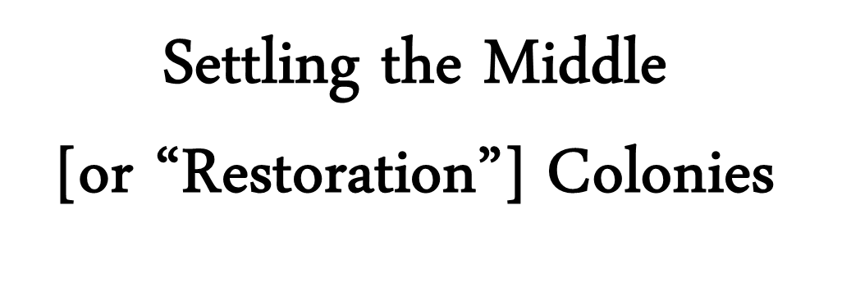

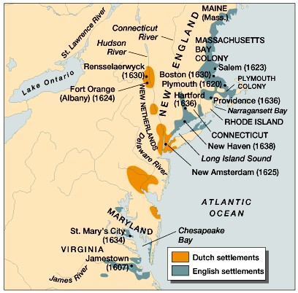
Settling the Middle
[or “Restoration”] Colonies

Slide 4
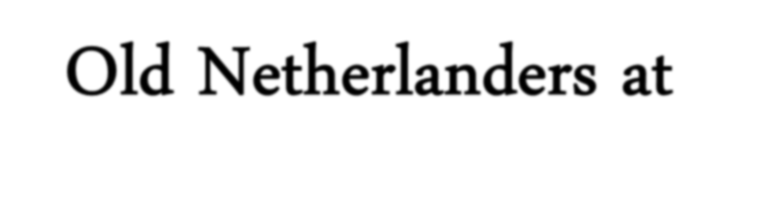

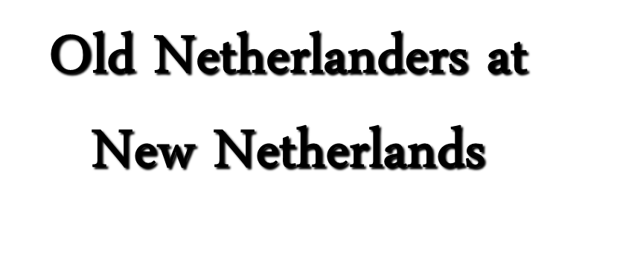

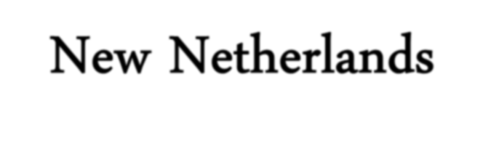
Old Netherlanders at
New Netherlands
1600s → Golden Age of Dutch history.
Major commercial and naval power.
Challenging England on the seas.
  3 major Anglo-Dutch Wars
Major colonial power [mainly in the East Indies].

Slide 5
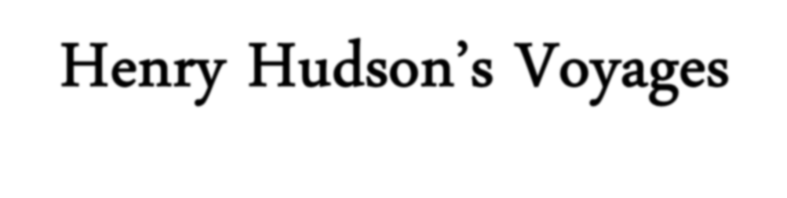



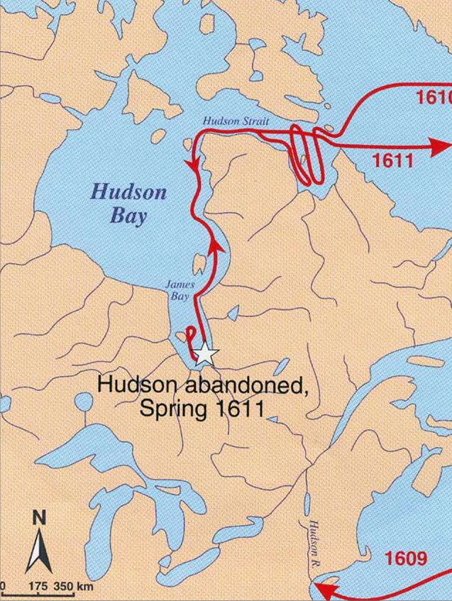
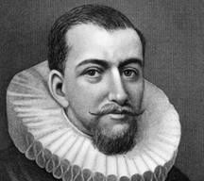
Henry Hudson’s Voyages

Slide 6
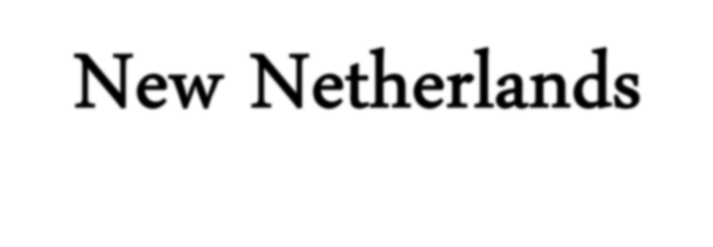

New Netherlands
New Netherlands → founded in the Hudson River area (1623-1624)
Established by Dutch West India Company for quick-profit fur trade.
  Company wouldn’t pay much attention to the colony.
Manhattan [New Amsterdam]
  Purchased by Company for pennies per (22,000) acre.

Slide 7
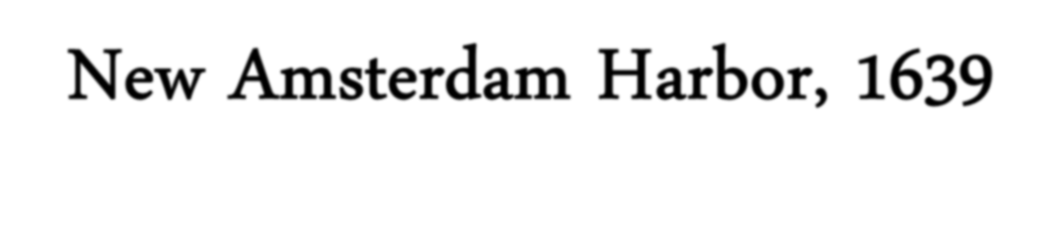


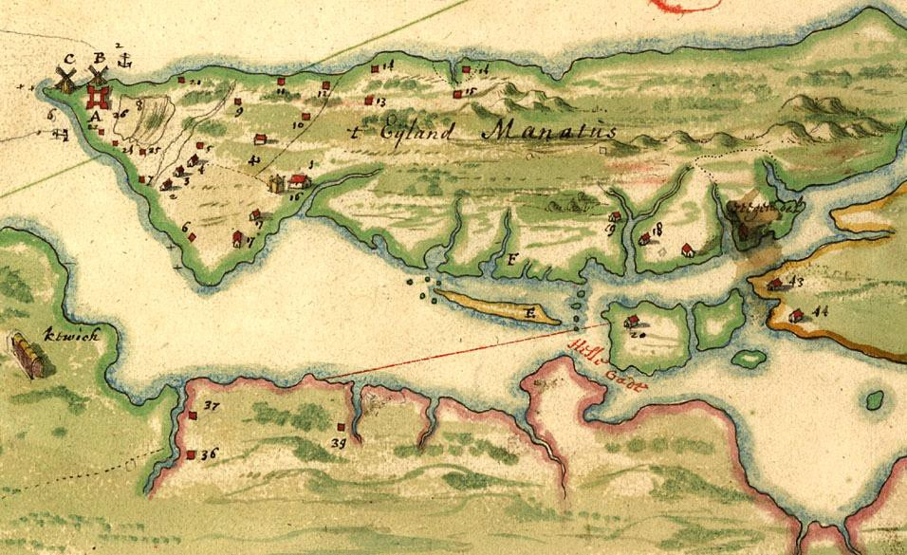
New Amsterdam Harbor, 1639
Company town run in interests of the stockholders.
No interest in religious toleration, free
speech, or democracy.
Governors appointed by the Company were
autocratic.
Religious dissenters against Dutch Reformed Church [including Quakers] were persecuted.
Local assembly with limited power to make laws
established after repeated protests by colonists.

Slide 8
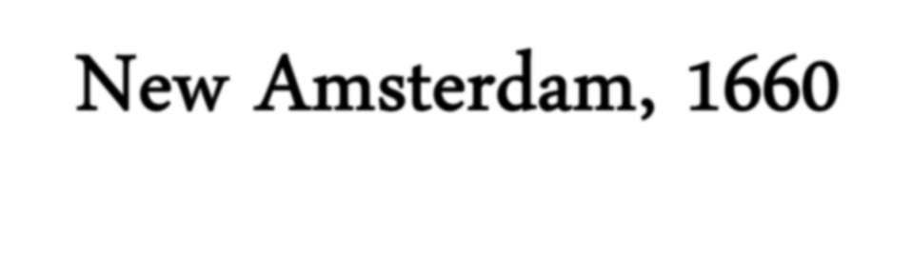



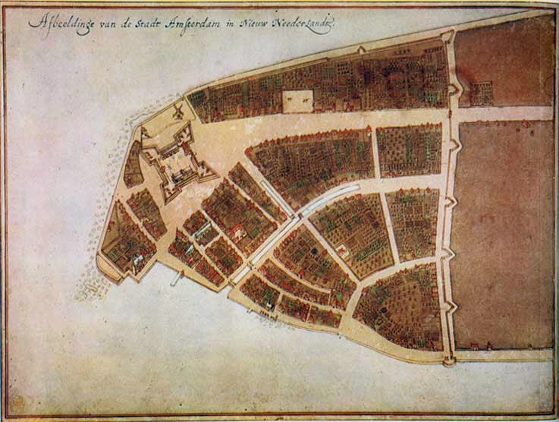
New Amsterdam, 1660
Characteristics of New Amsterdam:
Aristocratic → patroonships [feudal estates granted to promoters who would settle 50 people on them].
Cosmopolitan → diverse population with many different languages.

Slide 9
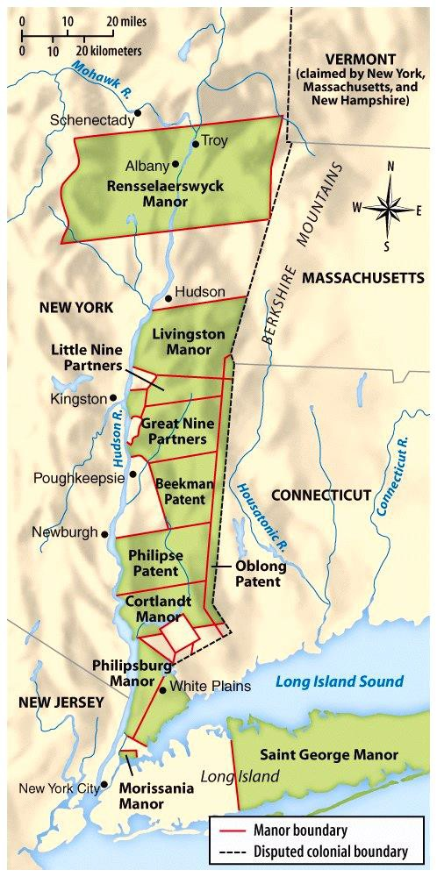
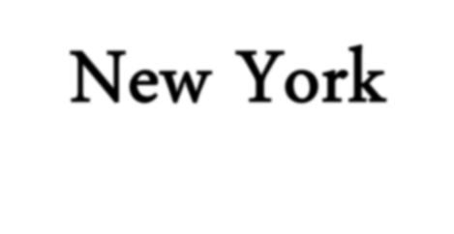
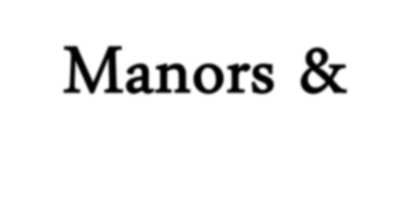
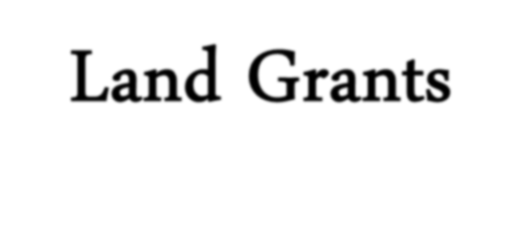


New York Manors & Land Grants
Patroonships

Slide 10
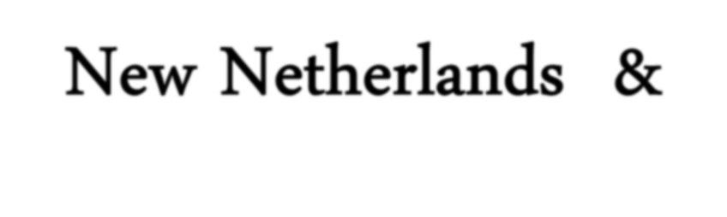
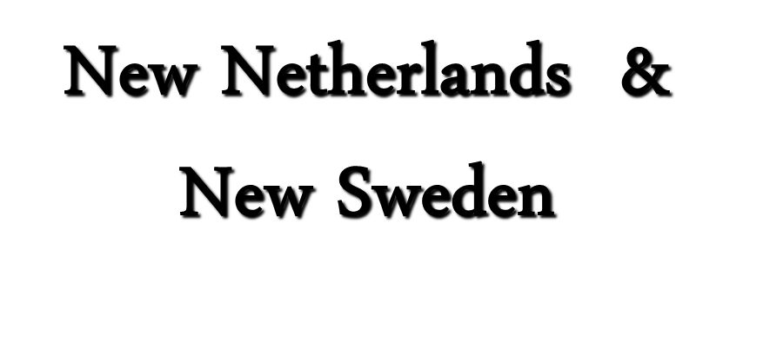

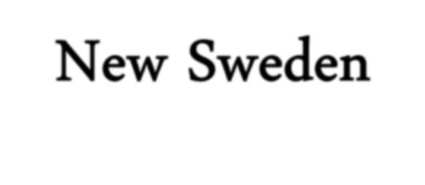
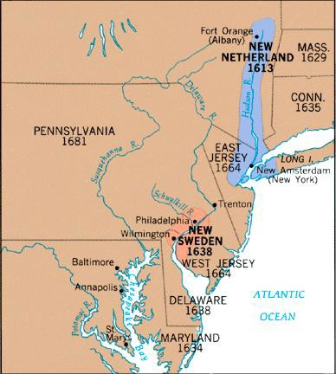
New Netherlands &
New Sweden

Slide 11
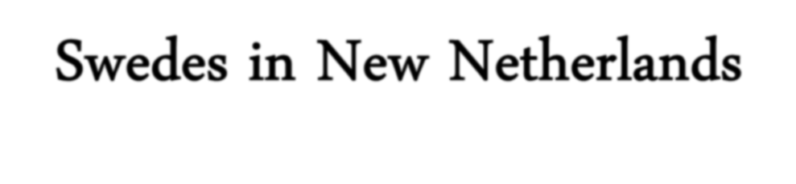

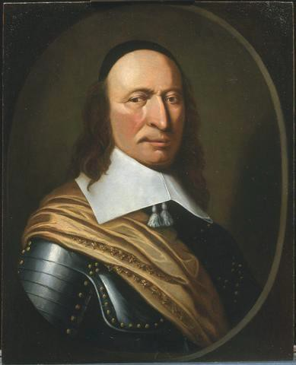
Swedes in New Netherlands
Mid-1600s → Sweden in Golden Age settled small, under-funded colony [called “New Sweden”] near New Netherland.
1655 → Dutch under director-general Peter Stuyvesant attack New Sweden.
Main fort fell after
bloodless siege.
New Sweden absorbed
into New Netherland.

Slide 12
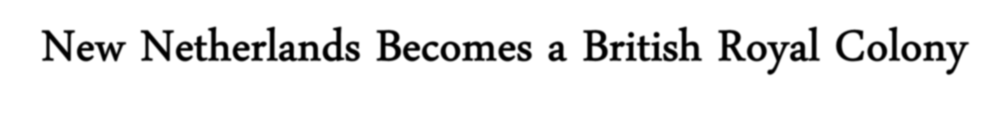



New Netherlands Becomes a British Royal Colony
Charles II granted New Netherland’s land to his brother, the Duke of York, [before he controlled the area!]
1664 → English soldiers arrived.
Dutch had little ammunition and poor defenses.
Stuyvesant forced to surrender without firing a shot.
Renamed “New York”
England gained strategic harbor between her northern & southern colonies.
England now controlled the Atlantic coast!

Slide 13
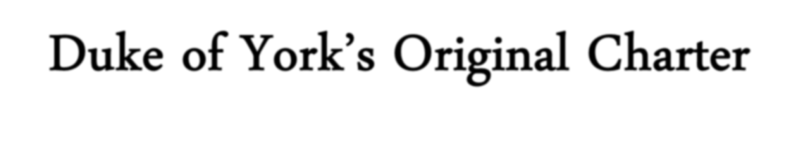

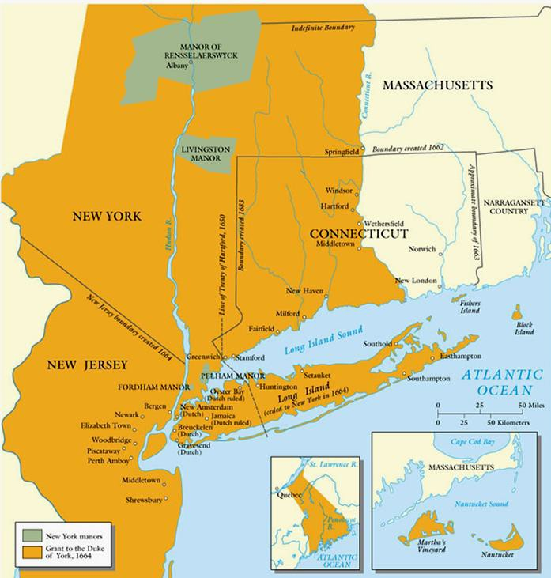
Duke of York’s Original Charter

Slide 14
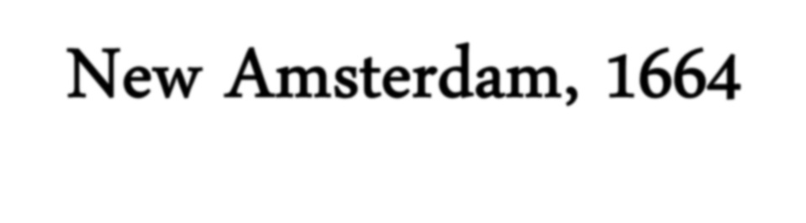

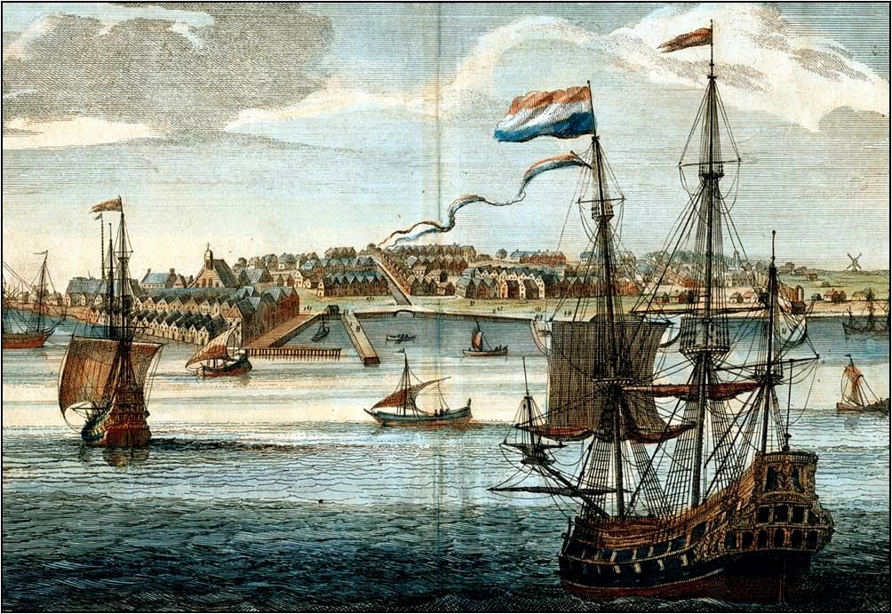
New Amsterdam, 1664

Slide 15
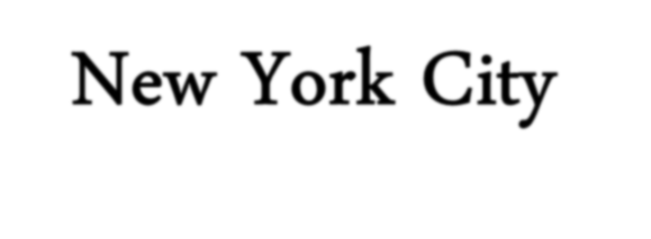
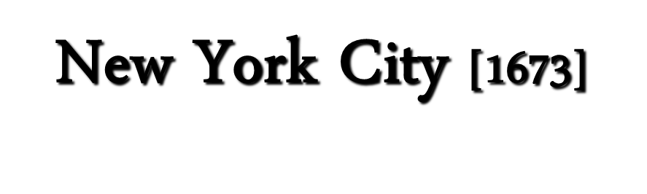
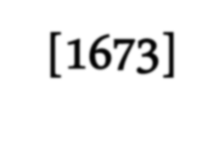


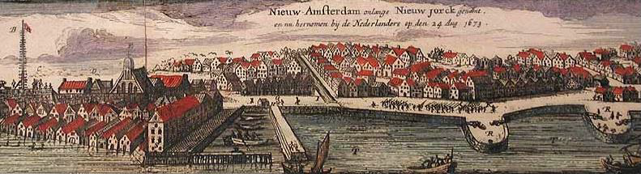
New York City [1673]

Slide 16
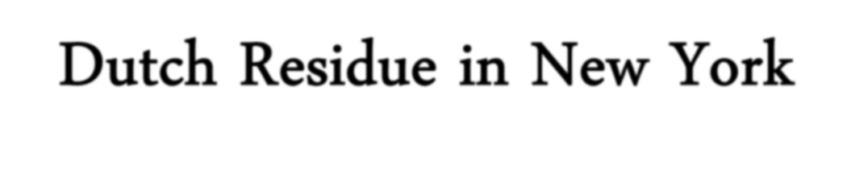






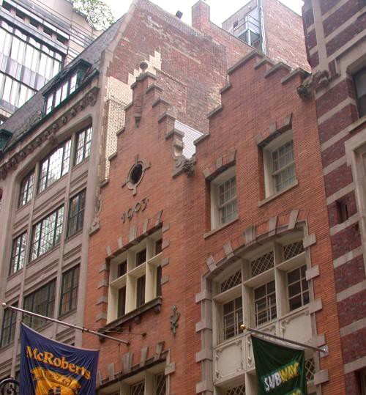


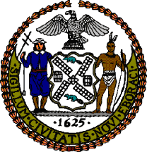



Dutch Residue in New York
Early 20^{c} Dutch Revival
Building in NYC.
New York City seal.
Names → Harlem, Brooklyn Architecture → gambrel roof
Customs → Easter eggs, Santa Claus, waf les,
bowling, sleighing, skating, kolf [golf].

Slide 17
Pennsylvania

Slide 18
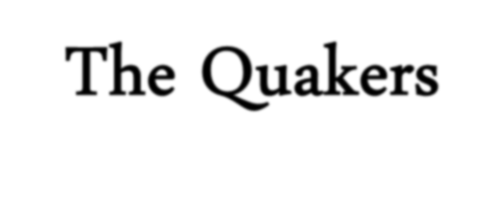

The Quakers
Called Quakers because they “quaked” during intense
religious practices.
They offended religious & secular leaders in England.
Refused to pay taxes to support the Church of England.
They met without paid clergy
Believed all were children of God→ refused to treat the upper classes with deference.
  Keep hats on.
  Addressed them as commoners →
”thees”/“thous.”
  Wouldn’t take oaths.
  Pacifists.

Slide 19
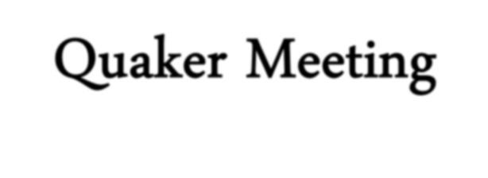


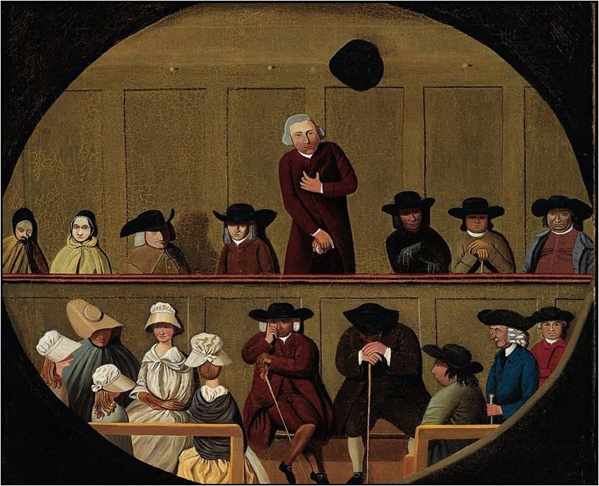
Quaker Meeting

Slide 20
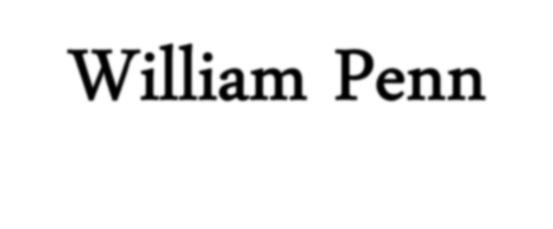

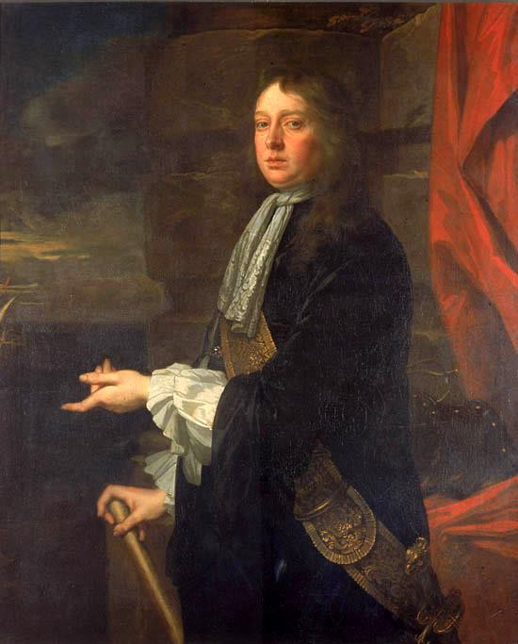
William Penn
Aristocratic Englishman. 1660 – attracted to
the Quaker faith.
Embraced Quakerism after military service.
1681 → he received a grant from king to establish a colony.
This settled a debt the king owed his father.
Named Pennsylvania [“Penn’s Woodland”].
He sent out paid agents and advertised for settlers
→ his pamphlets were pretty honest.
Liberal land policy attracted many immigrants.

Slide 21
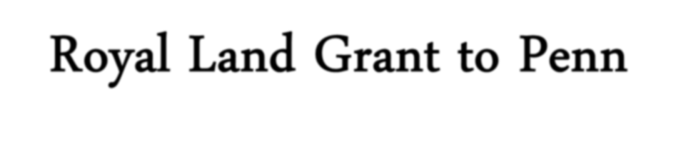

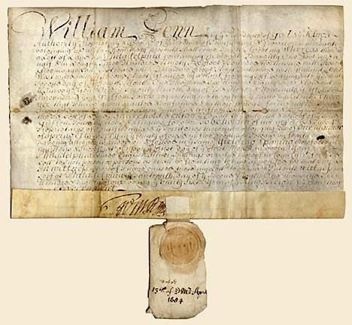
Royal Land Grant to Penn

Slide 22
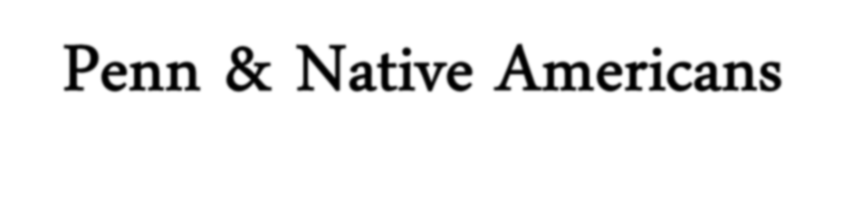

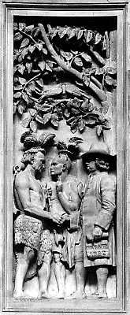
Penn & Native Americans
Bought [didn’t simply take] land
from Indians.
Quakers went among the Indians
unarmed.
BUT…….. non-Quaker Europeans flooded PA
Treated native peoples poorly.
This undermined the actions of
the Quakers!

Slide 23
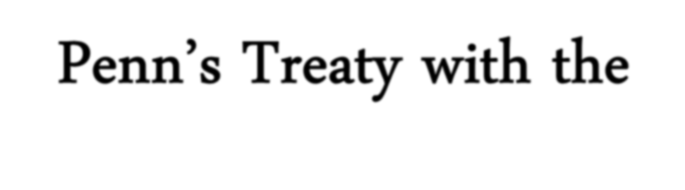
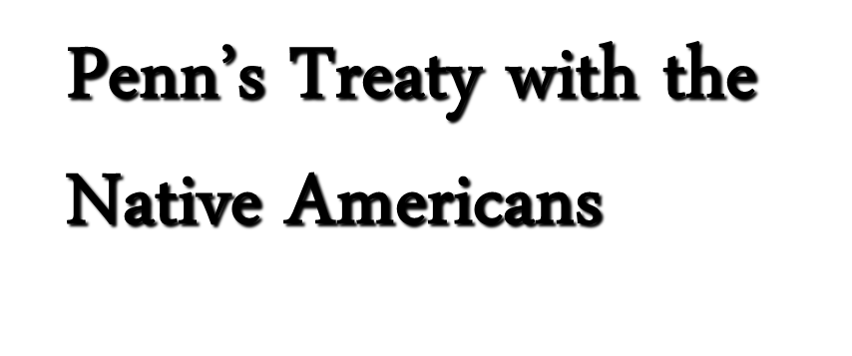

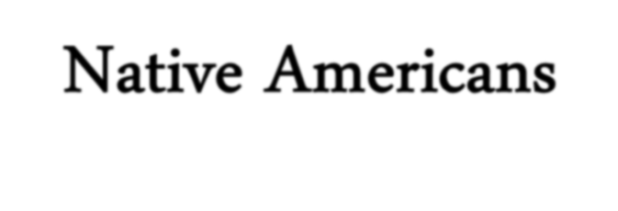
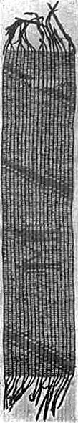
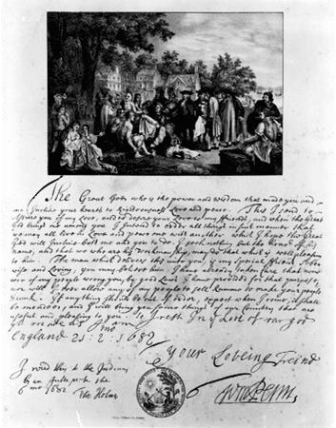
Penn’s Treaty with the Native Americans

Slide 24
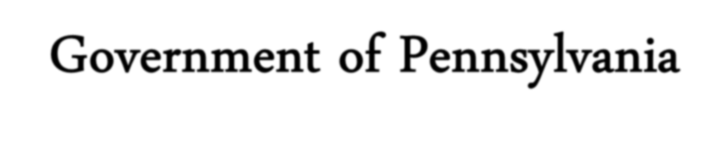

Government of Pennsylvania
Representative assembly elected by
landowners.
No tax-supported church.
Freedom of worship guaranteed to all.
Forced to deny right to vote & hold office to Catholics & Jews by English govt.
Death penalty only for treason & murder.
Compared to 200 capital crimes in England!

Slide 25




Pennsylvanian Society
Attracted many different people
Religious misfits from other colonies.
Many different ethnic groups.
No provision for military defense. No restrictions on immigration.
No slavery!!
“Blue Laws” [sumptuary laws] → against stage plays, cards, dice, excessive hilarity, etc.
A society that gave its citizens economic opportunity, civil liberty, & religious freedom!!

Slide 26





Philadelphia & Boston Compared

Slide 27








Urban Population Growth
1650 - 1775

Slide 28





New Jersey — PA’s Neighbor
1664 → aristocratic proprietors rcvd. the area from the Duke of York.
Many New Englanders [because of worn out soil] moved to NJ.
1674 → West NJ sold to Quakers.
East NJ eventually
acquired by Quakers.
1702 → E & W NJ
combined into NJ and
created one colony.

Slide 29





Delaware — PA’s Neighbor
Named after Lord De La Warr [harsh military governor of VA in 1610].
Closely associated with
Penn’s colony.
1703 → granted its own assembly.
Remained under the control of PA until the American Revolution.

Slide 30



Ethnic Groups

