Slide 1



THE AGE OF
JEFFERSON
1800-1816

Slide 2
QUIZ Chapter 7 pg 144 # 1 - 3

Slide 3
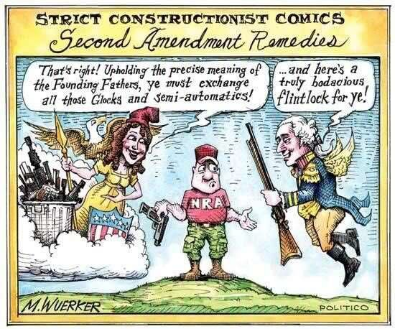
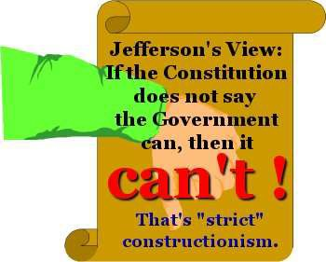
Essential Question
With respect to the Constitution, Jeffersonian Republicans are usually characterized as strict constructionists who were opposed to the broad constructionism of the Federalists. To what extent was this characterization of the two parties accurate during the presidencies of Jefferson and Madison?

Slide 4
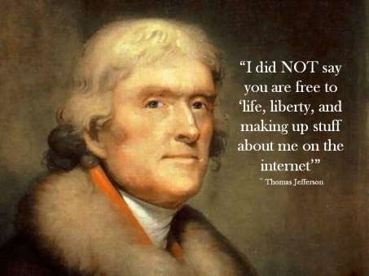
The Jefferson Administration
Continue Neutrality
-did not adhere
Encouraged the sale of western lands
Reduced:
  Military (3,000)
  Bureaucracy
  Power of the federal gov’t
  Repealed excise taxes
  National Debt (did not eliminate)
  Government Jobs eliminate
Maintained:
  National Bank
  Debt-repayment plan

Slide 5
AMSCO pg 145
# 4 - 6

Slide 6
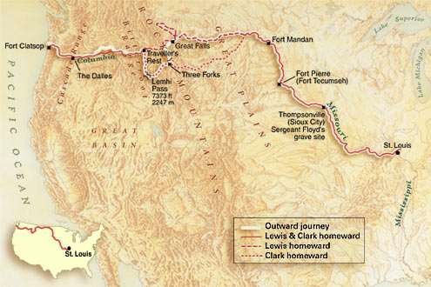
Western Expansion
Importance of Mississippi River
  1800 – secret deal btwn Fr & Sp
  Spain closes New Orleans (1802)
Native Americans were offered a choice of assimilation or moving west of the Mississippi
Governor William Harrison drove
Indians out of Prophetstown
Louisiana Purchase (1803)
  - France doesn’t want land anymore
  Negotiations:
    $10 million for New Orleans and part of Florida
    Reply? $15 million for all of Louisiana
  Constitutional?
  Most territory was west of New
Orleans
  Jefferson wanted a port to provide an
outlet for western crops
  Lewis and Clark Expedition (1804- 1806)

Slide 7
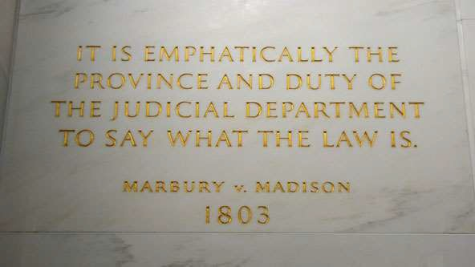
The Marshall Court
Federalist judges still in federal courts – can only be removed through impeachment
Adams’ “Midnight Judges”
  Jefferson – instructs Madison - don’t deliver commissions
  Marbury sues
  Marshall: under Judiciary Act Marbury should receive commission, however the Courts were given more power than the Constitution allows, so unconstitutional – no commission given (no more Federalist judges)
  Establishes judicial review
  Impeachment
    Alien & Sedition Acts
    2 more Federalist judges

Slide 8
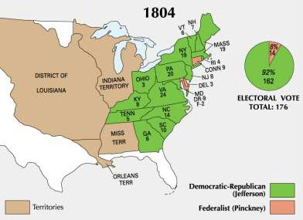
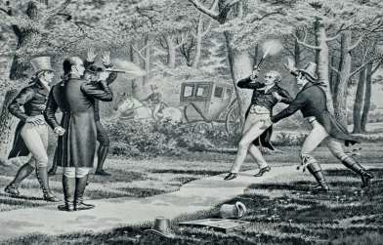
Partisan Squabbles
Election of 1804 (176 – 14) Jefferson as President
  Federalist Conspiracy & Burr vs. Hamilton – run for governor of NY
    Burr: united NY w/NE states then lead the group to secede from the nation
    Abandonment of Dem/Rep values
The Duel - Burr shoots and kills Hamilton
Burr’s Treason – plan to take Mexico from Spain, unite w/ LA with Burr as ruler
  ended in his acquittal because of strict standards that could not be met

Slide 9
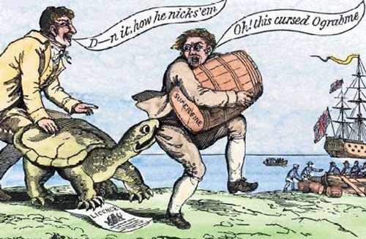
Foreign Affairs
Barbary Pirates
  Precedent – pay tribute
  Navy @ Tripoli (1801- 1805)
  Respect gained
Challenges to Neutrality
  British ship (Leopold) fired on Chesapeake - 3 killed, 4 impressed (1807)
  Embargo of 1807 – effects on economy?

Slide 10
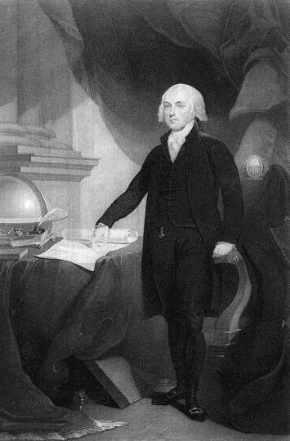
1809-1817
THE PRESIDENCY OF JAMES MADISON

Slide 11
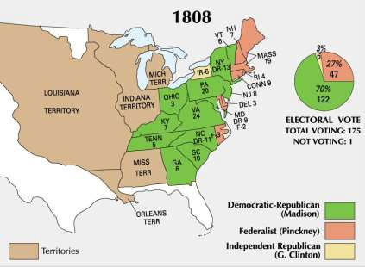
Madison Administration
Election of 1808 – Madison vs. Charles Pinckney (Federalist)
  Embargo leads to Fed seats in Congress
Commercial Warfare
  Non-intercourse Act of
1809
  Macon’s Bill No. 2 (1810)
    Will resume trade
    Formal agreement will lead to no trade with foe
    Napoleon’s Deception
      US cuts off trade w Br until 1811

Slide 12
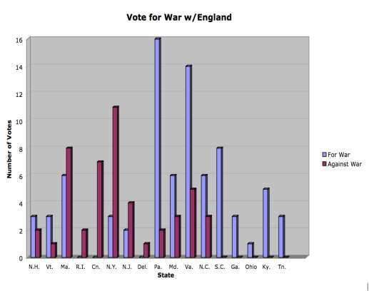
British–American Tensions
Causes:
  Impressment
  America’s desire for Florida
  British trade policy blockading European trade w/ America
  Western Expansion
    Battle of Tippecanoe (1811)- failure of Tecumseh forming Indian confederacy
    British incited Indians to attack American settlements in Indiana
    New States & Congressmen
      “War Hawks”
      Clay & Calhoun
Declaration of War (June,
1812)

Slide 13
AMSCO pg 146 # 7 & 8

Slide 14
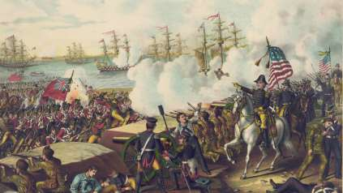
The War of 1812
A Divided Nation
  Election of 1812
    Declining Federalist Party
    James Madison - reelected
  Support for the War
    Southern & Western states, Pennsylvania, Vermont
  Opposition to War
    New England Merchants- making profits from the war between Britain & France also sympathetic to Protestant British
    “Old” Democratic-Republicans & Federalists – saw it as a scheme to gain more support for the new Democratic –Republicans to conquer Florida and Canada to gain more political support
    Old vs New – Old believed the war violated the classic commitment to limit federal power & maintain peace
The War
  Invasion of Canada – 3 part invasion – only spurred retaliation from British
  Perry’s Navy
    Battle of the Thames – led by William Henry Harrison (Gov) - Tecumseh killed – forced British to retreat
    “Old Ironsides”
  Chesapeake Campaign – defeat of Napoleon allowed for British to increase forces in North America
    Burning of Washington
    Baltimore Saved (Ft. McHenry)
  Southern Campaign
    Battle of New Orleans – Andrew Jackson - Florida campaign

Slide 15
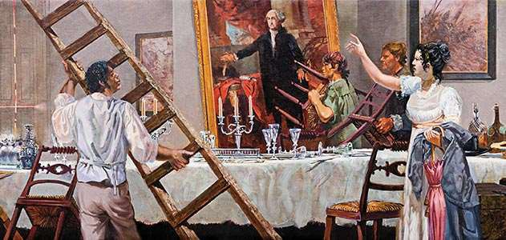
The War of 1812
Hartford Convention
(1814)
New England – secession
2/3 vote on future declarations of war
  Death of the Federalists – “unpatriotic”
Treaty of Ghent (1814- 1815)
  “Not one inch of territory ceded or lost”
  America continued to expand westward as Indian defenses weakened

Slide 16
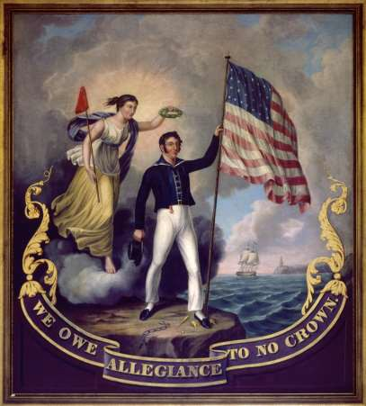
Legacy of the War
US Gains Respect of Other Nations
US accepts Canada as part of British
Empire
Decline and death of the Federalist
Party
– Although precedent for nullification and secession set
Continued decline and decimation of American Indians
Blockade served as catalyst for industrial self-sufficiency
Emergence of war heroes (Jackson, Harrison)
Growth of Nationalism and Western Expansion – “Era of Good Feelings”

