Slide 1
1816-1848
NATIONALISM AND ECONOMIC DEVELOPMENT

Slide 2
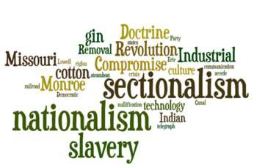
Essential Question
Both nationalism and sectionalism increased during the Era of Good Feelings. How did both of these beliefs develop concurrently, and did one become of greater importance in the economics and politics of the period?

Slide 3
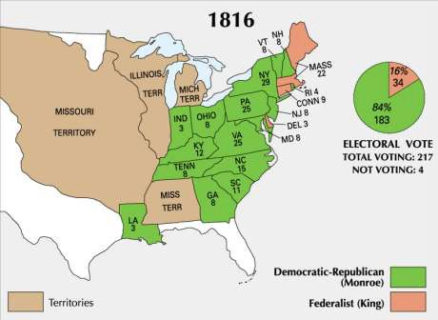
The Era of Good Feelings
Election of 1816
  End of Federalists
  Monroe only loses 1 electoral vote in 1820 (John Q. Adams)
James Monroe
Themes:
  Nationalism
  One party?
  Manifest Destiny
    Western & Economic Expansion

Slide 4
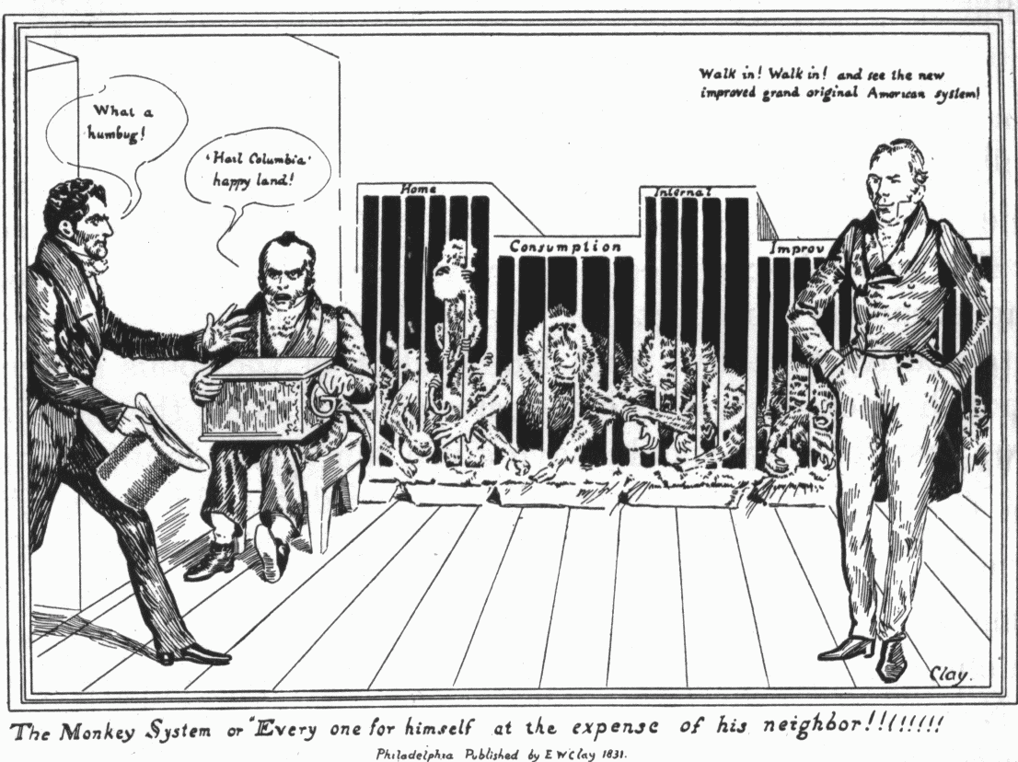
Nationalism
Cultural
– Nationalism & Patriotism emerge in art, literature, and education
Build Infrastructure: roads & canals (internal improvements)
-debate over constitutionality
2. Protective Tariffs
3. National Bank: 2nd BUS
Economic
-Interstate Commerce (see Gibbons vs. Ogden)
Clay’s American System
Tariff of 1816 – raised taxes for sole purpose of protecting American manufacturing
Panic of 1819 – 2nd BUS – tightened credit – banks closed, unemployment, bankruptcies, debtors , foreclosure on western farms
Political
– Split in the Democratic-Republican Party
Judicial – Marshall Court – central government strength
– Marbury vs. Madison
Established principle of judicial review (enforced checks and balances)
Fletcher v. Peck (1810) – 1st time state law declared unconstitutional - contracts
Dartmouth v. Woodward (1819) – privately chartered vs. public
McCulloch v. Maryland (1819)
2nd BUS – in MD, could not tax federal institution
Established implied power of judicial branch
Gibbons v. Ogden (1821)
Extended federal government’s ability to regulate interstate commerce to avoid monopolies

Slide 5
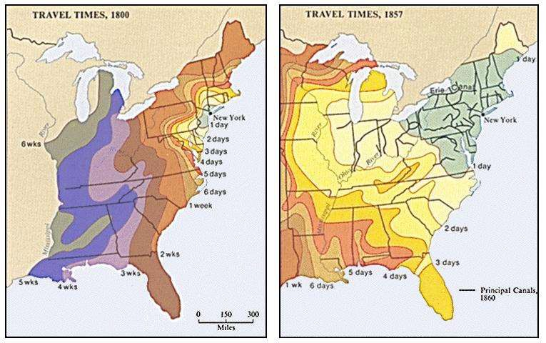
Early Western Expansion
Examples
  Louisiana Territory
  New Orleans Purchase
  Missouri Compromise
  Florida Purchase (Adams-Onis Treaty)
Causes
Acquisition of Indian Land
  Harrison & Jackson
Economic Pressures
  Need for land – cash crops
    Tobacco & cotton
  Improved Transportation
    Canals, roads, steamboats, RR’s
  Immigration
    Irish & German
Issues w/Western Expansion
  “Cheap money” – easy credit from state banks
  Cheap Land
  Improved Transportation

Slide 6
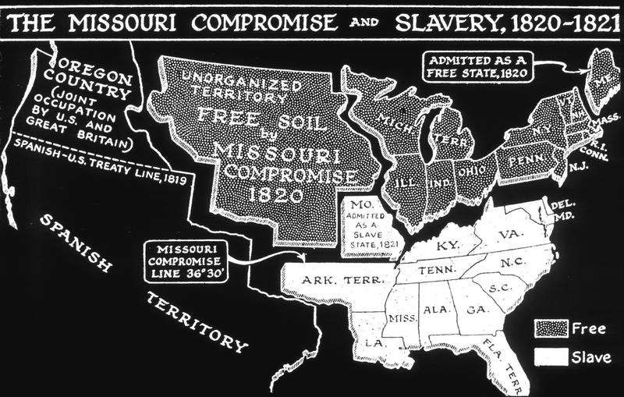
Missouri Compromise (1820)
North-South Balance
  Representation
  Slavery
Tallmadge Amendment
  Prohibit further slavery in Missouri
  Require gradual emancipation
Clay’s Proposals
  Admit Missouri as slave-holding
  Admit Maine as free
  Prohibit slavery above 36º30’
Results:
  Nationalism vs. Sectionalism

Slide 7
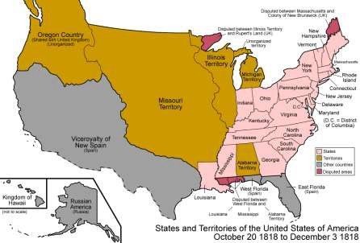
Foreign Affairs
Canada
  Rush-Bagot Agreement (1817)
    Borders between British Canada & US
  Treaty of 1818
    Joint fishing rights, joint occupation of Oregon Country – 10 years, 49th parallel boundary line
Florida
  First Seminole War (1817-1818)
  Florida Purchase Treaty (Adams-Onis Treaty) (1819)
Monroe Doctrine (1823)
  Response to: Russian presence in Alaska, Spanish involvement in Latin America, ties w/British trade
  Impact:
    Declared US position in world
affairs (although unenforceable)

Slide 8
AMSCO pg 168 # 4 - 6

Slide 9
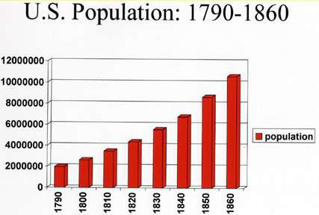
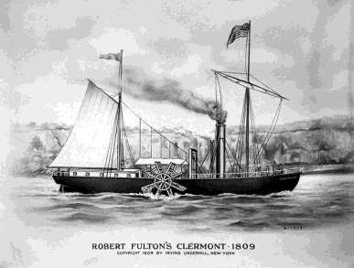
Economic Nationalism
Population Growth
  Doubling every 25 years
Transportation
  Roads (turnpikes)
    National (Cumberland)
  Canals (who did they
benefit?)
    Erie Canal
  Steamboats
    Fulton’s Clermont (1807)
  Railroads
    Largely private lines

Slide 10
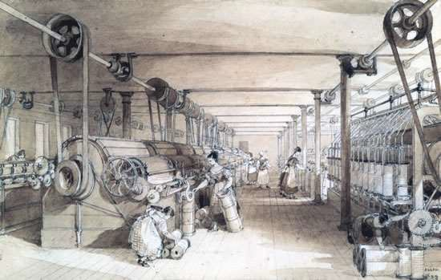
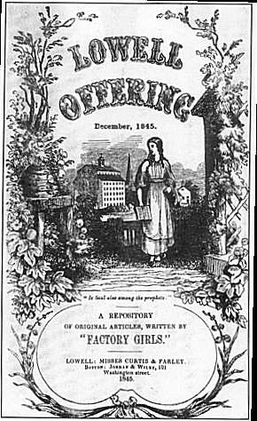
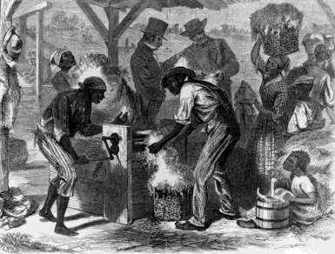
Economic Nationalism (con.)
Industrial Growth
  Mechanical inventions
    Interchangeable parts & the cotton gin (Whitney)
    Water powered spinning
machines
  Factory and Mill System
    Samuel Slater
      NE Emerges as industrial center
    Labor
      Immigrants
      Women & children
» Lowell System
      Weak early unions
Commercial Agriculture
  Cheap land & credit
  Improved transportation
  Birth of “king cotton”

Slide 11
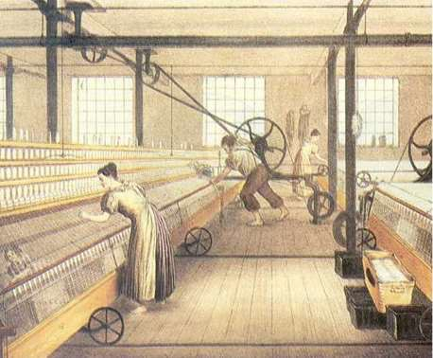
Effects of the Market Revolution
Social
  Increased standard of living
  Immigrants & Nativism
  Women
    Cult of domesticity vs. women in the workplace
    Decreasing family size
  Mobility
    Increasing wealth gap
  Slavery
Economic
  Cottage → Market System
  Rise of Capitalism
Continued Western Expansion
Political
  Second party system created
    Better economy=more voter interest
  Renewed Sectional Struggles
  Reemergence of States’ Rights

