Slide 1
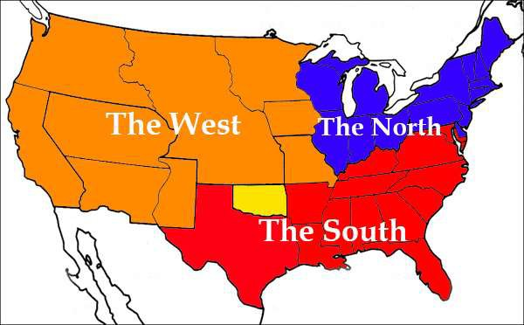
Sectionalism
1820-1860

Slide 2
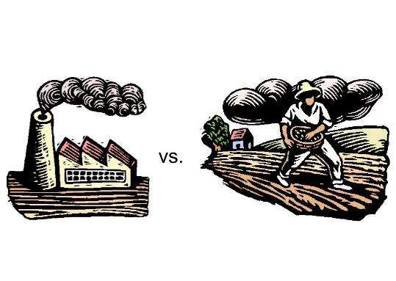
Essential Question
Compare and contrast the characteristics and influences of the three major sections of the United States by the mid-19th century.

Slide 3
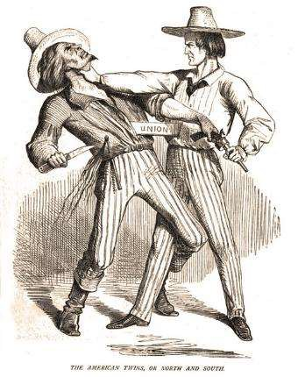
Causes of Sectionalism
Loyalty to region
Social & cultural
differences
Economic differences
Federal vs. States’ Rights

Slide 4
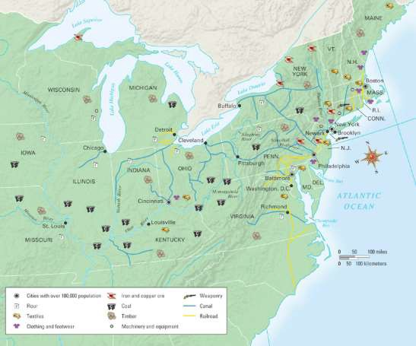
The North
•Northeast, Mid-Atlantic,
and Old Northwest
•Commonalities:
•Bound by transportation
advances
•Industrialization and commercial
farming
•Prohibition of slavery (most)
•Characteristics:
•Most populous
• High birthrate
• Large # of immigrants

Slide 5
The North
•Industrial Northeast
•Organized Labor - factories
National Trades’ Union (1837) -
failure
•Urban Life
expansion of population —>
expansion of slums
  poor sanitation, disease, high
crime rates
•African Americans
1% of population but 50% of free
blacks
2nd class, non-citizens

Slide 6
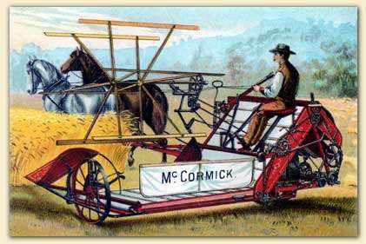
The Agricultural Northwest
Old Northwest (OH, IN, IL, MI, WI, MN)
  Tied to North East as result of:
    military campaigns against Indians
    building of canals and railroads
Agriculture
  New inventions lead to expansion
    McCormick reaper, Deere steel plow
New Cities
  Buffalo, Cleveland, Detroit, St. Louis,
Chicago
    distribution/shipping points

Slide 7
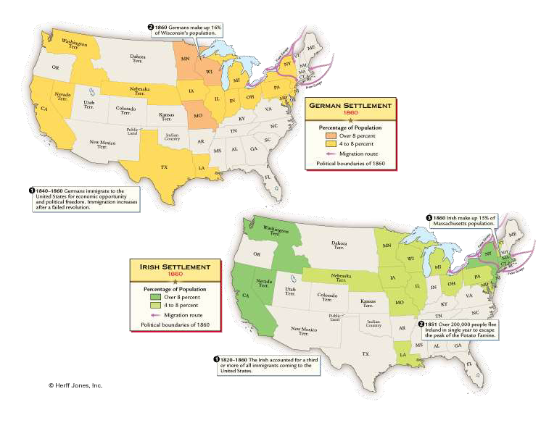
Immigration
Causes of Influx:
  inexpensive and expedited ocean travel
  famines and political unrest (push)
  economic opportunity in U.S. (pull)
Largest Groups:
  Irish
    potato famine
    settled in cities
      NY, Boston, Philadelphia
    identified w/Democratic party
    influence of/on Tammany
  Germans
    Revolutions of 1848 and economic hardships
    settled in rural areas of Old
Northwest
    pro-public education
    anti-slavery

Slide 8
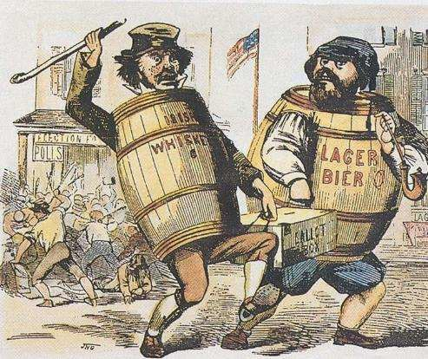
Nativism
Reaction to:
  Immigrant culture:
    Catholicism (Irish)
    Alcohol (Irish & Germans)
    Political strength
Manifestations:
  Supreme Order of the Star
Spangled Banner
  American Party - “Know- Nothings”
  Riots in cities

Slide 9
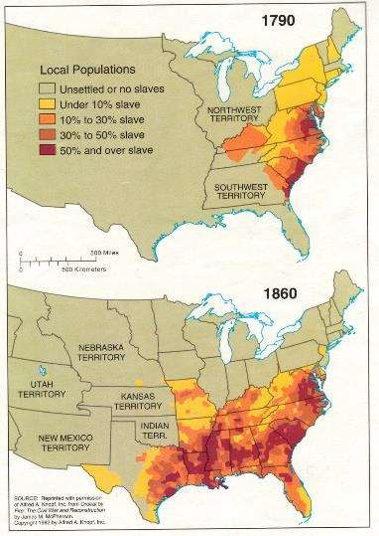
The South
Agriculture and King Cotton
  continued importance of cash crops and
plantation system
  only 15% of industrial production
  impact of cotton gin
Slavery, the “Peculiar Institution”
  Population Growth: 4 million (1860)
    all natural
      slave trade ended in 1808
      although some smuggling occurred
    Higher demand in Deep South
      majority of slaves now on plantations/large farms (opposite of early period)

Slide 10
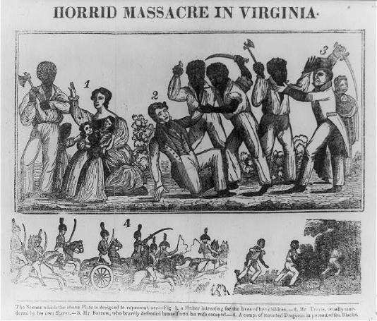
Nature of Slavery
Slave Life
  varied by plantation
    harsh to humane treatment
  development of slave culture
    religion
    slave hymnals
    retention of kinship
Resistance
  Routine: slowdowns, sabotage, escape
  Uprisings/Rebellions:
    Vesey (1822)
    Turner (1831)
Effects:
  Southern States tighten strict slave codes
  Polarized nation:
    Northerners became critical of institution
    Southerners became more defensive

Slide 11
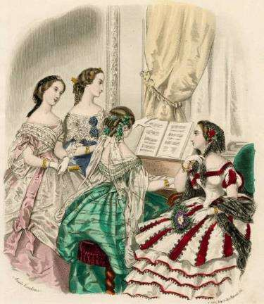
Southern Society
Free African Americans
  Roughly 250,000
  could own property
  could not vote
  had to prove status
White Society
  Rigid Hierarchy
    Aristocracy (Planters)
    Farmers
    Poor Whites
    “Mountain People”
    Cities
      small populations compared to North
Southern Thought
  Education
    higher education only for the wealthy
  Religion

Slide 12
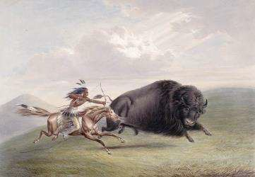
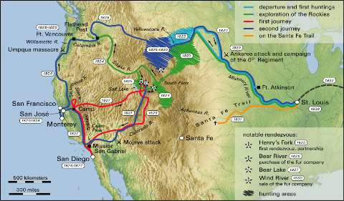
The West
American Indians
  Exodus to Great Plains
    Impact of the Horse
    Major Tribes:
      Cheyenne
      Sioux
The Frontier
  Mountain Men
    Beckwourth, Smith, Bridger
  The Homestead
  White Settlers
    Role of Women – short life span
    Environmental Damage
      land
      wildlife

Slide 13
Advances in technology & Transportation
Development of mechanized textile mills in England and Eli Whitney’s Cotton Gin made Cotton Cloth affordable
Advances in transportation led to more settlement in the West along with increased demands for cotton.

Slide 14
U.S. Manufacturing (1860)
Region | Number of Establishments | Number of Employees | Value of Product
North Atlantic | 69,831 | 900,107 | $1,213,897,518
Old Northwest | 33,335 | 188,651 | $346,675,290
South | 27,779 | 166,803 | $248,090,580
West | 8,777 | 50,204 | $71,229,989

Slide 15
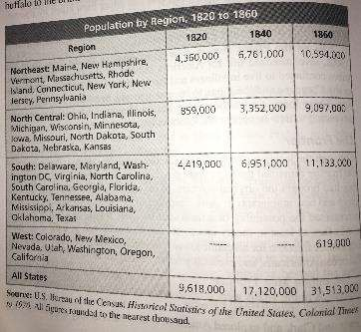
Population and Occupation
Increase surge of Immigration due to developments in transportation
1832
  Germans- West
  Irish- North
Small villages and towns
grew into thriving cities

