Slide 1
1820-1860
SOCIETY, CULTURE, AND REFORM

Slide 2
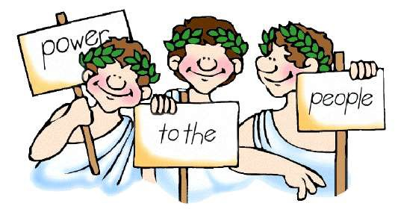
Essential Question
Evaluate the extent to which reform movements in the United States from 1820-1860 contributed to maintaining continuity as well as fostering change in American society.

Slide 3
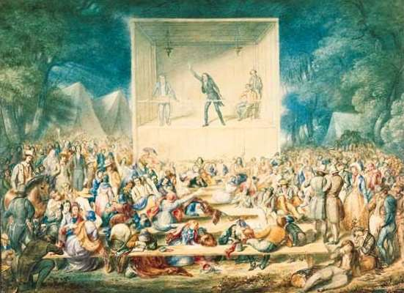
Religion: The 2nd Great Awakening
Causes:
  Reaction to:
    Rationalism/Enlightenment
Ideals – belief in human reason – motivate young men to become evangelical preachers – salvation for all
    Rejection of Puritan foundations – original sin and predestination
  Western expansion – touched off social reform
  Perceived “godlessness”

Slide 4
Religion: The 2nd Great Awakening
Characteristics:
  Camp meetings/revivals
  Grass-roots organization
  Individual salvation: all can be saved, man is inherently good and capable of change, predestination abandoned
  Democratic, egalitarian

Slide 5
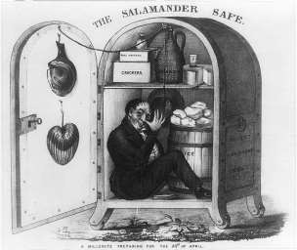
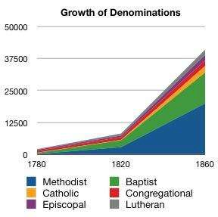
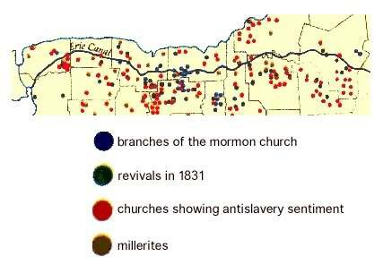
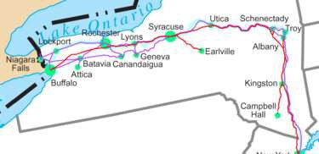

Revivalism Expands
The “Burned Over District”
  New York
    Charles G. Finney
Expansion of Denominations
  Baptists and Methodists
Offshoots:
  Millennialism/Millerites
    7th Day Adventists
  The Mormons
    Joseph Smith, Bringham Young
    NY → OH → MO → Nauvoo → SLC
    Moved out West to escape persecution
    Polygamy

Slide 6
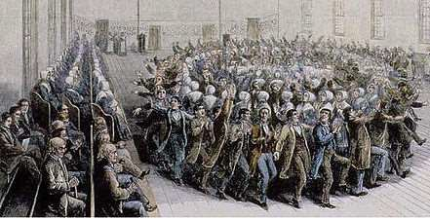

American Culture
Transcendentalism
  Characteristics:
    Challenged materialism of society that resulted from the rapid industrialization of the United States - artistic expression more important than material wealth
    Also helped spark reform movement:
inherent goodness of man
    Didn't love organized religions but still
encouraged spirituality
    Mystical and intuitive self-discovery to go beyond conventional understanding
  Examples:
    Emerson
      Reject European traditions and create a distinct American culture with an individualistic and nationalistic spirit; self- reliance and independent thinking; Spiritual matters over material ones; abolitionist
    Thoreau
      “On Civil Disobedience,” and Walden
      Early advocate of nonviolent protest and
disobeying unjust laws
    Margaret Fuller- advocate of women’s rights

Slide 7
American Culture
Utopian Experiments
  Brook Farm – bridge the gap
  The Shakers – held property in common, men and women were kept strictly separate (forbade marriage and sexual relations) - egalitarian but celibate
  New Harmony – secular experiment- utopian and socialist community
  Oneida – rejected demands of the male lust by practicing open marriage, planned reproduction, and communal child rearing ("free love")
  Fourier Phalanxes – work and housing communities – failed – people too individualistic

Slide 8
American Culture
Arts and Literature
  Romanticism/Romantic Age: a movement with its roots in Europe; art and literature that focused on emotion and feeling, the innate goodness of man, individuality, heroism, and beauty of the natural world
  Painting
    Hudson River School
      Cole and Church
  Architecture
    Greek revival
  Literature
    Irving, Cooper, Hawthorne, Melville
      Cooper's Leatherstocking Tales glorified the frontiersman as nature's nobleman
      Hawthorne's The Scarlett Letter questioned American intolerance and conformity
      Melville's Moby Dick reflected the theological and cultural conflicts of the era
  Performance
    Minstrel shows

Slide 9
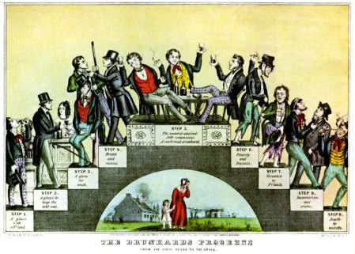
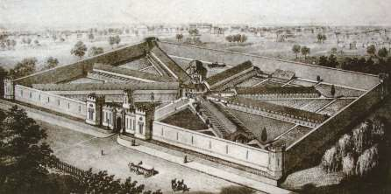
Reforming Society
Temperance
Opposed by German/Irish immigrants
and Catholics
Supported by women (wives
especially) and Protestants
Generally had more impact in northern and western states, where the antebellum reform movement was largely, than in the South
Causes
  Overconsumption/alcoholism (5 gal/person)
  Domestic violence
  Absenteeism/loss of jobs
  Nativism
Organizations and Methods
  American Temperance Society
  Neal Dow and the Maine Law

Slide 10
Reforming Society
Penal Reform
  Punishment vs. Rehabilitation: discipline and humane, professional treatment to rehabilitate criminals and the mentally ill
  Mental Hospitals
    Dorthea Dix - reforms
  Auburn vs. Pennsylvania System
    Rigid rules & moral instruction with work programs vs. solitary confinement to force reflection of sins

Slide 11
Reforming Society
Educational Reform
  Public Schools & Teacher
Training
    Horace Mann- Massachusetts
  Moral Education – literacy and morals
    McGuffey Readers
  Higher Education
    Denominational colleges in the
west.
    College education for women: Mount Holyoke & Oberlin

Slide 12
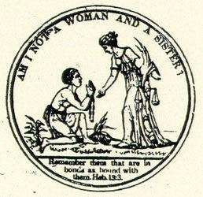
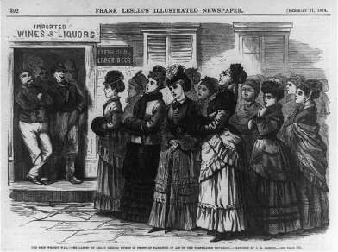
Changing Role of Women and Families
Gender Roles:
– Cult of Domesticity
Strengthened by men’s absence
Idealized view of women as moral leaders in the home as a result of changing roles within families (thanks to industrialization)
Don't confuse with Republican Motherhood: the post-American Revolution idea that women should be schooled in virtue and educated enough that they could teach their children to become successful citizens and ensure a successful republic. Elevated the female role by giving them a place as "special keepers of the nation's conscience."

Slide 13
Changing Role of Women and Families
Gender Roles:
  Women in the Workplace
    Effects on marriage and children
– Industrial Revolution decreased economic value of children and increased use of birth control

Slide 14
Changing Role of
Women and Families
Movement for Women’s Rights
  Grimké Sisters (Angelina wrote Letter on the Condition of Women and the Equality of the Sexes, 1837), Lucretia Mott, Elizabeth Cady Stanton
    Connection to abolitionist movement; objected to
male opposition to their antislavery activities
– Rejection at World Anti-Slavery Society, 1839
Seneca Falls Convention (1848)
  Declaration of Sentiments modeled after Declaration of Independence; "all men and women are created equal"

Slide 15
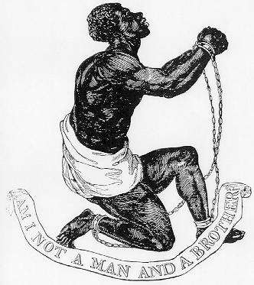
Antislavery Movement
American Colonization Society (1817) - advocated transporting freed slaves back to Africa (Liberia)
American Antislavery Society (1831)
  William Lloyd Garrison
    Radical abolitionist movement, advocated immediate abolition without compensation
    The Liberator
Liberty Party (1840): bring about the end of slavery by political and legal means rather than violence and radicalism

Slide 16
Antislavery Movement
Abolitionists
  Immediatists vs. Gradualists
  Black Abolitionists
    Frederick Douglass
– The North Star
    Tubman, Truth
  Rebellions
    Nat Turner (1831)
  Underground Railroad

Slide 17
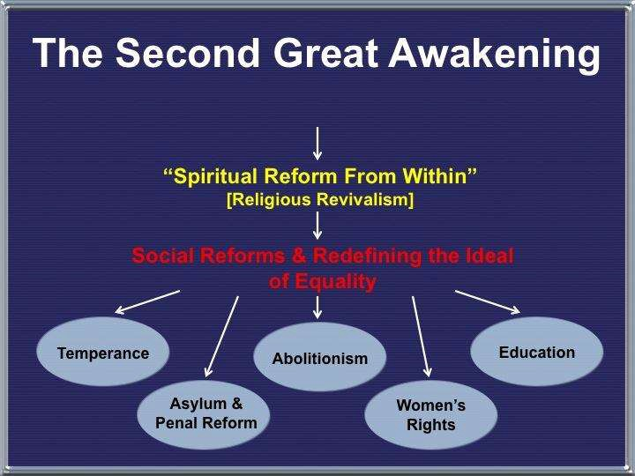
Reaction and Legacy
Sectionalism:
  Southerners viewed northern reforms as alarming
    Threats to:
      Slavery
      Way of life
  In the North, advances in transportation allowed for widespread influence of both religious and secular movements
  Western expansion created both
social and economic conflict
Legacy:
  Birth of “American” culture and
ideals
    Religion, education, arts, and entertainment
  Widespread reform movements both
united and divided the country.

