Slide 1
The Union in Peril
The Coming of the Civil War (1848-1861)

Slide 2
Essential Question
“The Civil War was essentially a struggle between North and South for the West.” Support, refute, or modify this statement.

Slide 3
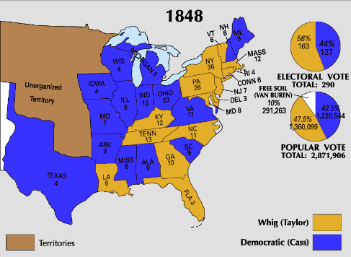
Conflict Over Status of Territories
1848 – 15 Slave, 15 Free
Political Factions
  Northern Democrats & Whigs
    Anti-expansion (slavery)
  Abolitionists
    Anti-slavery
  Free-Soilers
    Anti-slavery, free land
  Southern Democrats
    North attempting to restrict rights
Popular Sovereignty
  Lewis Cass
Election of 1848
  Cass (D) vs. Taylor (W) vs. Van Buren (FS)
Notes:
Election of 1848: http://upload.wikimedia.org/wikipedia/commons/c/ce/1848_Electoral_Map.png

Slide 4
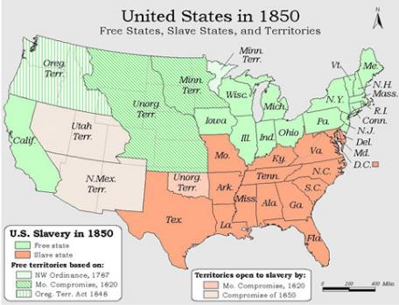
Compromise of 1850
CA Eligible for Statehood (Gold Rush)
  Submits constitution banning slavery
  Emergence of “fire-eaters”
    Secession talk
    Nashville Convention (1850)
Clay’s Compromise of 1850
  CA admitted as free
  Utah & New Mexico decided by popular sovereignty
  Ban the slave trade in DC
  Adopt a strengthened Fugitive Slave Law
Webster (for Compromise) vs. Calhoun (against Compromise)
  Death of Zachary Taylor
  Fillmore signs into law
Impact
  Northern political power increases
  Strengthened desire to maintain Union
  Controversy over Fugitive Slave Law
Notes:
Map: http://americanhistory.unomaha.edu/module_files/Compromise%20of%201850%20Map.jpg

Slide 5
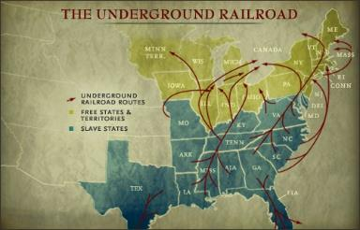
Agitation Over Slavery
North vs. South: The Fugitive Slave Law
  Northern states begin passing Personal Liberty Laws
Underground Railroad
Publications:
  Anti-Slavery:
    Stowe’s Uncle Tom’s Cabin (1852)
    Helper’s Impending Crisis of the South (1857)
  Southern Reaction:
    George Fitzhugh -
      Sociology for the South (1854)
      Cannibals All! (1857)
Category | Free States | Slave States | Slave States as % of Free
Population | 18,484,922 | 9,612,979 | 52
Patents | 1,929 | 268 | 14
Value of Church Buildings | $67,778,477 | $21,674,581 | 32
Newspapers & Periodicals | 1,790 | 740 | 41
Bank Capital | $230,100,840 | $109,078,940 | 47
Value of Exports | $167,520,098 | $107,480,688 | 64
Notes:
Underground RR: http://thomaslegion.net/theundergroundrailroadandamericancivilwarhistory.html
Chart: From AMSCO text, sourced from Hinton Helper’s Impending Crisis

Slide 6
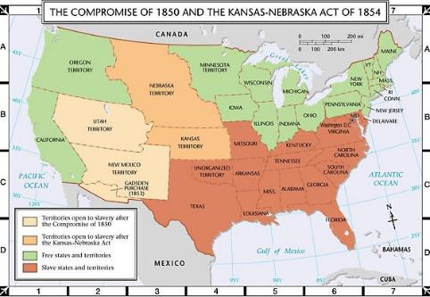
National Parties in Crisis
Election of 1852
  Winfield Scott (W) vs. Franklin Pierce (D)
    Both sides choose not to take a stand on the biggest issue: slavery
    Pierce wins in landslide
      Demise of the Whigs
Kansas-Nebraska Act (1854)
  Stephen Douglas’ on the national stage
    Impact of Railroad & western development
  Proposal:
    Two territories, decided by popular sovereignty
    Violation of the Missouri Compromise
Notes:
Map: http://wps.pearsoncustom.com/wps/media/objects/5407/5537171/atlas/atl_ah3_m009.html

Slide 7
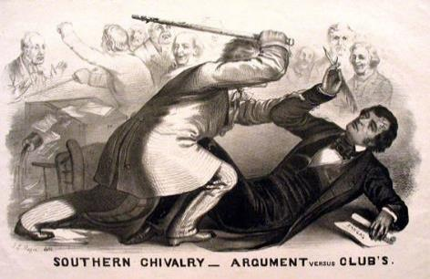
Extremists and Violence
“Bleeding Kansas”
  “Border ruffians”- proslavery Missiourians vs. New England Emigrant Aid Societies (abolitionists & free soil)
  Lecompton vs. Topeka
  The loot of Lawrence and the attack at Pottawatomie Creek
    John Brown attack on proslavery farm settlements
Sumner-Brooks Affair
  Charles Sumner’s “The Crime Against Kansas”
Notes:
Image: http://upload.wikimedia.org/wikipedia/commons/3/31/Southern_Chivalry.jpg

Slide 8
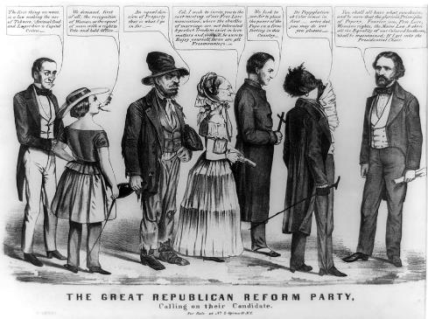
New Parties Emerge
American Party (1850’s)
  “Know-nothings” weakened Whigs
Republican Party (1854)
  Free-Soilers, antislavery Whigs and Democrats
  Early Platforms:
    Oppose spread of slavery
    Repeal of Fugitive Slave Law
    Repeal of Kansas-Nebraska
Notes:
1856 Cartoon of Fremont Campaign: http://upload.wikimedia.org/wikipedia/commons/b/b9/1856-Republican-party-Fremont-isms-caricature.jpg

Slide 9
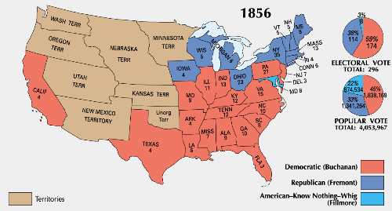
The Election of 1856
John C. Fremont (R) vs. Millard Fillmore (Am) vs. James Buchanan (D)
  Strong showing from Republicans in North
  James Buchanan wins
Notes:
Map: http://www.factbook.org/wikipedia/en/u/u_/u_s__presidential_election__1856.html

Slide 10
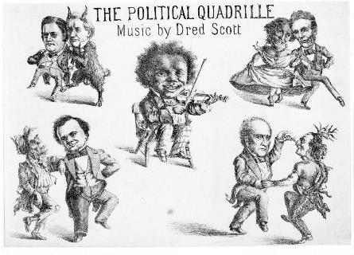
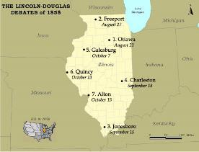
Constitutional Issues
Kansas:
  Lecompton Constitution
    Didn’t support majority of voters in Kansas over slavery
    Democrats like Stephen Douglas and Republicans in Congress rejected it – final rejection in 1858
Supreme Court (Taney):
  Dred Scott vs. Sandford (1857)
    African Americans/slaves not citizens
    Congress could not deprive individuals of property without due process
    Missouri Compromise of 1820 = unconstitutional
Lincoln-Douglas Debates
  Unprecedented
  Impact:
    Lincoln portrayed as abolitionist
    Douglas loses support from Southern Democrats
Notes:
1860 Candidates Cartoon: http://elections.harpweek.com/1860/cartoon-1860-large.asp?UniqueID=39&Year=
Map: https://mstartzman.pbworks.com/w/page/32933296/Lincoln%20Douglas%20debates%20(second)

Slide 11
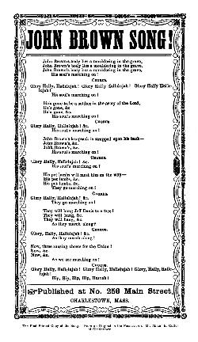
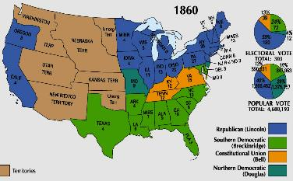
The Road to Secession
Harper’s Ferry (Oct. 1859)
  John Brown vs. Robert E. Lee
    Martyr?
Election of 1860
  Republican Nat’l Convention
  Four Parties
  Results:
    Lincoln Wins w/only 40%
    Secession:
      SC (Dec. 1860)
      GA, FL, AL, MS, LA, & TX (by Feb 1861)
      Confederate States of America – Jefferson Davis - President
Crittenden Compromise – last ditch effort
  Extend 36º30’ (Republicans opposed)
Notes:
John Brown’s Body: http://upload.wikimedia.org/wikipedia/commons/3/3a/Original-john-brown-words-george-kimball-1890.jpg
1860 Map: http://3.bp.blogspot.com/_n0kOLTsDBsw/TNXTisqh__I/AAAAAAAABMA/tOmGCVvfivQ/s1600/ElectoralCollege1860-Large.png

Slide 12
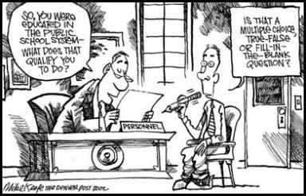
Short-Answer Review
Explain ONE important political conflict over the extension of slavery in the period 1850-1860.
Explain ONE important social conflict over the extension of slavery in the period 1850-1860.
Explain ONE political response to the conflict explained in Part a) OR Part b).
Notes:
Cartoon: http://pumpkindelight.blogspot.com/2012/05/well-at-least-monday-is-over.html

