Slide 1
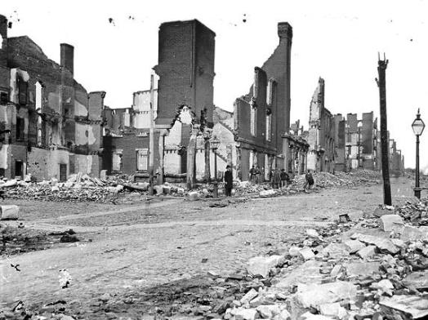
Reconstruction
1863-1877

Slide 2
Essential Question
Explain the extent to which constitutional and social developments contributed to maintaining continuity as well as fostering change during the Civil War to the end of Reconstruction.
Notes:
Harper’s Weekly Illustration – Johnson & Reconstruction – Source and Description here: http://www.harpweek.com/09Cartoon/RelatedCartoon.asp?Month=September&Date=1

Slide 3
A Series of Challenges
How would the South rebuild its shattered economy and society?
What would be the place in society of 4 million freedmen?
To what extent was the federal government responsible for helping them?
How should the former Confederate states be treated?
Recognize secession, or not?
How would they be brought back into the Union?
Who has the authority to decide these questions?
Congress or the President?
Notes:
Granger Collection Image: https://johnib.wordpress.com/2014/01/19/reconstruction-was-meant-to-tear-slavery-from-the-american-soil-by-stripping-ex-confederates-of-political-power-and-transforming-slaves-into-educated-landowning-citizens/

Slide 4
Plans for Reconstruction
Lincoln’s Plan
Wade-Davis Bill
Proclamation of Amnesty and Reconstruction (1863)
Full pardons for:
Oath of allegiance
Accepting emancipation of slaves
States can draw constitution and be reestablished as soon as ten percent of voters took oath (10% Plan)
Summation:
Lenient, designed for expedited implementation and enforcement of Emancipation Proclamation.
NOT “readmission” – did not recognize secession
Congressional Plan (1864)
Required 50% of 1860 population to take “iron-clad” oath
Required state constitutional convention to be held before elections for office
Only non-Confederates could vote
Enacted specific safeguards of freedmen’s liberties
Lincoln pocket vetoed
Summation:
Would be a laborious, if not impossible task, for the South to comply.
Recognized secession. Harsh; Meant to punish the South.

Slide 5
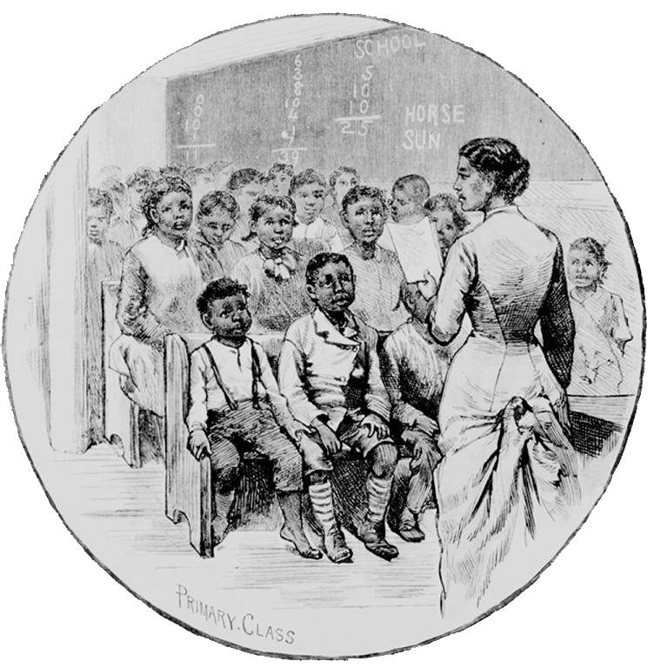
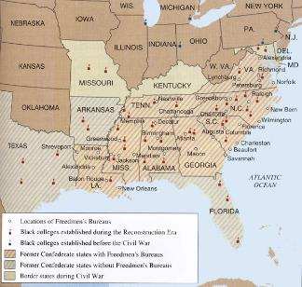
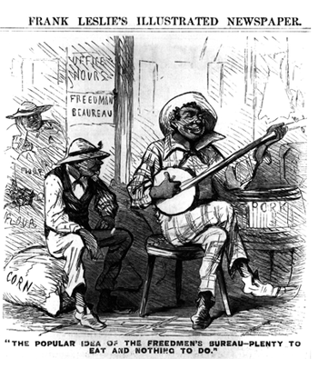
The Freedmen’s Bureau
March, 1865
Welfare Agency
Food, shelter, and medical aid
Resettlement
Hampered by Johnson’s pardons
Successes:
Established 3,000 schools, including several colleges
Educated over 200,000 African Americans
Notes:
School Image: http://www.vahistorical.org/collections-and-resources/virginia-history-explorer/freedmens-schools
Frank Leslie Image: http://wwnorton.com/college/history/america9/full/ch/17/research.aspx?selTab=5#titles
MAP: http://www.latinamericanstudies.org/freedmans-bureau.htm
Compare views of the Freedmen’s Bureau in these two images.

Slide 6
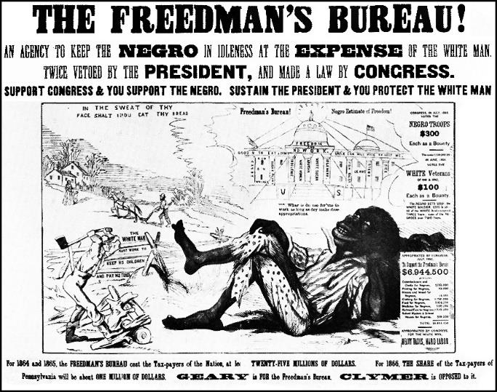
Notes:
http://www.latinamericanstudies.org/freedmans-bureau.htm

Slide 7
Johnson and Reconstruction
Andrew Johnson
Democrat from Tennessee, only senator from the South to remain loyal
Anti-aristocrat, White Supremacist
Reconstruction Policy
Continue Lincoln’s Plan
Additional Provisions (Ten Percent Plus Plan):
Disfranchisement (loss of the right to vote and hold office ) of:
Former Confederate leaders and officeholders
Confederates with more than $20,000 in taxable property
Gave president the power to pardon “disloyal” Southerners
Johnson pardoned over 13,000
Results:
Expedited eligibility of states to become functioning members of the Union
Pardons allowed for return of Confederate office holders and the planter aristocracy to power
Battle between Johnson and the Republicans
Use of the Veto (29)
Notes:
Image: Sue Pojer, Reconstruction PowerPoint, http://historyteacher.net

Slide 8
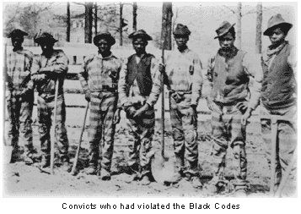
Black Codes
Southern States begin to retaliate against the 13th Amendment
Purpose:
Guarantee stable labor supply
Restore pre-emancipation system of race-relations
Manifestations:
Prohibited blacks from renting land or borrowing money to buy land
Anti-vagrancy laws, curfews, and forced labor contracts
Prohibited blacks from testifying against whites in court
Results:
Contract-labor system
Sharecropping
Notes:
Louisiana Black Code: http://college.cengage.com/history/us/resources/students/primary/blackcode.htm
Chain Gang & Description of Black Codes: http://www.u-s-history.com/pages/h411.html

Slide 9
Congressional Reconstruction
The Radical Republicans Retaliate
Led by Charles Sumner & Thaddeus Stevens
Provisions:
Civil Rights Act of 1866
Sought to override Johnson vetoes
Nullify Dred Scott
Shield against Black Codes
14th Amendment (ratified 1868)
Citizenship for all persons born or naturalized in the United States
Afford “due process” and “equal protection”
Punished the South
Disqualified former Confederate leaders, repudiated debt, and could reduce a state’s proportional representation
Notes:
Johnson’s Veto of the Freedmen’s Bureau: http://www.authentichistory.com/1865-1897/1-reconstruction/1-johnson/

Slide 10
Radical Reconstruction
Report of the Joint Committee (June, 1866)
Congress, not the President, had sole authority to determine readmission of Southern states.
Officially rejects Presidential Reconstruction plans
Congressional Election of 1866
Referendum for radicals
3 to 1 majority in Congress
Reconstruction Acts of 1867
Military Reconstruction Act – South under military control
Tenure of Office Act- prohibited the President from removing a federal official or military commander without approval of the Senate
Notes:
Map of Reconstruction Act: http://education-portal.com/academy/lesson/reconstruction-acts-of-1867-definition-lesson-quiz.html

Slide 11
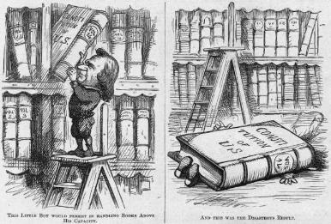
Impeachment of Andrew Johnson
Passage of Tenure of Office Act
Senate’s “advise and consent” applies not only to nominations, but terminations as well.
To combat the Military Reconstruction & Command of the Army Acts, Johnson fires Edwin Stanton, Secretary of War
House responds by drawing up 11 articles and impeaching Johnson for “high crimes and misdemeanors”
Senate falls one vote short of removal.
Notes:
Johnson Impeachment Cartoons: http://law2.umkc.edu/faculty/projects/ftrials/impeach/imp_imag.htm

Slide 12
Reforms After Grant’s Election
Election of 1868
Grant vs. Seymour
Black vote garners victory for Grant
600 African American elected to State Assemblies
Majority in SC lower house
Electoral Gains for African Americans
15th Amendment (ratified 1870)
First black senator – Hiram Revels, MS (1870)
8 African Americans elected to House of Representatives (by 1875)
Civil Rights Act of 1875
Prohibited discrimination in public places and prohibited courts from excluding blacks
Weak enforcement
Notes:
Image w/explanation: http://elections.harpweek.com/1868/cartoon-1868-Medium.asp?UniqueID=9&Year=

Slide 13
Reconstruction in the South
Composition of the Reconstruction Governments
Republican occupation until Reconstruction requirements were met.
Governments consisted of primarily Republican legislators, freedmen, and recently arrived Northerners.
“Scalawags” – Southern Republicans
“Carpetbaggers” – Northern and western newcomers
Notes:
Carpetbagger: http://gardap.wordpress.com/2013/06/11/berry-carpetbagger-reincarnation/

Slide 14
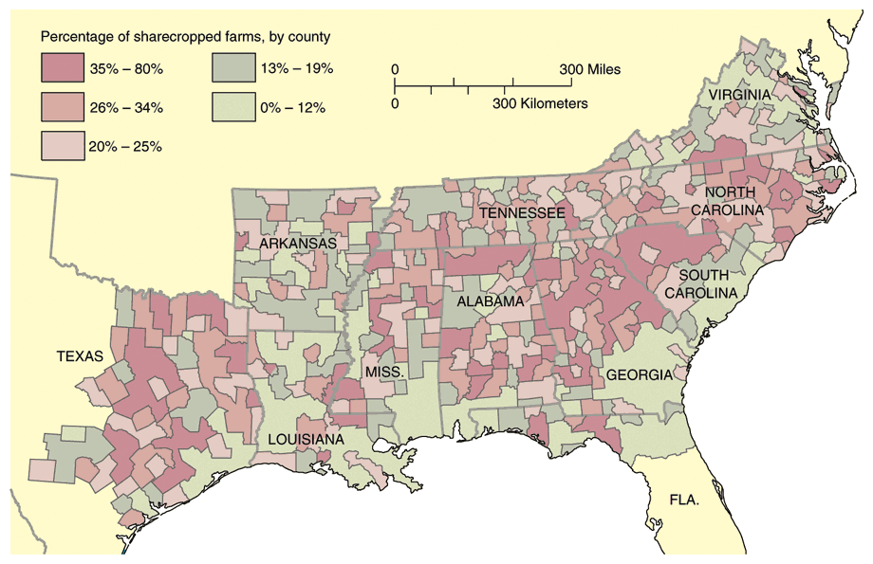
Black “Adjustment” in the South
The Taste of Freedom
Freedom of movement
Search for families
Land Ownership
Sherman’s “40 acres and a mule”
Land seized
Johnson returned
Freedom to Worship
Black Churches (Baptist, Methodist, Episcopal)
Freedom to Learn
1860: 90% illiterate
Between 1865-1870, 30 Black Colleges established
Sharecropping “crop-lien”
Landowner retained ¼ to ½ of production
Cycle of debt (mortgage “lien”)
By 1880, less than 5% of Southern blacks owned land
Notes:
Sharecropping and Description of the history of “40 Acres”: http://blackhistorymonth2014.com/359/reparations40-acres-and-a-mule/

Slide 15
The North During Reconstruction
Industry drove both Northern economics and politics.
Greed and Corruption
The New Spoils System- jobs & favors
Corruption in Business and Government
Grant Administration Scandals
Jay Gould and James Fisk – gold market
Crédit Mobilier – free stock to members of Congress to avoid investigation of profits being made
Whiskey Ring- defraud the government of millions of dollars in taxes
Rise of Bossism and Political Machines
* Tammany Hall & Boss Tweed- $200 million stolen from NYC taxpayers
Election of 1872
Grant vs. Greeley
Notes:
Image source unknown

Slide 16
Evaluating the Republican Record
Accomplishments
Failures
State Constitutions
Universal manhood suffrage
Property rights for women
Debt relief
Modern penal codes
Economic Reform
Built infrastructure
Constructed factories
Reformed tax system to support improvements
Social Reforms
Hospitals
Asylums
Homes for disabled
State-supported public education
Corruption
Graft and wasteful spending
Kickbacks and bribes
Most improvements were short term & met with resistance
“redeemer” governments would emerge
Did not improve the social, political, or economic positions of African Americans and poor whites.

Slide 17
The End of Reconstruction: Causes
Political
Social
Economic
Grant Administration Corruption
Southern Politics
Rise of Bourbons
Redeemer Governments
“Solid South” – states rights, reduced taxes, reduced spending on social programs, white supremacy
Supreme Court Decisions
Texas v. White
Slaughterhouse Cases
Bradwell v. Illinois
U.S. v. Cruikshank
U.S. v. Reese
Rise of Sharecropping
Increase in Black Codes → advent of Jim Crow Laws
target: voting rights
Increase in Violence & Lynching
Ku Klux Klan
Force Acts (1870 & 1871)
White League (1874)
Segregation and socio-economic disparity
Limited Southern Industrialization
Textiles, tobacco processing, railroads
11k → 29k miles
Coinage Act of 1873
Demonetization of silver
Panic of 1873
Collapse of southern economy
Cotton ½ value
Widespread bankruptcy
Notes:
Image: http://inamerica.blogs.cnn.com/2012/11/01/parallels-to-countrys-racist-past-haunt-age-of-obama/comment-page-1/

Slide 18
The End of Reconstruction
Election of 1876
Hayes (R) vs. Tilden (D)
Tilden wins popular, but lacks electoral majority
Compromise of 1877
The Corrupt Bargain, Part II?
Troops Removed from South
Notes:
Carpetbaggers Go Home: http://fineartamerica.com/featured/6-reconstruction-cartoon-granger.html

Slide 19
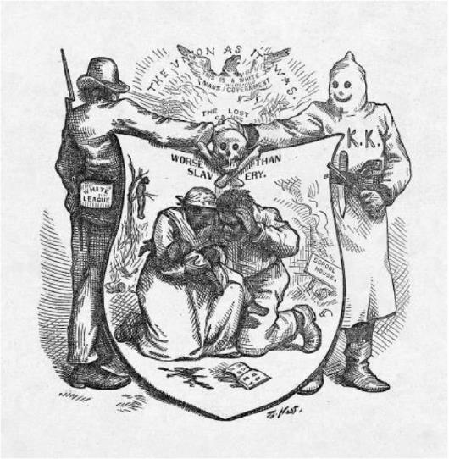
Primary Source Analysis
Thomas Nast, Worse Than Slavery, 1874
Notes:
Nast, Worse Than Slavery, 1874: http://www.loc.gov/pictures/item/2001696840/

