Slide 1
Chapter 15 The Ferment of Reform and Culture 1790-1860

Slide 2
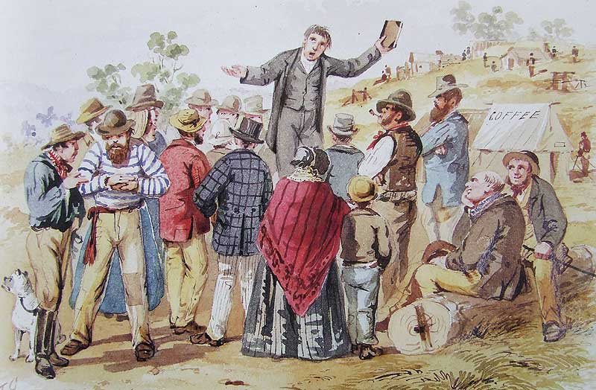
Reviving Religion
Thomas Paine promoted doctrines of Deism
Relied on science rather than Bible and denied the divinity of Christ
Believed in a Supreme Being who had created a universe and endowed human beings with a capacity for moral behavior
Unitarianism was derived from Deism
Believed God existed in only one person, not the Trinity
Mostly appealed to intellectuals
The Second Great Awakening began in 1800.
Religious fervor swept over country
Women became more involved in religion during the Second Great Awakening

Slide 3
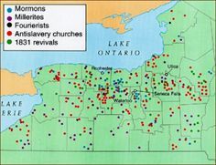
Denominational Diversity
The Second Great Awakening widened the gap between the societal classes and regions
More prosperous and conservative denominations in the East were little touched by revivalism
Episcopalians, Presbyterians, Congregationalists, and Unitarians derived its members from wealthier parts of society
Methodists and Baptists came from less prosperous communities in the South and West
The issue of slavery split the churches apart

Slide 4
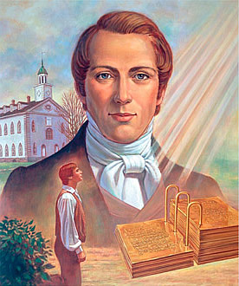
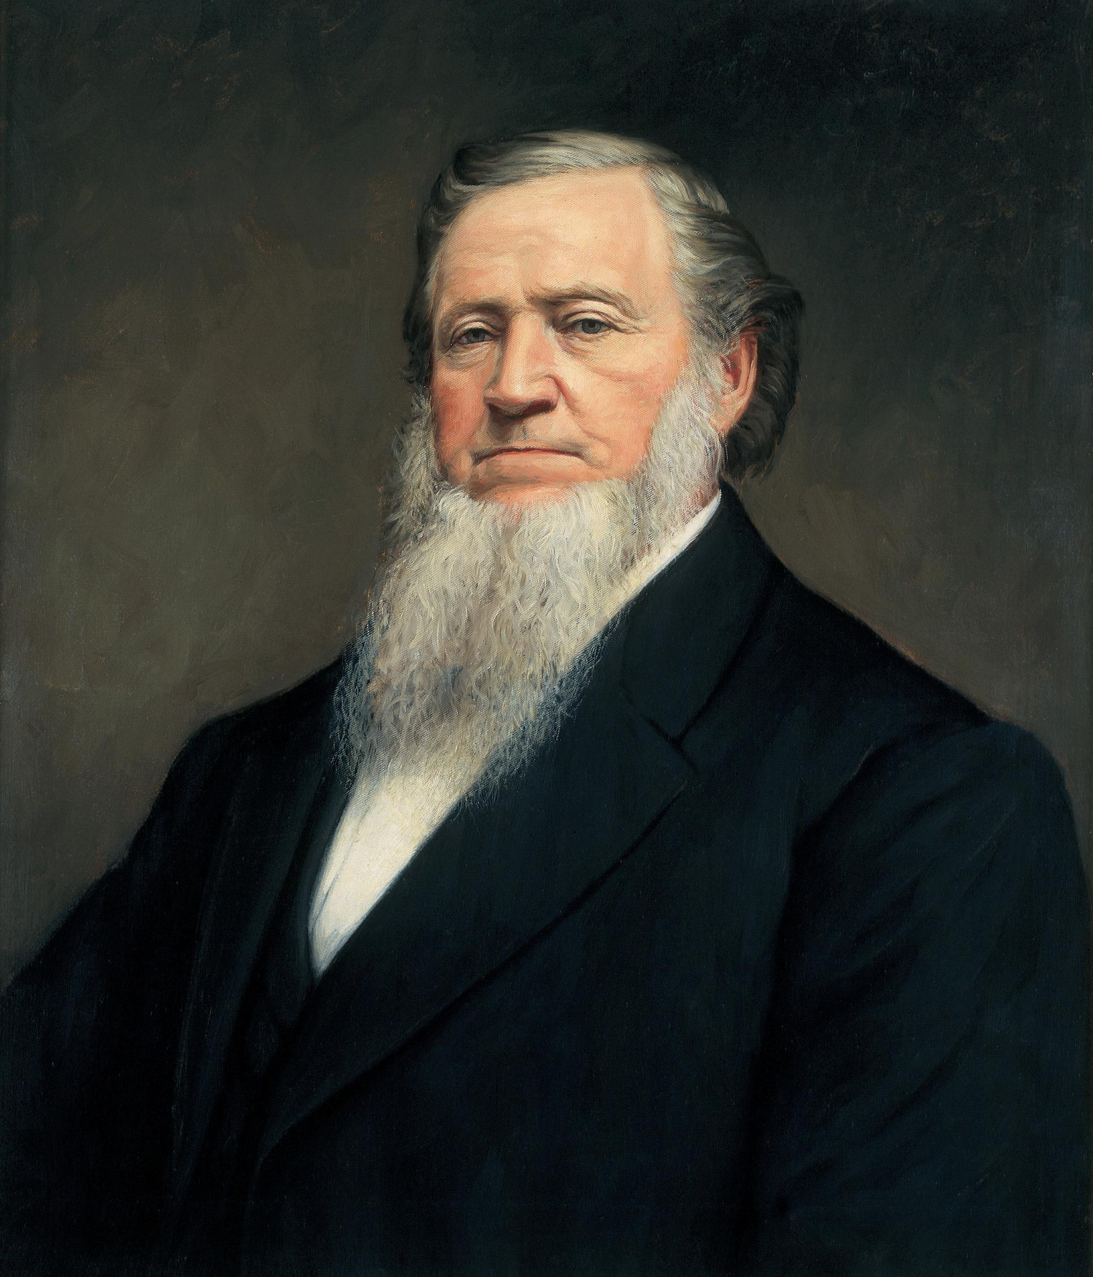
Mormons
Joseph Smith: formed Church of Jesus Christ of Latter-day Saints, 1830
Deciphered Book of Mormon from golden plates given to him by an angel
Led Mormons to Illinois
After Joseph Smith was killed 1844, Brigham Young led Mormons to Utah to avoid persecution

Slide 5
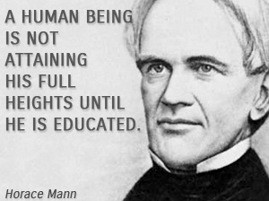
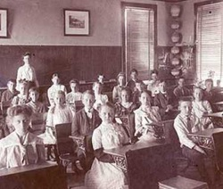
Public School
Tax-supported public education came about between 1825-1850
Americans eventually saw they had to educate their children because the children were the future
Teachers of schools were mostly men and did not know how to teach
Not very many schools in the U.S. because of their high costs to communities
Horace Mann: campaigned effectively for a better school system

Slide 6
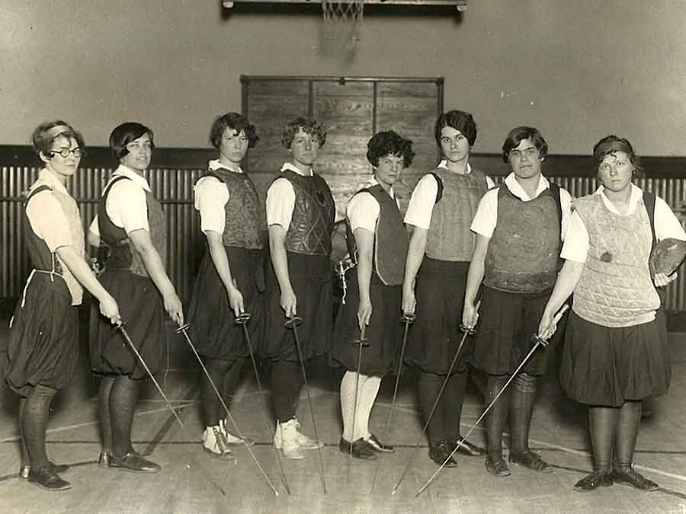
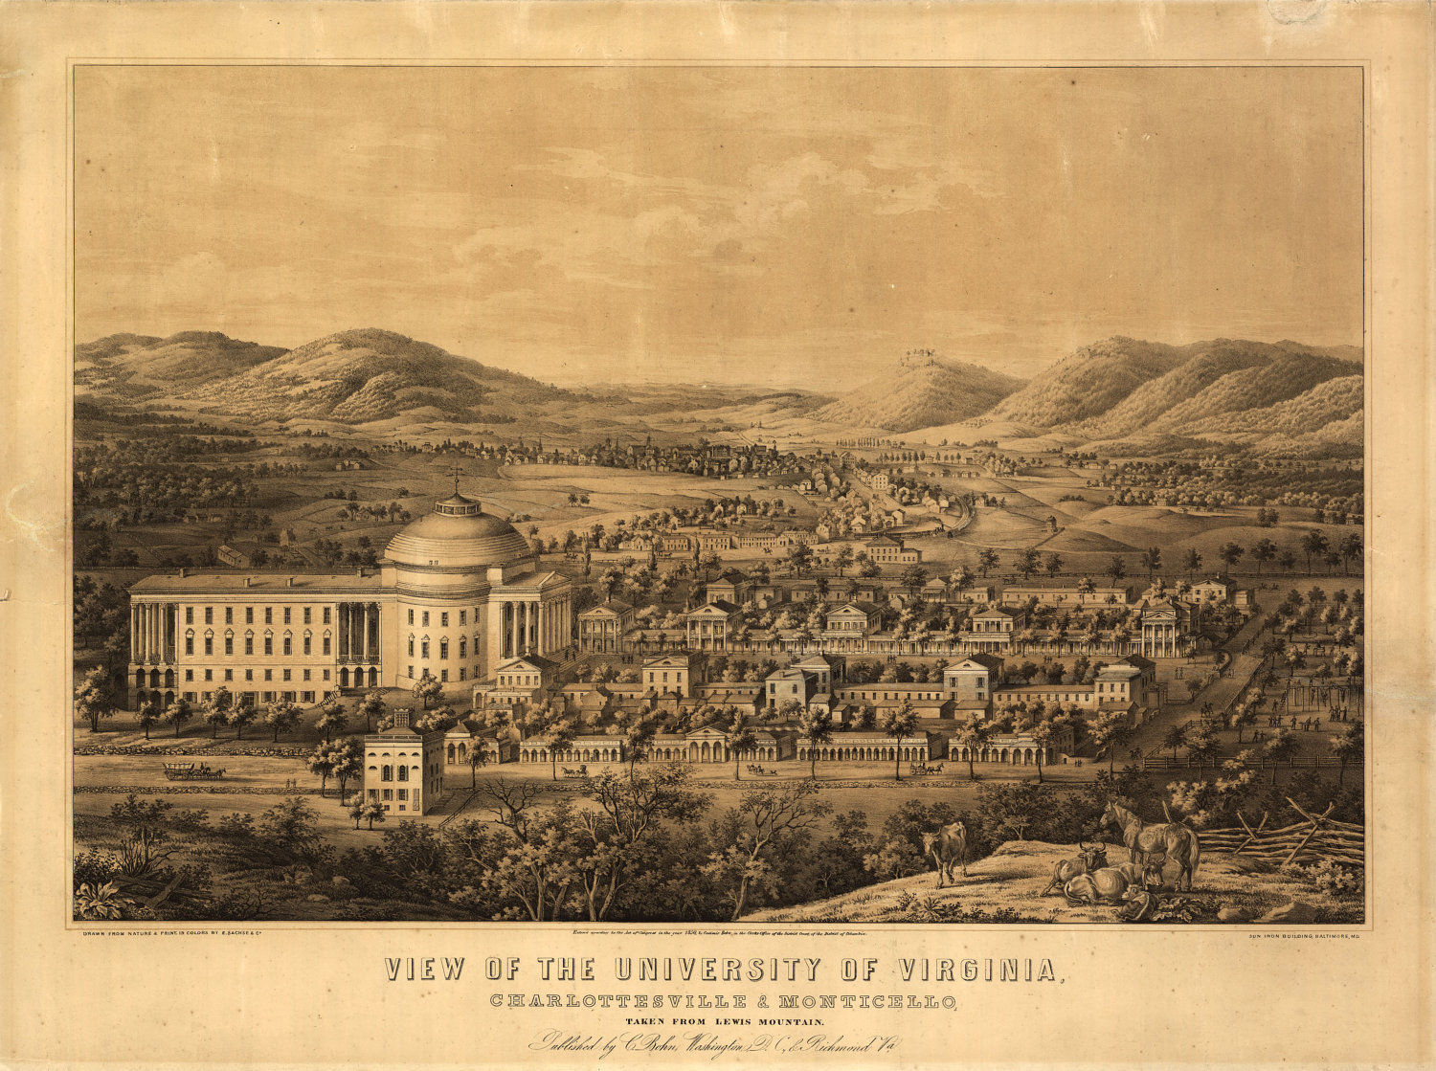
Universities
First state-supported universities showed up in the South in 1795.
University of Virginia was founded by Thomas Jefferson
Women's schools at the secondary level came in the 1820s because of Emma Willard.
At the time, it was still widely believed that a women's place was in the home

Slide 7
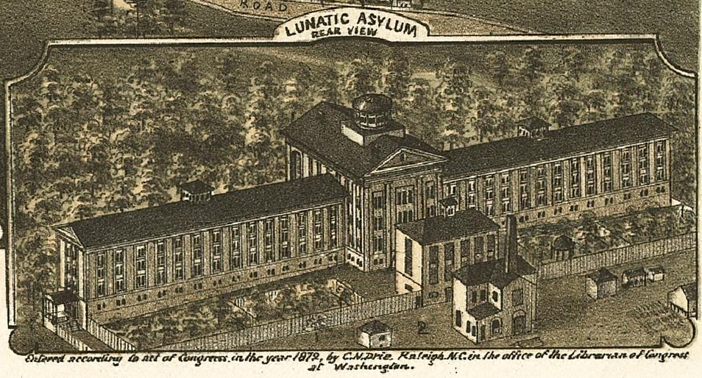
An Age of Reform
States gradually abolished debtors' prisons due to public demand.
Criminal codes in the states were being softened
Number of capital offenses was being reduced
Society began to think that prisons should reform as well as punish
Dorothy Dix: traveled the country, visiting different asylums; released report on insanity and asylums; her protests resulted in improved conditions for the mentally ill

Slide 8
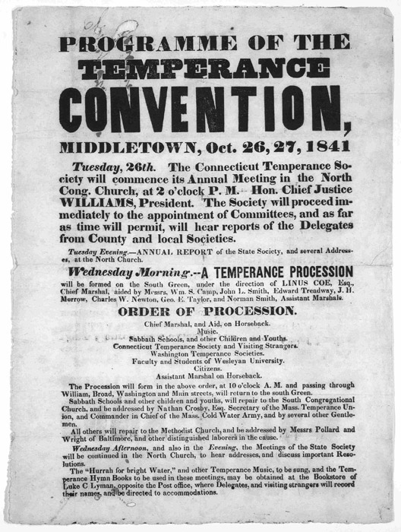
Demon Rum - The "Old Deluder"
Early 1800s, many people developed drinking problems due to looser social norms and hard/monotonous life
Included women, clergymen, members of Congress.
American Temperance Society was formed in 1826
Members persuaded people to stop drinking
Drinking decreased worker efficiency and threatened the family structure
Neal S. Dow: thought that alcohol should be outlawed; "Father of Prohibition"; supported the Maine Law of 1851 which banned the manufacture and sale of liquor in Maine.

Slide 9
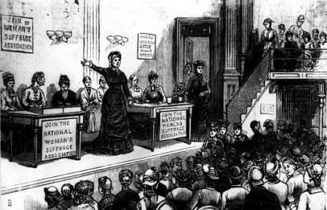
Women in Revolt
Early 19th century, role of women was to stay at home and be subordinate to husband
Women couldn’t vote and when married, she couldn’t retain her property
Because of these things, women actually started to avoid marriage
Gender differences were emphasized in 19th century
Market economy was separating women and men into distinct economic roles
women viewed as artistic and keepers of society's conscience, while men were viewed as strong but crude
Feminists met at Seneca Falls, New York in a Woman's Rights Convention in 1848 to rewrite the Declaration of Independence to include women.

Slide 10
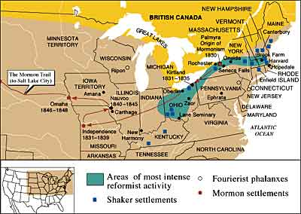
Utopian Societies
Several utopian communities were created in early 1800s, but all of them ultimately failed
Shakers, Oneida Society, Brook Farm, New Harmony
All aimed to seek human betterment

Slide 11
Scientific Achievement
Americans were more interested in practical gadgets than in pure science
Americans invented practical gadgets, but borrowed and adapted scientific findings from Europeans
Medicine in America was still primitive by modern standards.
Early 1840s, several American doctors and dentists successfully used laughing gas and ether as anesthetics

Slide 12
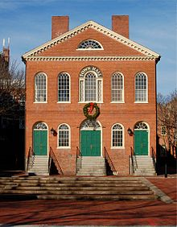
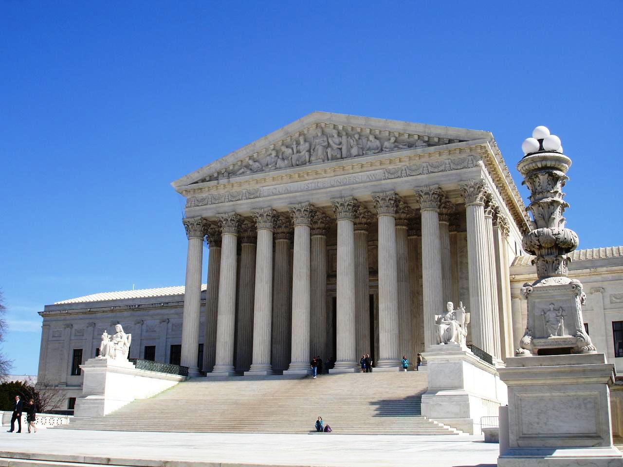
Artistic Achievements
Early American architects used a Federal Style that emphasized symmetry, balance, and restraint (columns, domes, pediments).
Between 1820 and 1850, a Greek revival in architecture came to America. Most of the ideas of art and painting were taken from Europe.

Slide 13
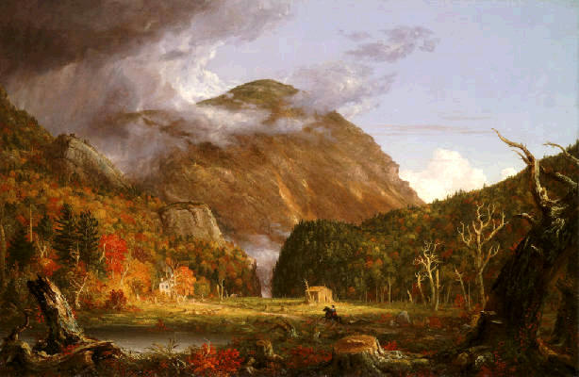
The Start of National Literature
Before the mid-1800s, most literature in America was imported from Britain
Following War of 1812, American literature received a boost from the wave of nationalism and the arrival of romanticism to America

Slide 14
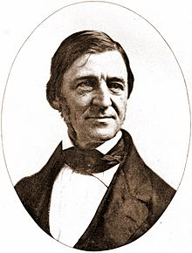
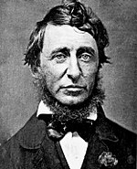
Transcendentalism
Transcendentalist movement came about in 1830s
Believed that knowledge transcends the senses and can't be found just by observation – action and reflection
Knowledge comes from within the person
Associated traits: self-reliance, self-culture, and self-discipline
Ralph Waldo Emerson: poet and philosopher
Urged American writers to forget European traditions and write about American interests
Henry David Thoreau: naturalist and writer
Believed that people should ignore societal desires and pursue truth through study and meditation

Slide 15
Other Artistic and Historic Accomplishments
Romanticism
Not all poets and writers of the time were transcendentalists – many considered Romantics
Emphasis on emotion and individualism as well as glorification of all the past and nature
Literary Individuals and Dissenters
Edgar Allan Poe: wrote with a pessimistic tone, unlike the literature at the time
Herman Melville: wrote Moby Dick
Portrayers of the Past
In the mid-1800s, American historians began to emerge

