Slide 1
Chapter 16 The South and the Slavery Controversy 1793-1860

Slide 2
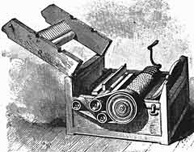
"Cotton is King!"
Late 1700s - slavery starting to die out
Invention of cotton gin prompted plantation owners to keep more slaves
Cotton accounted for half the value of all American exports after 1840
1850s - Britain's most important manufactured item was cotton cloth
Britain imported 75% of its raw cotton from the South
South had significant influence in Britain

Slide 3
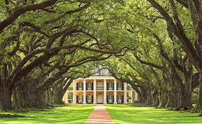
The Planter Class
South more of an oligarchy – gov’t ran by a few
Gov’t heavily affected by planter class
Southern aristocracy widened gap between rich and poor
Aristocrats made governmental decisions in their favor
Southern plantation wife commanded the female slaves

Slide 4
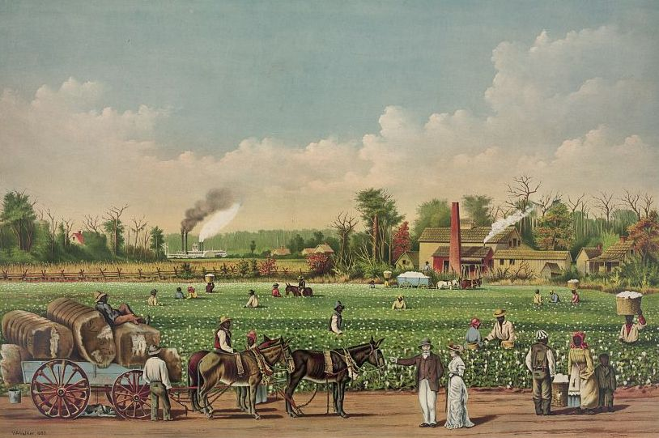
the Slave System
Slavery in South known as the "peculiar institution"
Economic structure in South became increasingly monopolistic
Southern economy very dependent on cotton, which made economy unstable
Many plantation owners over-speculated in land and slaves, causing them to fall into debt

Slide 5
The White Majority
The white population of the South was as follows (from smallest to largest):
a) Wealthy slave owners
b) Less wealthy slave owners –
Didn’t own a majority of slaves, but made up majority of the masters.
c) Non-slave-holding whites (3/4 of South white population)
Supported slavery because they wanted to eventually own slaves and achieve the "American dream" of moving up in society.
Less prosperous non-slave-holding whites
Civilization hadn't reached mountain whites who lived in valley of the Appalachian range
Supported Abraham Lincoln's Union party

Slide 6
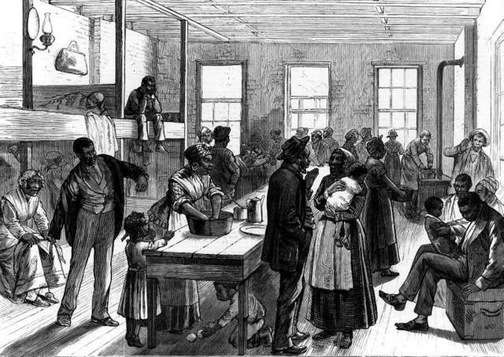
Free Blacks
Many settled in New Orleans
Generally not liked in North or South.
South - free blacks prohibited from having certain jobs and forbidden from testifying against whites in court
Known as the "3rd Race"
South - Liked them as individuals, but hated their race
North - professed to like race, but disliked individual

Slide 7
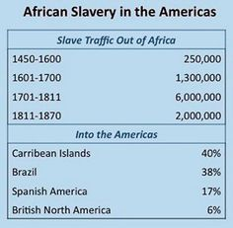
Plantation Slavery
Price of slaves high → smuggled slaves into South
Legal importation of African slaves into America ended in 1808
Most slaves were offspring of slaves here
Planters regarded slaves as major investments

Slide 8
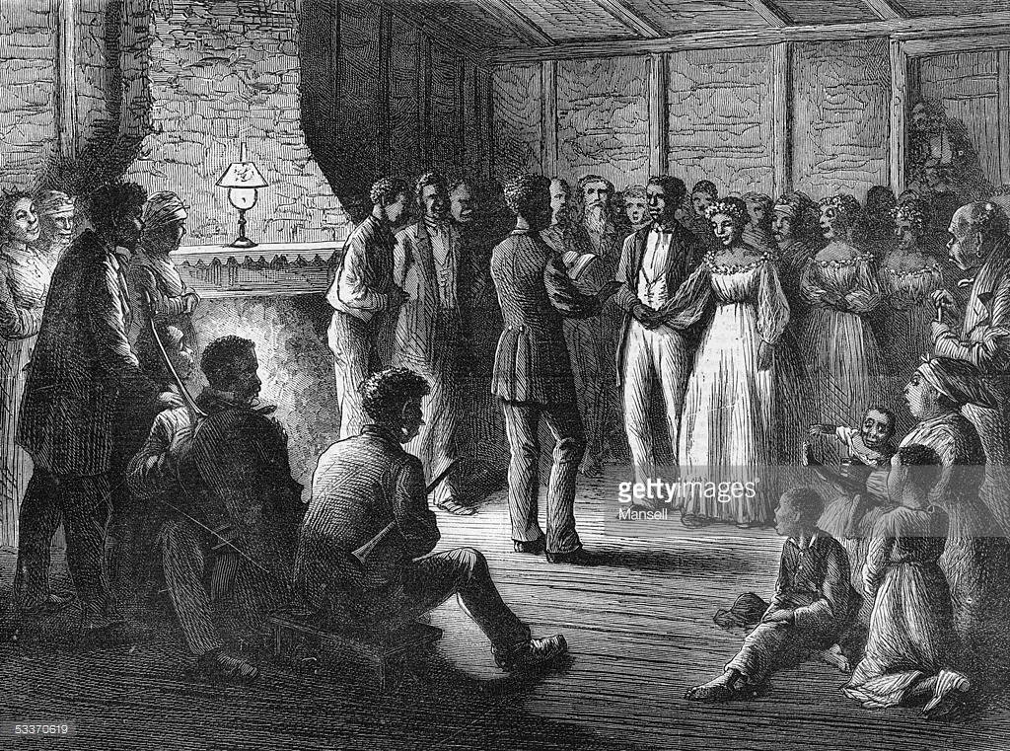
Life as a slave
Black Belt - region of South where most slaves were concentrated
Stretched from South Carolina and Georgia into Alabama, Mississippi, and Louisiana
Sustained family life in slavery
Formed own religions & traditions from a mixture of Christian and African elements
Responsorial

Slide 9
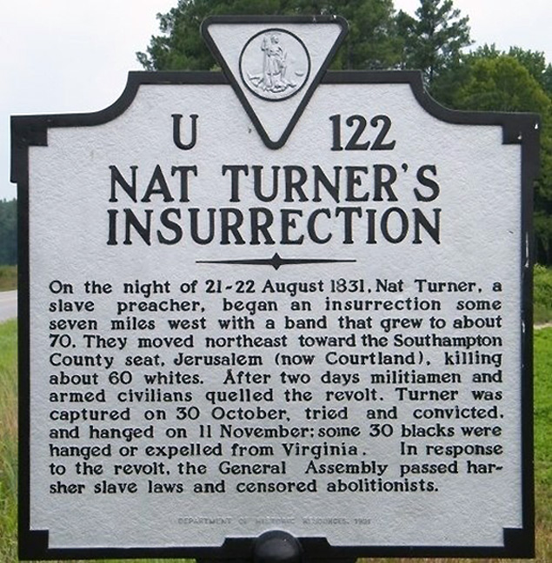
Slave Rebellions
Not permitted to read because reading brought ideas and ideas brought discontent
Nat Turner's Rebellion
In south, led by Nat Turner
Preacher – had been taught to read by master to try and convert other slaves
Instead used religion as reason for rebellino
Rebellion was defeated
Enslaved Africans aboard the slave ship Amistad rebelled and took control of the ship in 1839.
The ship landed in Long Island, but Africans were eventually returned to Sierra Leone – Court Case

Slide 10
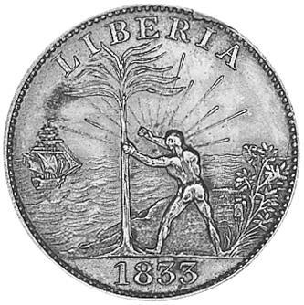
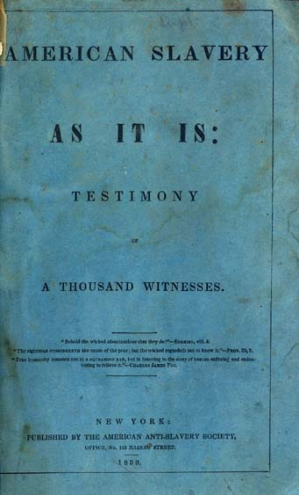
Early Abolitionism
American Colonization Society
Founded in 1817
Focus - Transporting blacks back to Africa
Republic of Liberia: founded in 1822 as a place for former slaves.
Problem - by1860, all southern slaves were born in America
Second Great Awakening inspired many abolitionists to speak out against sins of slavery
Theodore Dwight Weld: abolitionist who spoke against slavery
Wrote pamphlet American Slavery As It Is (1839) - made arguments against slavery

Slide 11
Anti Slavery vs. Abolitionist vs. Radical Abolitionist
Anti-Slavery – opposed to slavery, and wanted gradual emancipation
Abolitionists – wanted slavery to end now
Radical Abolitionists – wanted slavery to end now, wanted equal rights under the law, and were willing to use more militant tactics

Slide 12
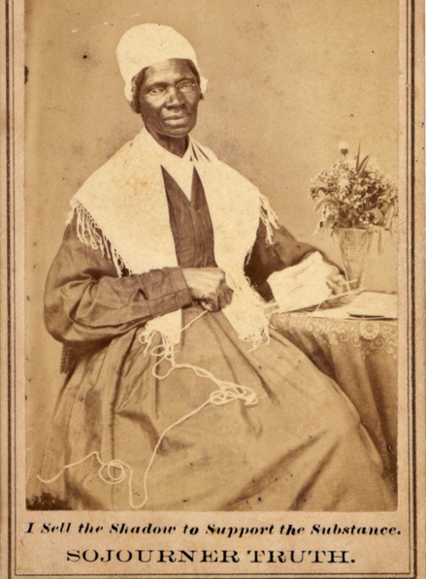
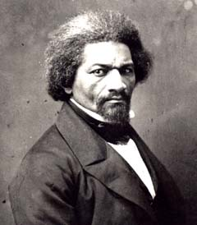
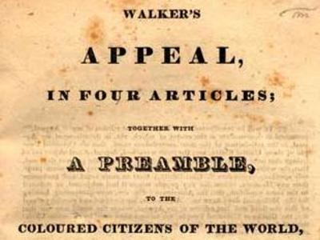
Radical Abolitionism
William Lloyd Garrison
wrote newspaper The Liberator
Publicly burned copy of the Constitution.
American Anti-Slavery Society
Founded in 1833 to oppose slavery
Mostly women
Sojourner Truth
Freed black woman who fought for black emancipation and women's rights
Frederick Douglass
Runaway slave who lectured for abolitionism
Looked to politics to end slavery
Published his autobiography, Narrative of the Life of Frederick Douglass
Invited around the world to lecture about abolition
David Walker
Black abolitionist who spoke out against slavery and argued that Blacks need to out-citizen the whites
Wrote, The Appeal to the Coloured People of the World

Slide 13
Southern reaction
1831-1832 - VA defeated numerous emancipation bills
Other states followed suit, prohibiting all forms of emancipation
Series of emancipation setbacks was known as nullification crisis of 1832
Silenced voice of wt. southern abolitionists
Southerners argued that slavery was supported by Bible, and slavery was good for Africans because it introduced them to Christianity
Gag Resolution
Required all anti-slavery appeals be tabled without debate in House of Representatives
1835 - gov’t ordered southern postmasters to destroy abolitionist material due to anti-abolitionist mobbing and rioting at a postal office in Charleston, South Carolina

Slide 14
Abolitionist Impact in the North
Abolitionists were unpopular in many parts of North
Southern planters owed lots of money to northern bankers
If Union collapsed, these debts would not be repaid
Additionally, New England textile mills were supplied with cotton raised by slaves
If slavery was abolished, then cotton supply would be cut off, resulting in unemployment.
Free soilers - opposed extending slavery to the western territories

