Slide 1
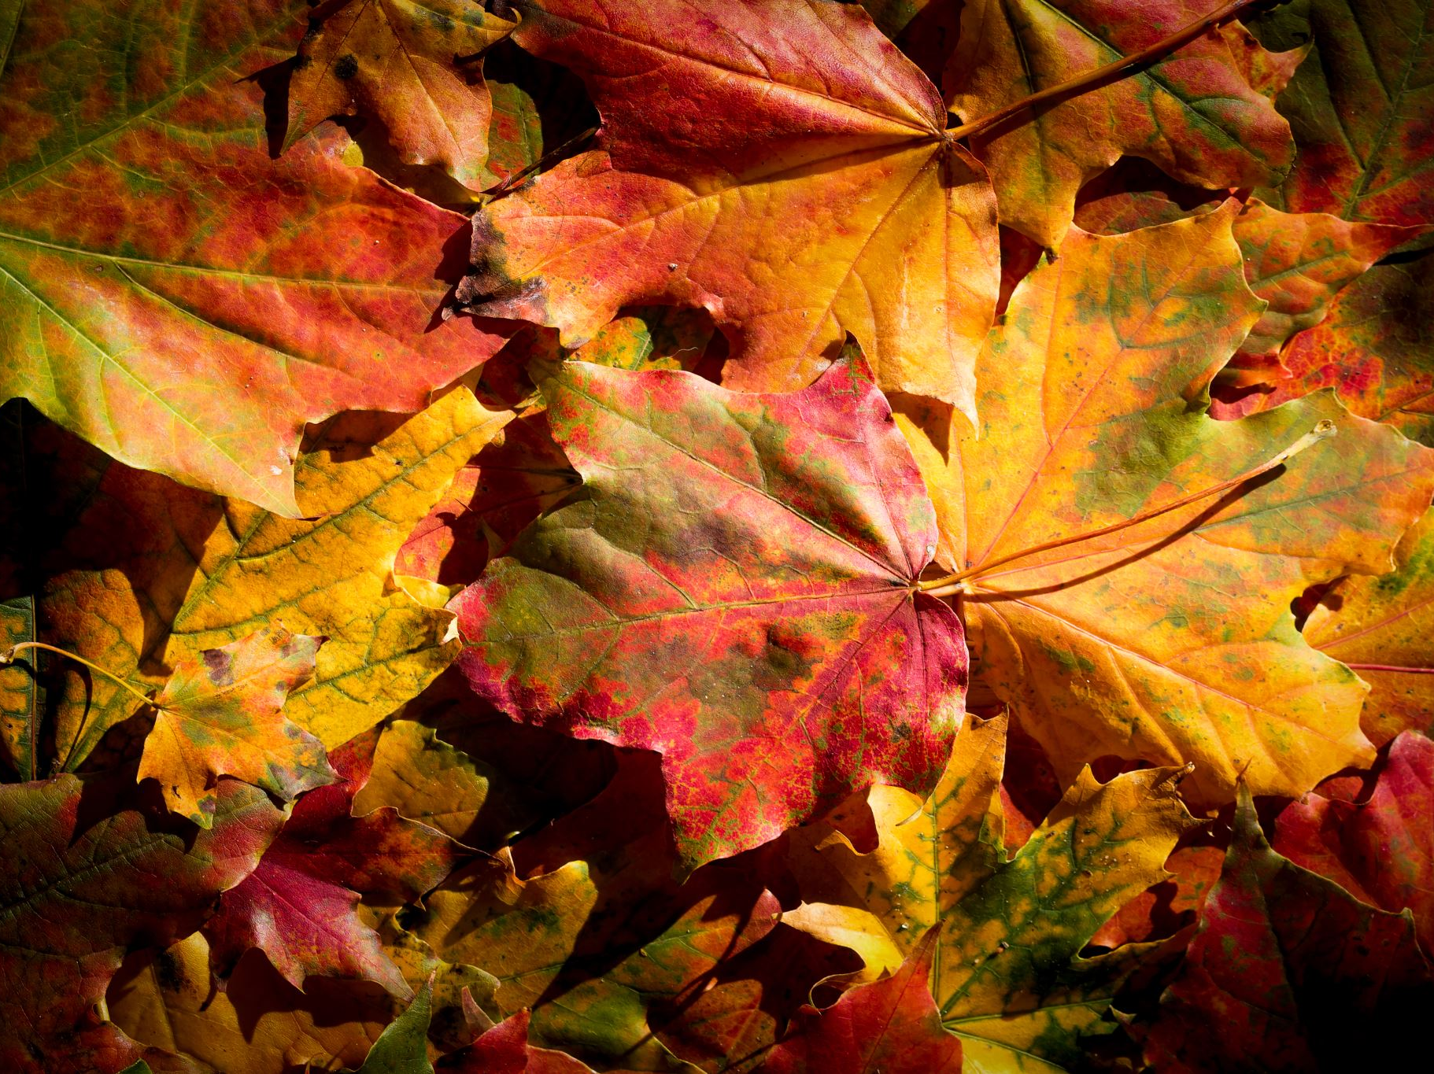
Period 1 Overview
1491 - 1607

Slide 2
Why 1491?
What was going on in the World before European Exploration began?

Slide 3
Pre-European Contact
What do we know about the different peoples in the Americas before European contact?
South and Central America
Mayans, Aztec, Incas
Theme - GEO

Slide 4
Pre-Columbian Contact
North America
How did the tribes of the different regions compare and contrast with one another?
Great Basin & Great Plains
Northeast & Mississippi Valley
California & Northwest Coast
Theme - GEO

Slide 5
Document Analysis
H – historical context – what was going on at the time when this was created? Where and when was it created? By who? Why is this important?
I – intended audience – who was this created for? Why would the author or artist want this group to see this?
P – point of view – what perspective of this topic does the author or artist have? How can you tell? Why is this important?
P – purpose – what was the artist or author trying to accomplish with their work? How can you tell?

Slide 8
Amerigo Vespucci describes the Indians in South America in a letter in 1502
We found the region inhabited by a race of people who were entirely naked, both men and women. . .They have no laws, and no religious belief, but live according to the dictates of nature alone. They know nothing of the immortality of the soul; they have no private property, but every thing in common; they have no boundaries of kingdom or province, they obey no king or lord, for it is wholly unnecessary, as they have no laws, and each one is his own master. They dwell together in houses made like huts in the construction of which they use neither iron nor any other metal. This is very remarkable, for I have seen houses two hundred and twenty feet long, and thirty feet wide, built with much skill, and containing five or six hundred people. They sleep in hammocks of cotton, suspended in the air without any covering; they eat seated upon the ground, and their food consists of the roots of herbs, or fruits and fish. . . . They are a warlike race, and extremely cruel. . .. The most astonishing thing in all their wars and cruelty was, that we could not find out any reason for them. . They made wars against each other, although they had neither kings, kingdoms, nor property of any kind, without any apparent desire to plunder, and without any lust for power, which always appeared to me to be the moving causes of wars and anarchy. When we asked them about this, they gave us no other reason than that they did so to avenge the murder of their ancestors...They are neither Muslim nor Jew and worse than heathen; because we did not see that they offered any sacrifice, nor yet did they have a house of prayer.”

Slide 9
European Exploration
What different European nations began exploring the world at this time?
Why did these different nations begin to explore and colonize?
What allowed these different nations to explore at this time?
Theme – WOR & WXT

Slide 10
Columbian Exchange
How did the Columbian Exchange impact the lives and the environment of Native Americans, Europeans, and Africans?
Theme - GEO

Slide 12
Spanish Colonial System
What was the relationship between the Spanish and the Native Americans?
Encomienda System
What was the relationship between the Spanish and Africans?
Slave trade

Slide 13
Caste System in Spanish Colonies
What short- and long-term effects is a system like this going to have on:
Relationships between the different groups?
Establishment of government and economic systems?
Theme - SOC

Slide 14
Cultural Interactions – Europeans, Native Americans, and Africans
In what ways did these groups vary in regards to their worldviews?
Religion, gender roles, family, land use, power
How did these different groups relate and deal with one another?
Europeans – Spanish, English, French – how did they vary?
Native Americans
Africans
How did the interaction between these groups force each to adapt to these new relationships?
How did the Native Americans and Africans react to European encroachment?
Theme - WOR

