Slide 1
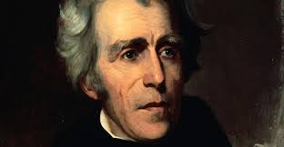
The Age of Jackson
1824-1844

Slide 2
American Growth – Era of Good Feeling
Implementation of the American System
Improved Transportation – roads, canals, steamboats, railroads
Improved Industry
New inventions to make mechanical work easier – cotton gin
Corporations raising capital
Factory system – started using women and children as labor
Unions
Commercial Agriculture
Cheap land and easy credit

Slide 3
Alexis de Toqueville
French Aristocrat – travelled to America to study American democracy in practice
Surprised at how informal Americans were
Simple clothing made it difficult to distinguish class in most of America
Equality of opportunity for all white males seemed universally important
Discrimination against not only enslaved blacks, but also free blacks – widespread
America ideal – “self-made man”
End of 1840s – “Self-made woman”

Slide 4
Jacksonian Democracy – “Democracy of the Common Man”
1820s – politics no longer just for wealthy
Western states began the process of allowing for universal white male suffrage (Indiana [1816]; Illinois [1818]; Missouri [1821])
From 350,000 voters in 1824 to 2.4 million by 1840
No promise of suffrage for African Americans
Party Nominating Conventions – people began to have a say in who would be the primary candidate for their party
Popular Election of the President – people chose the electorate
Two-party system – campaigns were becoming a national issue/debate
Rise of third parties – The-Anti-Masonic party; Workingmen’s party
More Elected Officials – more officials at a state and local level were being elected instead of nominated
Popular Campaigning – politics is now a part of popular culture
Spoils System – giving jobs to people who supported one’s party – not because they were qualified

Slide 5
How do these changes affect the US’s political system?

Slide 6
Jackson v. Adams
Election of 1824 – 4 D.R. Candidates
Jackson won popular vote, but b/c electorate was split 4 ways – so no electoral majority
House of Reps got to handle vote – Clay v. Adams v. Jackson
“Corrupt Bargain” – Adams wins and Clay becomes Adams Secretary of State
Adams as President
All attempts at internal improvements = turned down by Jacksonian influenced Congress → waste of money and violation of the Constitution
“Tariff of Abominations”
Election of 1828
Jackson helps to split the parties
Smear campaigns
Jackson wins with special help of western states

Slide 7
Andrew Jackson Presidency
Presidential Power
Presented himself as a leader of the “common man”
Frugal; limited number of vetoes
“Kitchen Cabinet”
Indian Removal Act
Indians did not got same protections under democracy
Sign treaties to convince Indians to move west of the Mississippi
Trail of Tears – Cherokee v. Georgia and Worcester v. Georgia
Jackson sided with states
Jackson used US Military to forcibly remove the Cherokee

Slide 8
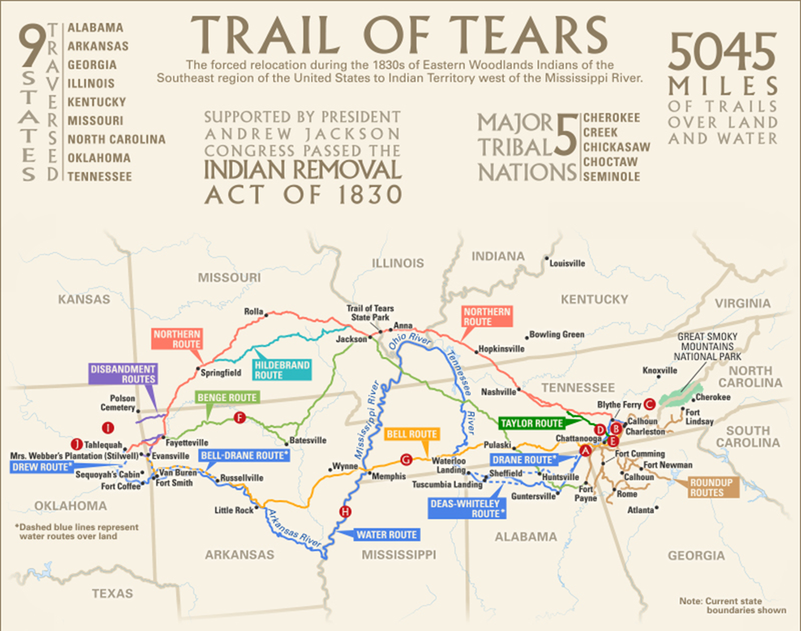

Slide 9
Jackson and the Economy
1st Term – mostly states rights activist until…..
Nullification Crisis
S.C. wanted to nullify the increase of the tariff of 1828 and eventually the tariff of 1832
After much debate the Jackson threatened the use of the military to force S.C. to fall in line – not allowed to nullify federal law (treason)
Bank War and Bank Veto
Re-chartering of the Bank of the United States
Jackson didn’t trust the bank – vetoed re-charter
People approved and re-elected Jackson
2nd Term – Greatest focus – destroy national bank
Pet Banks – withdrew federal funds from banks and transferred them to state banks
Species Circular – require that all future purchases of federal lands be in specie (gold/silver) instead of paper bank/notes
Due to Jackson’s financial polices and feverish speculation in western lands, prices for land and various goods became badly inflated
Jackson used this to try and control inflation – banknotes lost value and land sales plummeted
Panic of 1837

Slide 10
How does the Era of Good Feeling End?

Slide 11
Texas
Mexico won independence from Spain in 1821
Ownership of Texas passed to Mexico
Mexico gave a large chunk of Texas land to Stephen Austin - promised to bring families into Texas
Texans differed from the Mexicans
Mexicans against slavery, while Texans supported it
Santa Anna: dictator of Mexico; in 1835
Removed Texans' local rights and started to raise army to suppress rebelling Texans
The Lone Star Rebellion
Texas declared independence in 1836
Sam Houston: commander in chief for Texas army
General Houston forced Santa Anna to sign treaty in 1836 after Houston captured Santa Anna in the Battle of San Jacinto
Treaty defined Rio Grande as the southwestern boundary of an independent Texas
Texans wanted to become state in US – issue = slavery

Slide 12
Results of the era of good feeling
2 major changes in politics after the Era of Good Feelings that were highlighted by the election of 1840:
Common Man Politics
The Two-Party System
The two parties consisted of the Democrats and the Whigs (the National Republican Party had died out).
Democrats - supported individual liberties, states' rights, and federal restraint in social and economic affairs
Whigs - supported natural harmony of society and value of community, renewed national bank, protective tariffs, internal improvements, public schools, and moral reforms, such as prohibition of liquor and abolition of slavery
William Henry Harrison defeated Van Buren to win the election of 1840 for the Whigs.

