Slide 1
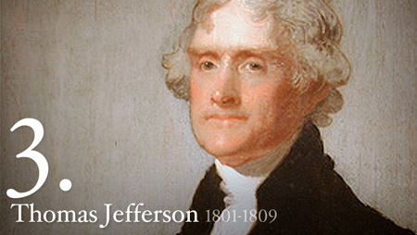
Chapter 11 The Age of Jefferson
1800-1809

Slide 2
Revolution of 1800
Why is Jefferson’s election in 1800 called a “revolution”?
How well did Democratic-Republicans and Federalists work together during Jefferson’s presidency? Beginning vs. the end

Slide 3
Election of 1800
Mudslinging
“Whispering Campaign"
Jefferson accused of having an affair with one of his slaves
The Jeffersonian "Revolution of 1800"
Beat Adams by a majority
Revolution of 1800
1st transistion of power between parties
No Federalist became president after this election

Slide 4
Jefferson as President
Strict Constructionist = limited federal gov’t
Reduced size of military
Eliminated many federal jobs
Repealed excise taxes (including Whiskey tax)
Lowered national debt
Democratic Republican
Maintained National bank and debt repayment – allegiance/trust of Feds.
Attempted to maintain neutrality with foreign nations
But, only allowed Republicans in his cabinet

Slide 5
1st Term – A Response to Adams
Dismissed few public servants for political reasons
Quickly pardoned prisoners of Sedition Acts
Naturalization Law of 1802
Reduced requirement of residence from 14 to 5 years
Repealed excise tax
Sec. of Treasury reduced national debt
Shrunk size of military
Until war with Tripoli

Slide 6
Judiciary Issues
Judiciary Act of 1801
Passed by expiring Federalist Congress
Created 16 new federal judgeships and other judicial offices
Republican-Democratic Congress repealed act and kicked out new judges
One Federalist judge - John Marshall not removed → served for 34 years.
Shaped American legal tradition more than any other person
Marbury vs. Madison (1803) -
Madison, secretary of state, cut judge Marbury's salary
Marbury sued Madison for his pay
Court ruled Marbury had the right to his pay, but court did not have authority to force Madison to give Marbury his pay.
Most importantly - decision showed that Supreme Court had final authority in determining meaning of the Constitution
JUDICIAL REVIEW

Slide 7
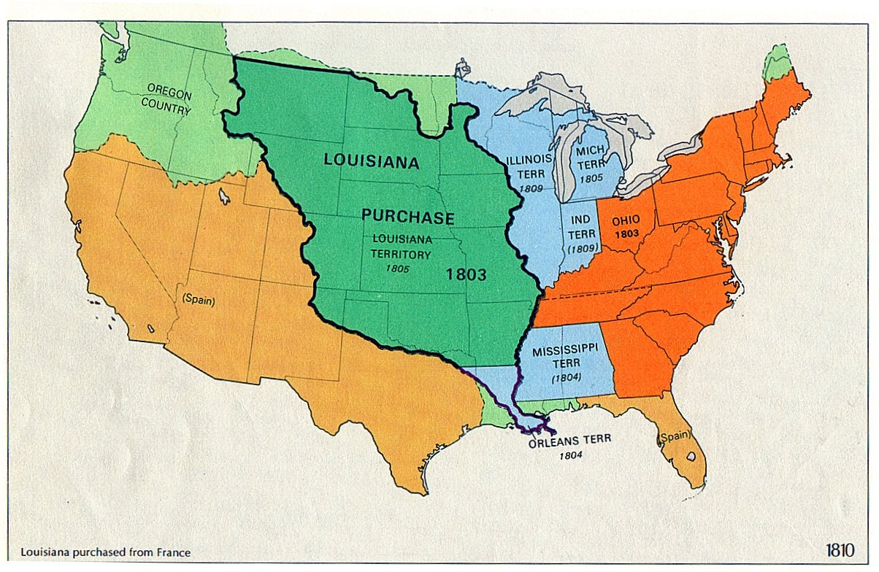
Louisiana Purchase
Why was the purchase so important?
Think about ports and our relationship with Spain/France/Britain
How did the purchase happen?
France and Britain
What did the US get out of the negotiations?
Consequences of purchase
Is Jefferson a strict constructionist?

Slide 8
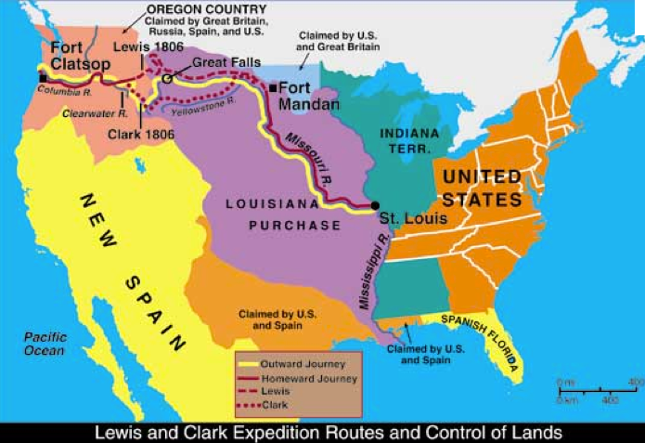
Lewis and Clark
What was the purpose?
What were the results?
How was this funded?
What conclusions can you make about Jefferson due to this fact?

Slide 9
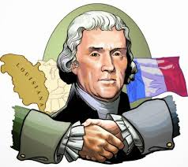
Louisiana and Lewis and Clark
Spain gave France territory in 1800
Jefferson sent Monroe to join Robert Livingston in Paris in 1803 to buy as much land as he could for $10 million
Signed treaty on April 30, 1803, ceding Louisiana to the United States for $15 million
Americans signed 3 treaties and got land to the west of the Mississippi
820,000 square miles at 3 cents/acre.
Jefferson sent Lewis and Clark to explore northern part of the LA Purchase – paid for by funds raised by the Nat’l Bank

Slide 10
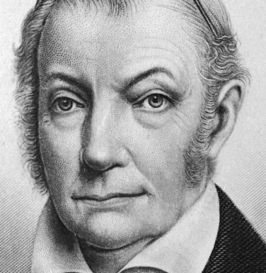
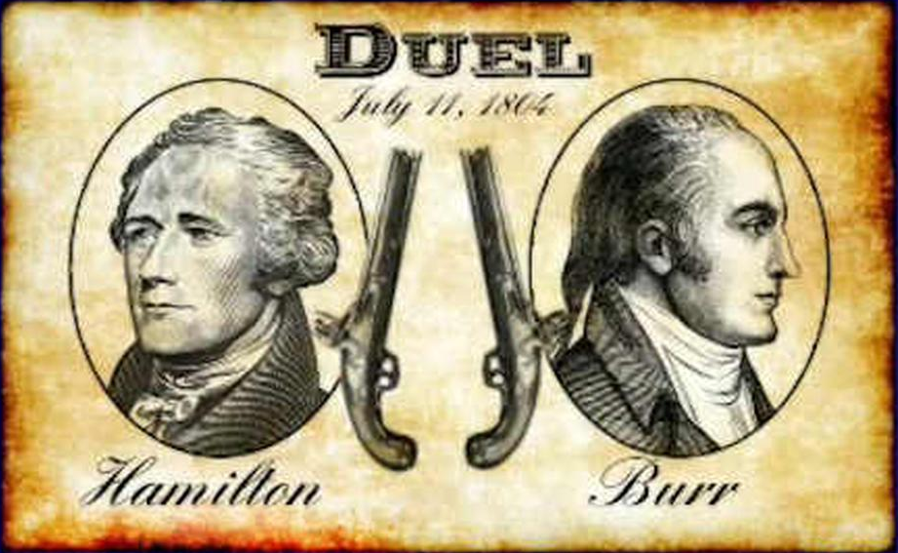
Aaron Burr
Aaron Burr: Jefferson's first-term vice president
After being dropped from Jefferson's cabinet, joined a group of extremist Federalists who plotted the secession of New England and New York → Alexander Hamilton uncovered the plot
Burr challenged Hamilton to a duel and Hamilton accepted.
Hamilton refused to shoot and was killed
General James Wilkinson:
Corrupt military governor of LA Territory
Made allegiance with Burr to separate western part of United States from East and expand their new confederacy with invasions of Spanish-controlled Mexico and Florida
Betrayed Burr when he learned Jefferson knew of the plot
Burr acquitted of the charges of treason by Chief Justice John Marshall and fled to Europe

Slide 11
Jefferson’s Second Term
Re-elected in 1804 (162 to 14 electoral votes)
Jefferson and Foreign Affairs
Barbary Pirates – refuse to pay tribute to their gov’t; American navy somewhat successful in stopping attacks
US Neutrality – Napoleonic Wars = more fighting between Britain and France
Both sides attacking US ships
France orders attacks on all ships entering British ports
Chesapeake attacked
Embargo Act 1807
Banned exportation of any goods to any countries
Attempt at hurting British and French trade
Hurt the US economically – economic depression
Britain and France got resources from other allies and colonies
Sours America’s feelings towards Jefferson
Repealed in 1809 – Non-importation Act passed (no trade with Britain and France only)

Slide 12
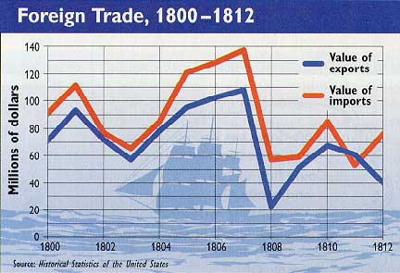
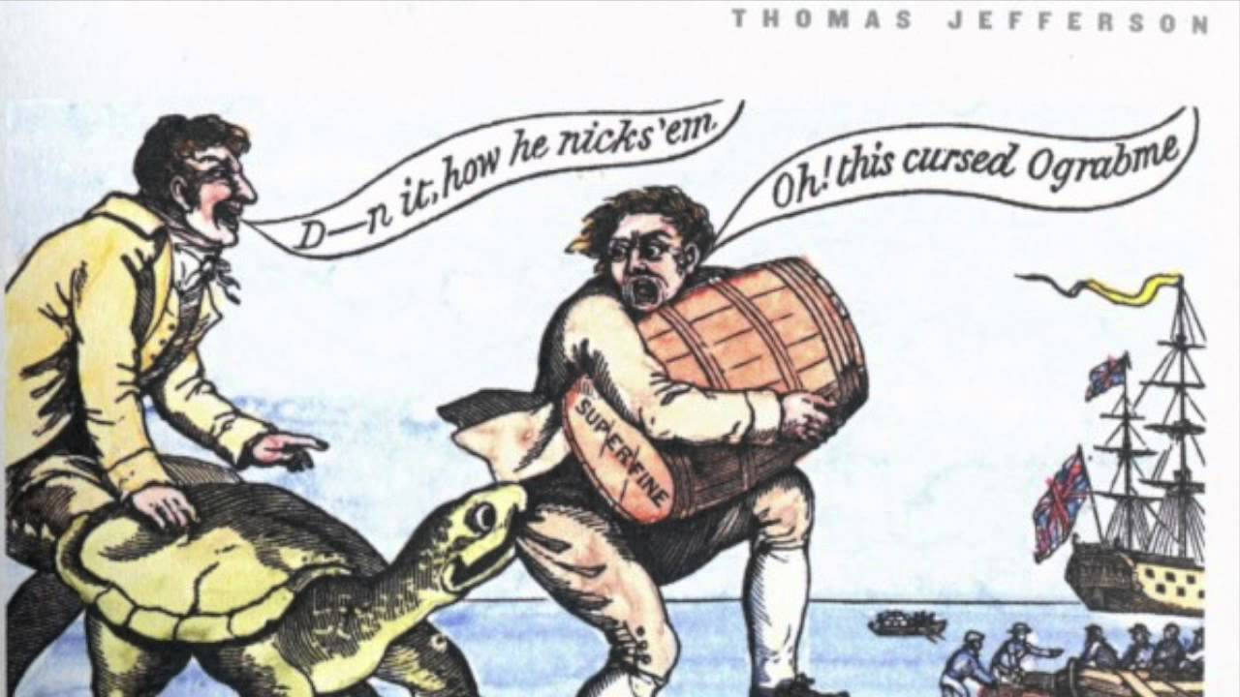

Slide 13
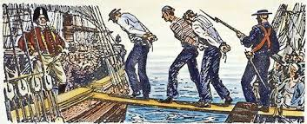
Madison’ Presidency
Became president on March 4, 1809
Congress issued Macon's Bill No. 2.
Reopened American trade with entire world
Stated that if Britain or France repealed its commercial restrictions, then U.S. would reinstate trading embargo against the non-repealing country
Napoleon convinced James Madison to give Britain three months to lift its Orders in Council
Madison did, but Britain chose not to lift its Orders
Re-enacted the US trade embargo, but this time just against Britain only
Macon's Bill No. 2 led to the War of 1812

Slide 14
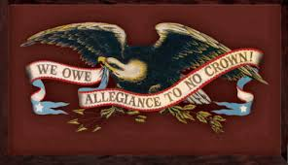
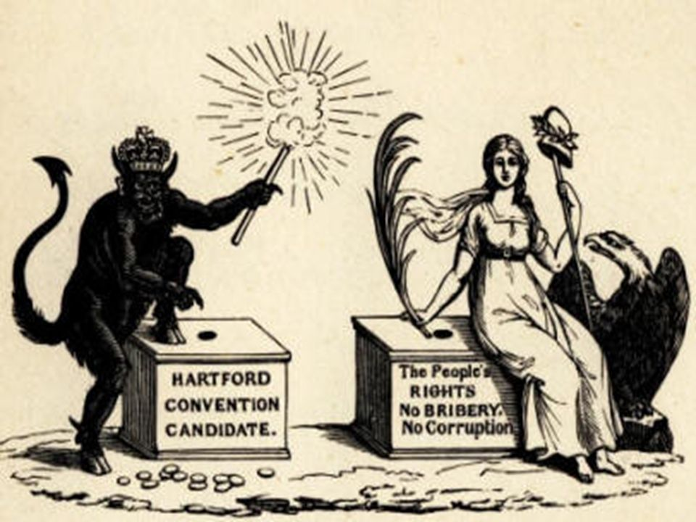
Mr. Madison’s War
June 1, 1812 - Madison asked Congress to declare war on the British → it agreed
Democratic-Republicans who supported war ("war hawks") felt country had to assert American rights to the world
Wanted to invade Canada, Indians' stronghold, because Indians were being armed by British to attack settlers
Federalists opposed because they supported Britain

Slide 15
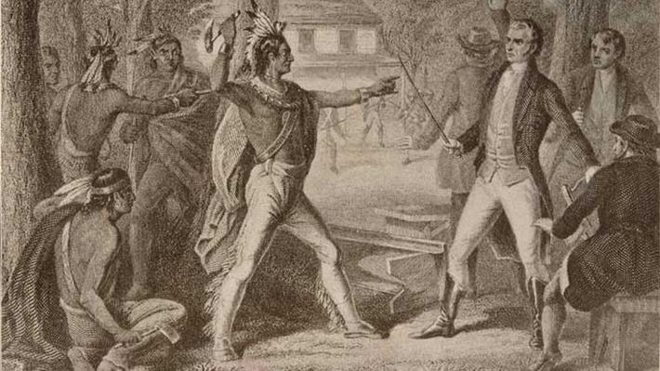
Native Relations
Tecumseh and the Prophet
12th Congress: met in 1811; the "war hawks" wanted to go to war with British and wanted to eliminate Indian threats to pioneers
Tecumseh & Tenskwatawa
Shawnee brothers who unified many Indian tribes in last ditch battle with settlers
Allied with British.
William Henry Harrison: governor of the Indiana territory; defeated Shawnee at the Battle of Tippecanoe

