Slide 1
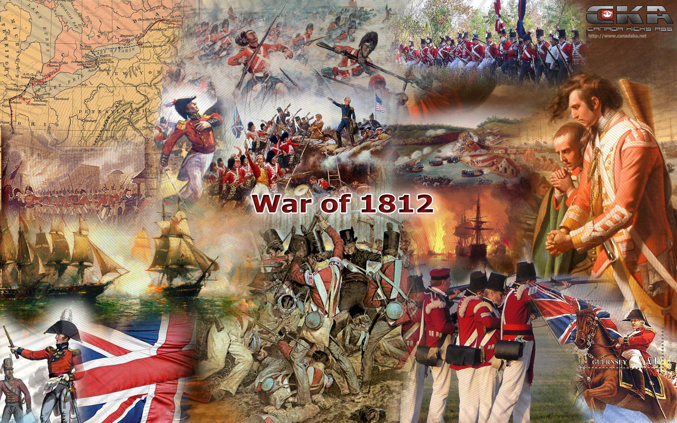
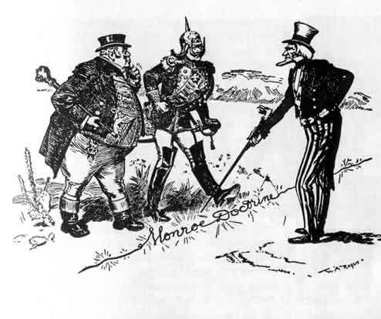
The Second War for Independence and the Upsurge of Nationalism

Slide 2
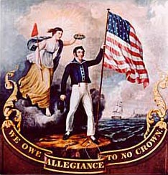
War of 1812
Causes – Why are these 2 causes so important to US in early 1800s?
Violation of US neutral rights at sea
Trouble with British along their borders
Path to War –
War Hawks – what are they and why did they want to go to war?
John C. Calhoun and Henry Clay
Divided national support
Election of 1812
“Mr. Madison’s War”
Opposition to War – who opposed war and why?
New England Merchants
Federalists and some old D.R.’s

Slide 3
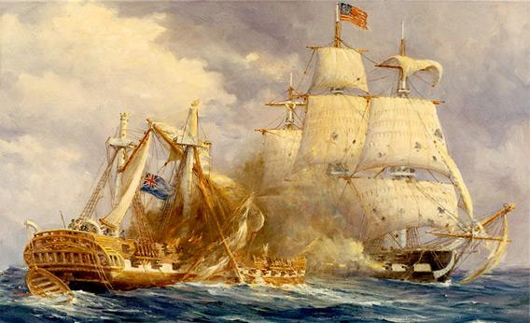
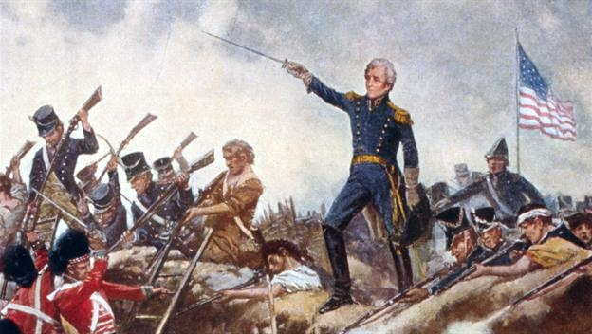
Random facts/nice to know – war of 1812
US military not as strong as British
British were at 1st fighting 2 wars, once the Napoleonic Wars ended – British came full force
US Navy had few important victories – U.S.S. Constitution, Lake Erie, Battle of Thames River
Britain burned down White House!
Battle of New Orleans = Andrew Jackson is now a war hero

Slide 4
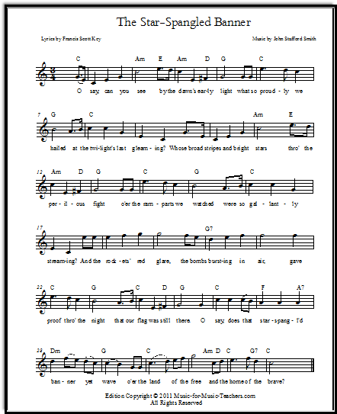
End of the war
Treaty of Ghent
Ended war and reset terms to pre-war conditions
No grievances were dealt with
Hartford Convention
Federalists met to try and defeat D.R.’s
New England threatened to secede from Union
Wanted to propose new rule for declaring war
Created all of this while US was losing the war, but after Jackson’s win in New Orleans many began to feel better about the war →Federalists = unpatriotic
Federalists lose all support

Slide 5
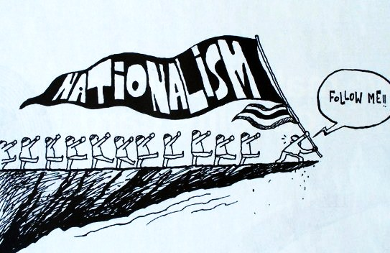
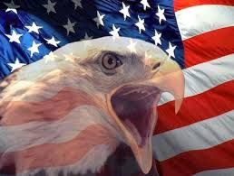
Legacy of the war
While war achieved none of its goals, it did provide:
Respect from other nations
Canada = British Empire
Talk of nullification and secession in New England would later be used by South
American Indians left to deal with Americans on their own
US factories were built due to continued blockade by British
New political leaders born out of war heroes (Jackson and Harrison)
Sense of nationalism and desire to move West

Slide 6
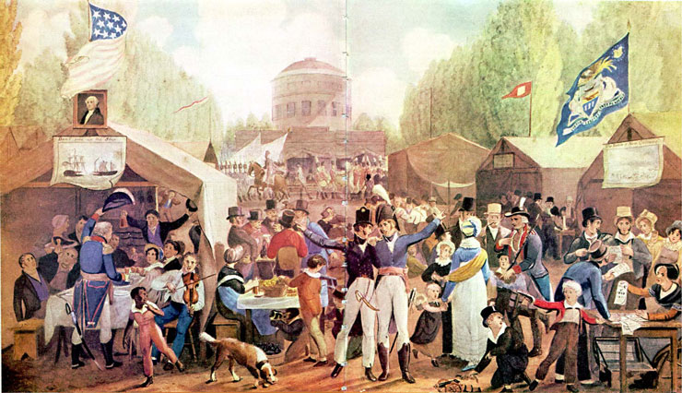
Era of good Feeling – Nationalism
Why is this era called the “Era of Good Feeling?”
How can one argue that this is an oversimplification?
New Spreading Nationalism
Cultural Nationalism – myths and folk stories; new younger voters; expansion of public school
Economic Nationalism –
Tariff of 1816 – what is it/significance
The American System – protective tariffs; national bank; internal improvements
Federal funding for roads and canals
Panic of 1819 – why and what kind of political change was caused by this economic downturn?
Where are the political parties headed?

Slide 7
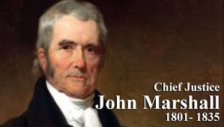
Marshall Court
Most important remnants of Federalist Party – most decisions favored the fed. Gov’t and it’s rights over the states
Fletcher v. Peck – declared a state law unconstitutional
Martin v. Hunter’s Lease – S. Court has jurisdiction over state courts in cases involving const. rights
Dartmouth College v. Woodward – struck down a state law as unconstitutional - contract for private corporation couldn’t be altered by a state
McCulloch v. Maryland – established constitutionality of the National Bank (implied powers) and said states do not have the right to tax federal institutions
Cohens v. Virginia – established principle that S. Court could review a state court’s decision involving any powers of the fed. gov’t
Gibbons v. Ogden – established the fed. Gov’t’s broad control of interstate commerce

Slide 8
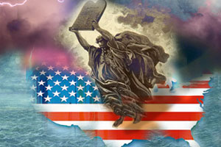
Westward expansion
Why did the Americans want to expand?
What issues would they face politically/economically/socially as they moved?
How would they deal with these issues?
What about slavery?????

Slide 9
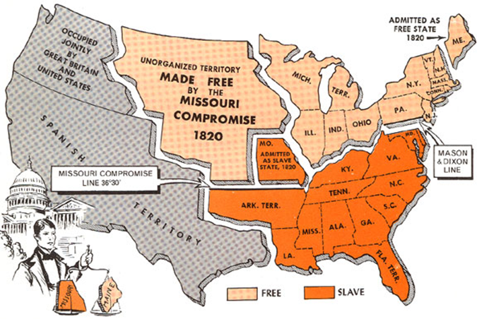
Missouri Compromise
Debate over how to include new states and what to do with the slavery as they expanded – all an issue of representation
Clay’s Proposal
Missouri = slave-holding state
Maine = free state
Established 36/30 line through the rest of the LA territory
Significance of this event?

Slide 10
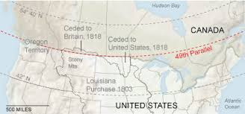
America and the world
Continued conflicts with other European Nations
Canada
Disarmament agreement with Britain along Canadian border
Joint British/US occupation of Oregon territory, shared fishing rights in Newfoundland
Established the 49th parallel – our northern border!!!
Florida
Spain unable to maintain control of Florida led to increased Indian raids of US territory
Jackson steps in with US military to deal with the Indians (Seminole)
Purchased Florida with Spain – Adams-Onis Treaty ($5million for Florida and US give up claims over Texas)

Slide 11
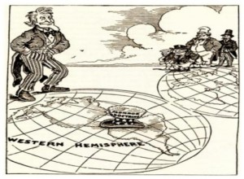
MONROE DOCTRINE
Monarchy’s taking over in Europe and an anti-republic sentiment + Spain losing control of much of S. America and Russia’s presence in Alaska + Britain trying to claim control over S. America = Monroe Doctrine
Aimed at keeping Europe out of the Western Hemisphere
Reaction? World v. US v. long term impact

